Slide 1
Bushfire Preparedness for Council’s Natural Areas
Environment, Parks and Sustainability Committee
17 Nov 2020

Slide 2
Content
Bushfire Management Objectives
What are Bushfires?
Roles and Responsibilities
Our Bushfire Preparedness
Communications
Climate Outlook
Questions?

Slide 3
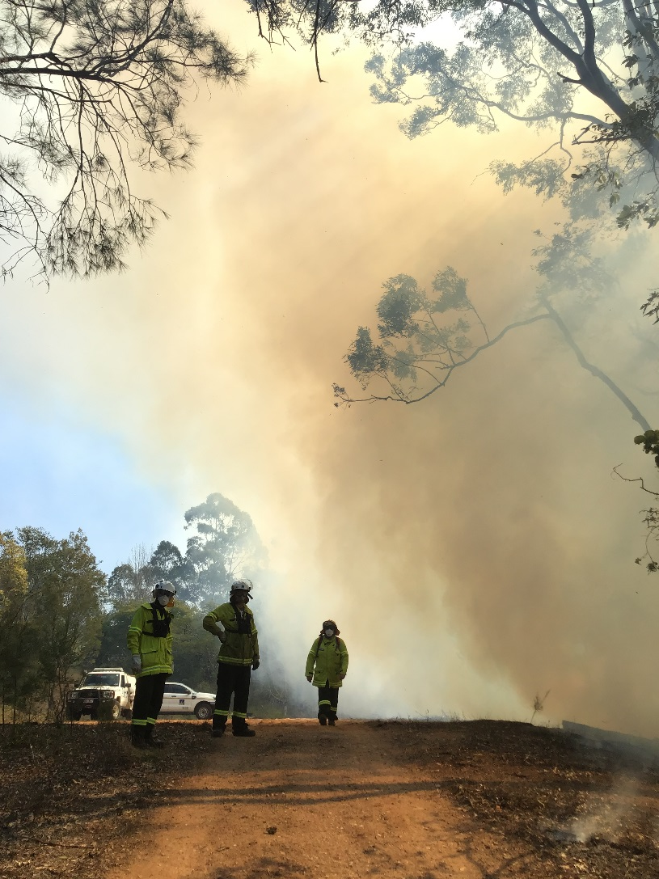
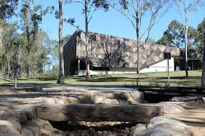
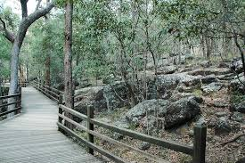
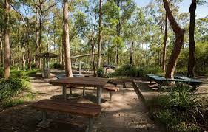
Bushfire Management Objectives
Objectives
Priority - Safety of human life including the community/firefighting staff
Protection of our Assets – Built and Natural Vegetation
10,280 hectares of Natural Area Estate
Three Environment Centres, plus board walks, picnic areas and signage
Natural Habitat - 81 different natural habitat types
Maintain the biodiversity of Brisbane
Protection of Brisbane’s clean air

Slide 4
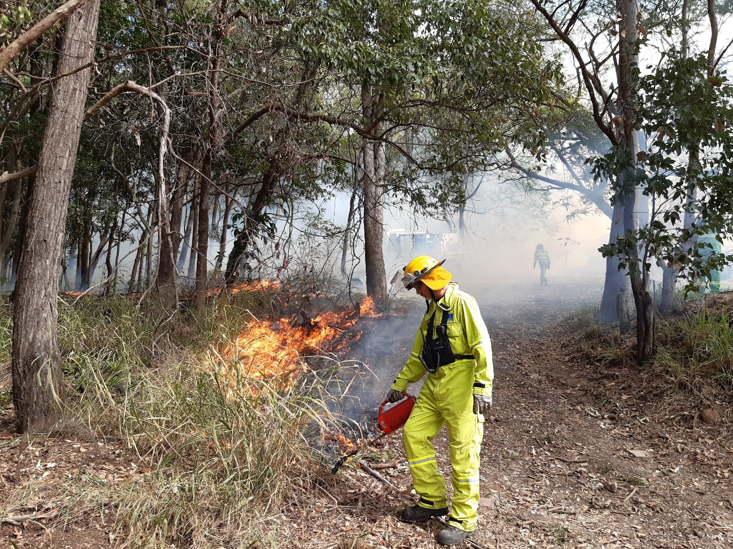
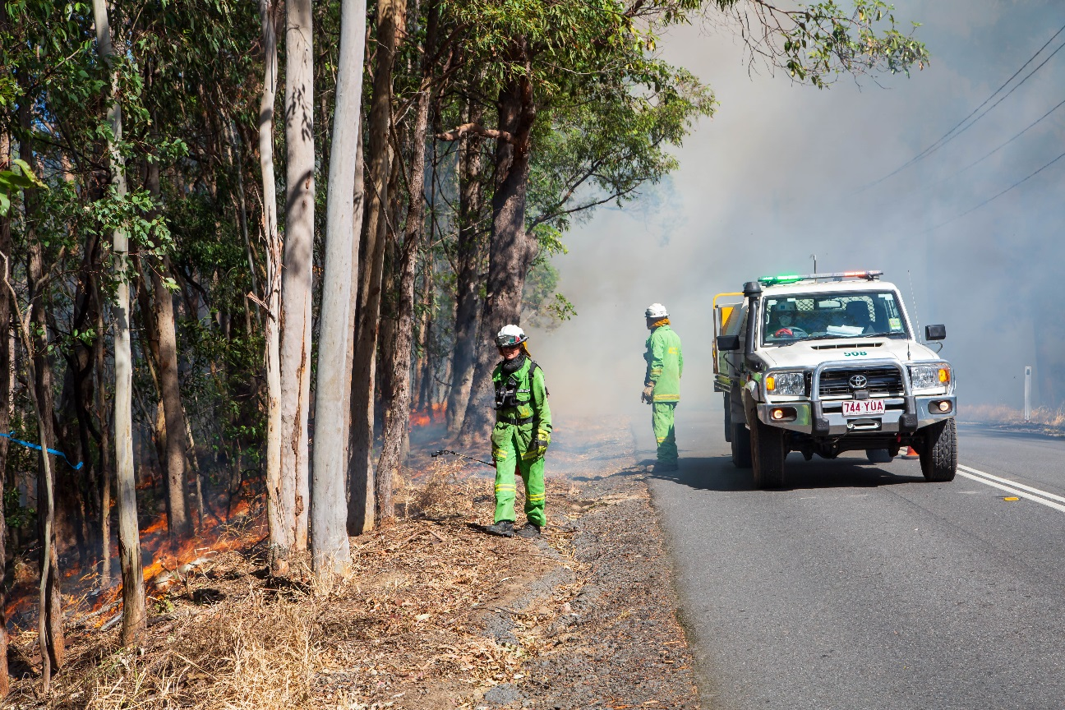
What are Bushfires??
Two types:
Planned Burns
Purpose - reduce risk; protect assets; maintain habitat cover, condition and biodiversity.
Burns dependant on fuel load, ecology, asset protection and prevailing weather conditions.
Bushfires
Many are deliberately lit
Can occur all year, but traditionally October to March
Impacts dependant on severity - loss of assets / human safety / natural habitat

Slide 5
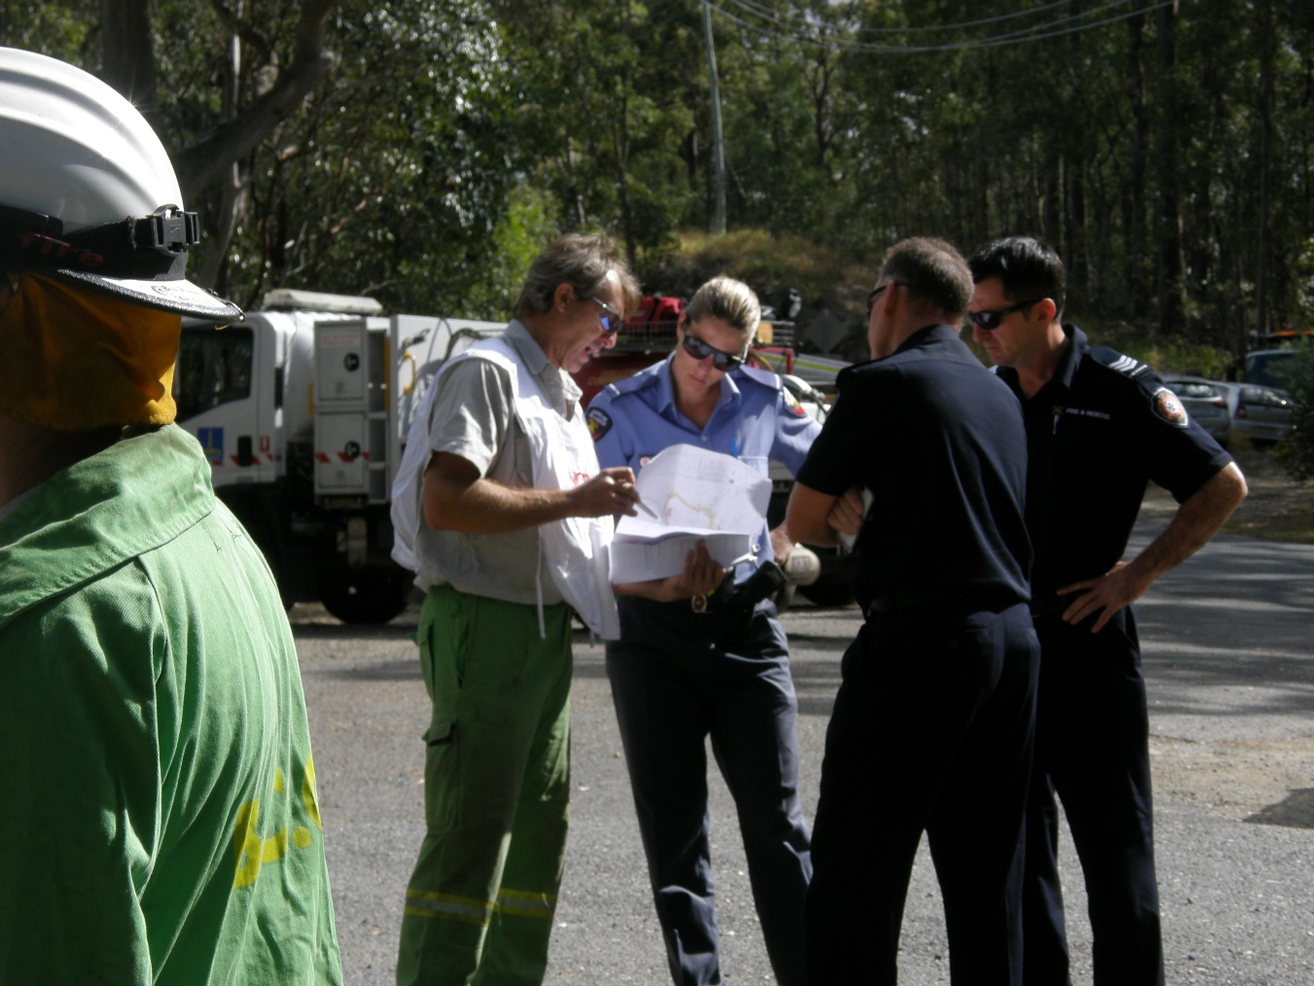
Roles and Responsibilities
Queensland Fire and Emergency Services
Lead agency for bushfire
Community Education and Awareness
BCC
Land manager
Bushfire planning; preparedness and response
Biodiversity Management
Local Authority
Disaster management
Local Support - Community Education and Awareness
Regulator
Regulation of development
Natural Assets Local Law

Slide 6
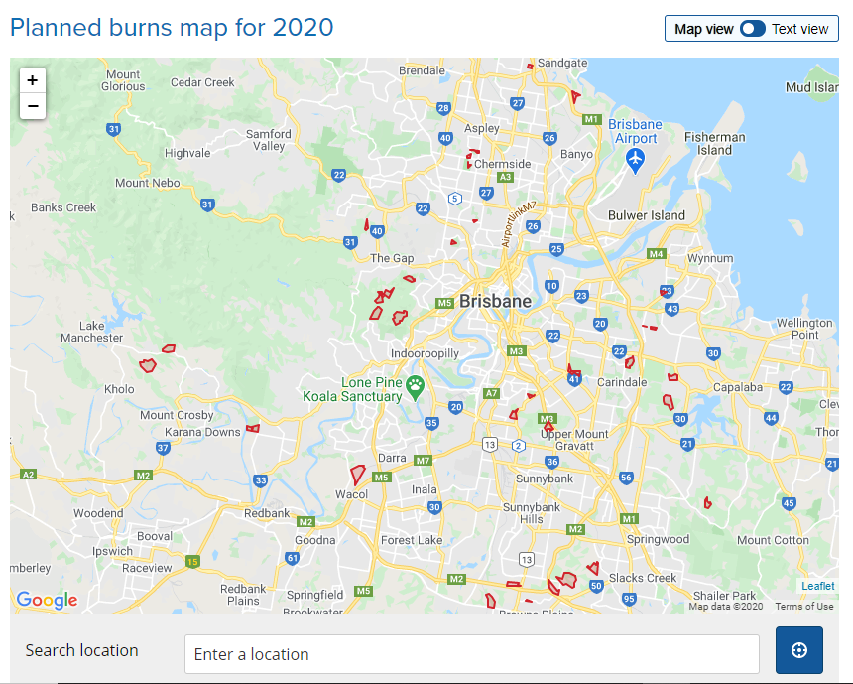
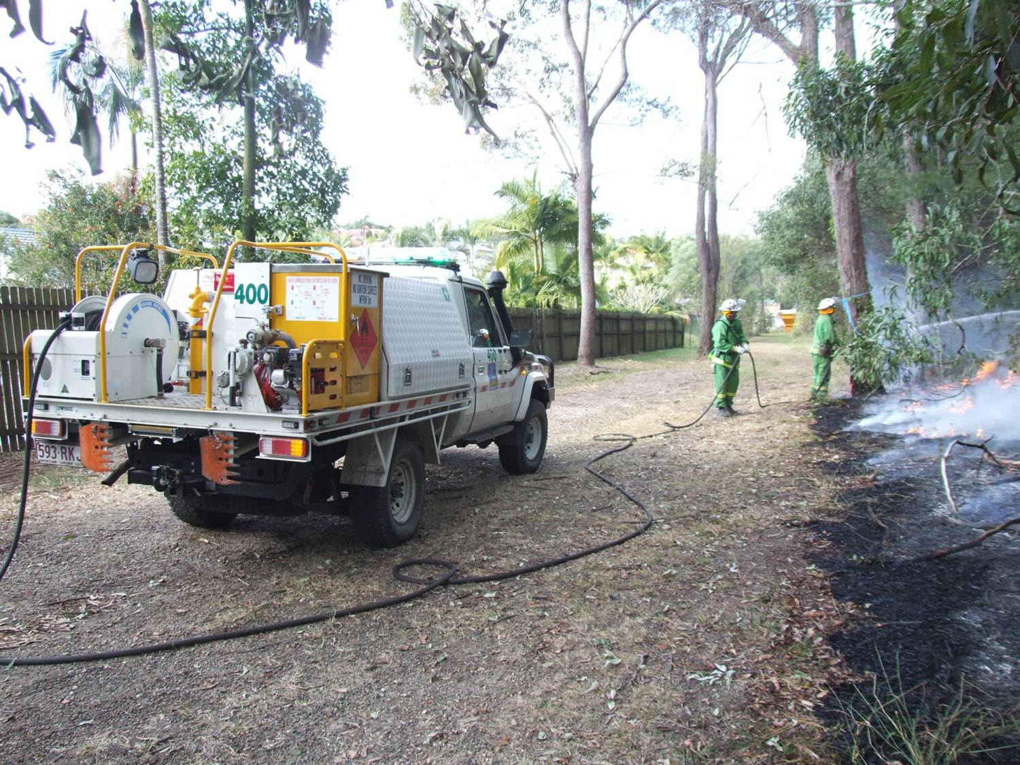
Our Bushfire Preparedness
Bushfire management policy, procedures and planning for our natural area estate
Bushfire preparedness for our natural area estate
Planned burns
Maintaining firebreaks (535km)
Fuel hazard assessments
Manual removal of Fuel load
Trained personnel/ Fire Trucks/ Water units
Since 2011
137 planned burns (2,121 ha)
191 bushfires (884ha): most <0.5ha

Slide 7
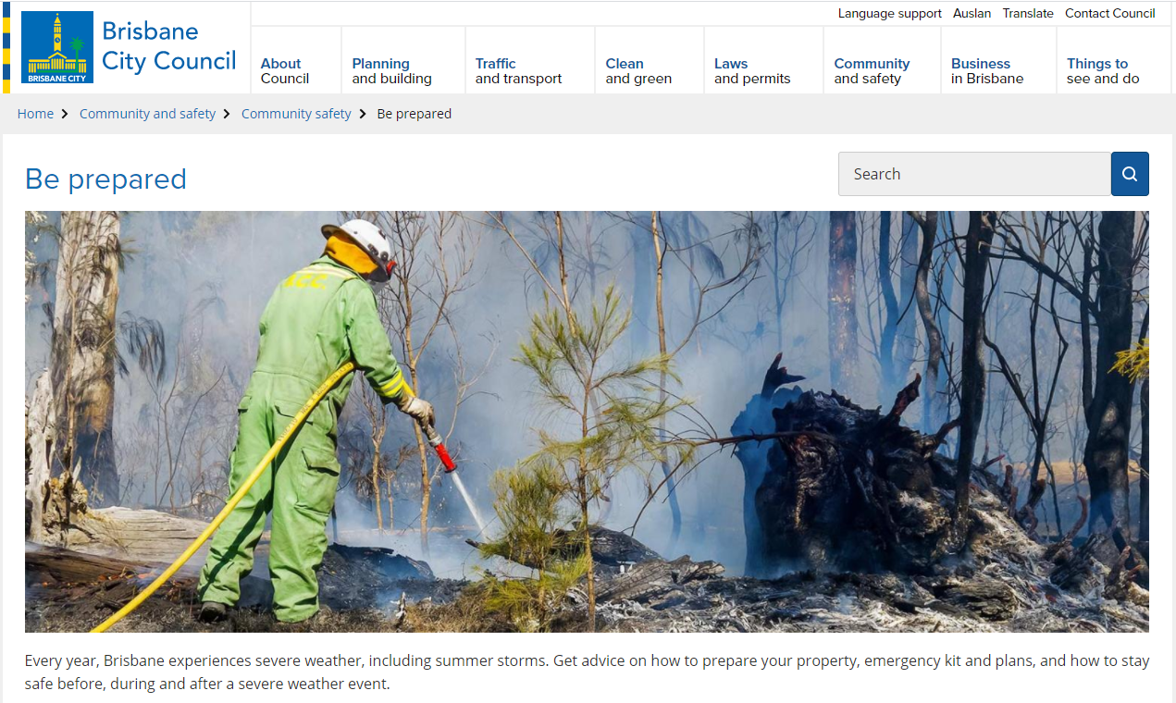
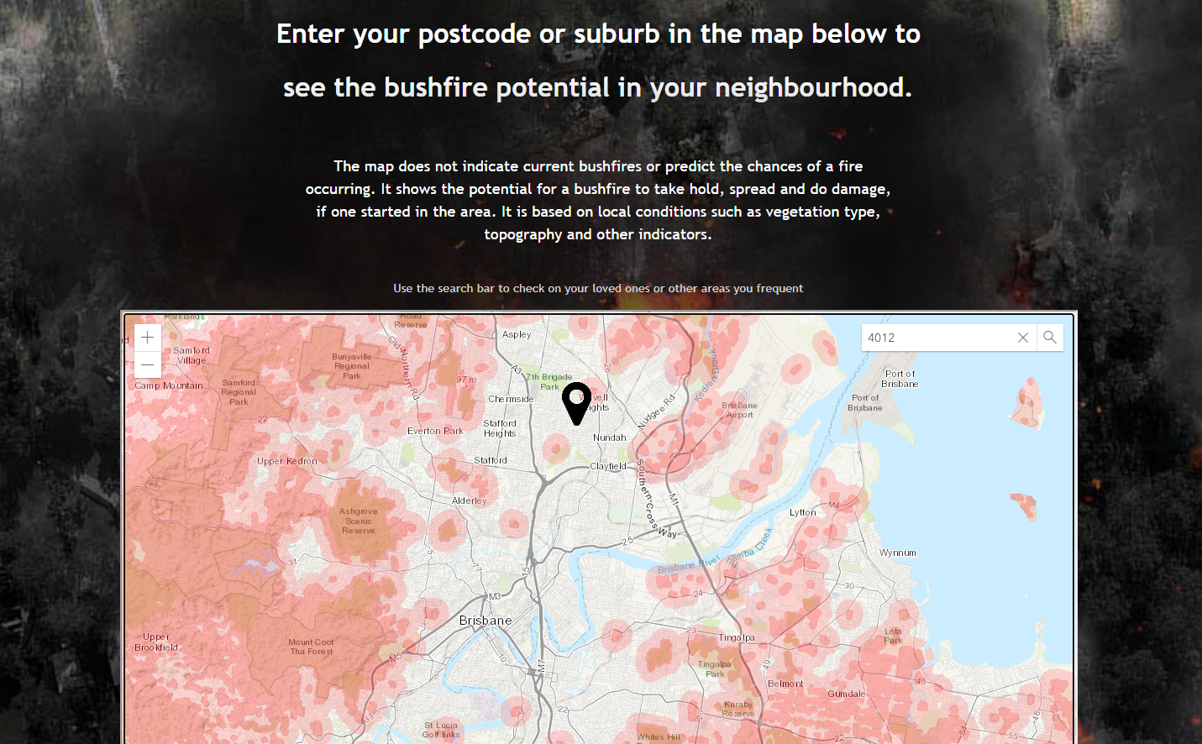
Communications
Planned Burns
Signage at entry points to natural areas
Letters to residents adjoining planned burns
Media, Contact Centre updates
Website with map showing location of burns
Wider Bushfire communications
Council’s ‘Be Prepared’ campaigns
Bushfire street meets/ information evenings
QFES post code checker for bushfire potential

Slide 8
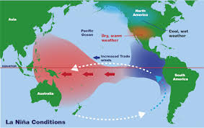
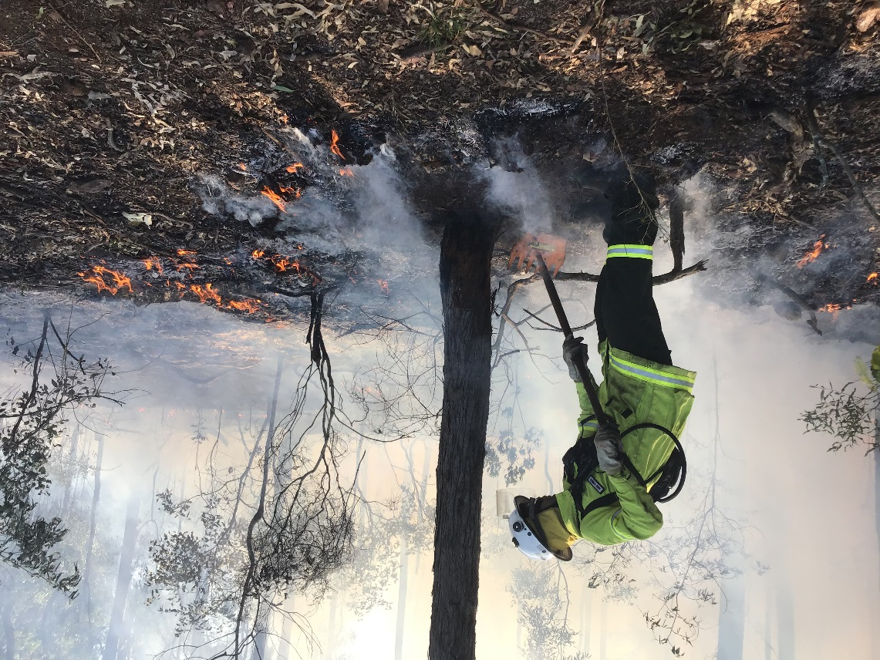
Climate Outlook
General Trends
Shorter windows of opportunity for planned burns
Longer wildfire seasons
Seasonal Outlook
La Nina now Active (BOM#) above average rainfall (Nov/Jan)
If forecast does not eventuate - above normal bushfire potential in forested areas in SEQ
# BOM – Bureau of Meteorology

Slide 9
Questions

