Slide 1
City Planning and Suburban Renewal Committee
Inner city construction management
30 November 2021

Slide 2
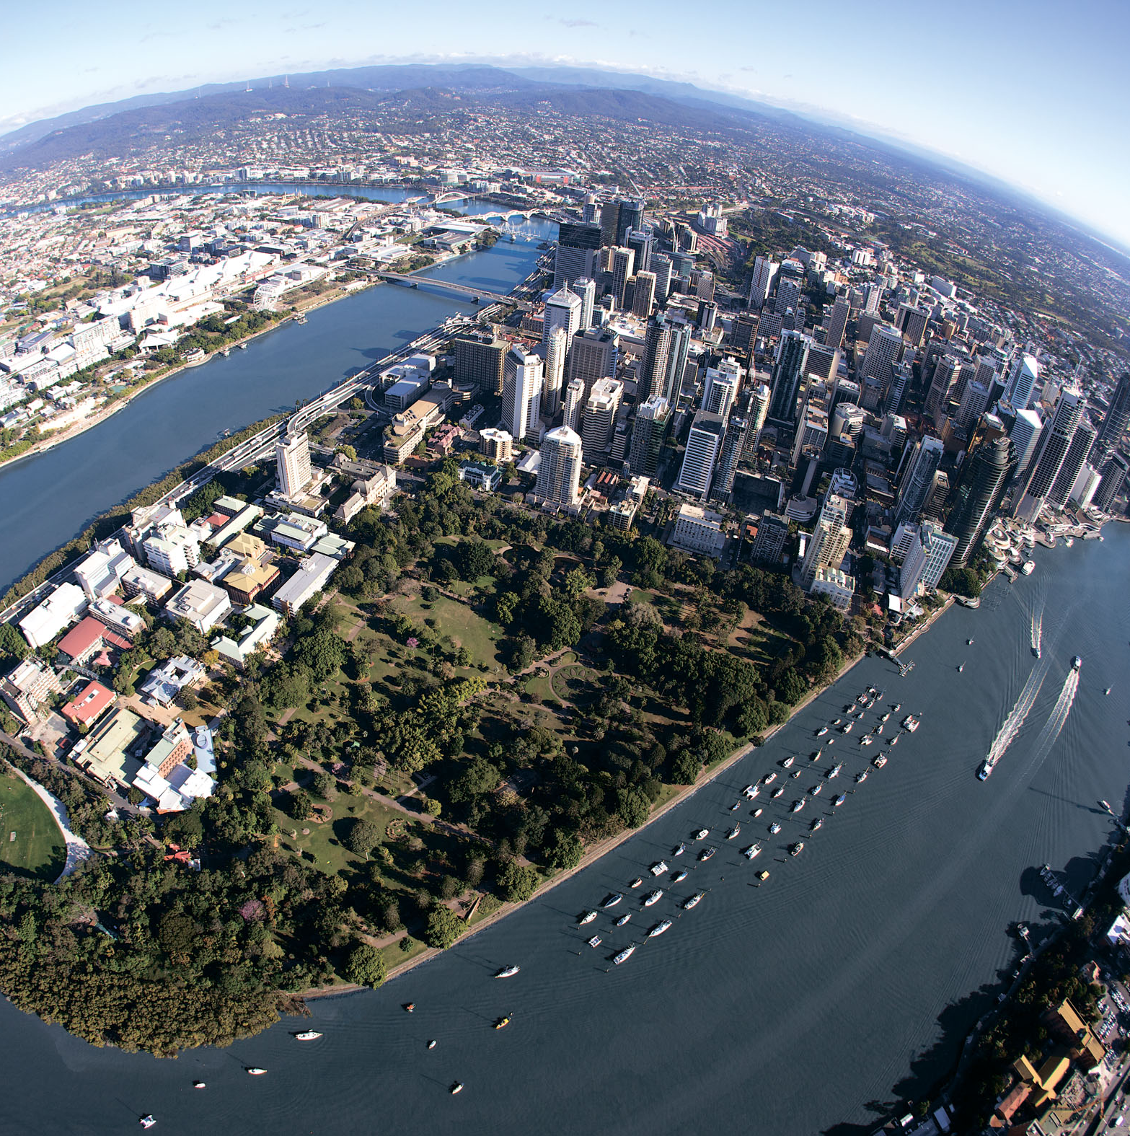
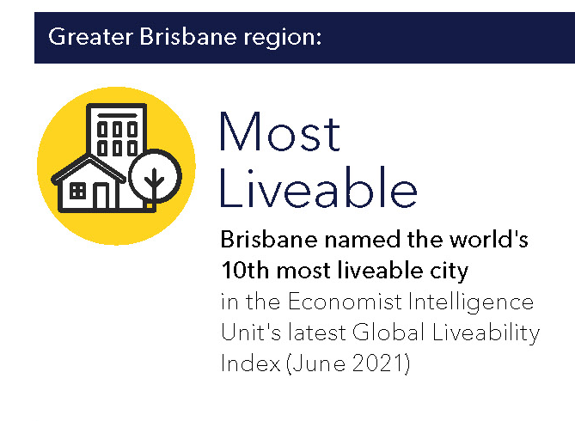
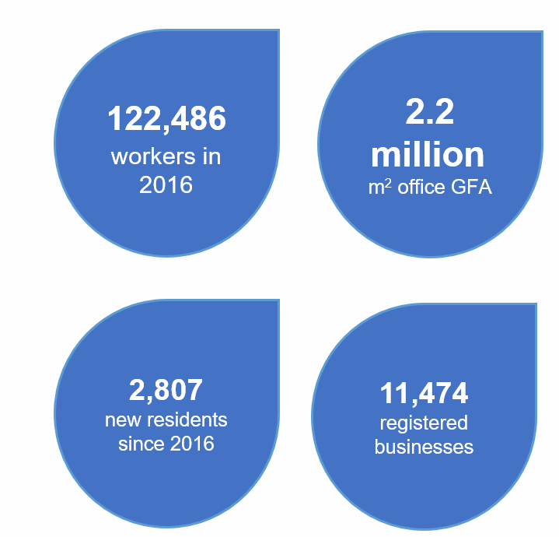
Brisbane’s city centre
12,000 residents
City Centre

Slide 3
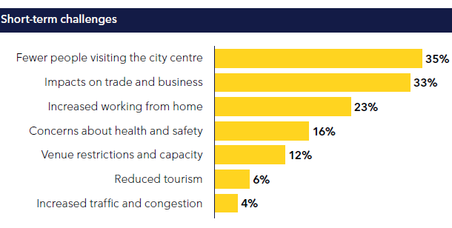
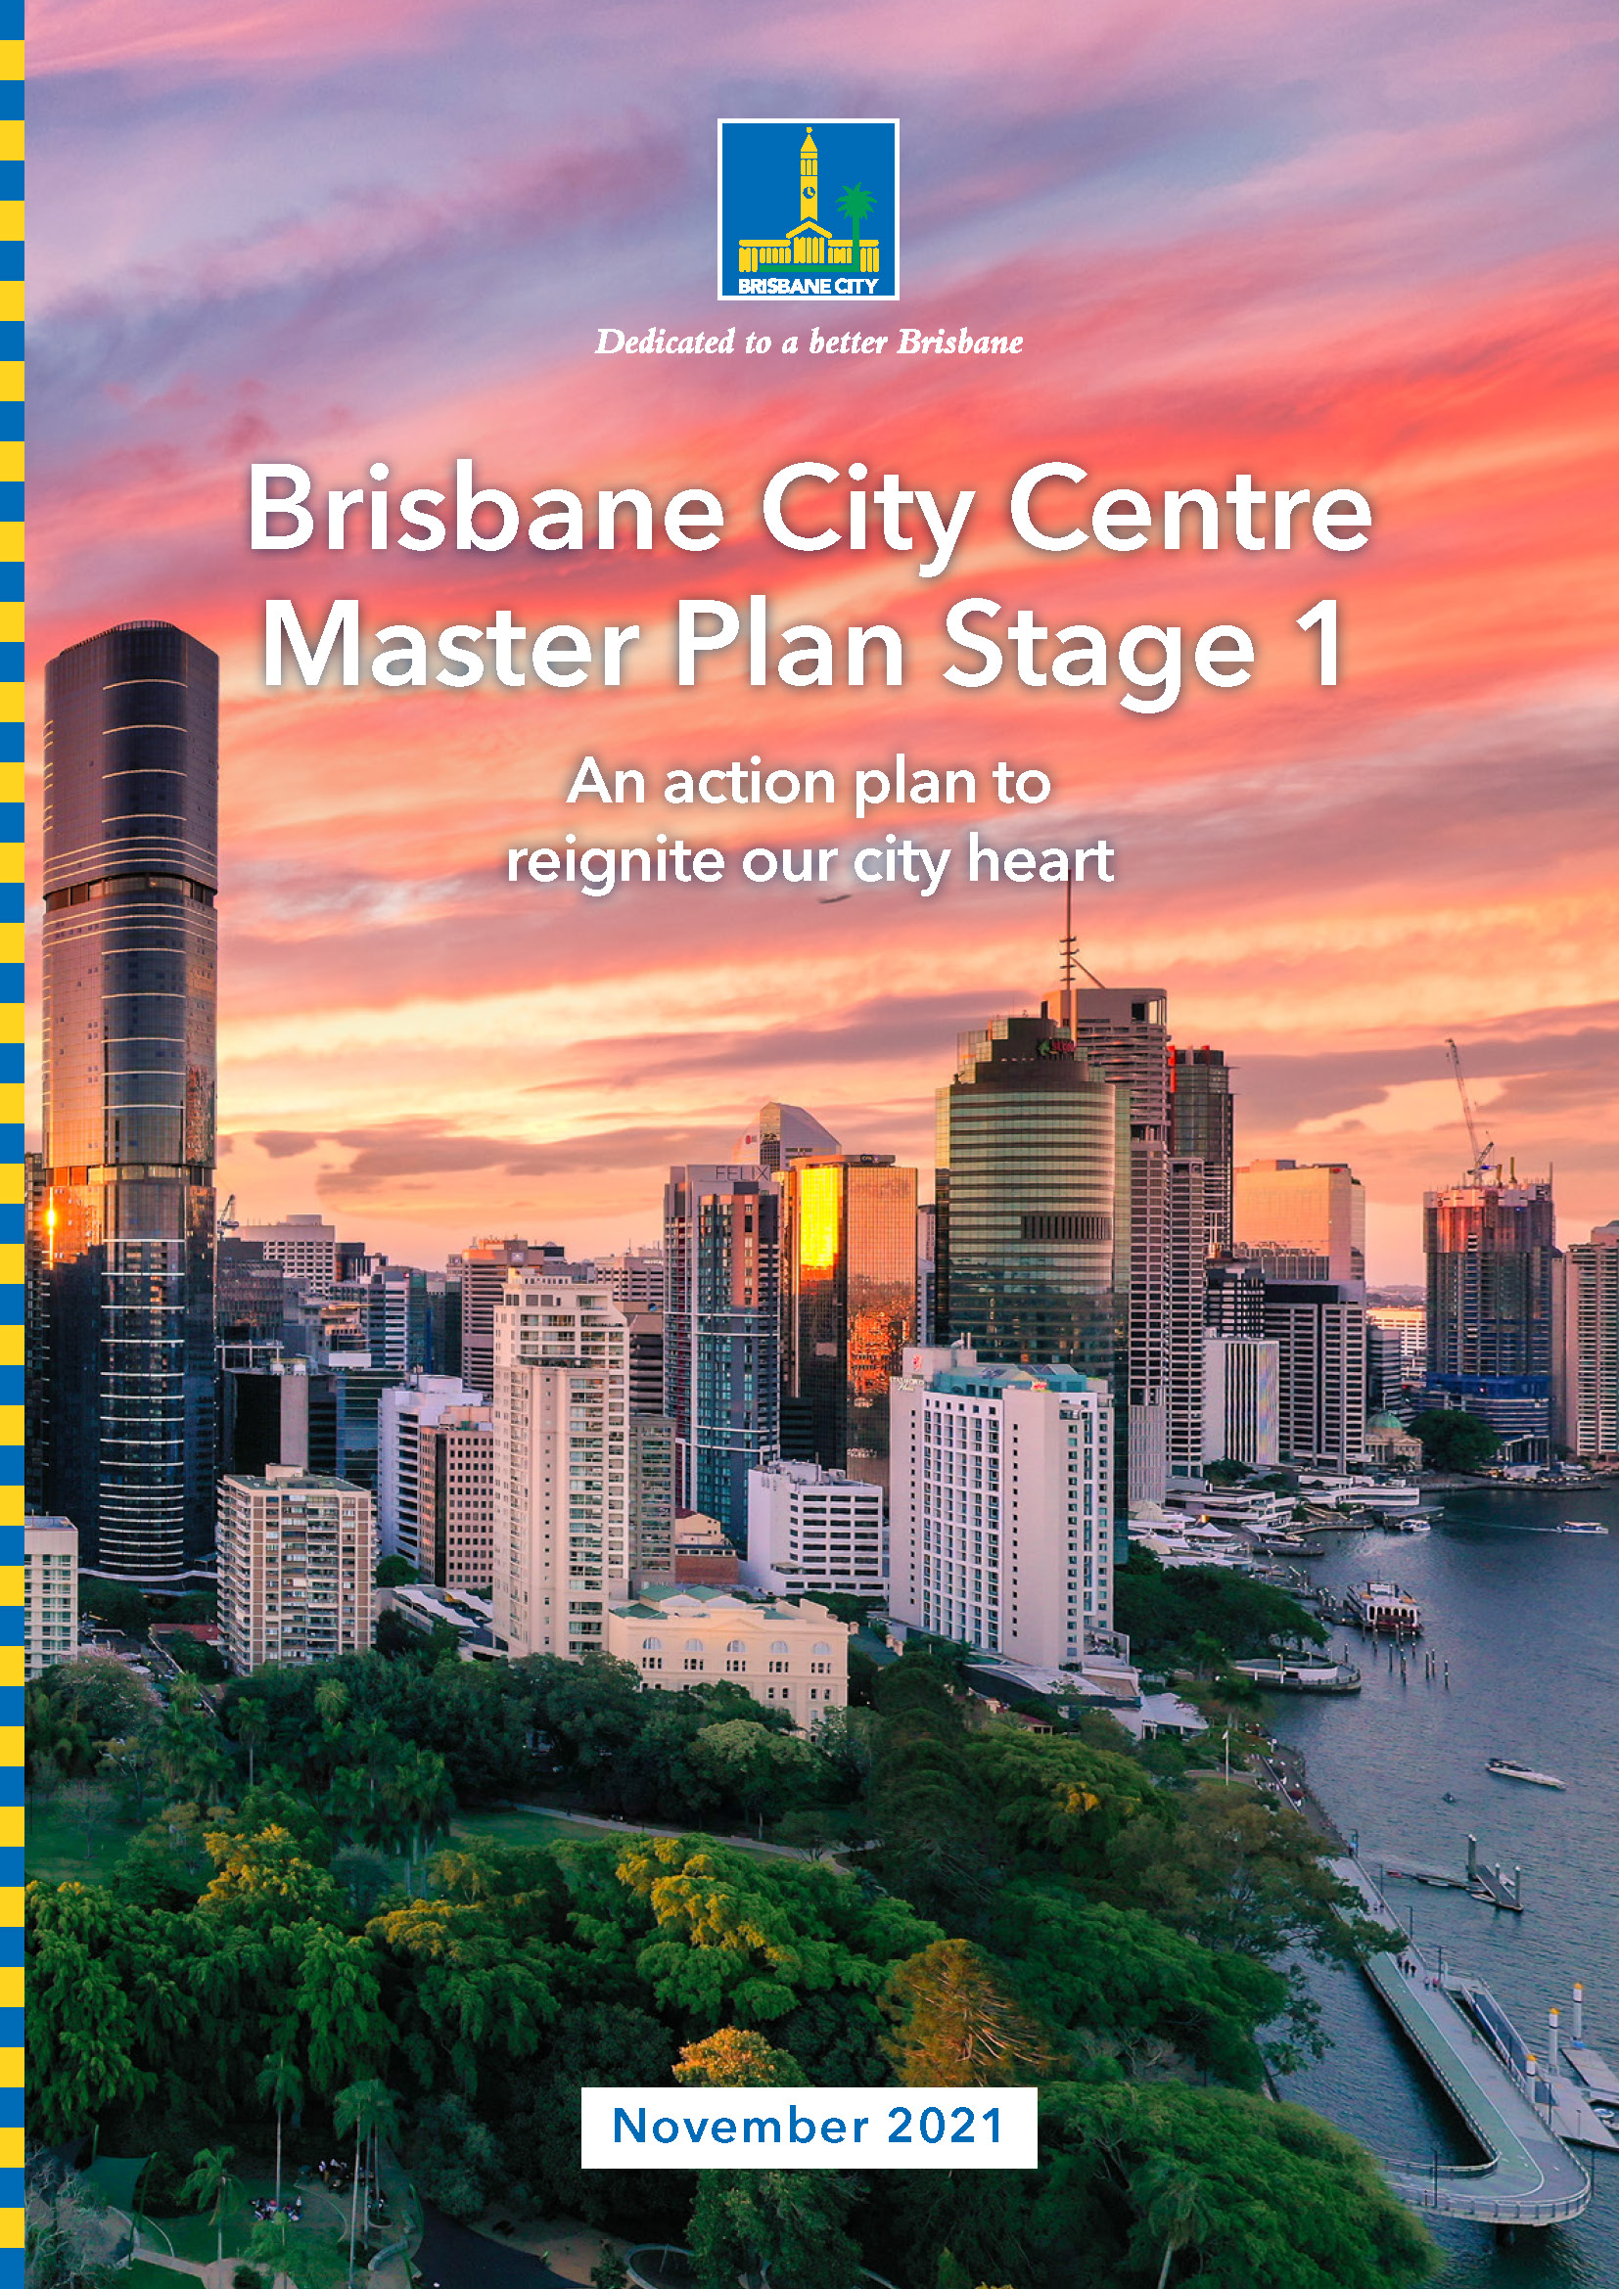
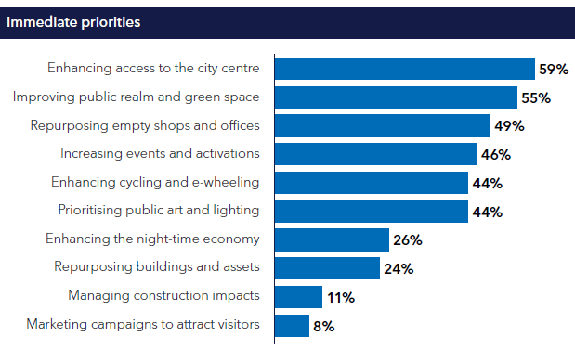
City Centre Master Plan – recent engagement

Slide 4
Inner city projects construction timeline
 |  | 2021 |  |  |  | 2022 |  |  |  | 2023 |  |  |  | 2024
Major Projects |  | 1 | 2 | 3 | 4 | 1 | 2 | 3 | 4 | 1 | 2 | 3 | 4 | 1 | 2 | 3 | 4
Queen’s Wharf Brisbane (QWB)
Neville Bonner Bridge (NBB)
Cross River Rail (CRR)
New inner city schools
Utility service upgrades
New Performing Arts Venue (NPAV)
Brisbane Metro
Kangaroo Point Green Bridge
CityCycle network re-purposing
South Bank Ferry Terminal upgrade
Howard Smith Ferry Terminal
Major private construction
We are here

Slide 5
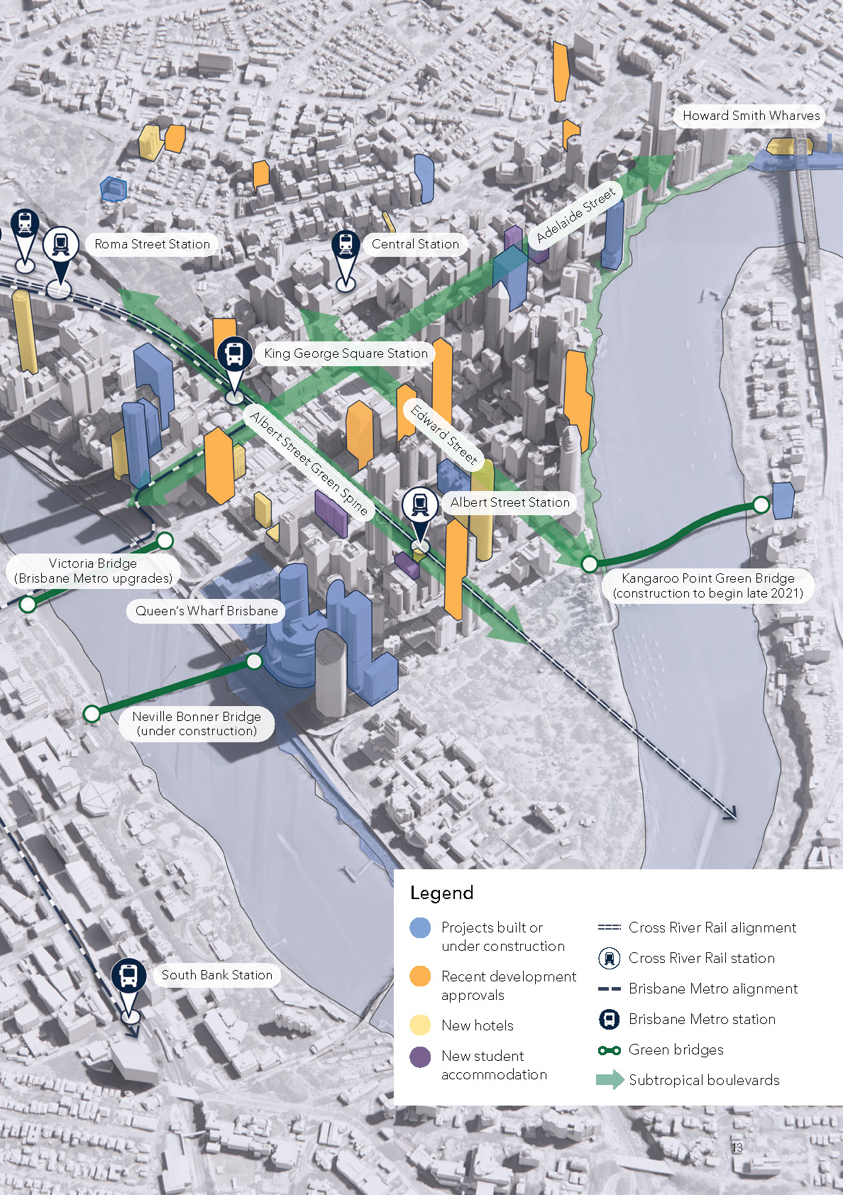
Inner city construction management planning
The Riverside Expressway provides the primary access to/from the city centre and accommodates 130,000 vehicles per day
The central CBD core has the highest daily pedestrian volumes of any area in Queensland
Cycle and scooter users access the city via the Riverwalk and North Brisbane bikeways with trials of an internal on-street network
The city centre is also the hub for major rail, busway and ferry connections between suburban and inner city employment. Glider and loop services provide for access around the precinct

Slide 6
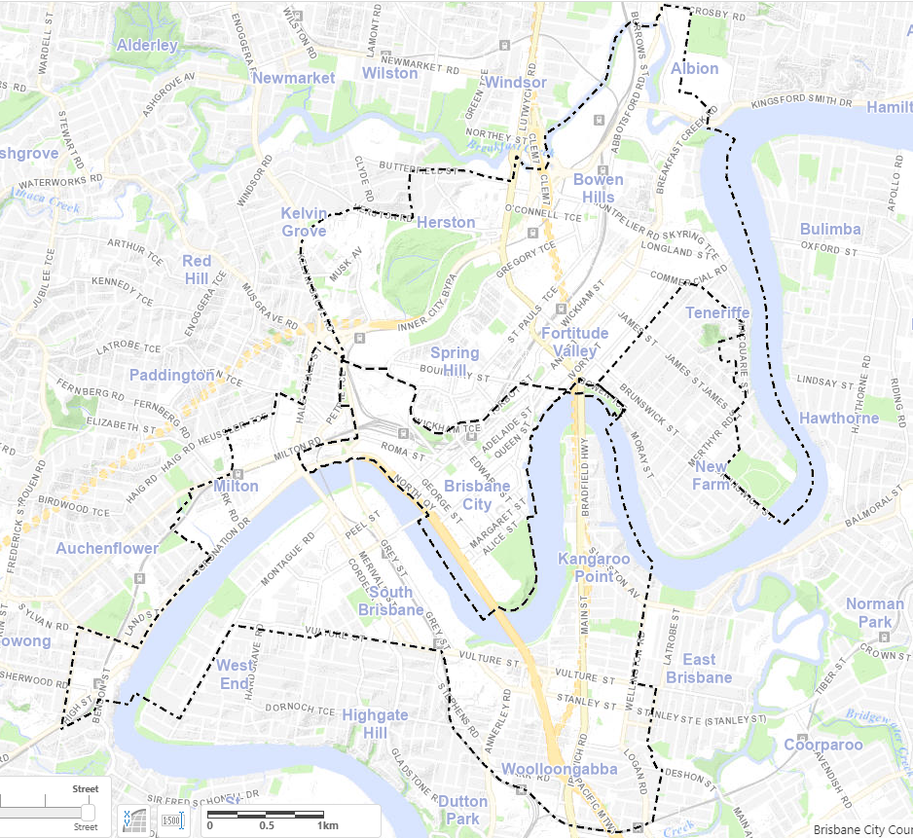
Inner city construction management planning
Inner city construction management
2020 Construction Management Guidelines (for any development to occur in the CBD or City Frame)
The guidelines apply to:
The CBD; and
City Frame, including:
  Woolloongabba
  East Brisbane
  Sections of West End
  Spring Hill
  Newstead
  Fortitude Valley
  Bowen Hills
  Herston
  Sections of Milton and Toowong

Slide 7
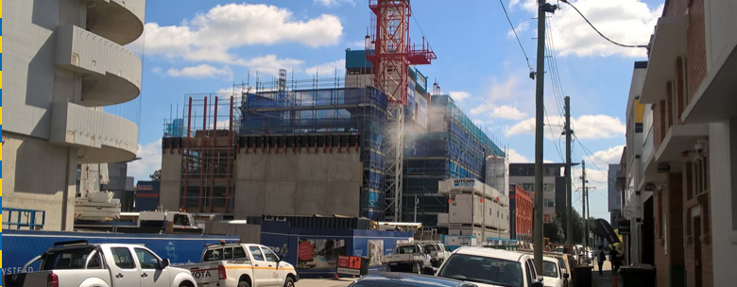
Inner city construction management planning
Full footpath closures are generally not permitted, with hoarding and gantry installation as the acceptable outcome
Partial footpath closures to maintain 2.4m minimum width of the verge
Qualified traffic controllers are required to allow pedestrians to safely pass the development site

Slide 8
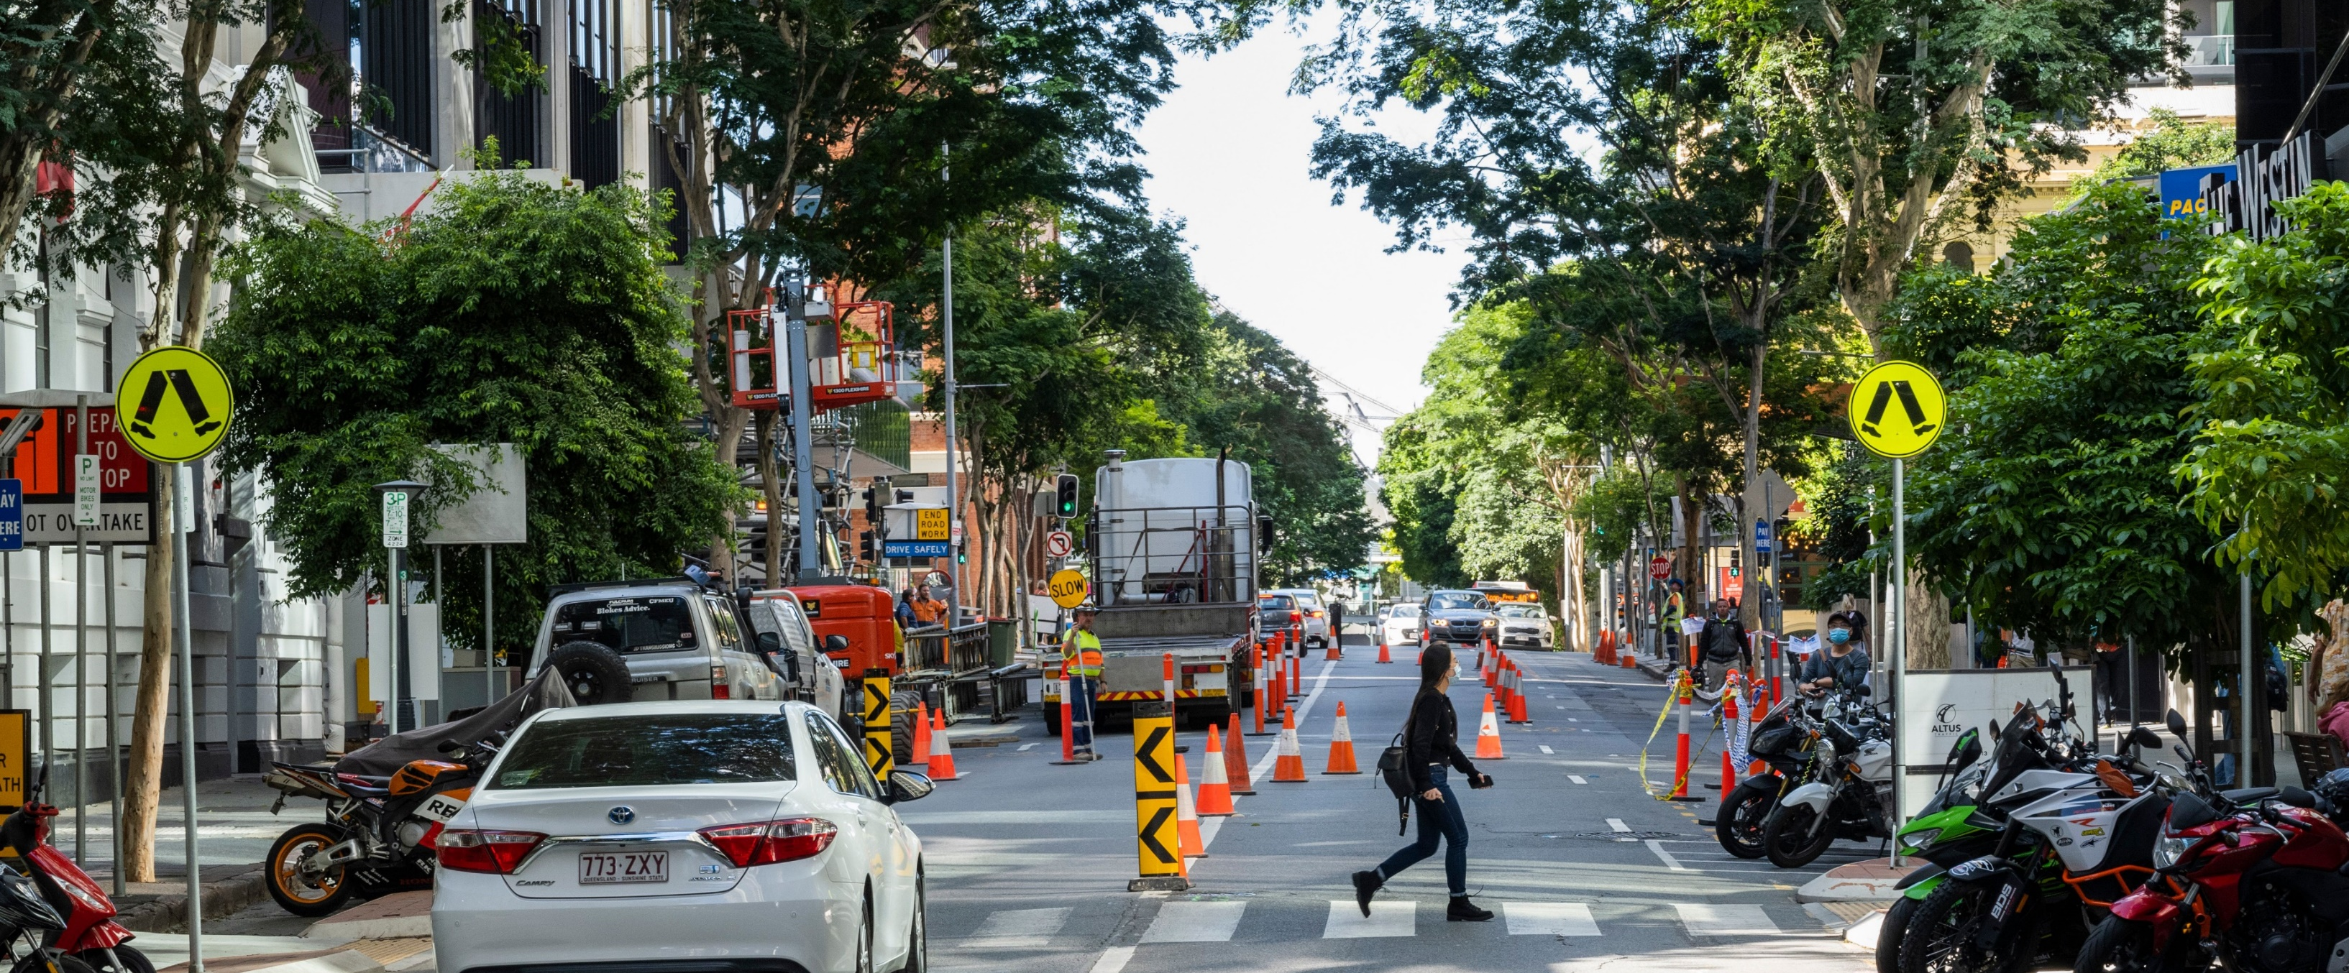
Inner city construction management planning
Temporary Road/Lane Closure generally will only be issued for short term temporary works carried out solely within the road corridor or for short term tower crane or air conditioner installations.
A Temporary Road/Lane Closure is not for the purpose of ongoing servicing of a construction site (concrete pours, crane lifts for materials and goods)
Heavy vehicle lock out periods -weekdays between 7.30am to 9am and 4pm to 6.30pm

Slide 9
Inner city construction management planning
Requirements for applicants:
Not to leave construction management to the last minute just before construction
Preparation of a Traffic Impact Assessment and a Construction Management Plan (CMP) at the upfront planning application
Planning and pricing construction management from the design stages onwards- all construction activities from demolition to excavation to building work to commissioning to be done within the development site
Planning any associated verge or streetscape works including changes to street trees, on-street parking or bus stops
Consult with other parties – utilities and telecommunications
Unless determined otherwise, a CBD City Frame CMP Compliance Assessment application will be required
Allow time for footway and road closure permits to be processed

Slide 10
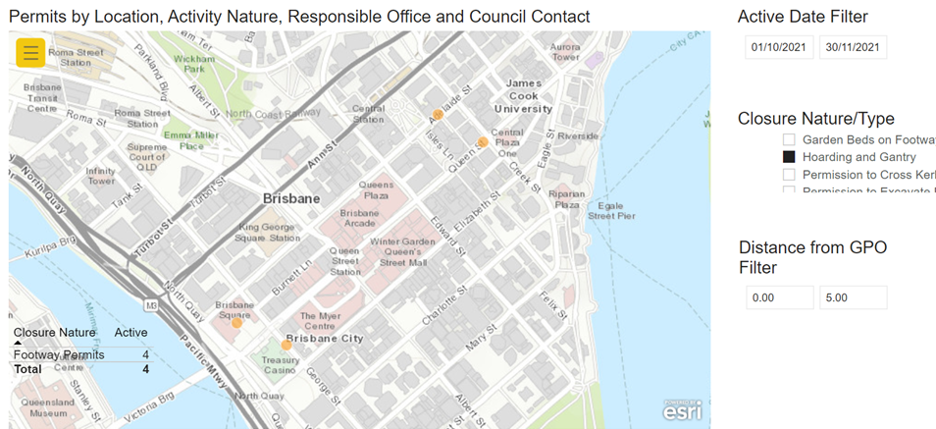
Footway permitting changes 2021
Updated online form and scoping tools:
Accountability to primary party undertaking the occupation of the footpath
Development Services assesses all applications associated with development
Scoping reviews the site history and surrounding development activity context

Slide 11
Footway permitting changes 2021
Permit zoning has changed to align with City Plan :
  Increases clarity and understanding of permit zones
  Zoning reflects the demand for the use of the available space
Zone Name | Current Definitions | New Definitions
A | City Centre | The principal centre (city centre) zone (PC1) as identified in the Brisbane City Plan 2014
B | Major centres | The principal centre (regional centre) zone (PC2) or major centre zone (MC), district centre (corridor) (DC2), high density residential (HDR) and mixed use (MU) as identified in the Brisbane City Plan 2014
C | All other areas | Other areas of Brisbane as identified in the Brisbane City Plan 2014

Slide 12
Footway permitting changes 2021-22
Footway permit fees and charges changes:
Council fees have been aligned to those of footpath dining occupation and benchmarked against other local governments around Queensland and Australia
Fee changes recognise the value and demand for use of areas
 | Application fee | Per sq metre/weekly charge for occupation of footpaths
Zone A | $300 | $9.30
Zone B | $300 | $4.45
Zone C | $150 | $2.65

Slide 13
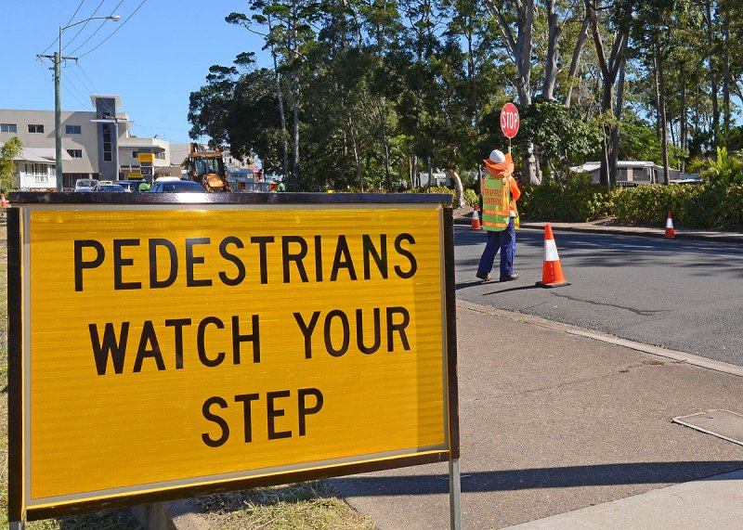
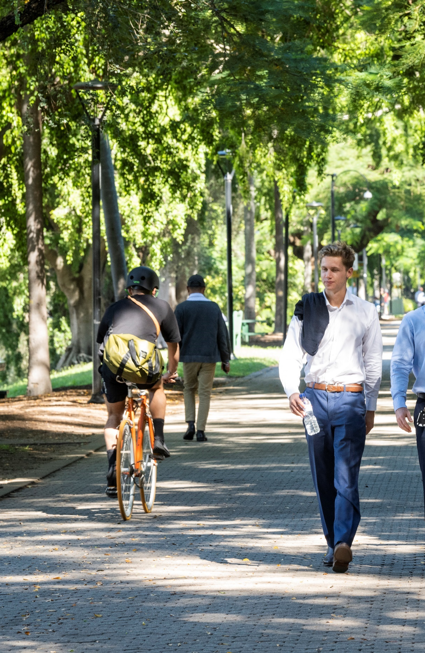
Building and Construction Management Team
Conduct pre-start meetings to check required permits and approvals are in place
Proactively regularly engage with development sites under construction
Ensure approved development construction occurs efficiently and with minimal disruption to the surrounding community
Resolve issues and ensure compliance with the approved conditions during construction
In the month of October 2021, 91 proactive inspections and 37 reactive inspections took place in North Brisbane including the CBD. There were 16 active construction sites visited at least once during October.

Slide 14

Questions?

