Slide 1

Lindum Level Crossing Upgrade
Initial Works
Infrastructure Committee
30 November 2021

Slide 2
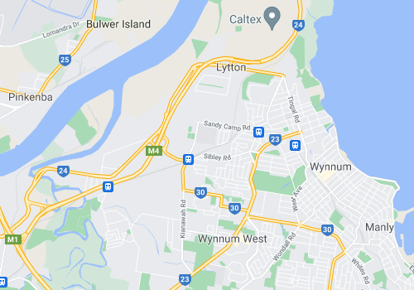
Site locality
Port of Brisbane Motorway
Iona College
Lindum Railway Station
Kianawah Road
Source: Google Maps

Slide 3
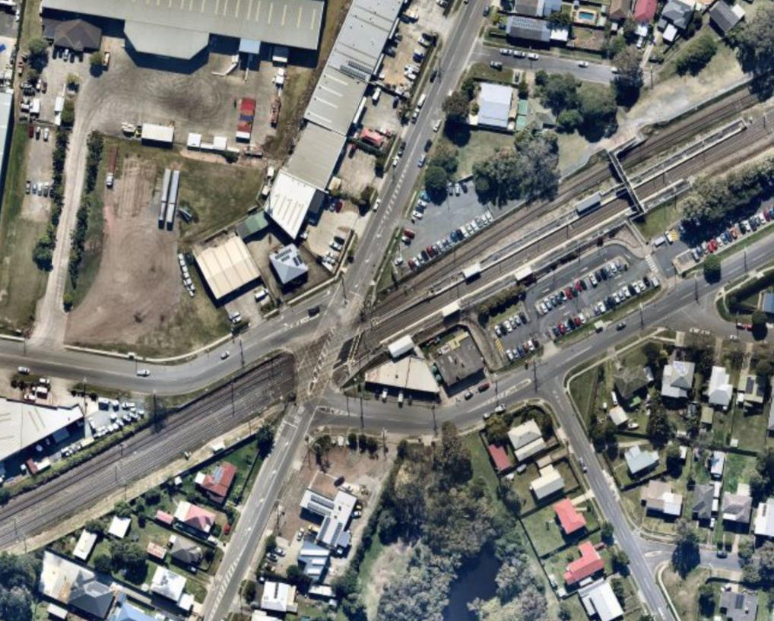
Location
Lindum Station
Commercial
North Road
Lindum Road
Sibley Road
Shops
Kianawah Road
Service Station
Source: Nearmap

Slide 4
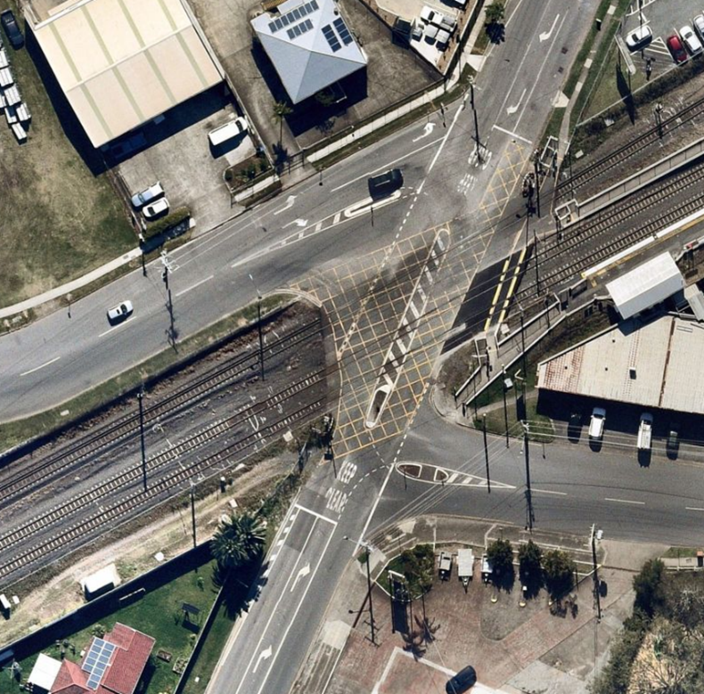
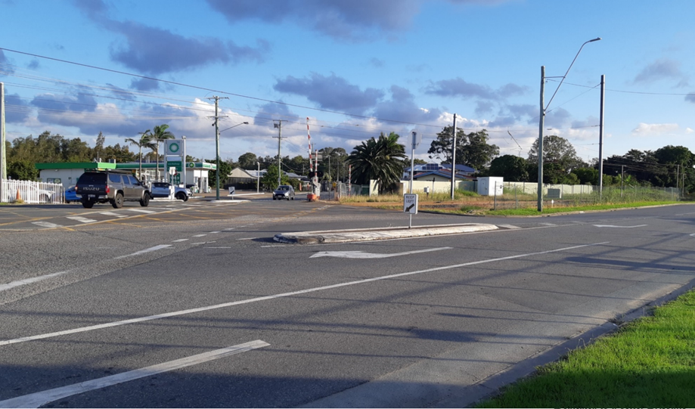
Previous configuration
North Road
Lindum Road
Railway line
Sibley Road
Source: Brisbane City Council
Kianawah Road
Source: Nearmap

Slide 5
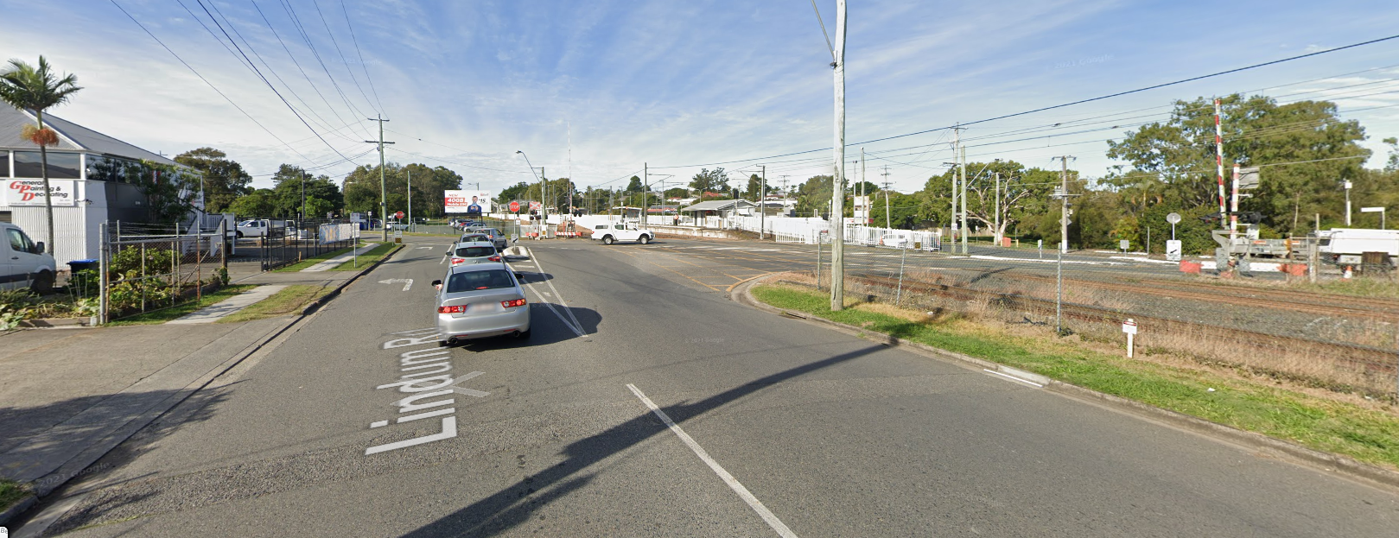
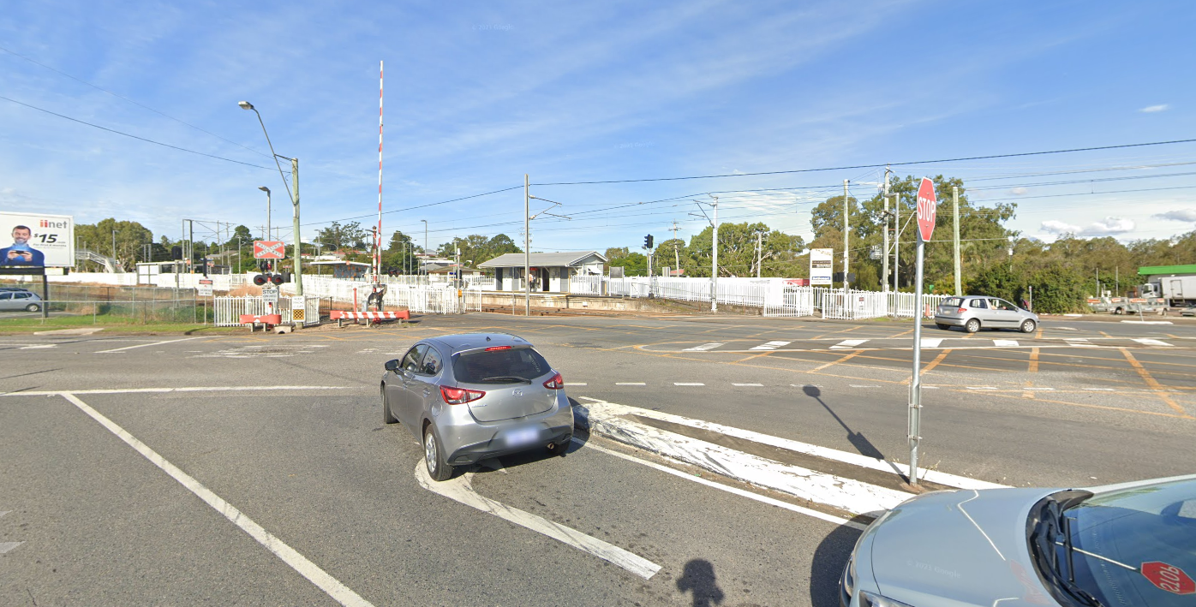
Lindum Road pre-existing median
Source: Google Maps
Lindum Level Crossing from Lindum Road pre-existing
Source: Google Maps

Slide 6
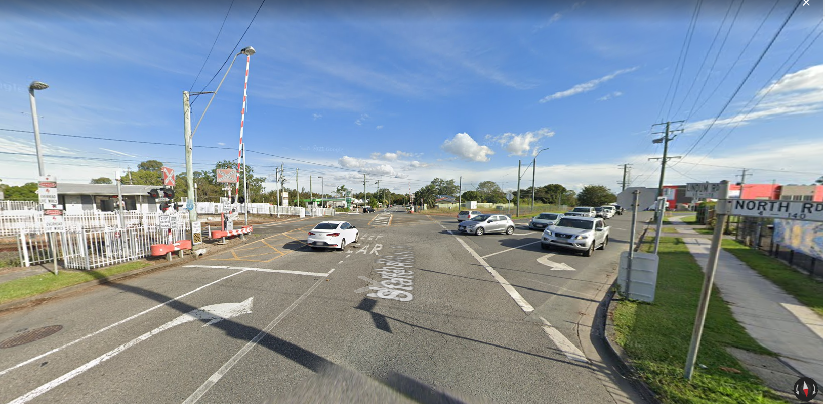
View form North Road – pre-existing
Source: Google Maps

Slide 7
Project background
Road hierarchy (under the Brisbane City Plan 2014):
  Lindum and Kianawah Roads are arterial roads
  North and Sibley Roads are district roads
There are two unsignalised T-intersections immediately adjacent to the north and south of the level crossing
The Lindum level crossing carries approximately 10,000 vehicles per day and 250 pedestrians per day
The Cleveland railway line carries 15 services in peak hour
(11 stop at Lindum station). As a result, the level crossing boom gates are closed 28% to 36% in peak times and 16% outside peak times, creating significant traffic congestion
Additional rail freight services run outside of peak to Port of Brisbane
Department of Transport and Main Roads (TMR) incident data (2016 to 2021) report shows there have been:
  82 pedestrian incidents (including 1 fatality)
  9 vehicle incidents (including 1 fatality)

Slide 8
Approach
Proposed staging
Three stage approach – initial, short-term and long-term
Tripartite government involvement
Coordination required a Steering Committee to be formed with representatives from Council, DTMR, TransLink, Queensland Rail (QR) and the Australian Government
April 2021 all levels of government met and confirmed a grade separated solution was the preferred long-term solution
All parties agreed Council would lead the investigation of:
  initial safety enhancements (initial works) to be implemented
  a short-term solution of signalising the level crossing intersections
To deliver initial and short-term solutions, a Technical Working Group was formed including representatives from Council, TMR, TransLink and QR

Slide 9
Delivery milestones
Initial-works
Start of construction:
1 November
2021
Rail closure works:
27 to 29 November 2021
End of construction:
29 November 2021

Slide 10
Funding
The Australian Government has committed $1.75 million through the
Urban Congestion Fund for:
  initial works design and delivery
  short-term signalisation planning and design
Further funding submission to be made for delivery of short-term signalisation.

Slide 11
Initial works
  Scope:
  Installation of a new median island on the northern side of the level crossing on North Road
  Extension of the median on Lindum Road
  New pavement and road line marking
  Installation of new 12 metre boom gate on the northern side of the level crossing approach
  Increased size of the twin red flashing LED lights

Slide 12
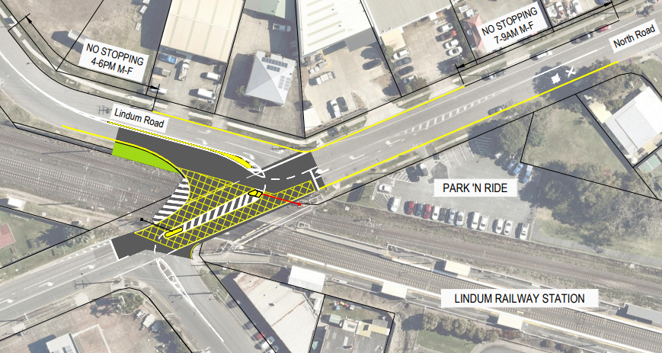
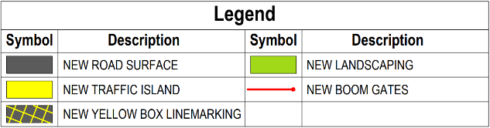
Initial works
Delivery Status
Council works:
Commenced early November 2021 – pavement and traffic islands
Completed 29 November 2021
Queensland Rail works:
12m boom gate installed November 2021
Main completed during planned rail corridor closure from Saturday 27 to Monday 29 November 2021 in the Scheduled Corridor Access System (SCAS)
COMMERCIAL
SHOPS
Source:
Nearmap (aerial imagery)
Brisbane City Council (concept)

Slide 13
Rail corridor (SCAS) works
Queensland Rail (SCAS) works area
COMMERCIAL
Source:
Nearmap (aerial imagery)
Brisbane City Council (concept)

Slide 14
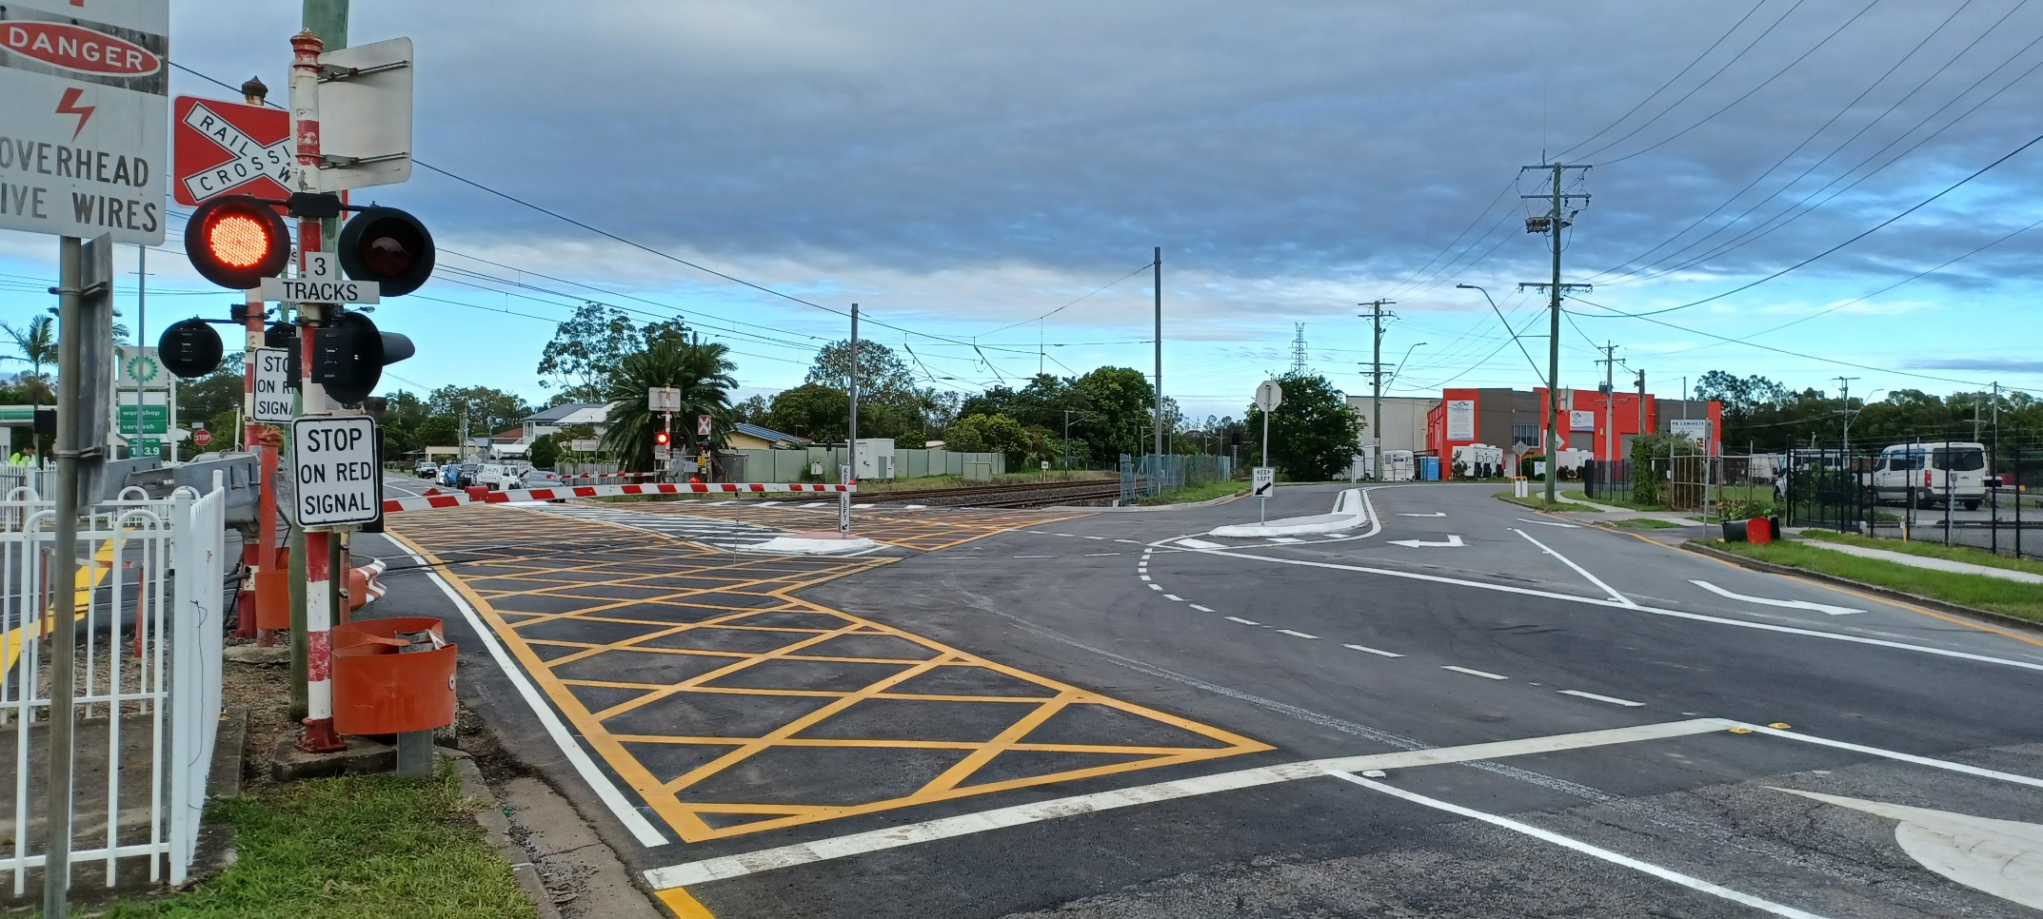
Rail corridor (SCAS) works
Lindum Level Crossing – from North Road
Source: Brisbane City Council

Slide 15
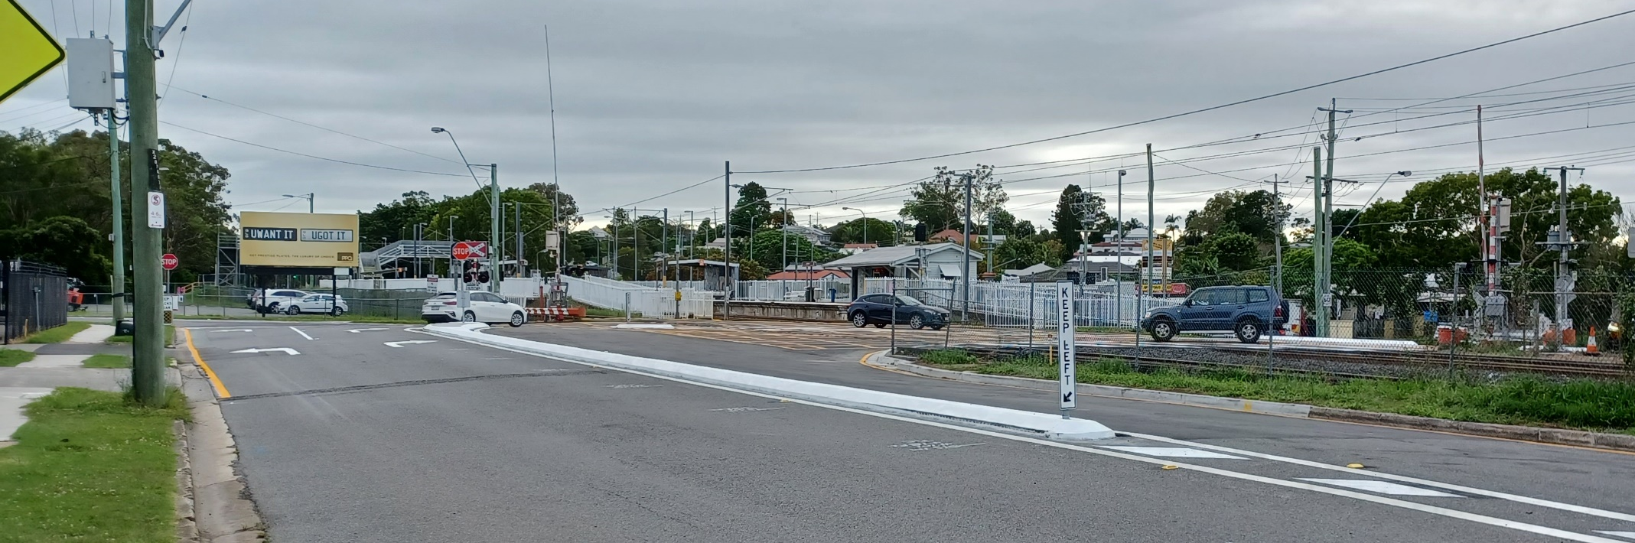
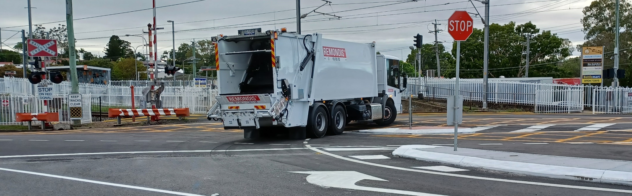
Lindum Road – Extended median
Source: Brisbane City Council
Lindum Level Crossing – from Lindum Road
Source: Brisbane City Council

Slide 16
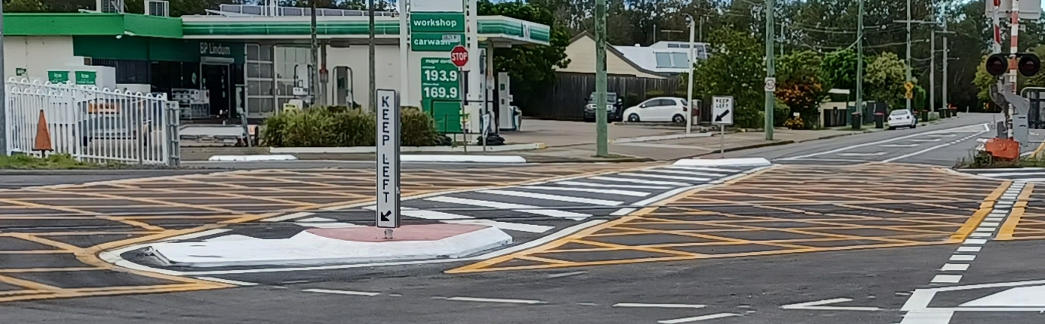
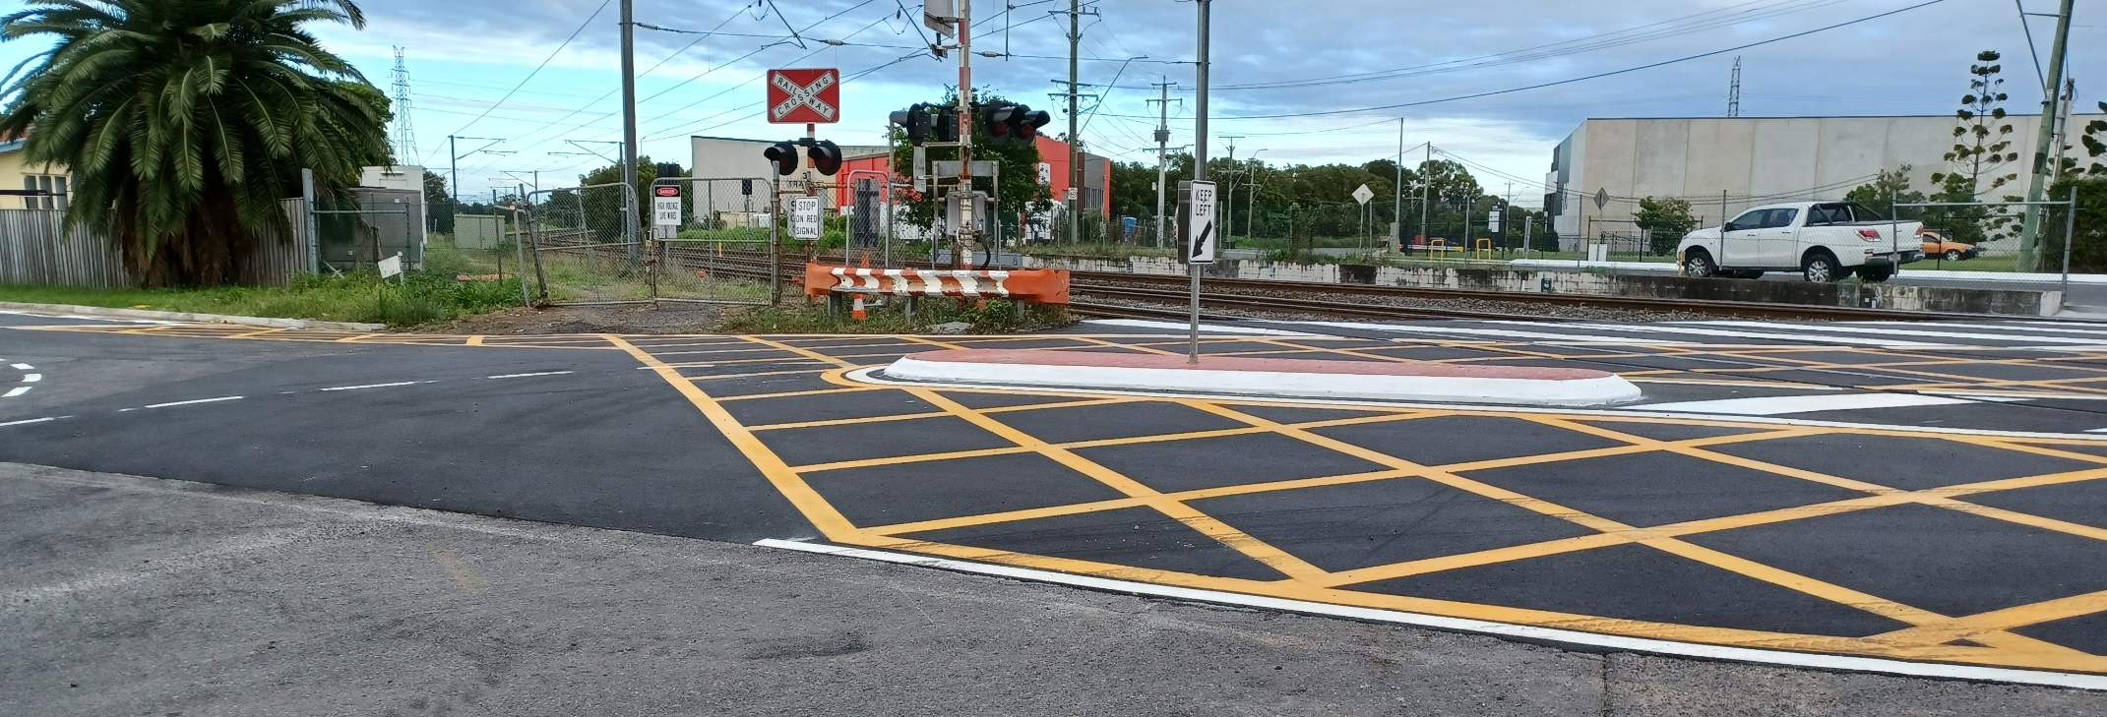
Lindum Level Crossing – from North Road
Source: Brisbane City Council
Lindum Level Crossing – southern side
Source: Brisbane City Council

Slide 17
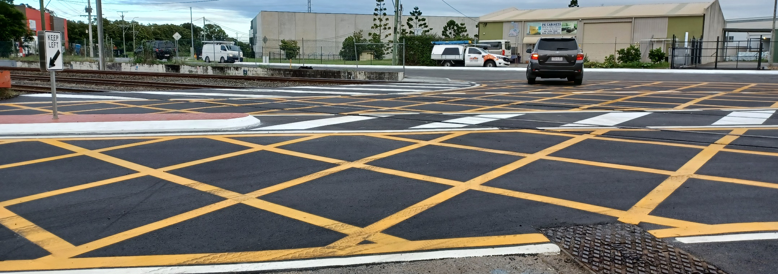
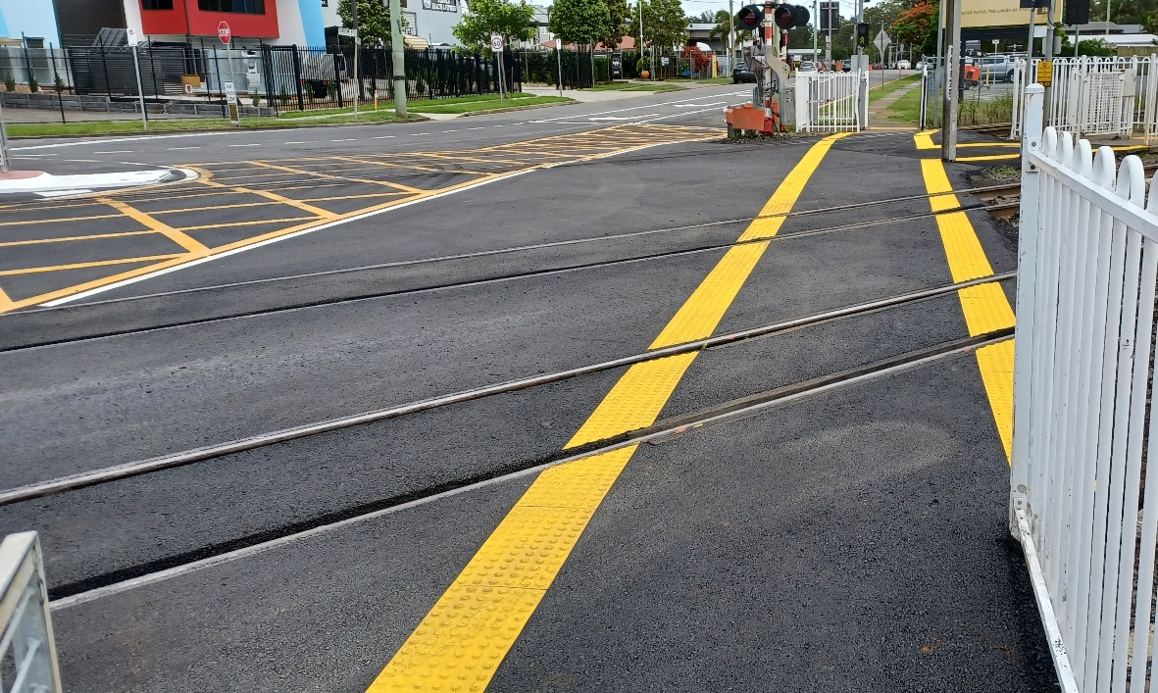
Lindum Level Crossing – towards Lindum Road
Source: Brisbane City Council
Lindum Level Crossing – realigned pedestrian crossing toward North Road
Source: Brisbane City Council

Slide 18
Questions

