Slide 1
First Home Owner Rebate Scheme (FHOR)
Finance, Administration and Small Business Committee
16 February 2021
Support Services Centre
Organisational Services

Slide 2
Purpose
To update the Committee on the FHOR:
Recap on:
Background
Who can apply?
How to apply
Take-up

Slide 3
Background
Partial rebate of rates and charges for eligible first home owners
From 1 October 2019: 50% rebate to a maximum of $1,000 for existing houses or units
From 1 October 2020: 100% rebate to a maximum of $2000 for new builds
Rebate is over a 12-month period (from next rate account following approval)
Applies to:
General rates (after rate capping)
Environmental Management and Compliance Levy
Bushland Preservation Levy
Waste Utility charges
Source: https://accrumelb.com.au/buying-first-home/

Slide 4
Who can apply?
Australian citizens or permanent residents over 18 years where:
property is in the Brisbane local government area
buying or building a new or established home
value, including land, is less than $750,000
Source: https://clipartstation.com/people-clipart-png-5/

Slide 5
Eligibility Criteria
Do not currently own or not previously owned a home in Australia and:
Will occupy the home as principal place of residence for a continuous period of at least six months within first 12 months of title transfer date, or build completion date
Source: http://clipart-library.com/clipart/rTnGxj6yc.htm

Slide 6
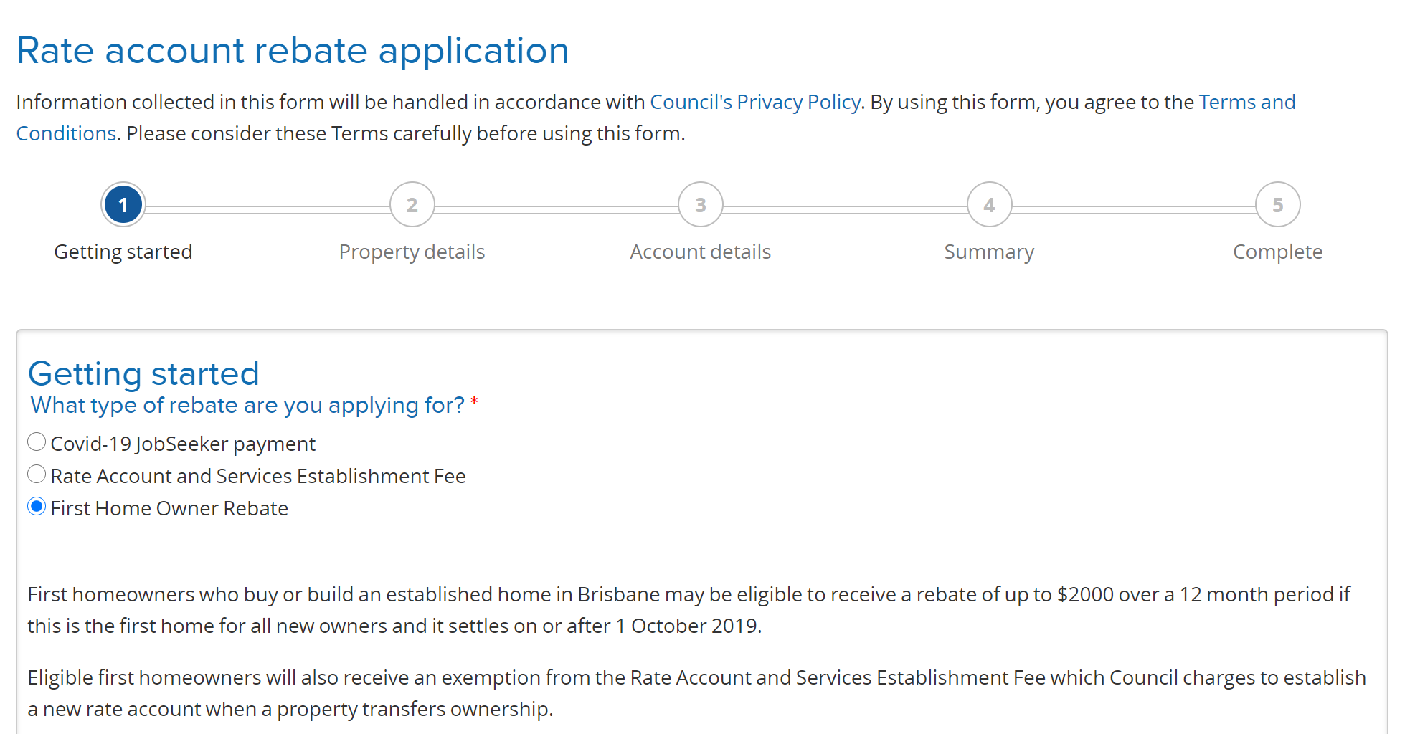
How to apply
Online application form
Hard copy form also available

Slide 7
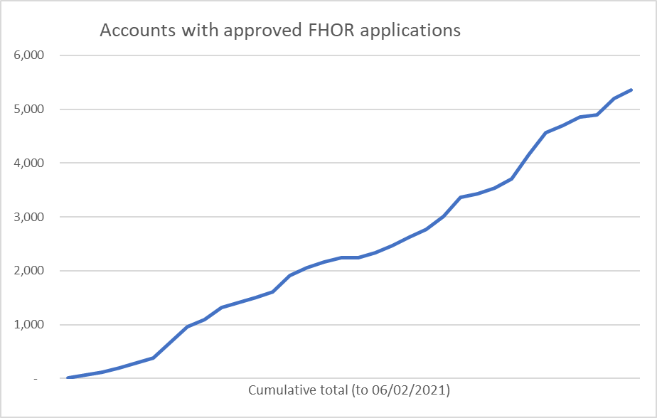
Take-up since starting in 2019
5363 accounts approved as at 6/02/2021
50% rebate = 5297 accounts (since Oct 1 2019)
100% rebate = 66 accounts (since Oct 1 2020)
Total rebate provided $2,003,834

Slide 8
Rebate period transition
First rebates applied in January 2020 rate accounts.
12 month rebate period has passed: transition off starting
Source: http://clipart-library.com/clipart/n193484.htm

Slide 9
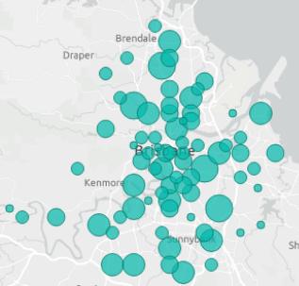
Take-up: current suburb view
Current recipients across 193 suburbs

Slide 10
Any questions?
10

