Slide 1
BRISBANE POWERHOUSE 21ST BIRTHDAY
Community, Arts and Nighttime Economy Committee
25 May 2021

Slide 2
POWERHOUSE 1846-1971

Slide 3
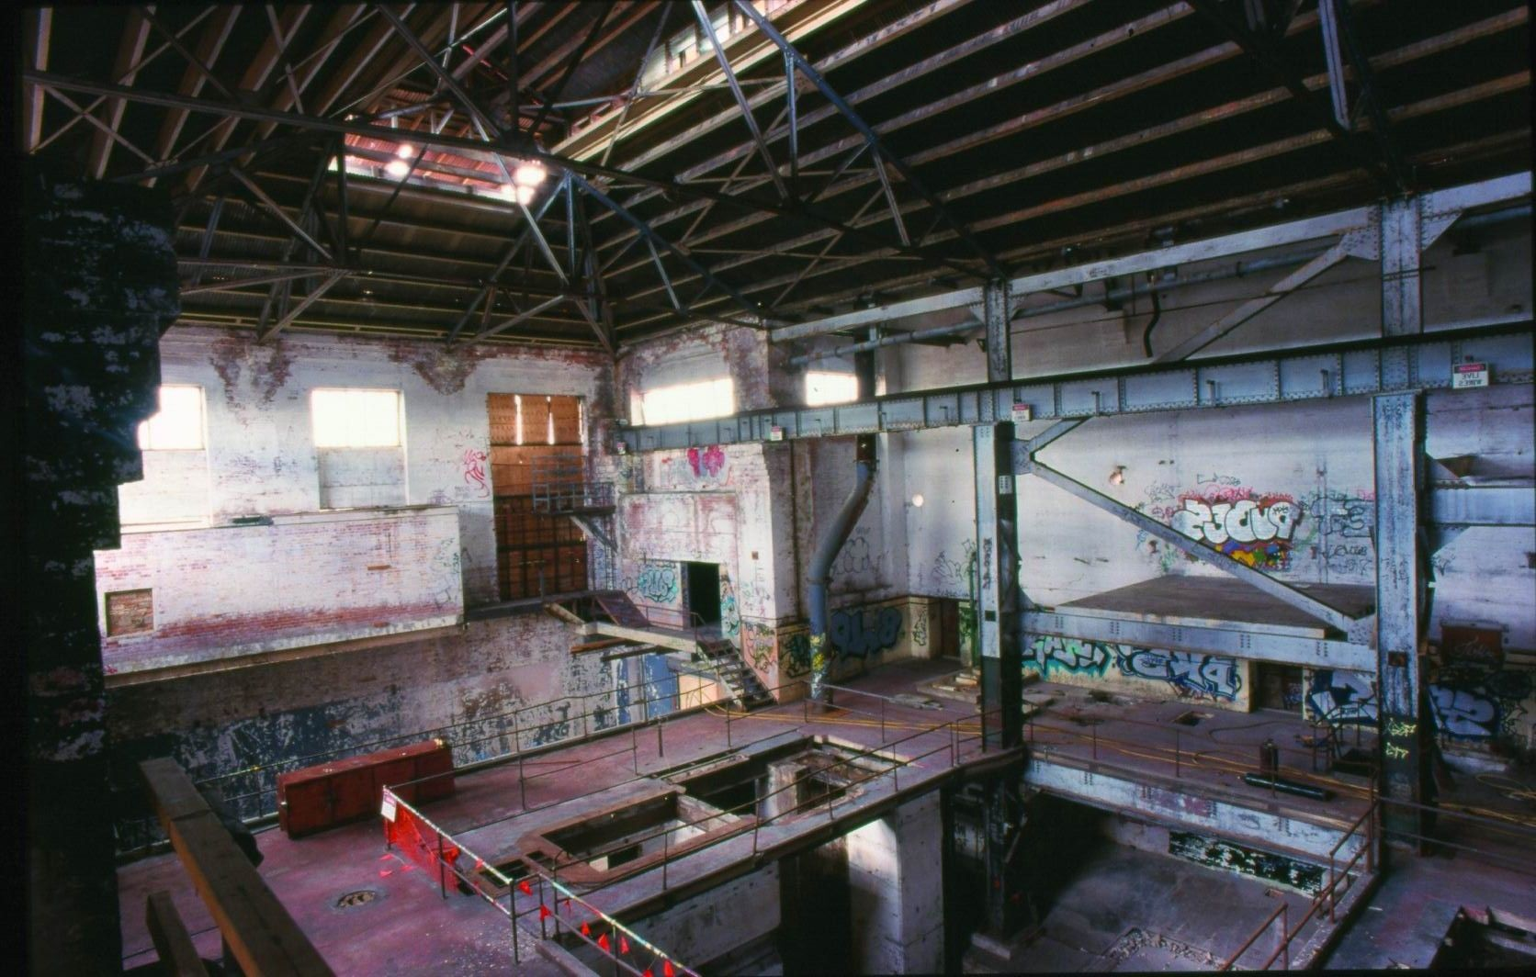
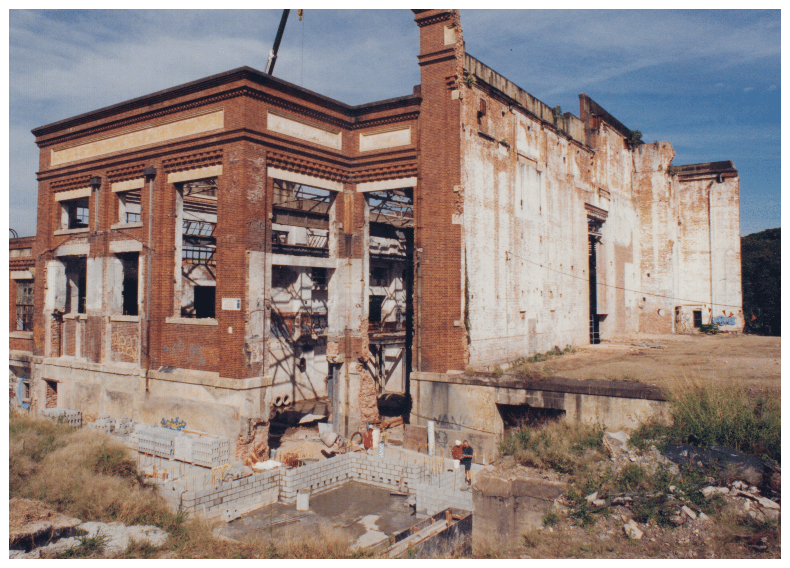
DERELICT
1971-1999

Slide 4
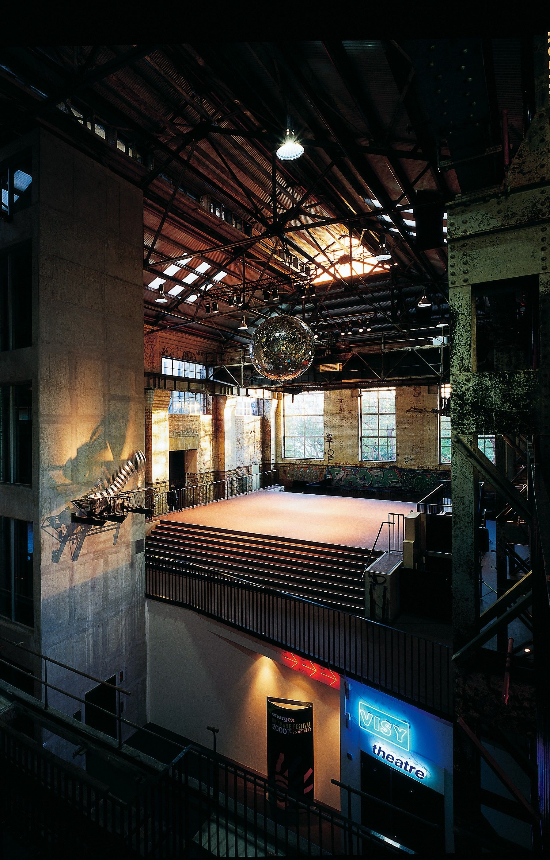
REIMAGINED 2000

Slide 5
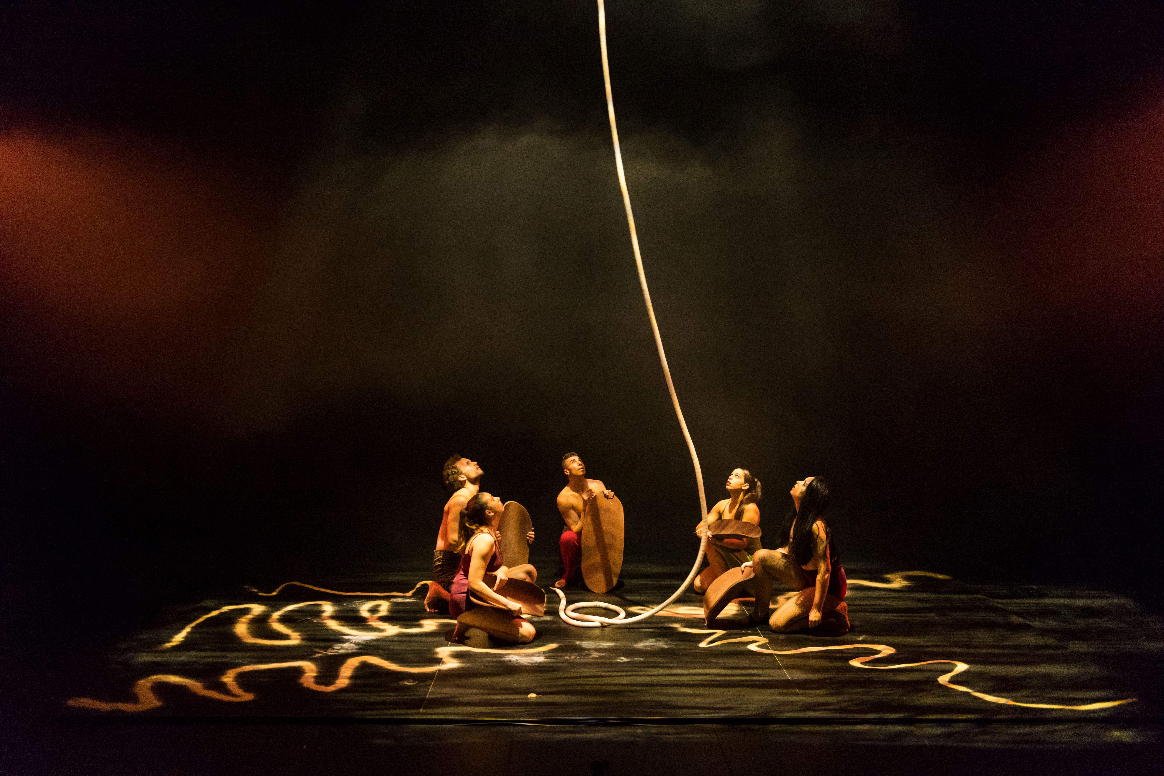
PHYSICAL
FIRST NATONS
BRISBANE

Slide 6
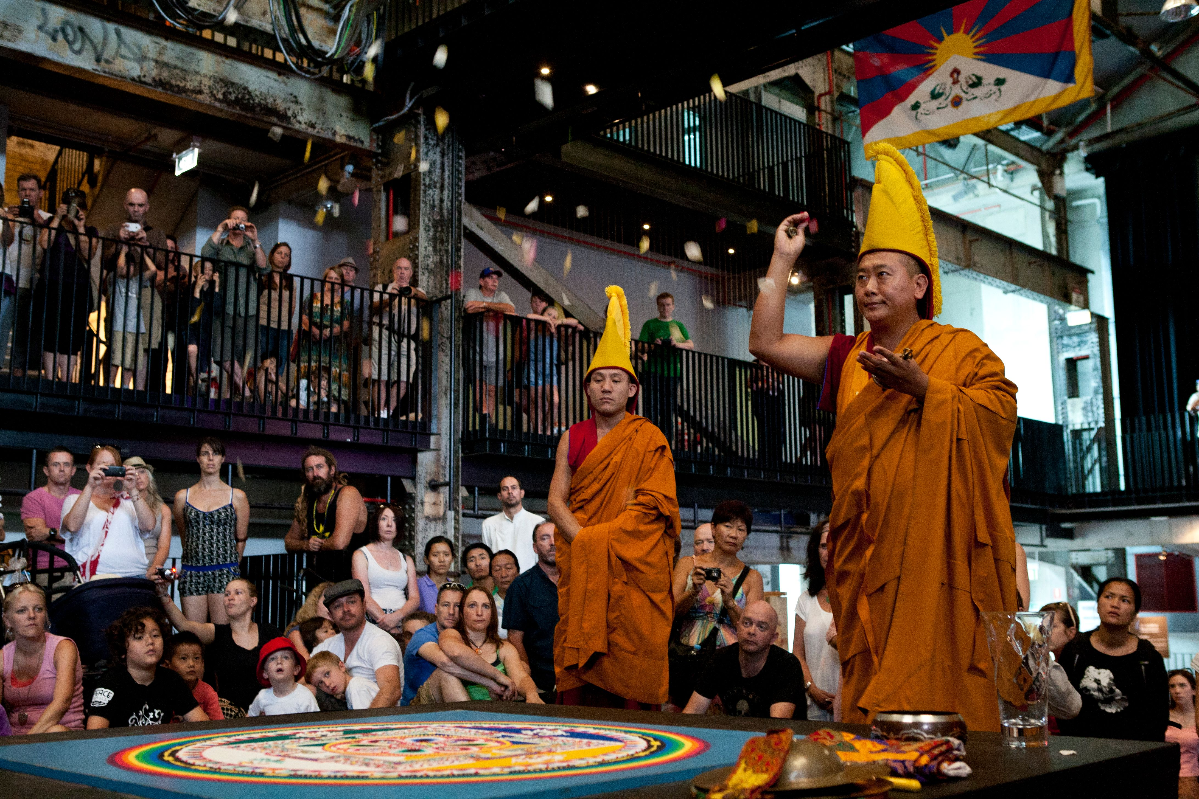
GLOBAL
DIGITAL

Slide 7
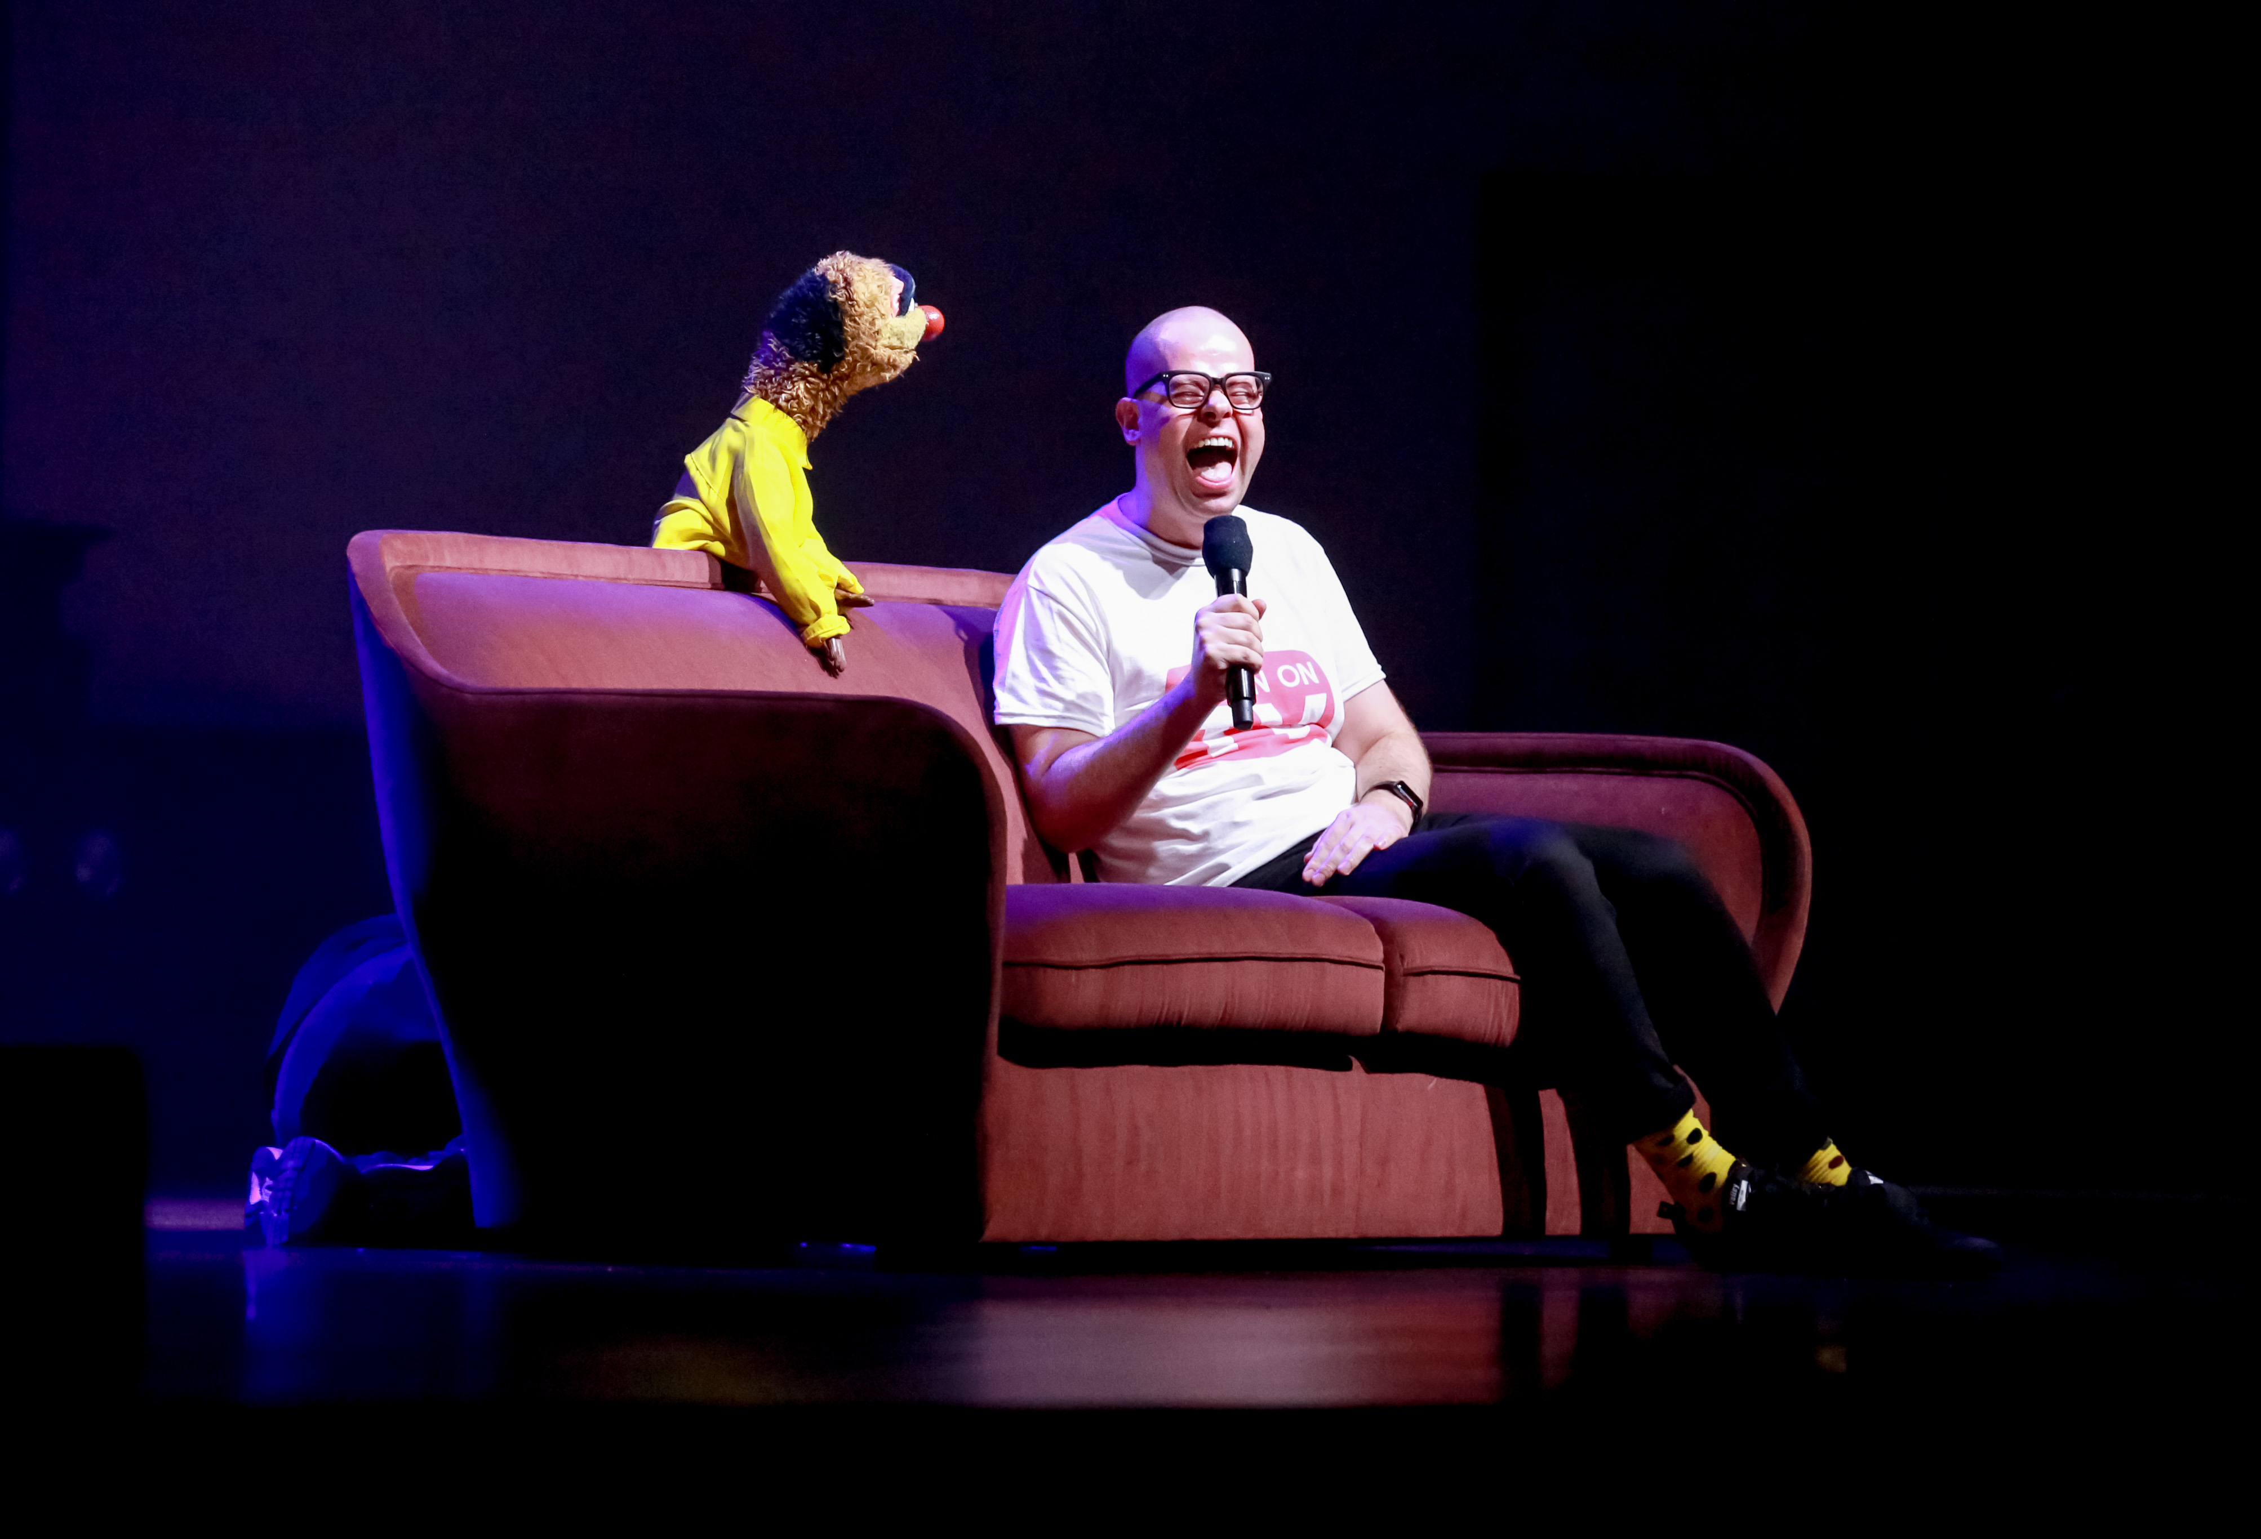
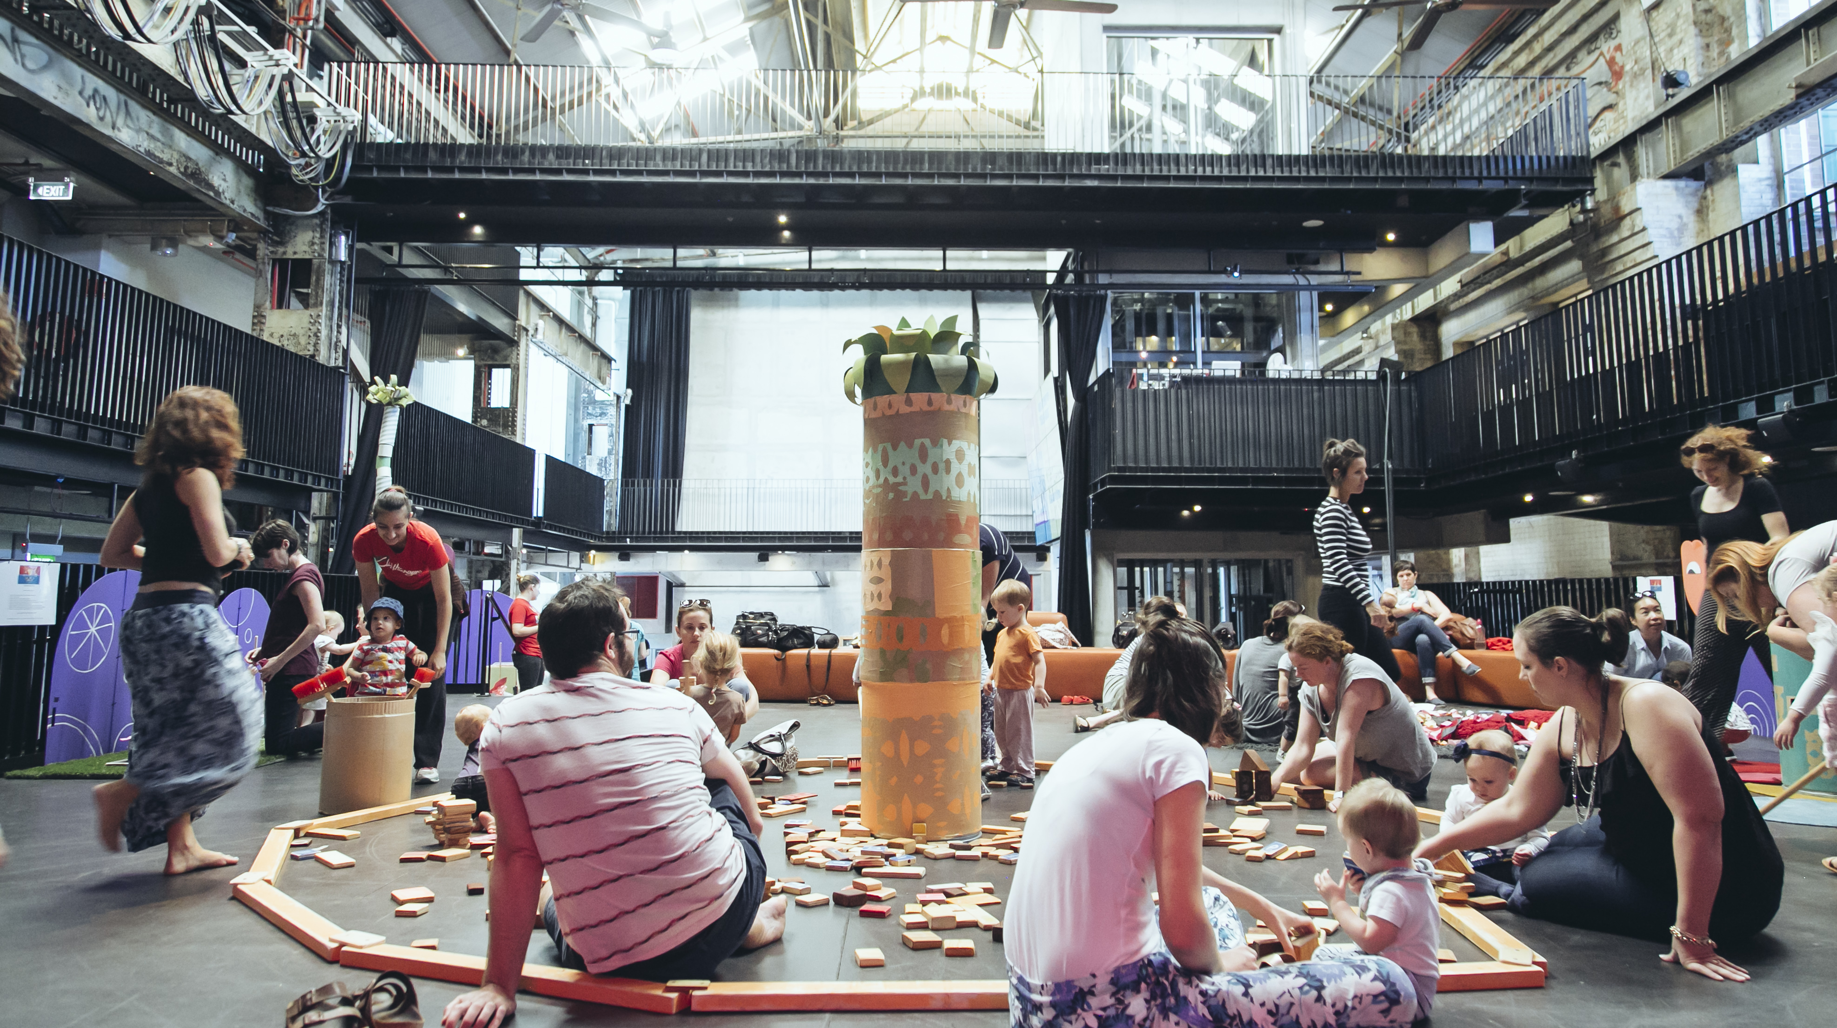
LAUGHTER
PLAYTIME

Slide 8
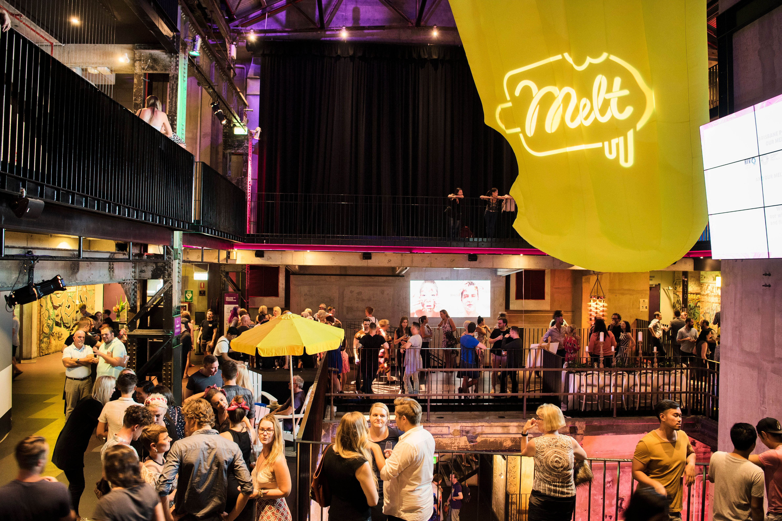
QUEER

Slide 9
MUSIC BOX

Slide 11
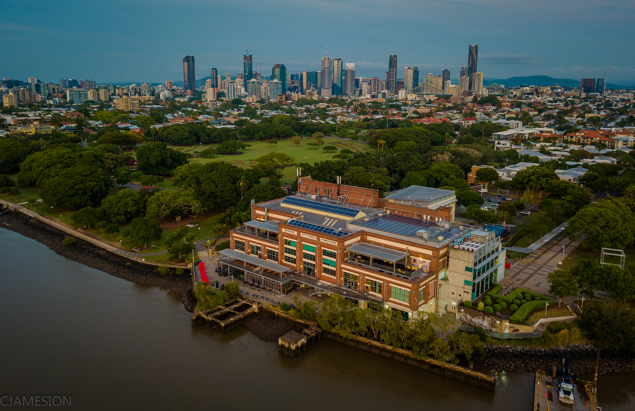
THANK YOU

