Slide 1
Managing the Impacts of Major Planned and Unplanned Events on Council’s Road Network
Infrastructure Committee
1 June 2021

Slide 2
Purpose
To provide information on the operational response to the impact of major planned and unplanned events on the performance of the road based transport network.

Slide 3
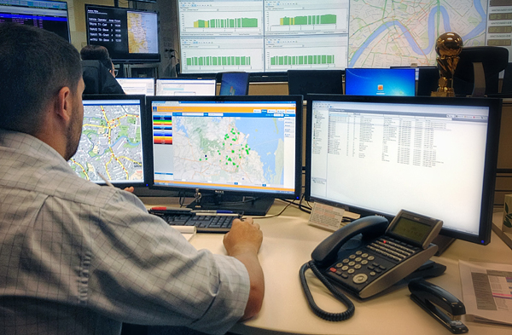
Incident Management Room
Some events can be of such magnitude that normal operations of the Brisbane Metropolitan Transport Management Centre (BMTMC) is inadequate to effectively manage the situation.
When these events occur the Incident Management Room (IMR) can be activated to provide support.
Any Alliance partner (TMR, BCC) can activate the IMR.
The IMR is activated to ensure the major event is effectively managed while maintaining normal service delivery on the balance of the network.
Source: Council

Slide 4
Incident Management Room
The IMR supports BMTMC activity by centralising a team of key staff, across the Alliance Partners, QPS and other key stakeholders, to focus entirely on the management of the major incident to:
co-ordinate actions that mitigate the impact of the event on the performance of the network;
co-ordinate accurate and timely public and internal information dissemination.

Slide 5
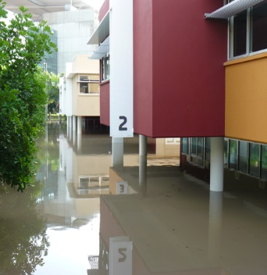
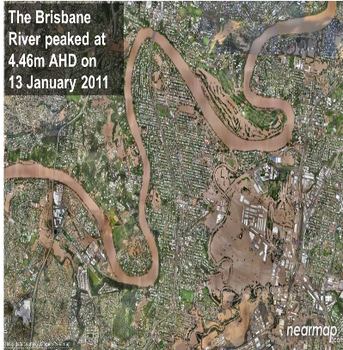
Examples
Planned Events
G20 (2014)
Commonwealth Games (2018)
Protest activity (ongoing)
Unplanned Events
Floods (2011)
Cyclone Debbie (2017)
Callide Power Station Fire (2021)
Source: GOLDOC WEBSITE 2017
Source: Council

Slide 6
Callide Power Station Fire - What happened?
At approximately 2pm power was lost to large areas of the State from Cairns to the NSW boarder towns.
Throughout metropolitan Brisbane, more than 500 traffic signal controlled intersections were affected (296 Queensland’s Department of Transport and Main Roads (TMR), 241 Council).
Within the areas affected, many electronic traffic systems were impacted, including Lane Use Management, Bluetooth, Variable Message Signs and more than 500 CCTV cameras (Council and TMR).
Some tunnels (BCC and TMR) reported loss of power resulting in the use of emergency backup supply.
Source: Council

Slide 7
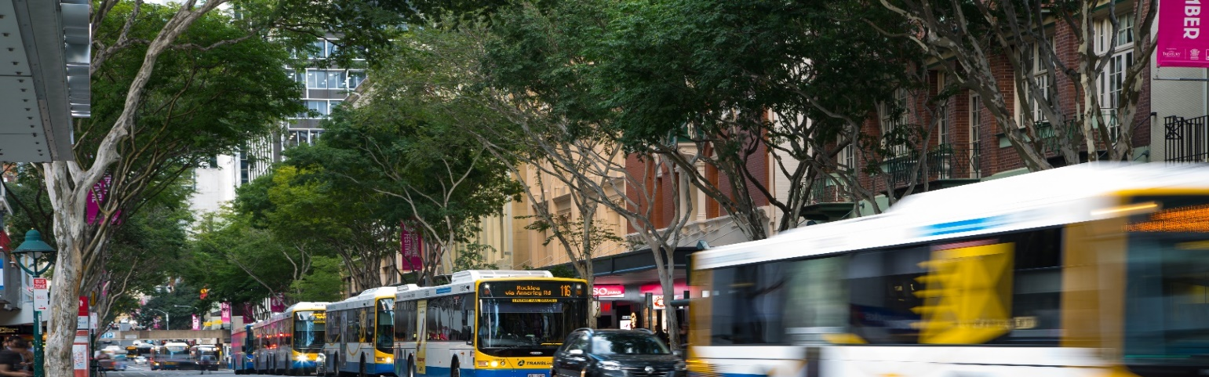
Response
There was no information on what had happened and when power would be restored.
By 2.30pm, the BMTMC Incident Management Room (IMR) was activated to deliver focused and coordinated network management across roads, bus operations and busways.
IMR was staffed both physically and virtually (via MS Teams) by TMR, Council and QPS.
QPS deployed all available resources to manage traffic at priority intersections.
Source: Council

Slide 8
Response
BMTMC provided traveller information through social media (twitter, QLDTraffic, etc) and to Australian Transport Network (radio).
Three additional Traffic Response Units (TRUs) deployed to manage potential increase in incident volume.
Two additional Traffic Operations Officers in the BMTMC to manage telephones and potential increase in incident volume.
IMR remained activated until 6pm.
Source: Council

Slide 9
Impact
Traffic on most key corridors was slow moving.
Received approximately 470 additional phone calls over a two hour period (645 calls in total).
No significant increase in traffic incident volume across the network.
After the first hour, intersections began to regain power (130 remained without power (Council and TMR)).
By 4pm, only 4 sets of Council traffic signals remained non-operational.
Source: Council

Slide 10
Network Performance
The network performed well due to both the timing (pre-evening peak) and duration (less than 2 hours) of the outage.
Traffic was slow moving along most key corridors however major congestion did not eventuate.
Only one significant incident involving 2 pedestrians and a motor vehicle was reported.
All tunnels remained open during the outage period with no incidents reported.
Intelligence gathering and dissemination of critical information from the BMTMC IMR to stakeholders was both accurate and timely.

Slide 11
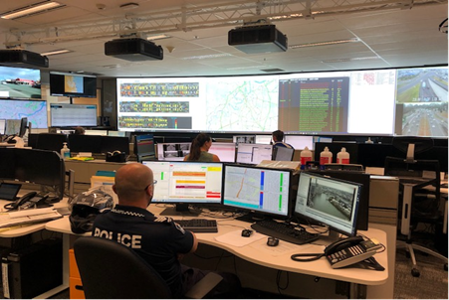
Questions
?
Source: Council

