Slide 1
Flora and fauna management in Council cemeteries Community, Arts and Nighttime Economy Committee 2 March 2021

Slide 2
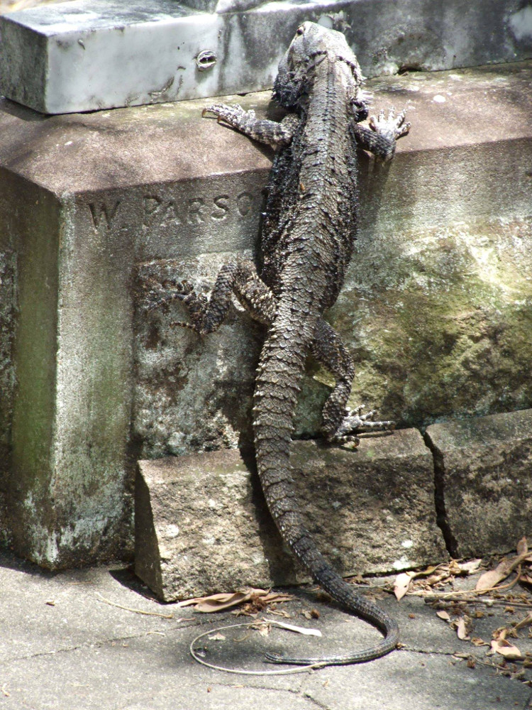
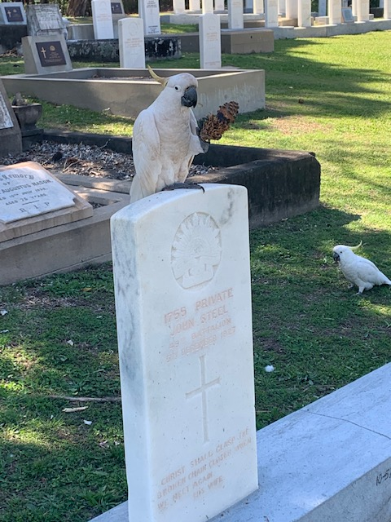
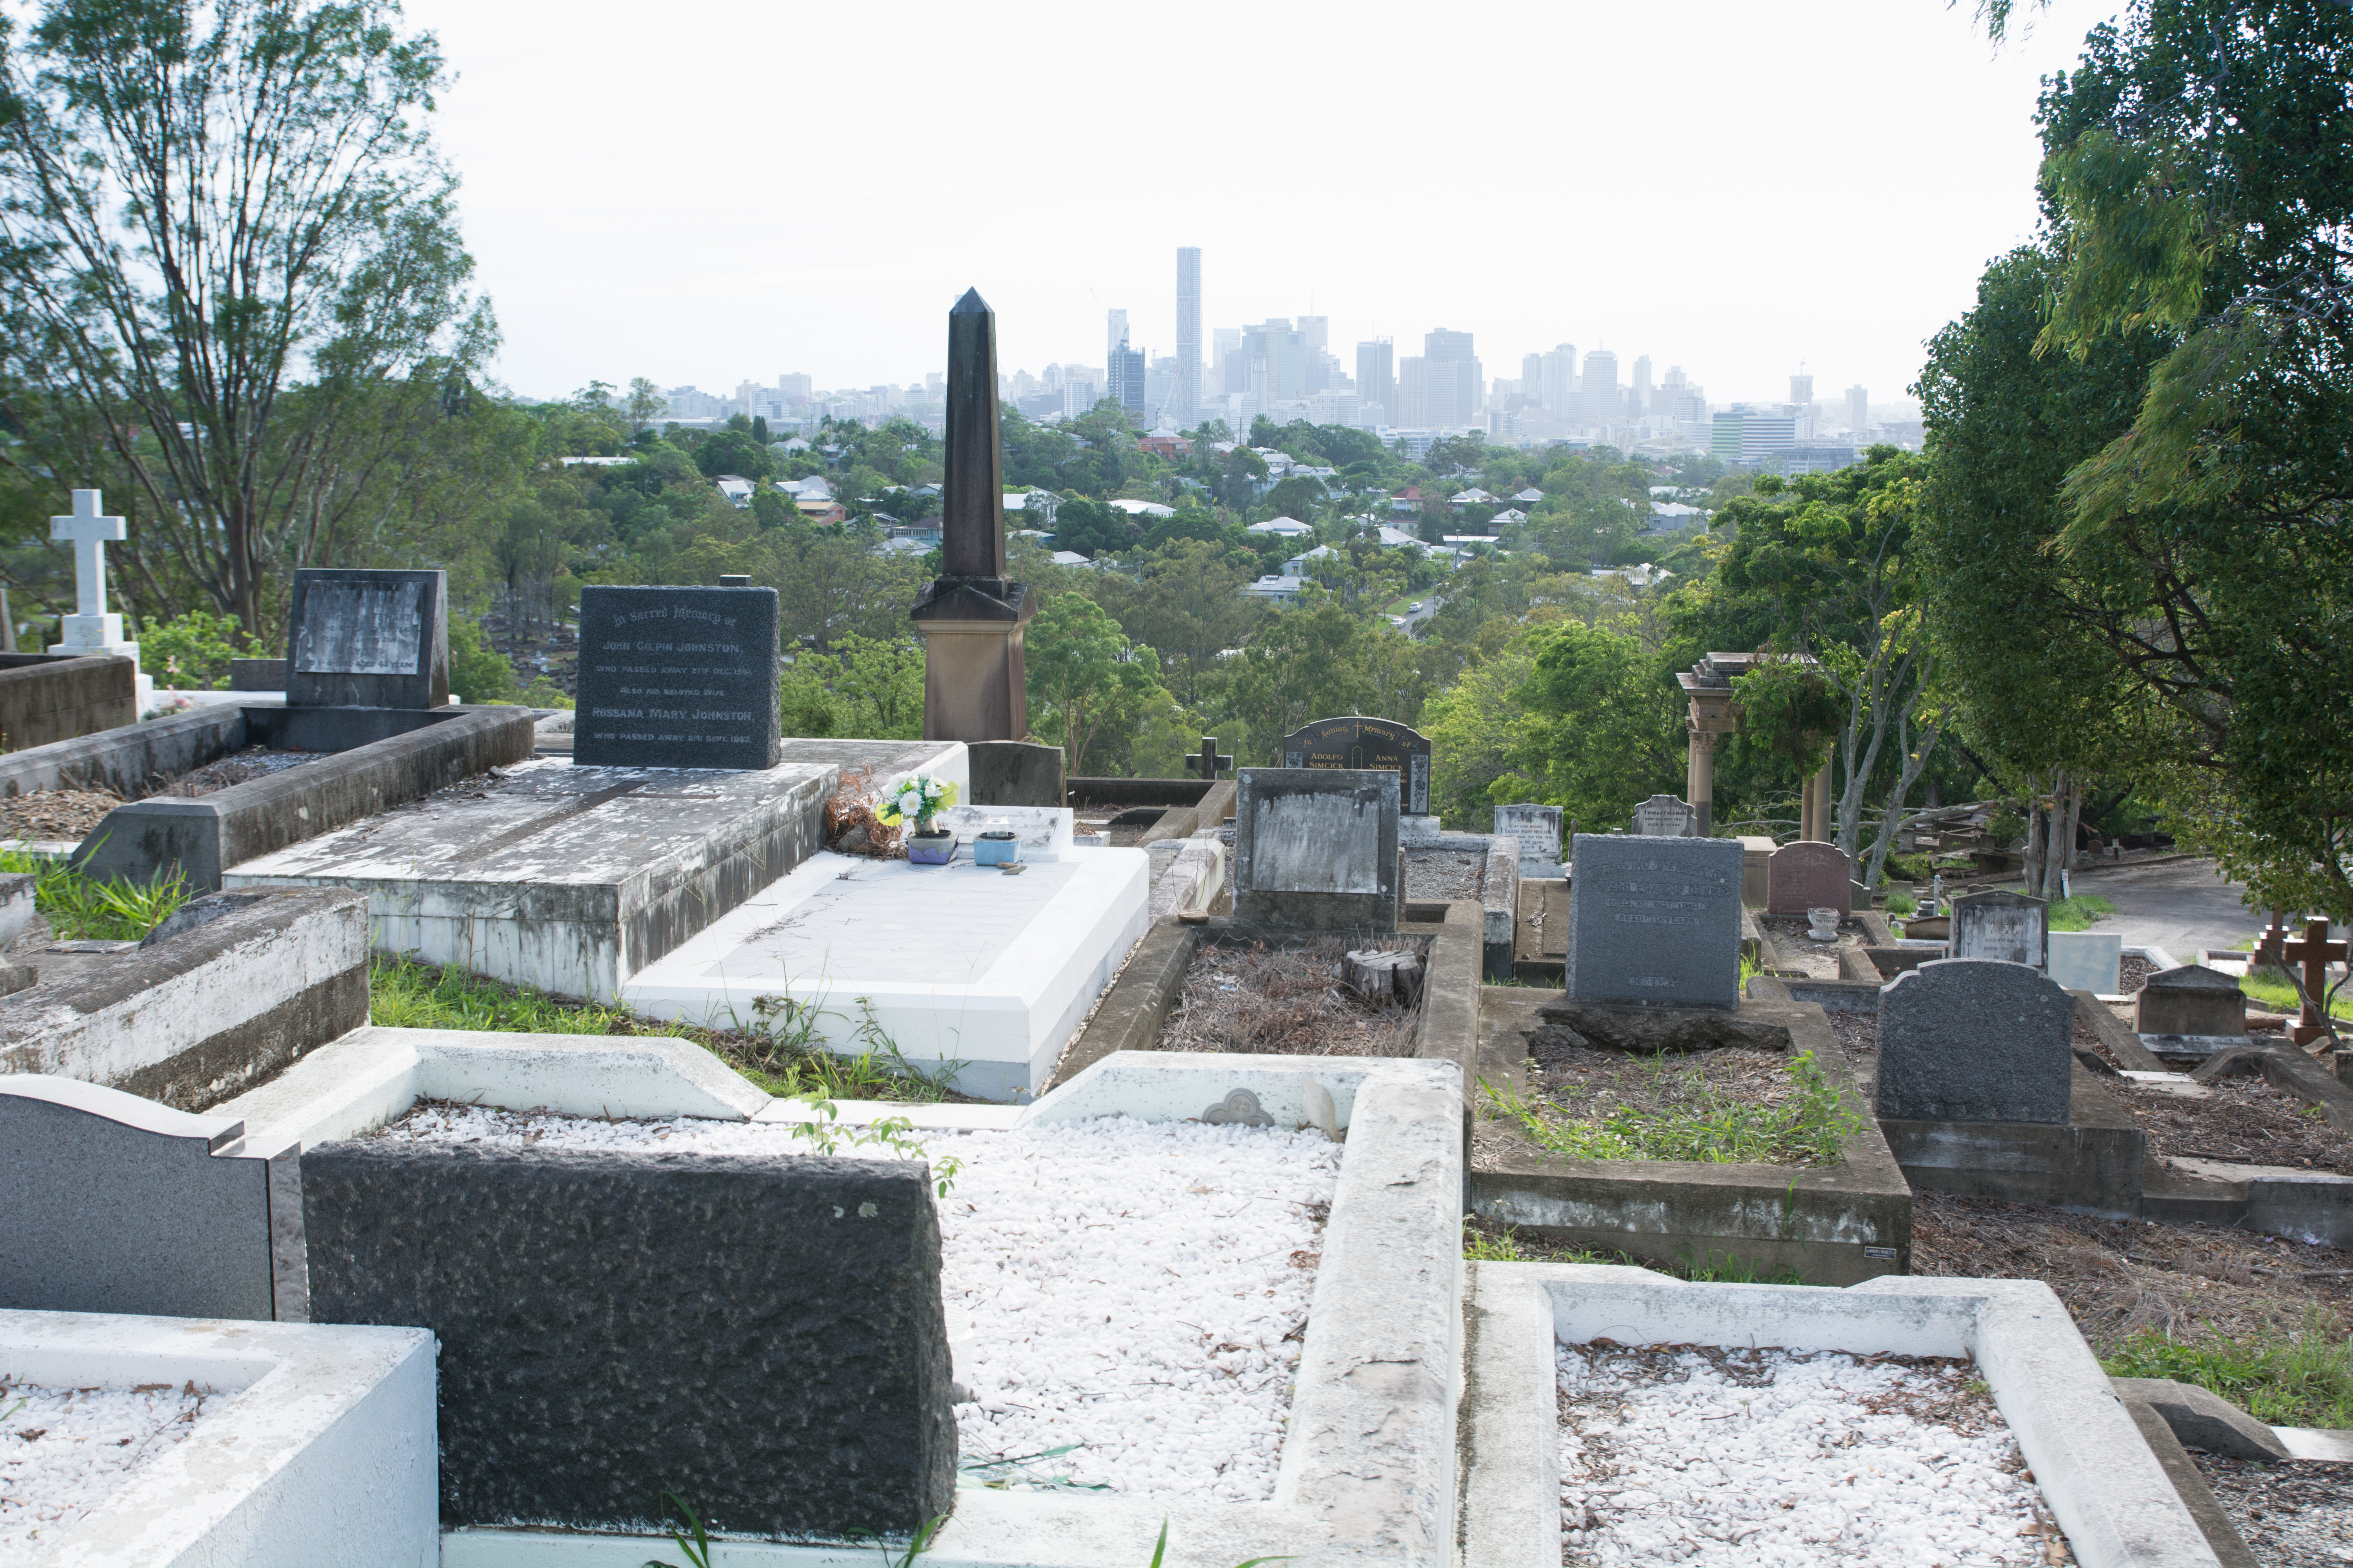
Fauna in Council cemeteries
City view from Toowong Cemetery
Cockatoo family at Toowong Cemetery
Bearded Dragon at Toowong Cemetery

Slide 3
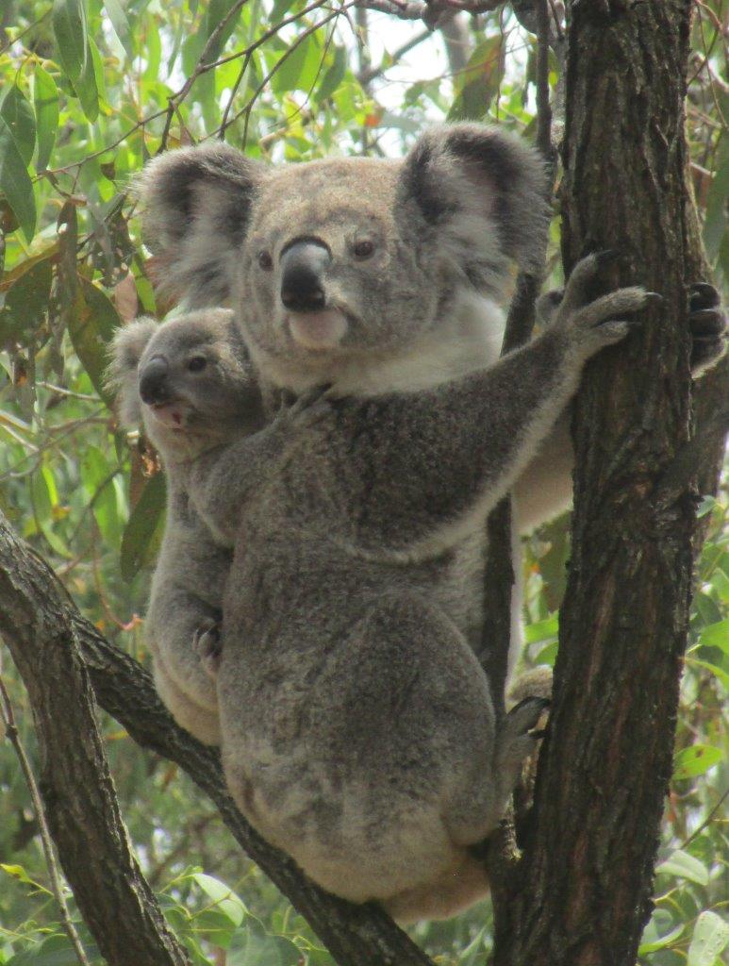
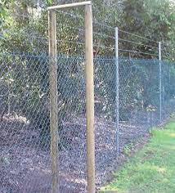
Koalas in Council cemeteries
Koala fencing that now borders the Mount Gravatt Cemetery between University Road and the grounds
Koala’s at Mount Gravatt Cemetery

Slide 4
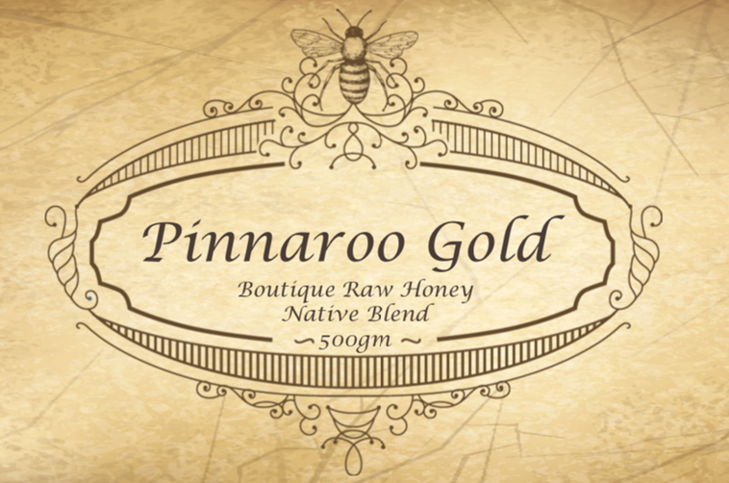
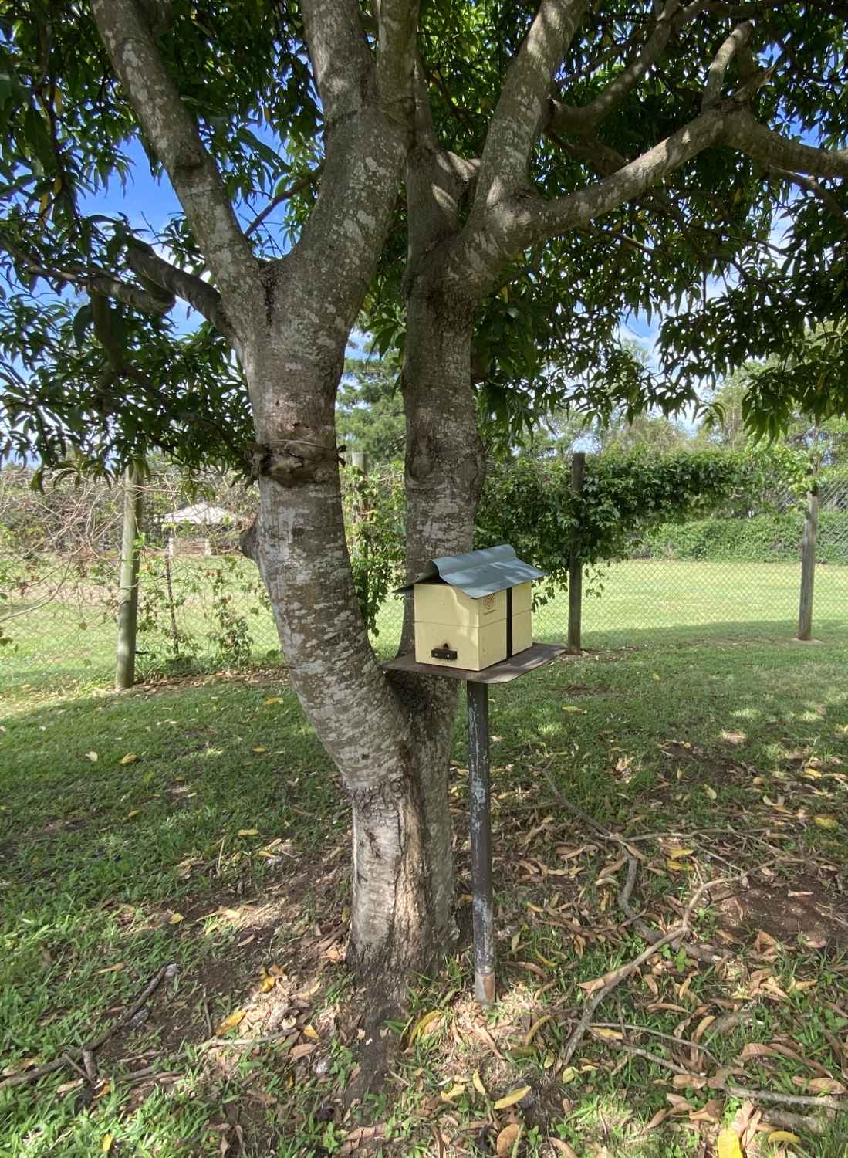
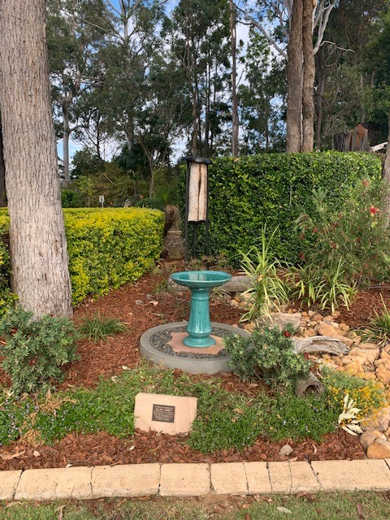
Bees in Council cemeteries
Pinnaroo Cemetery – native and European bee hives.
Managed by Joanne and Bruce Murphy of Native Gardens Pure Honey
Mount Gravatt Cemetery – native bees donated by Mr Allan Kinsey

Slide 5
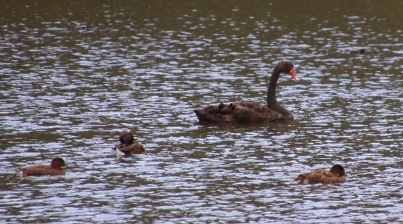
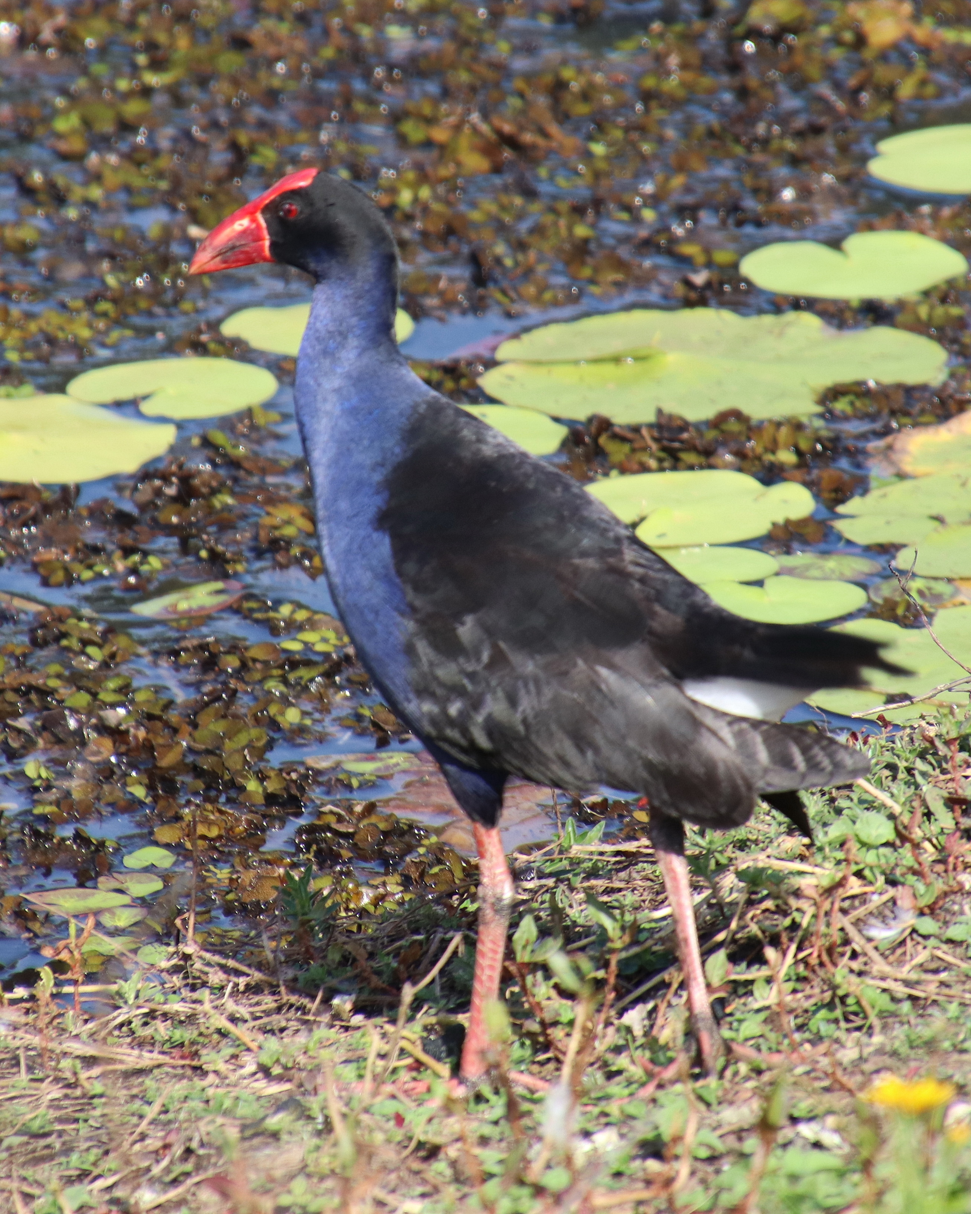
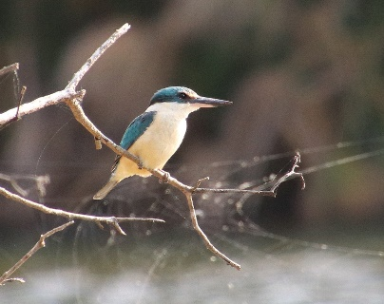
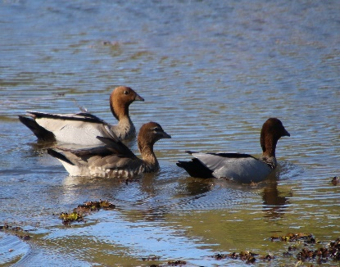
Birds in Council cemeteries
Photos taken at the Pinnaroo Cemetery waterway

Slide 6
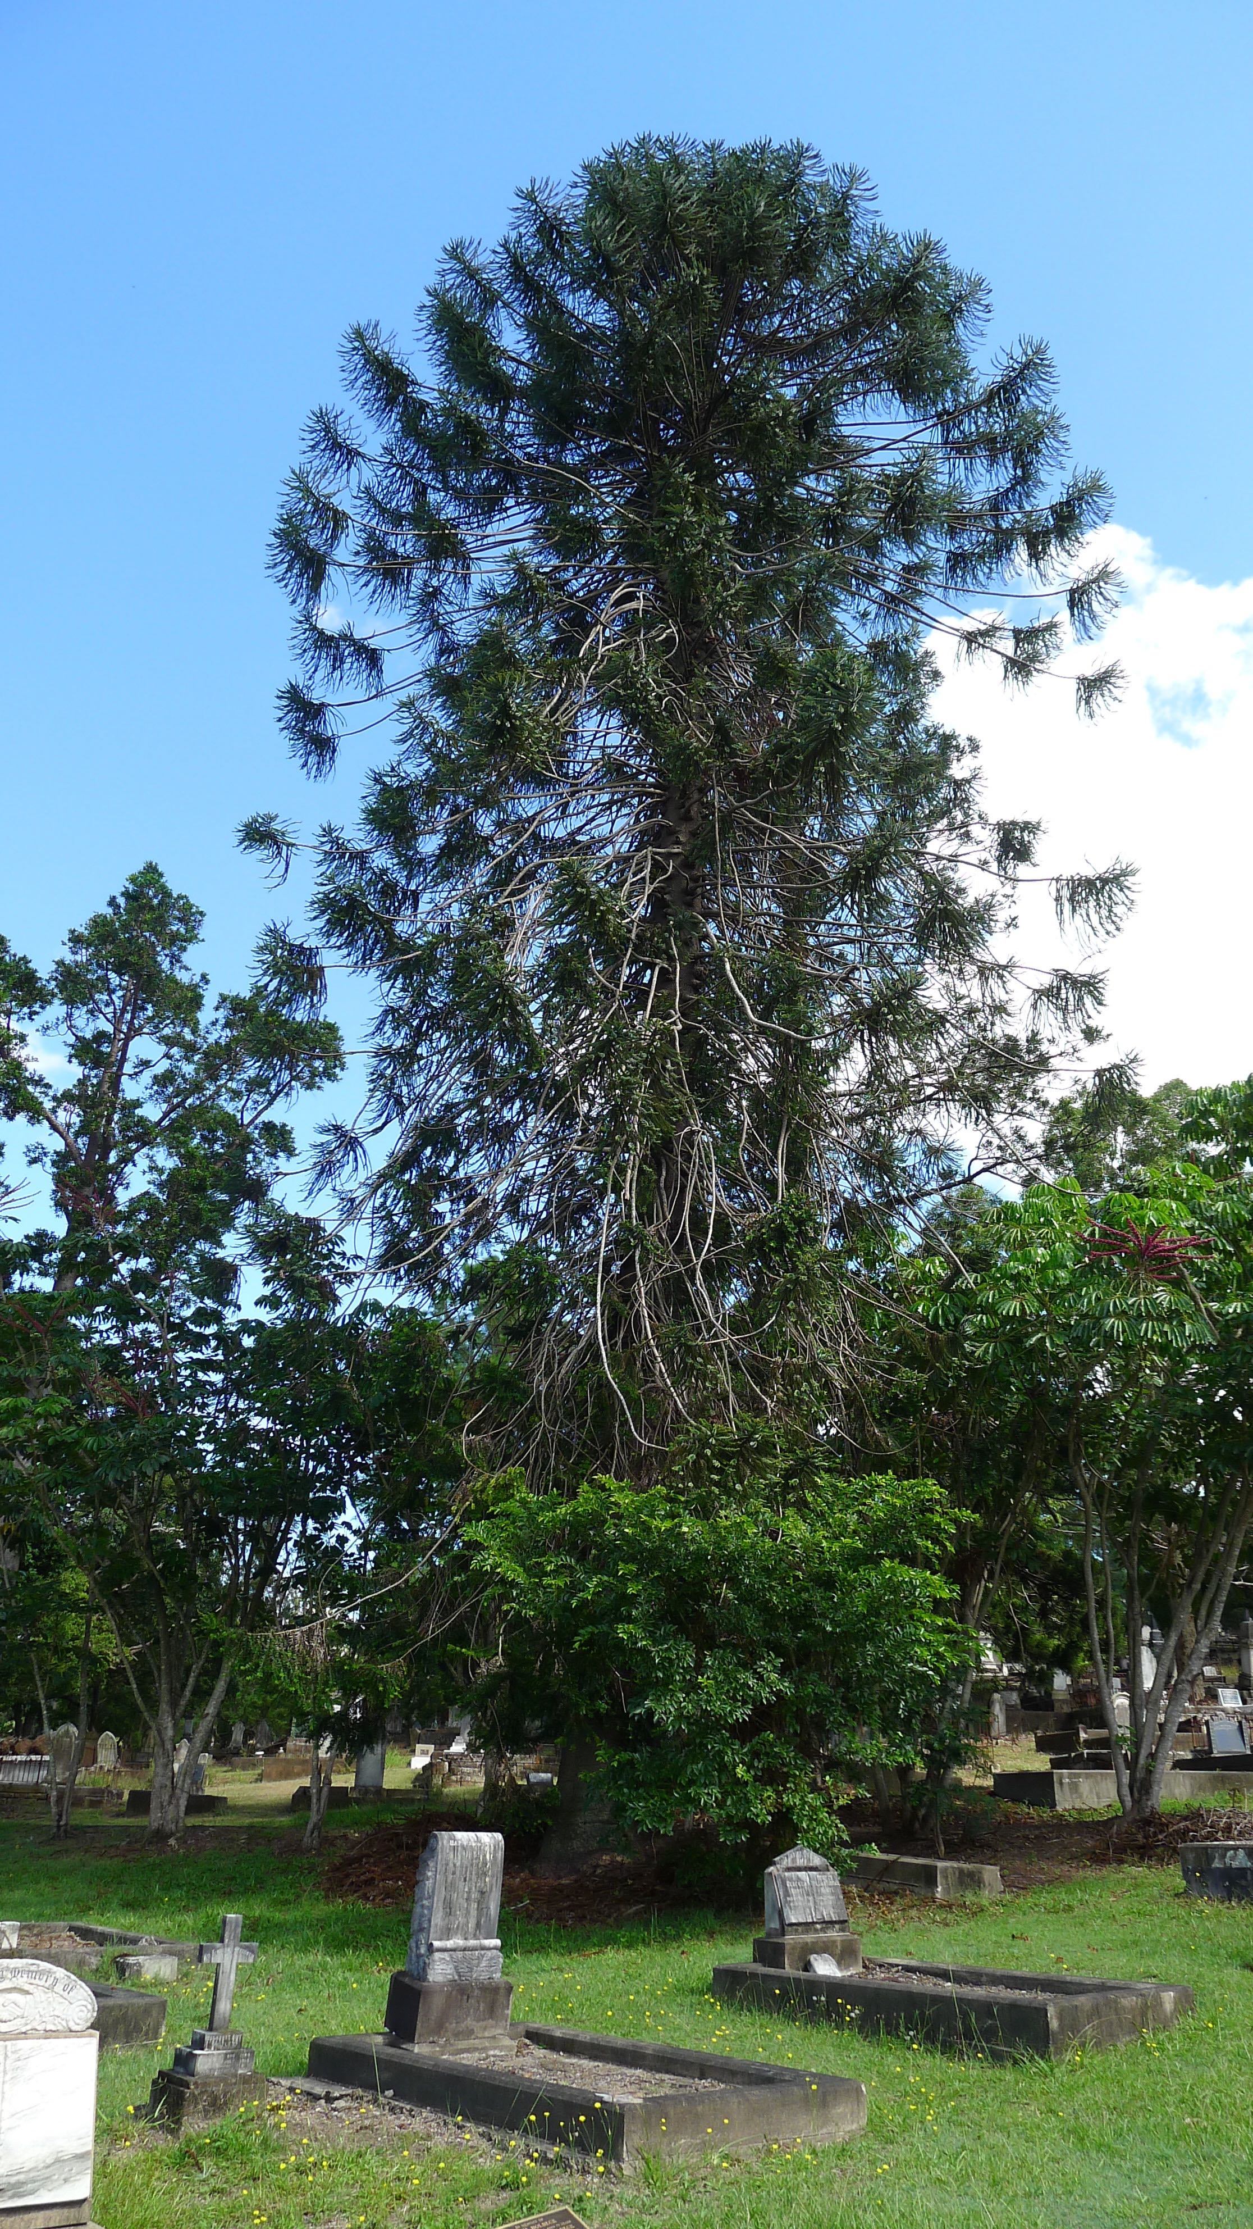
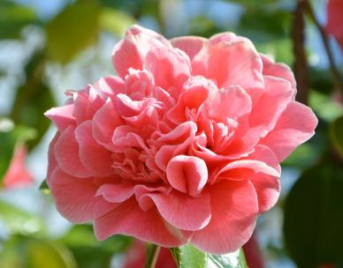
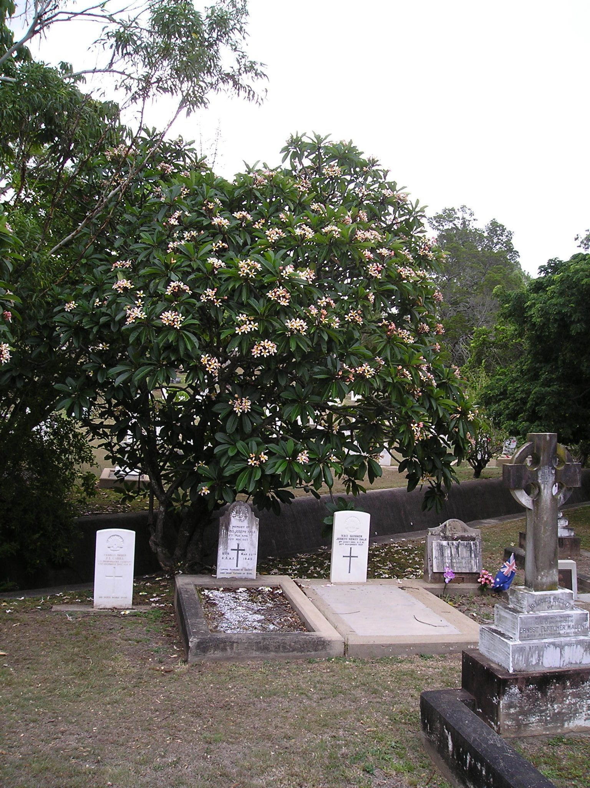
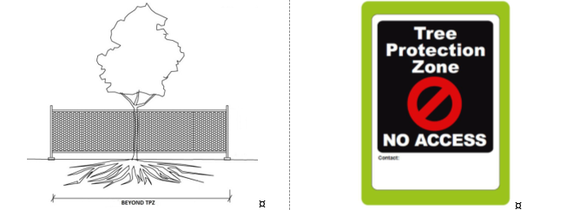
Flora in Council cemeteries
Camellia Japonica at Toowong Cemetery
Bunya Pine at Toowong Cemetery
Methods to protect tree root zones

Slide 7
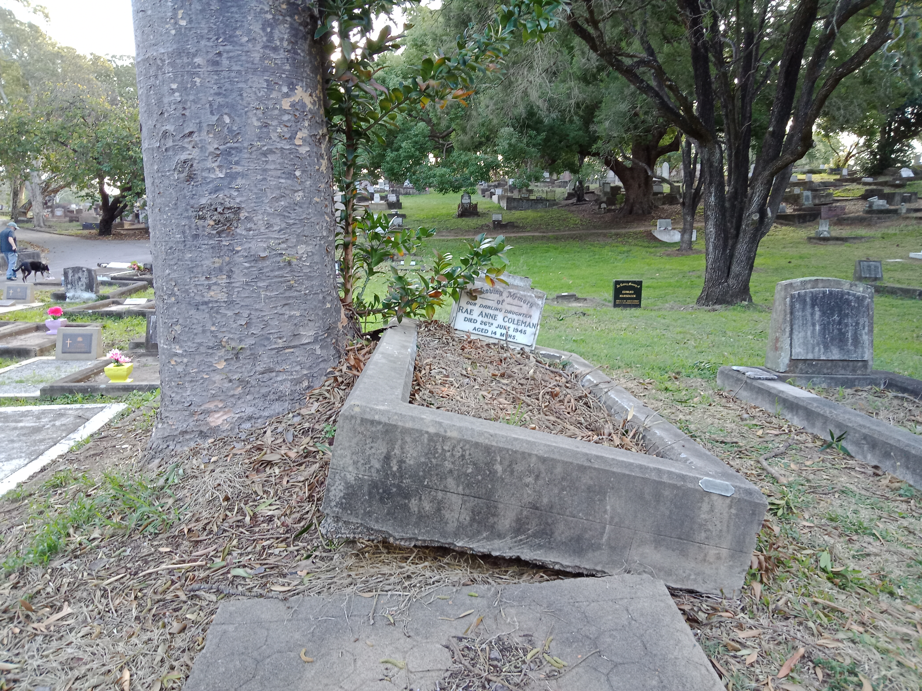
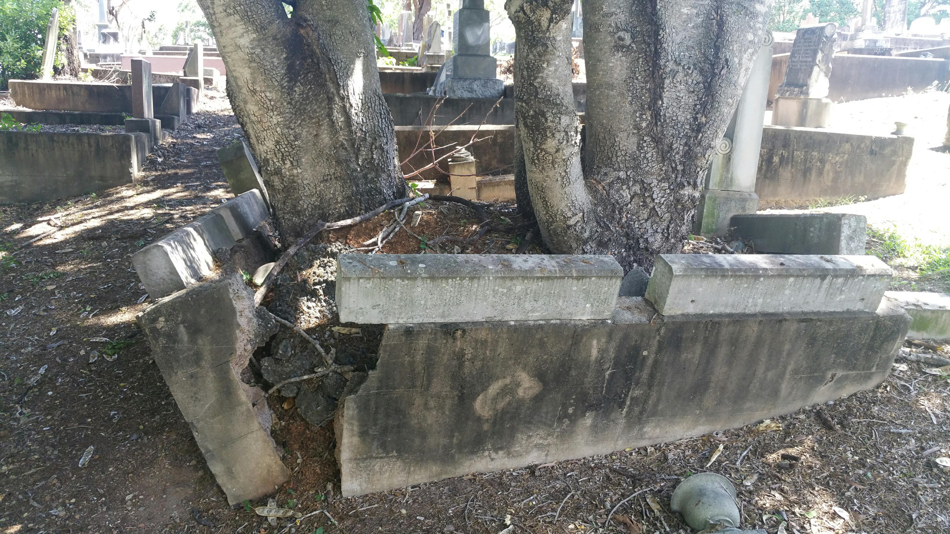
Tree challenges in Council cemeteries
Damage caused to graves by tree roots

Slide 8
Thank you
Questions?

