Slide 1
City Planning and Suburban Renewal Committee Presentation
Manly Harbour Village Precinct Project
November 2021

Slide 2
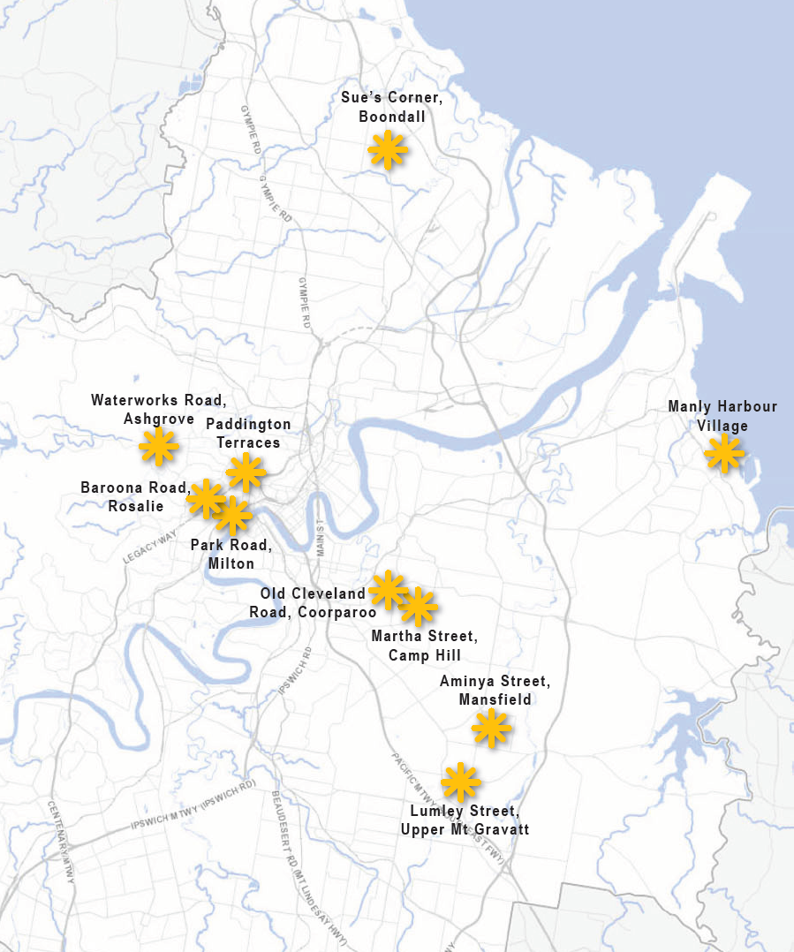
Village Precinct Projects Snapshot: 2020 – 2021
Manly VPP first completed VPP for the 2020 – 2024 4.2.3.1 Programme
Ashgrove West VPP under construction (completion early 2022)
3 VPP’s have commenced planning for delivery by mid 2022
- Paddington VPP
- Camp Hill VPP
- Coorparoo VPP
4 VPP’s preparing for launching:
Nov. 2021 to Feb. 2022
- Milton
- Mansfield
- Boondall
- Upper Mt Gravatt
Rosalie Village to launch in 22/23 FY
ECONOMIC
ENVIRONMENTAL
DESIGN
5

Slide 3
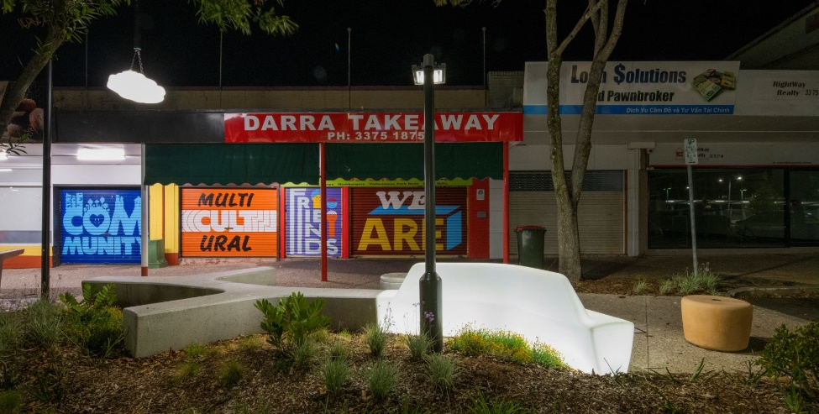
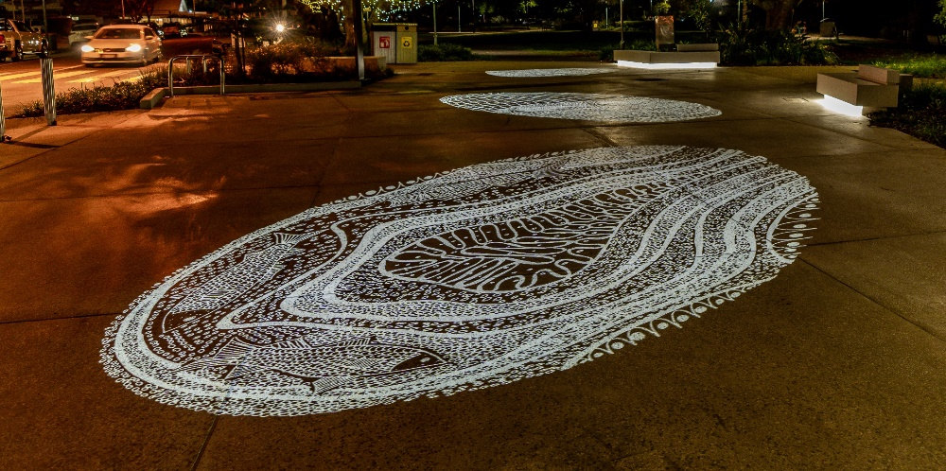
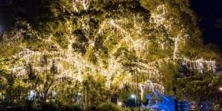
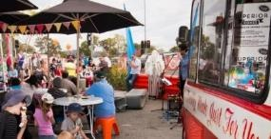
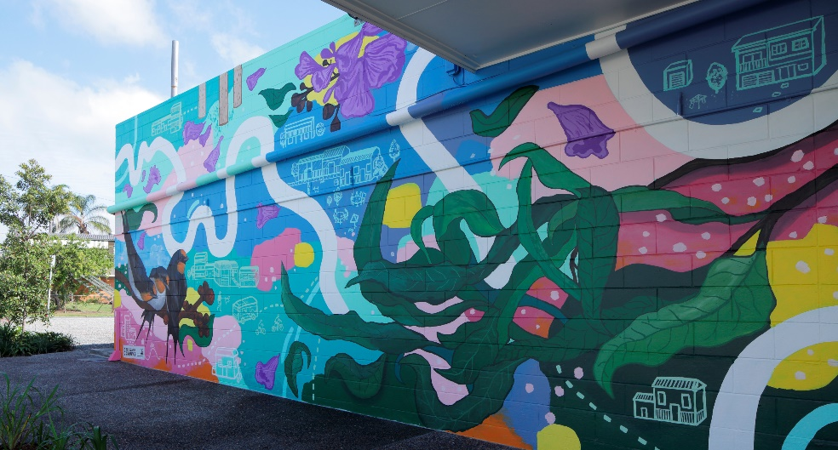
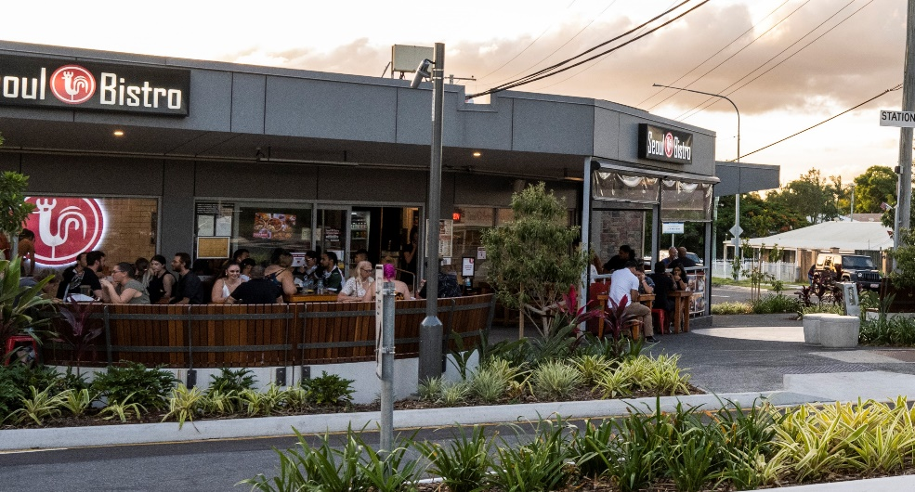
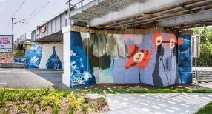
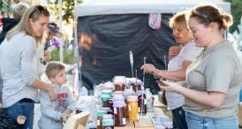
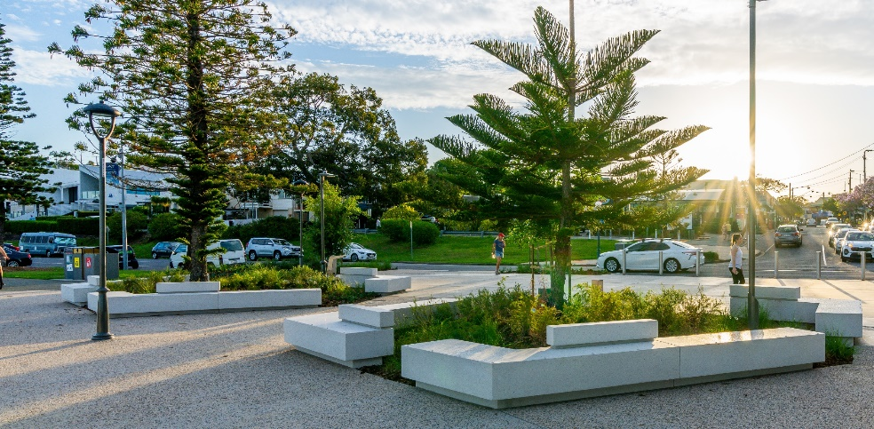
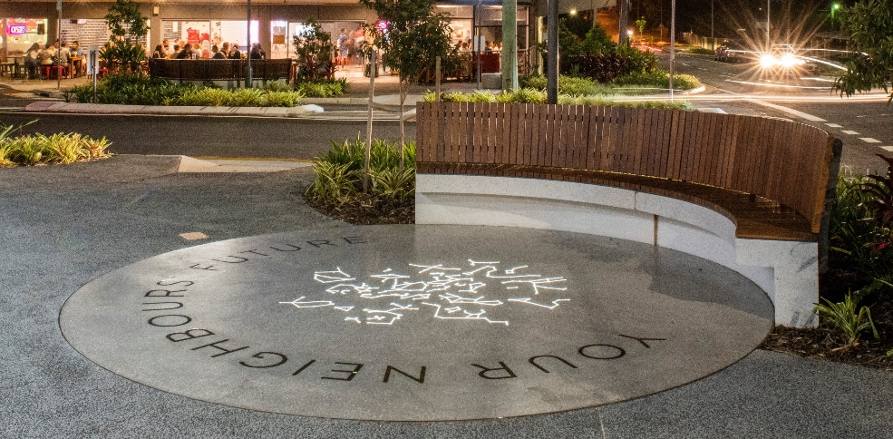
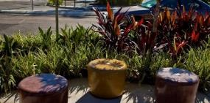
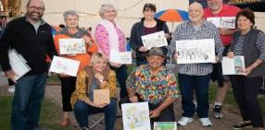
Village Precinct Projects Snapshot: 2020–2021
Placemaking
Strengthening Identity
Supporting Local Community
SOCIAL
ECONOMIC
ENVIRONMENTAL
DESIGN
5

Slide 4
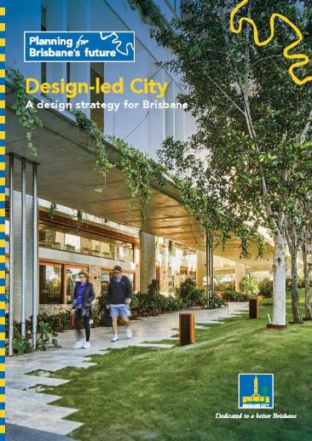
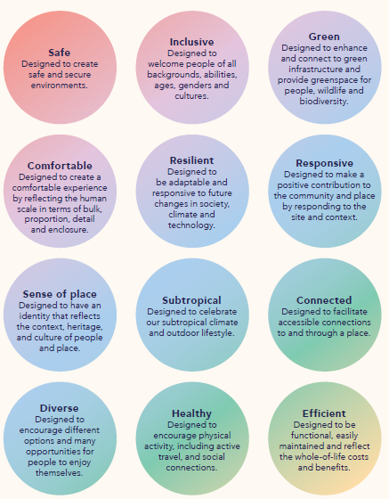
Design Values and Alignments
4

Slide 5
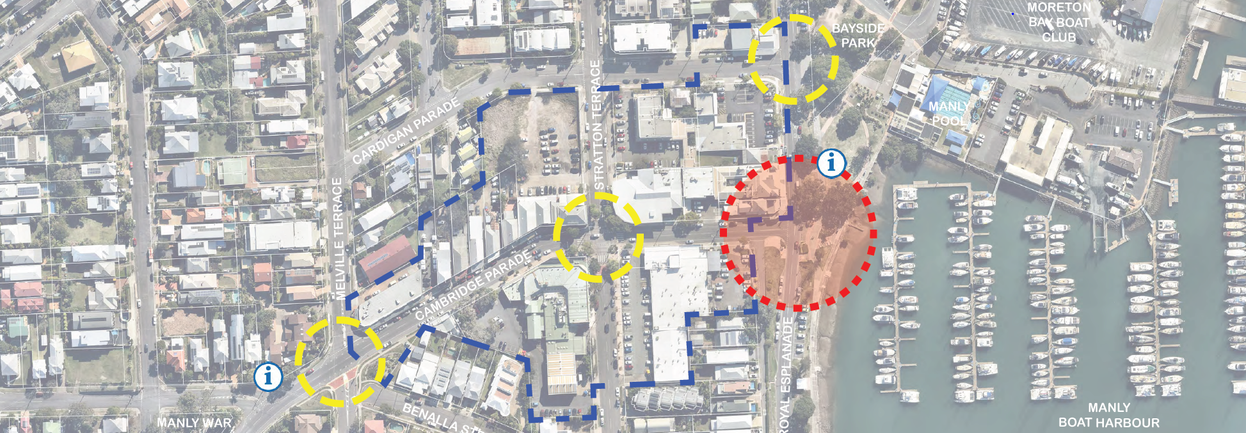
Project Launch
Site investigations
Stage 1 Engagement
Concept Design Opportunities Plan
Preliminary costings
Stage 2 Engagement
Design Development
Final Improvements Plan
Final costings
Stage 3 Engagement
Construction
+
Activation
Stage 4 Engagement
Manly VPP Delivery Process
4

Slide 6
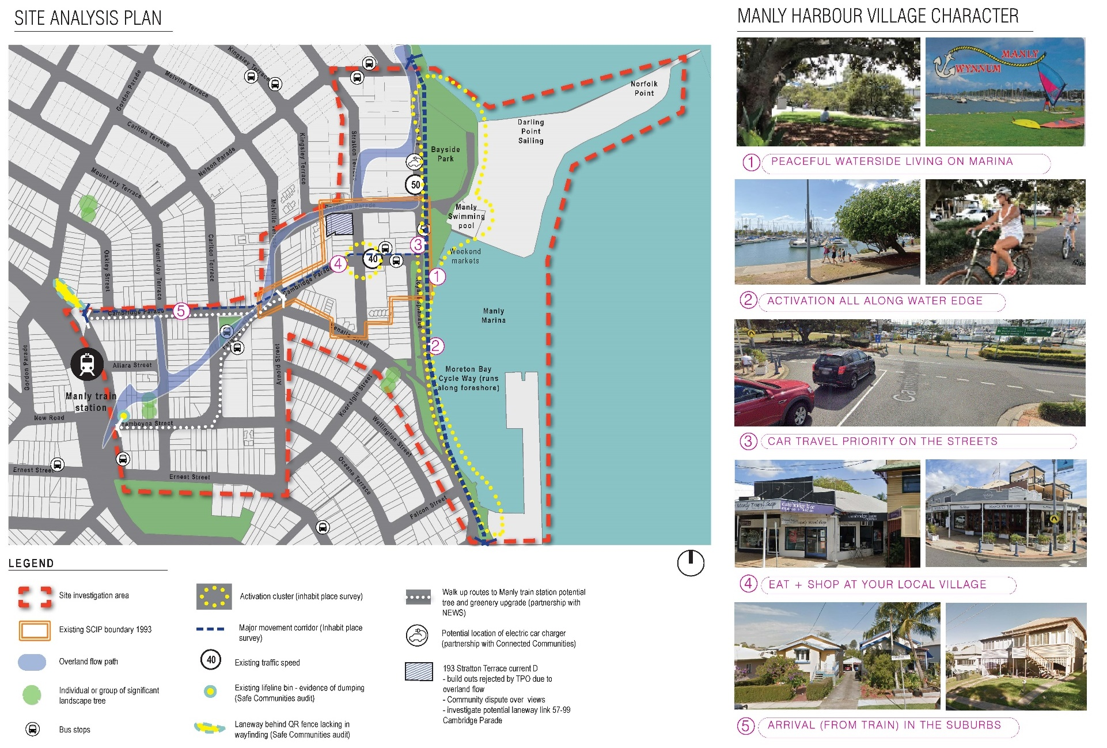
Manly Harbour Village Precinct – Site Analysis

Slide 7
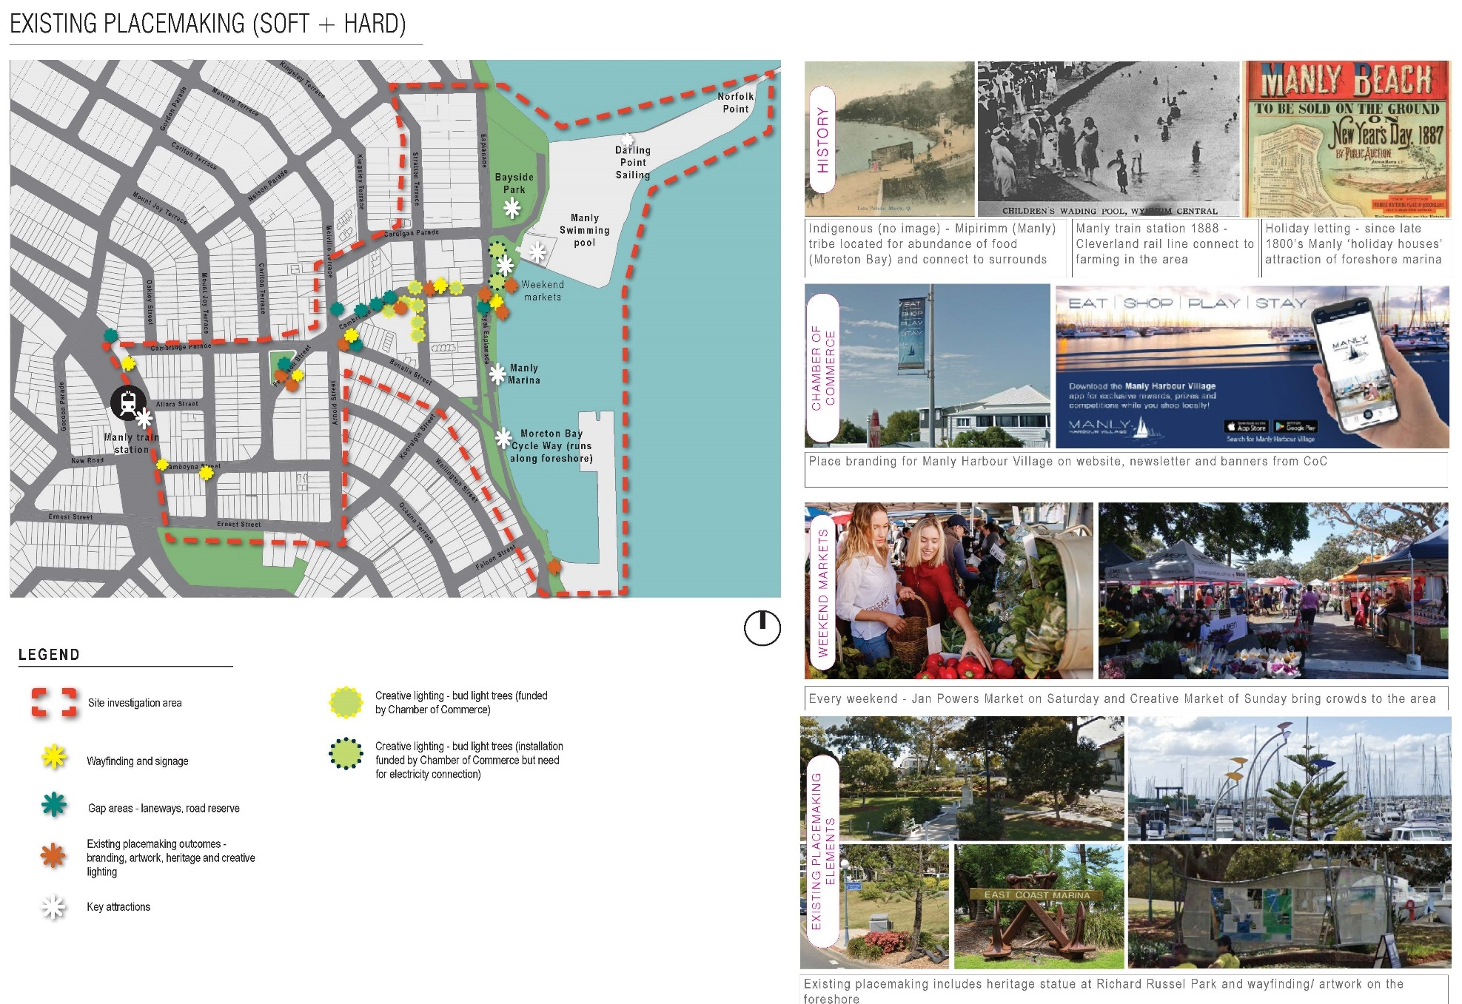
Manly Harbour Village Precinct – Site Analysis

Slide 8
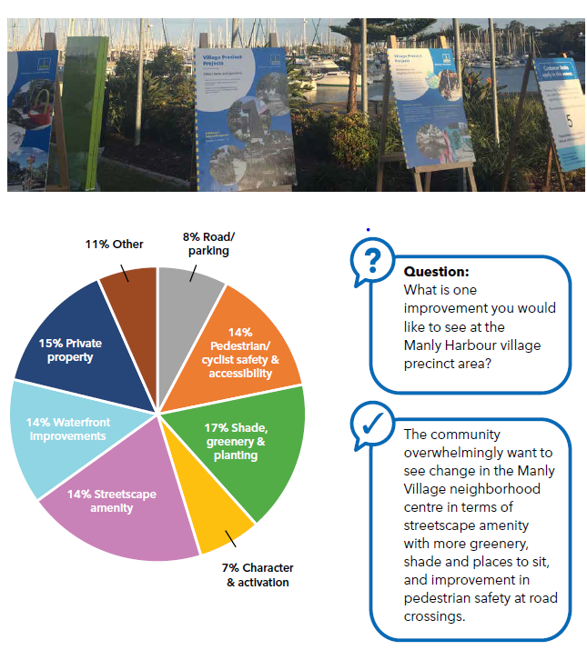
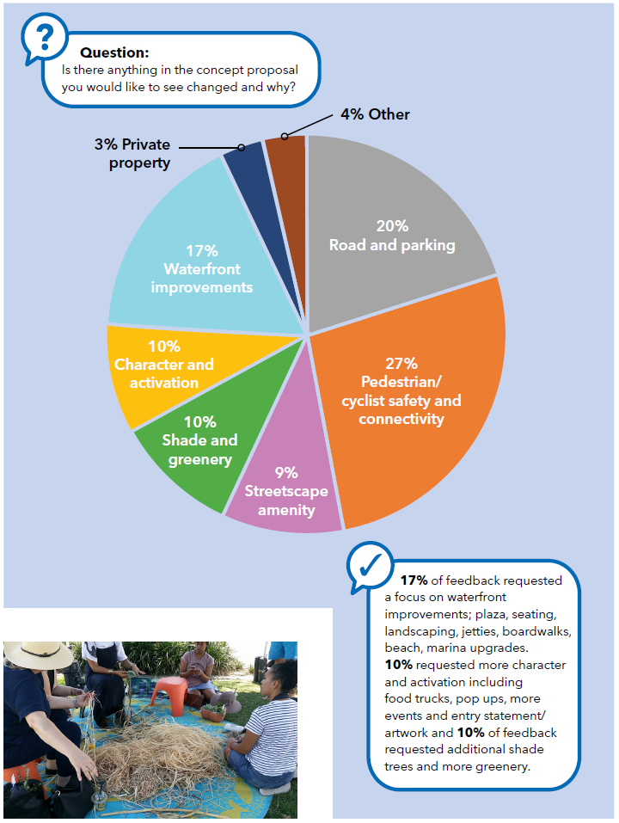
Manly Harbour Village Precinct – Engagement Outcomes
Stage 1
Stage 2

Slide 9
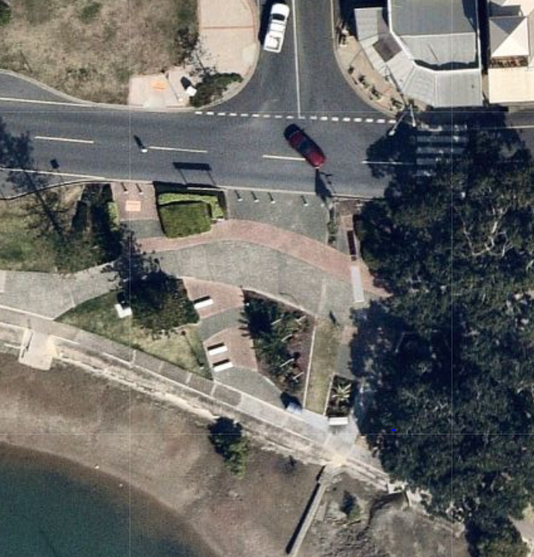
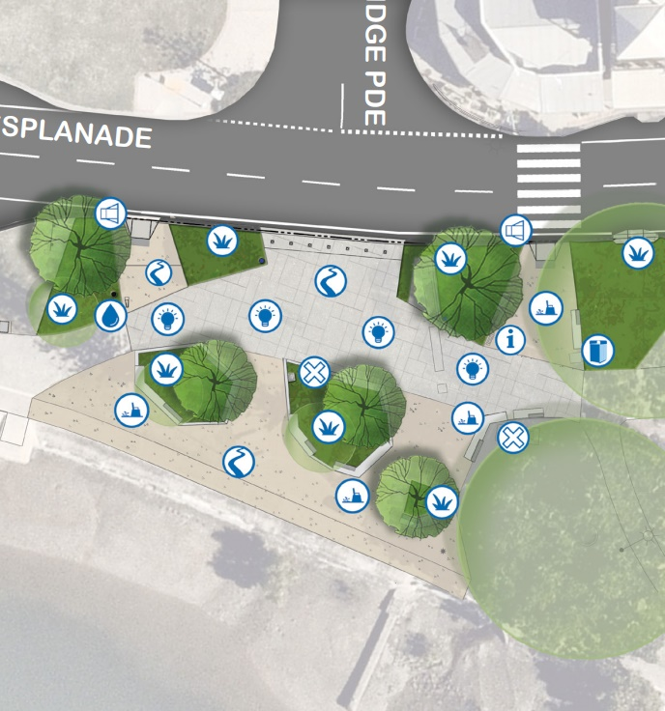
Manly Harbour Village Precinct – Final Improvement Plan
Before
After

Slide 10
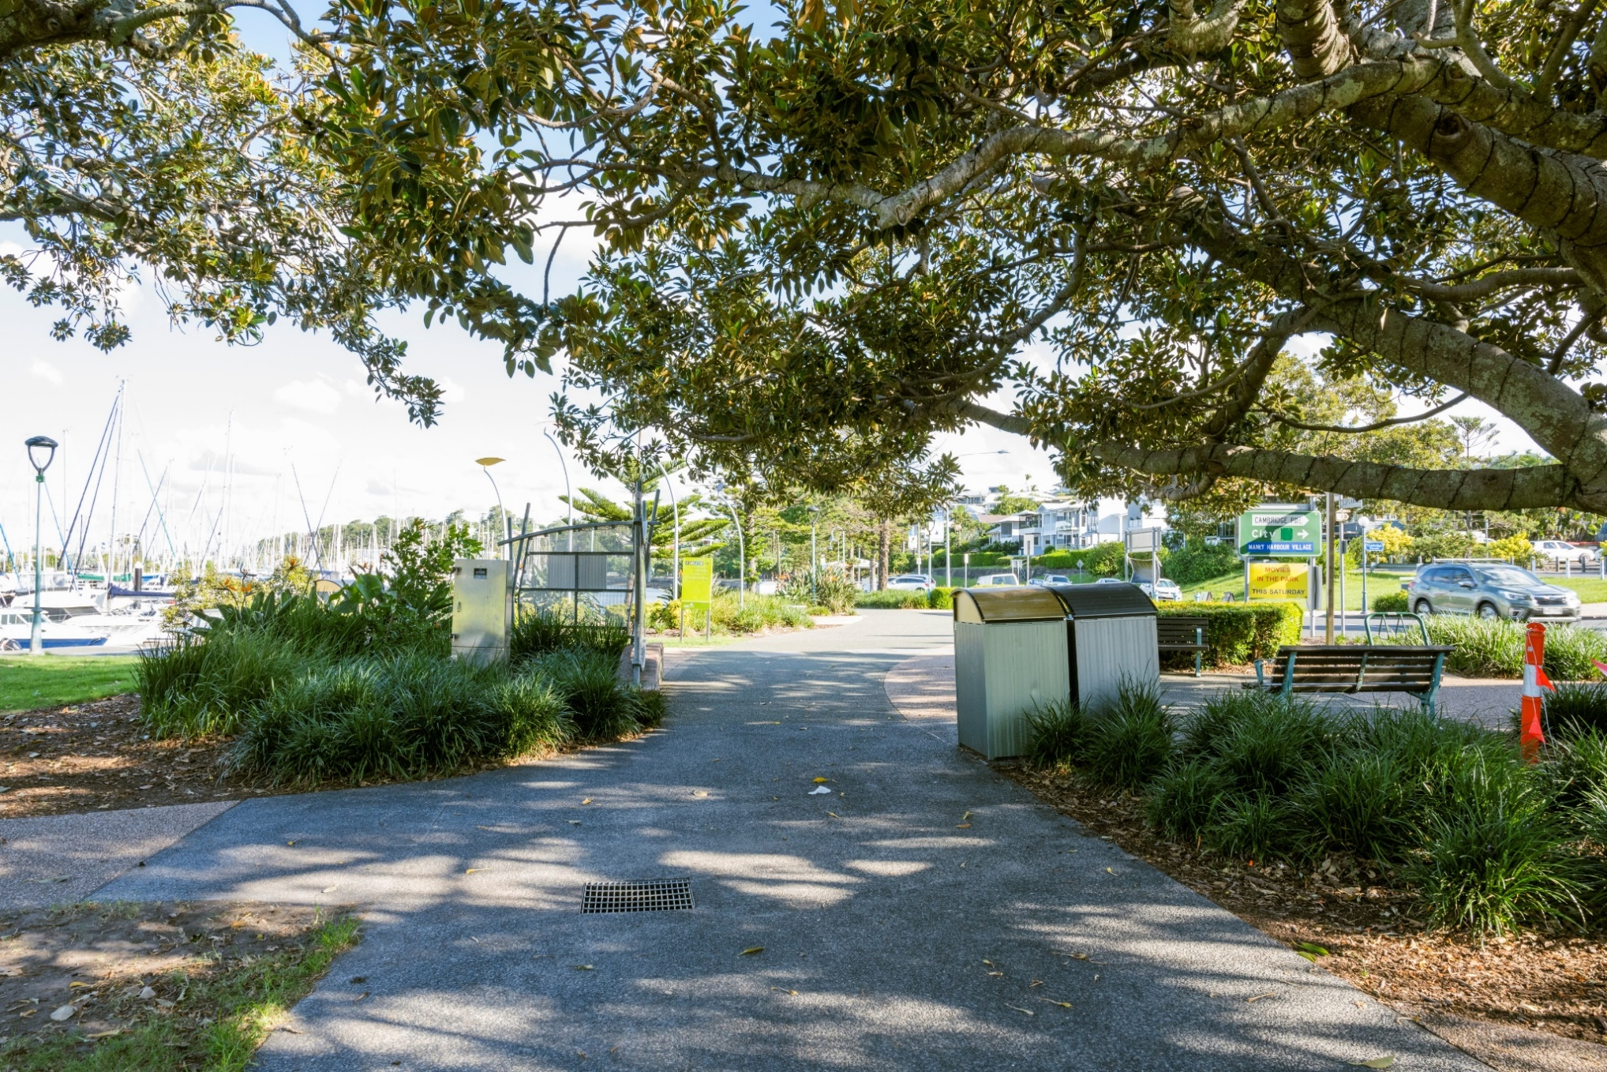
Manly Harbour Village Precinct – Before VPP Delivery
Before
After

Slide 11
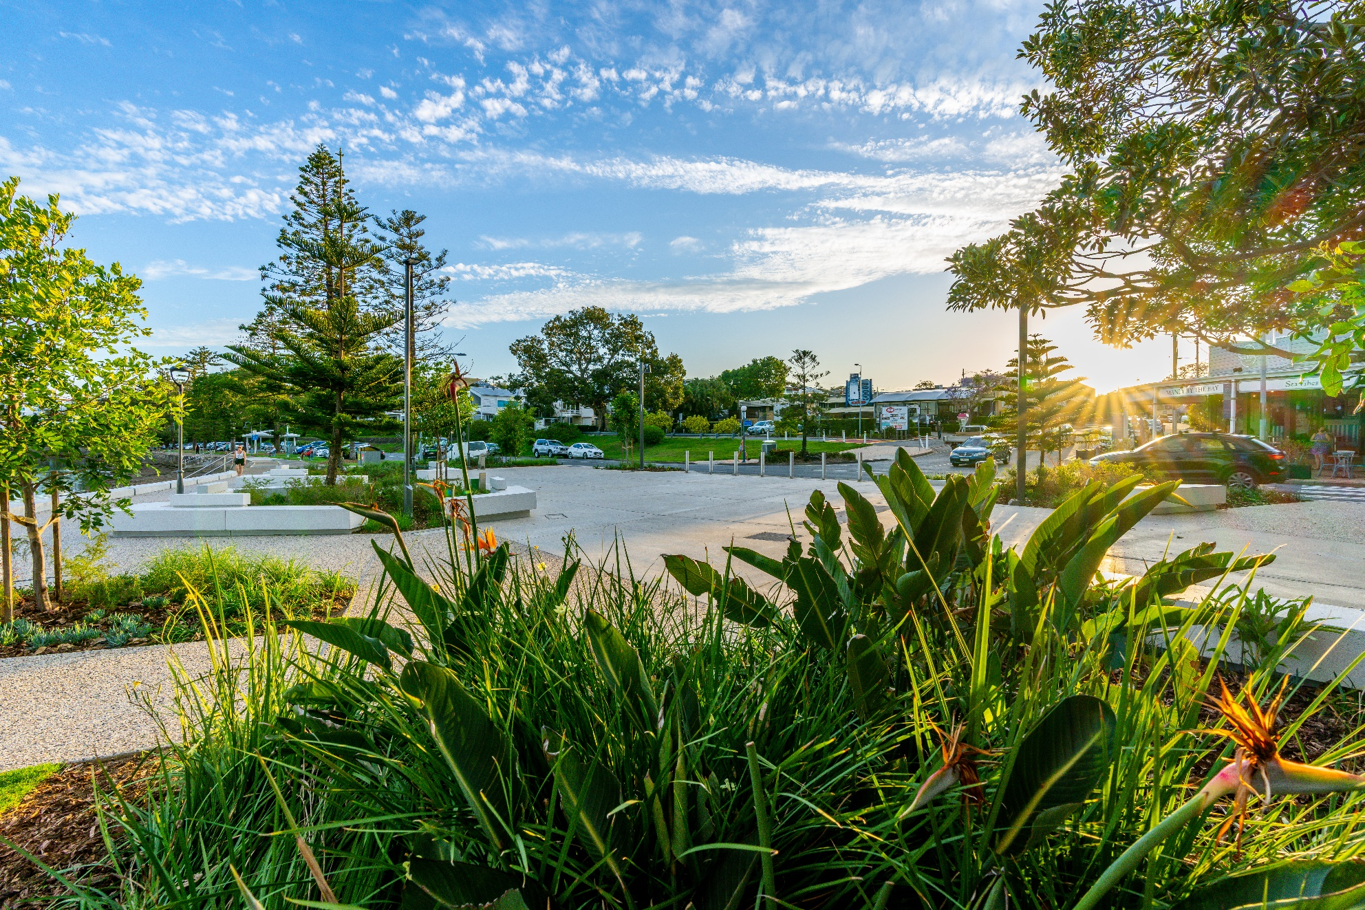
Manly Harbour Village Precinct – New Foreshore Plaza
Before
After
Before
After

Slide 12
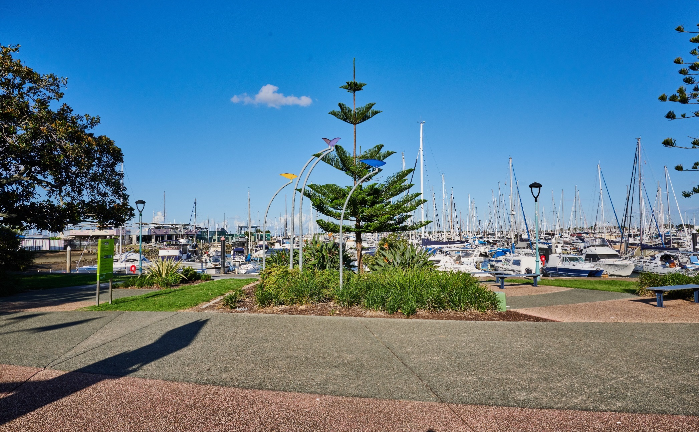
Manly Harbour Village Precinct – Before VPP Delivery
Before
Before
Before
After

Slide 13
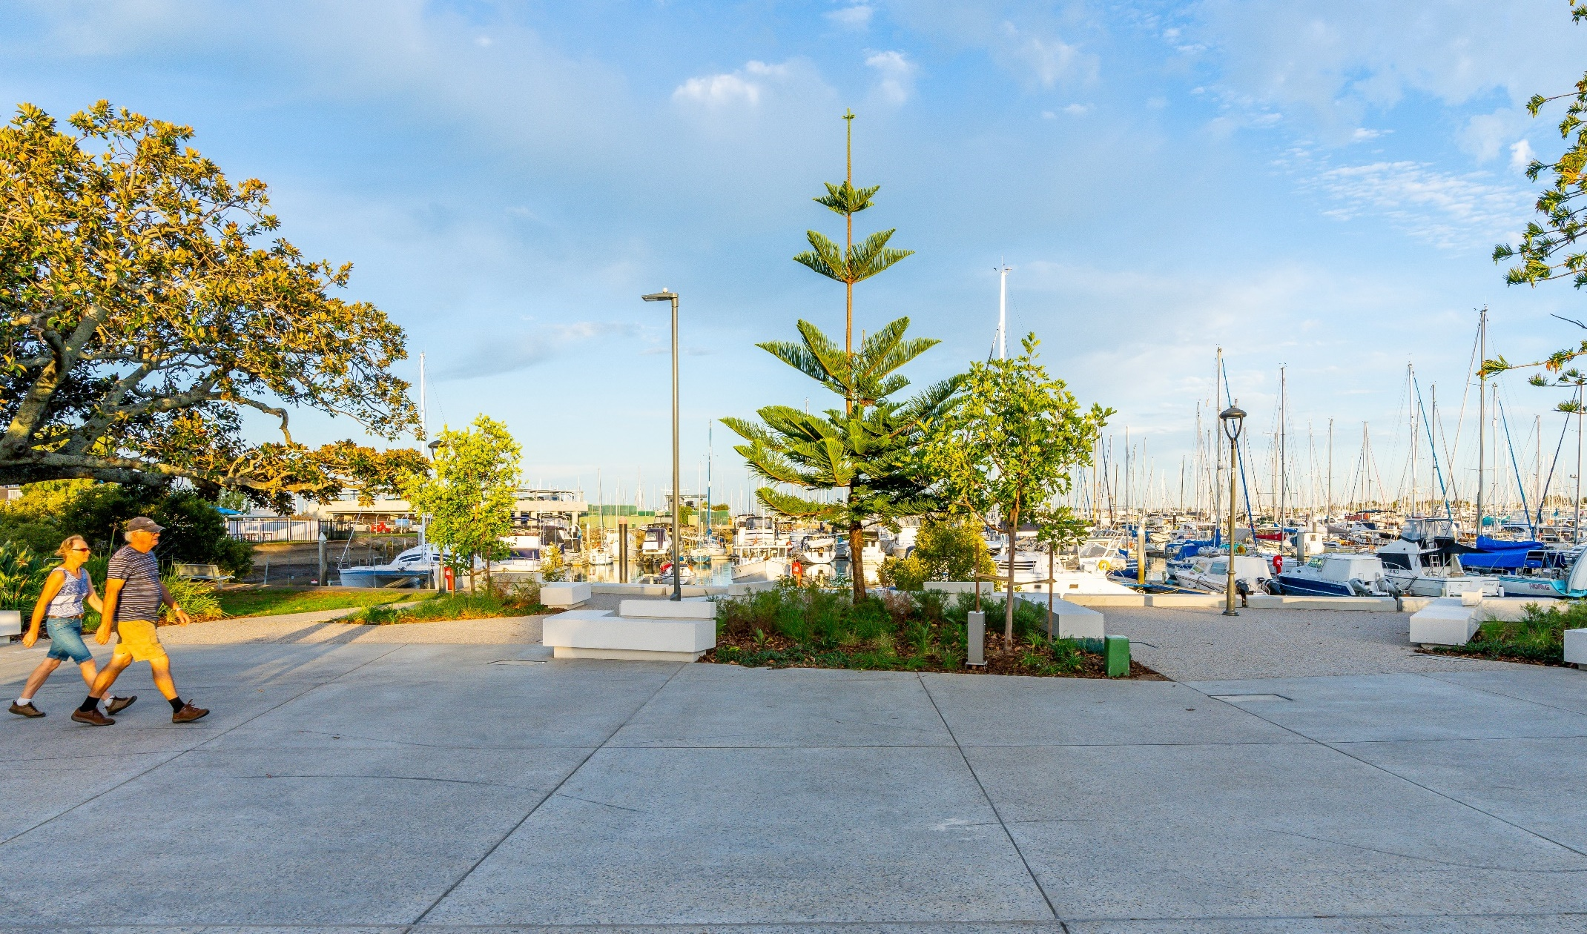
Manly Harbour Village Precinct – New Foreshore Plaza
Before
After
Before
After

Slide 14
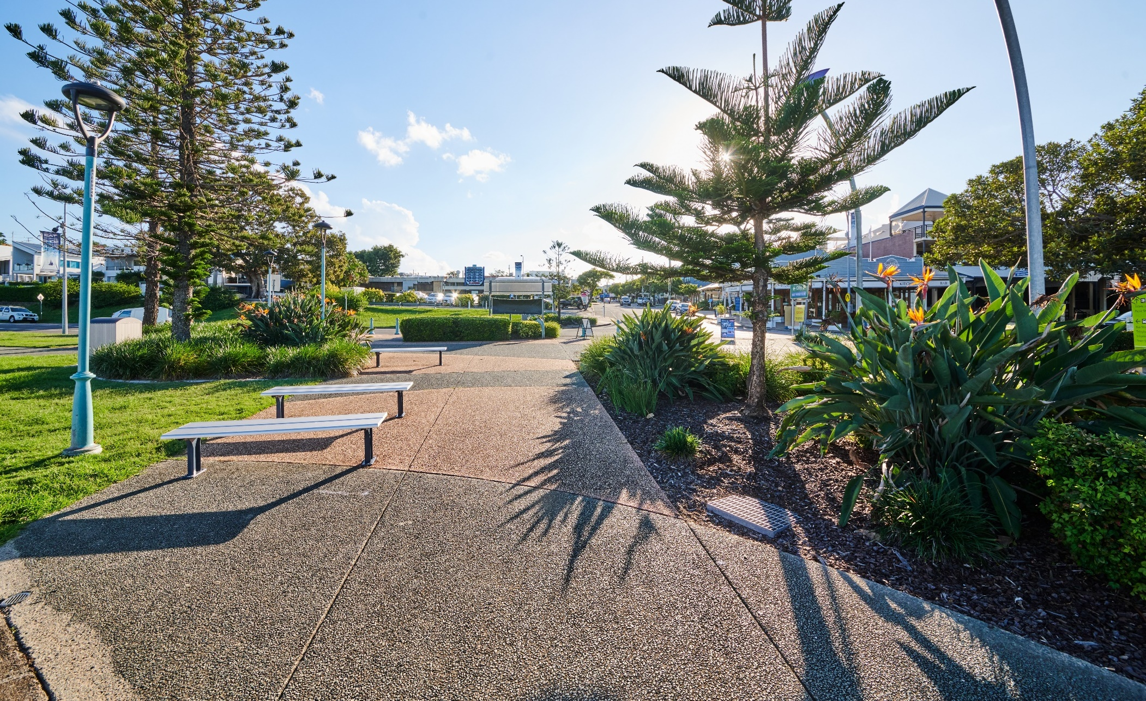
Manly Harbour Village Precinct – Before VPP Delivery
Before
After

Slide 15
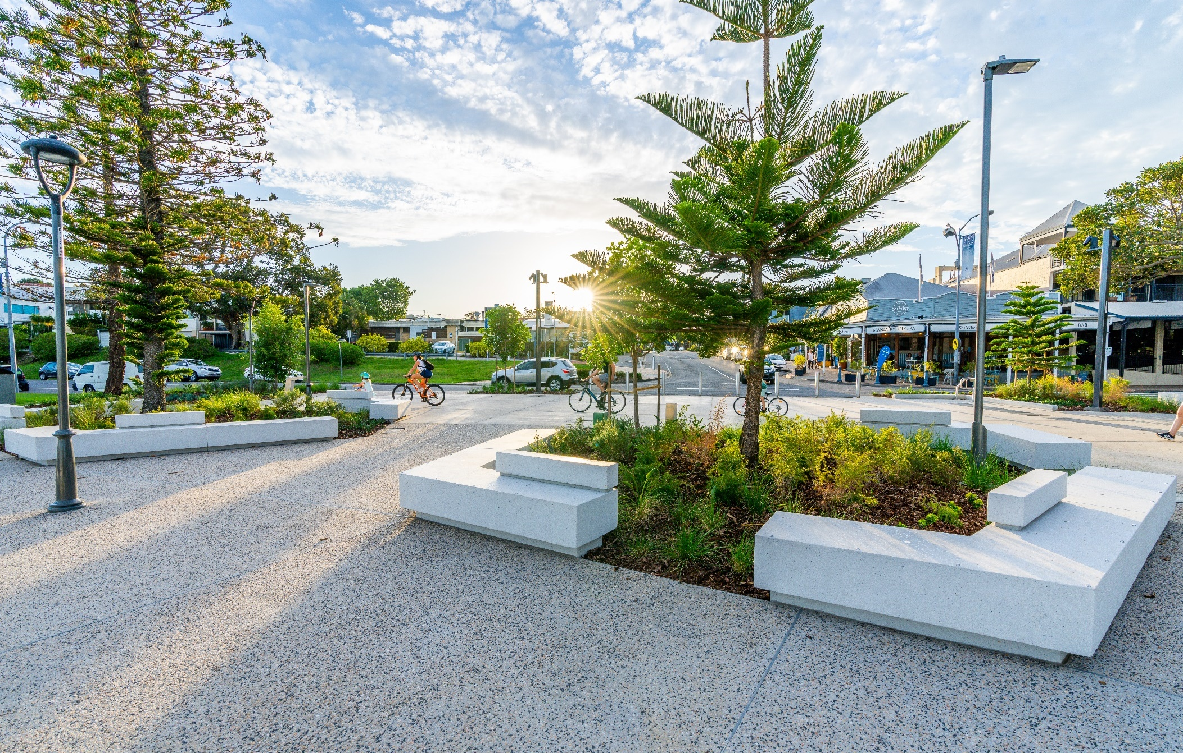
Manly Harbour Village Precinct – New Foreshore Plaza
Before
After

Slide 16
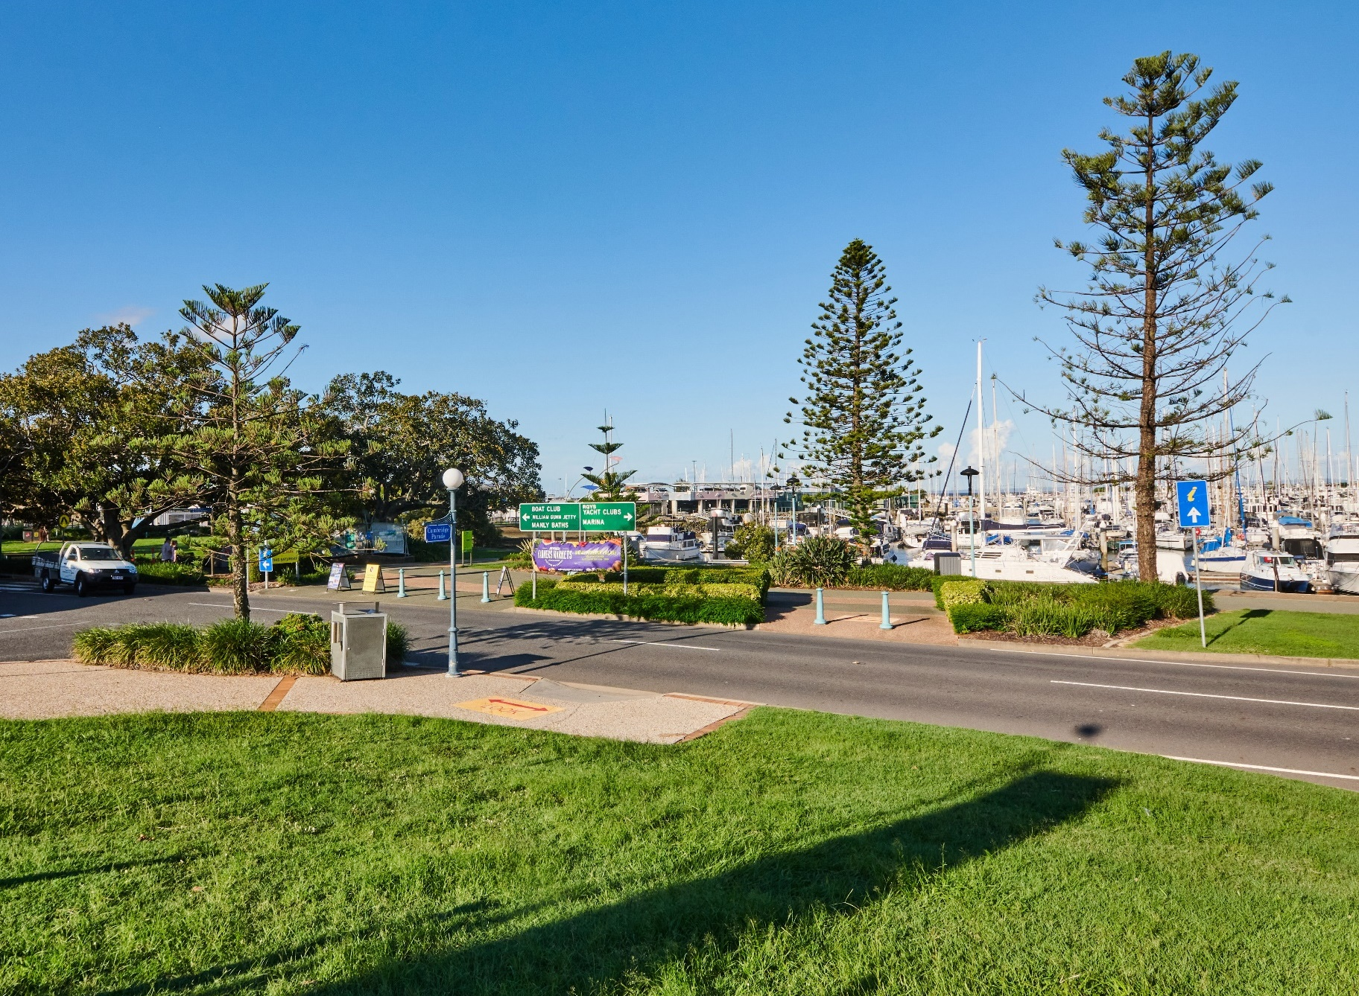
Manly Harbour Village Precinct – Before VPP Delivery
Before
After

Slide 17
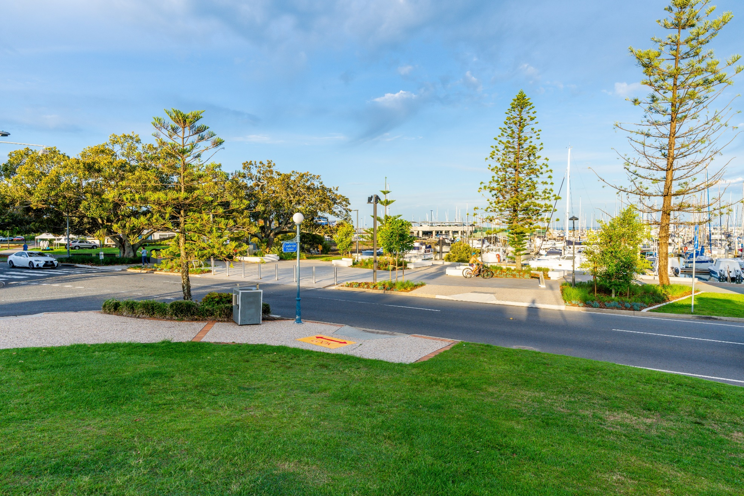
Manly Harbour Village Precinct – New Foreshore Plaza
Before
After

Slide 18
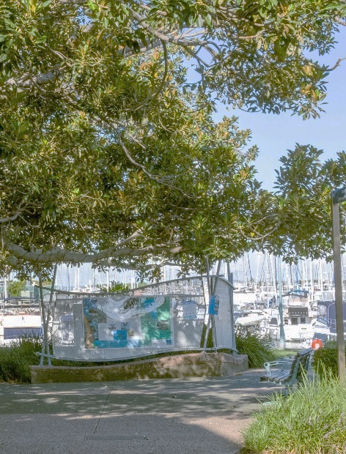
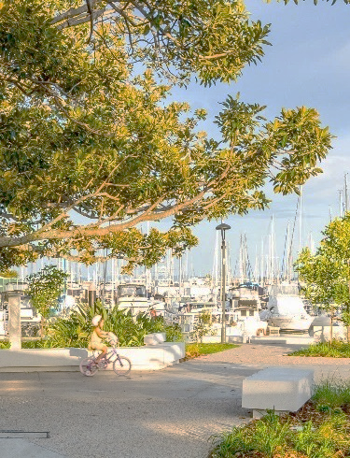
Manly Harbour Village Precinct – New Foreshore Plaza
Before
After
After

Slide 19
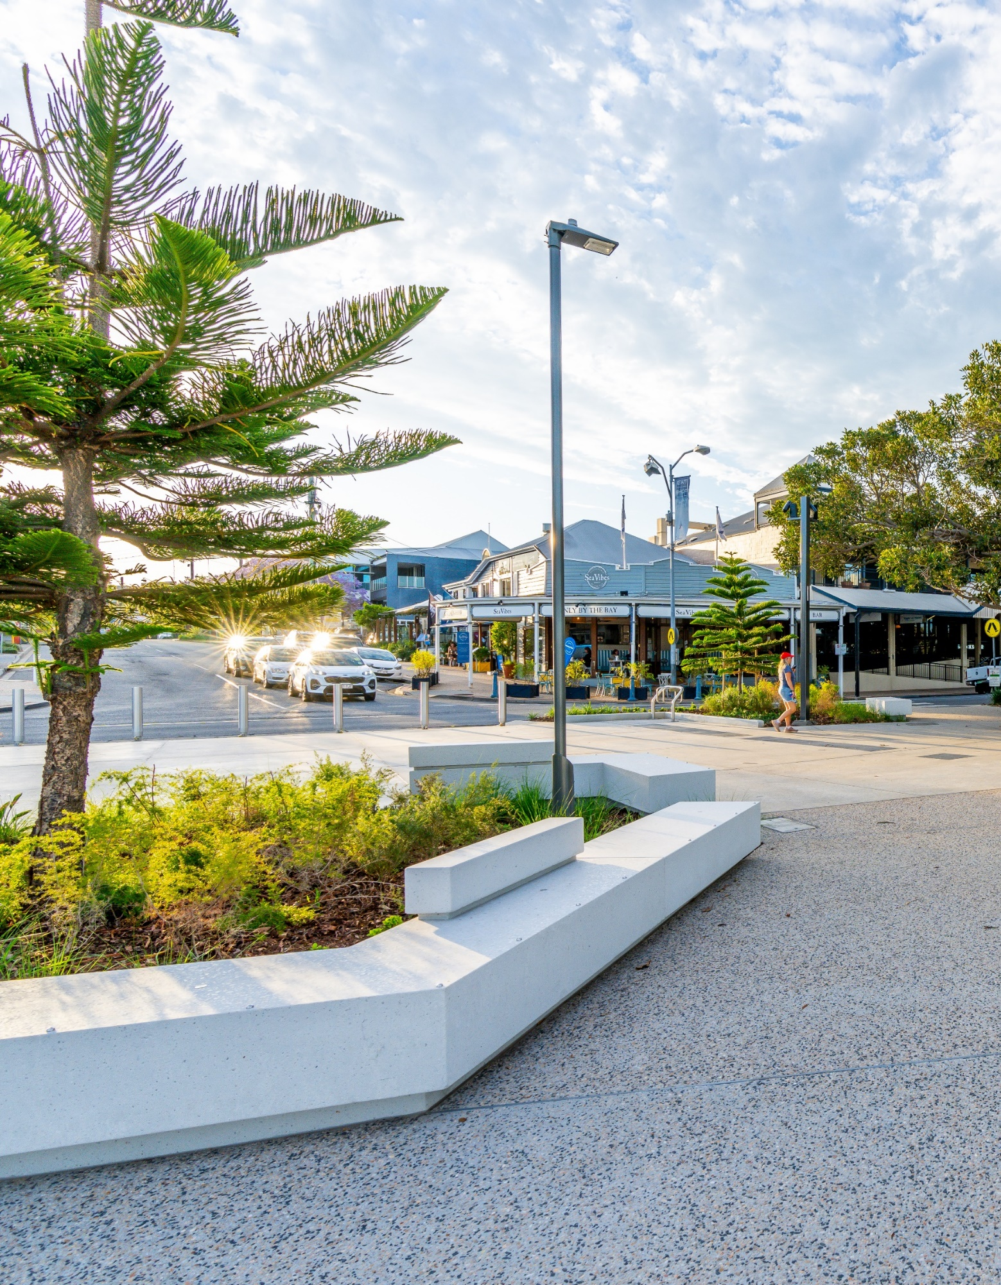
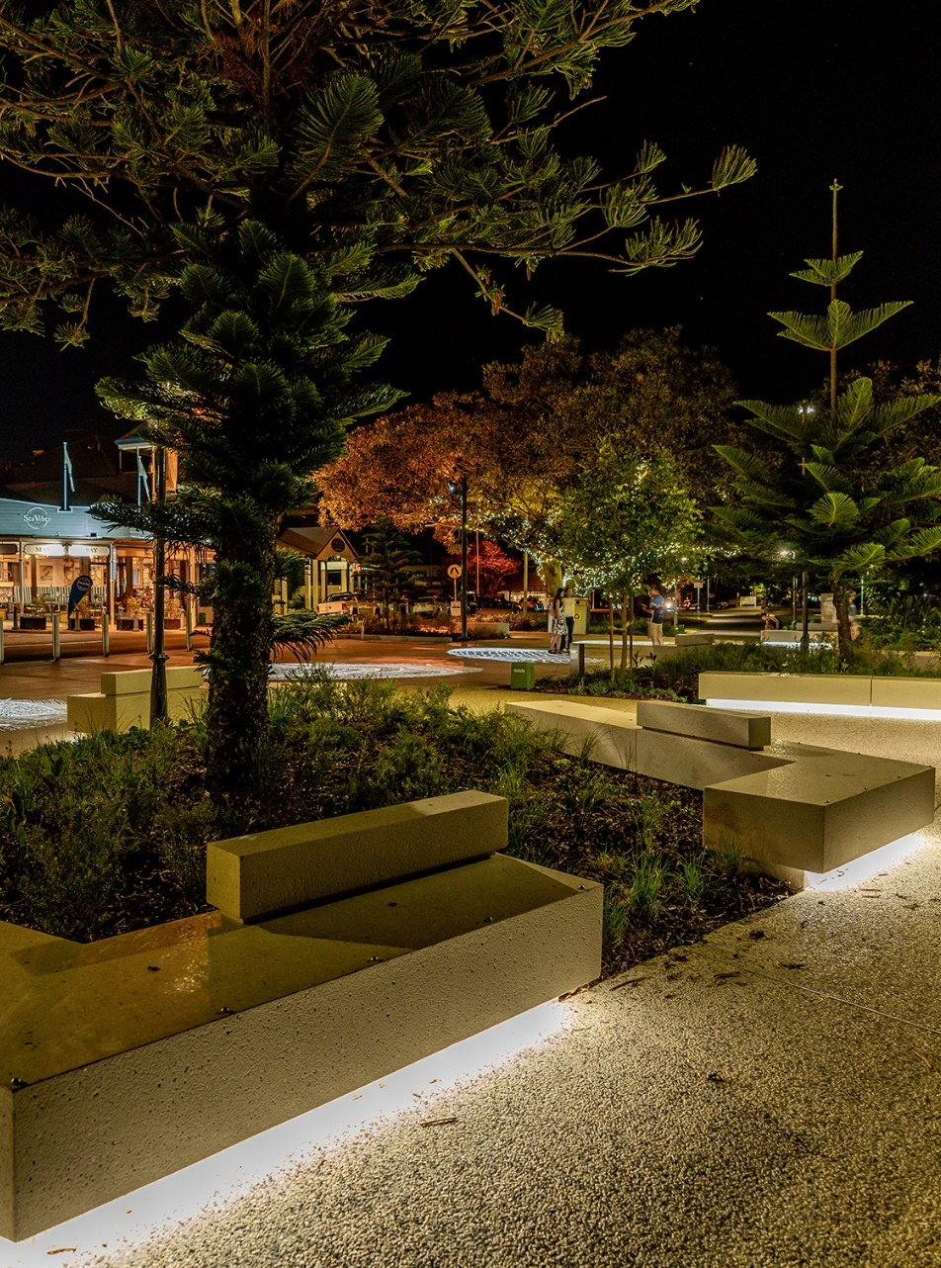
Manly Harbour VPP – Bespoke Seating Design
bespoke coloured concrete seat
integrated LED lighting

Slide 20
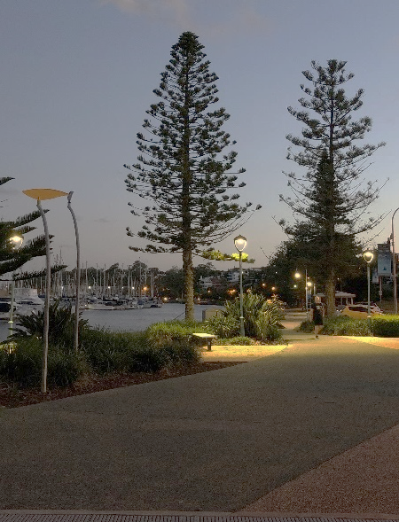
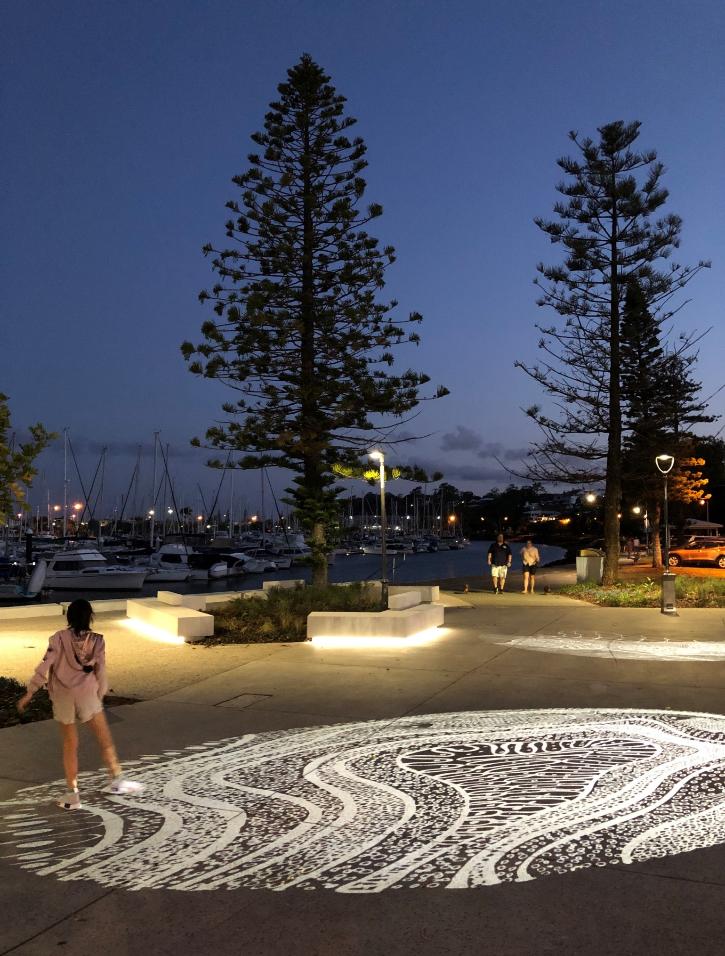
Manly Harbour Village Precinct – New Foreshore Plaza
Before
After

Slide 21
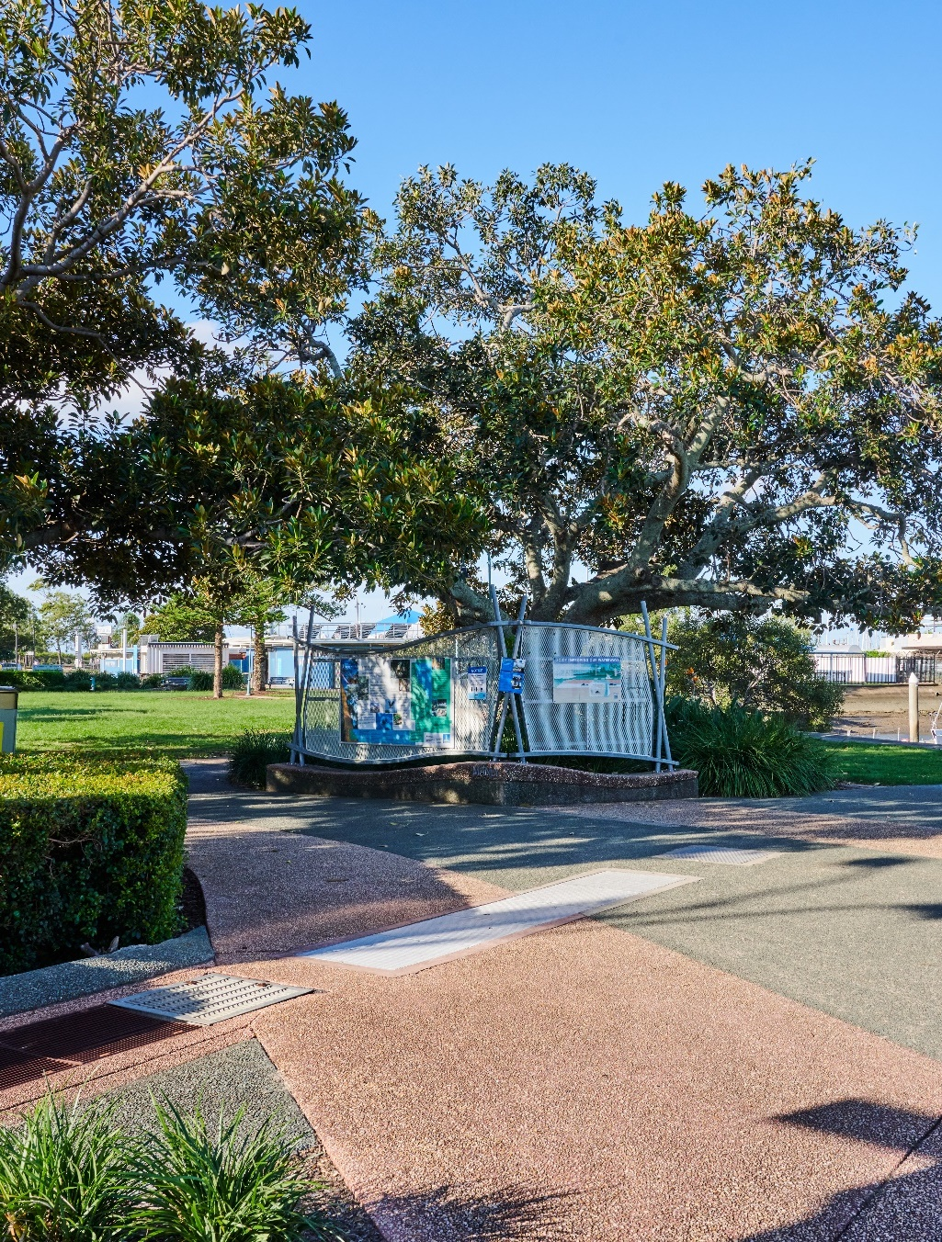
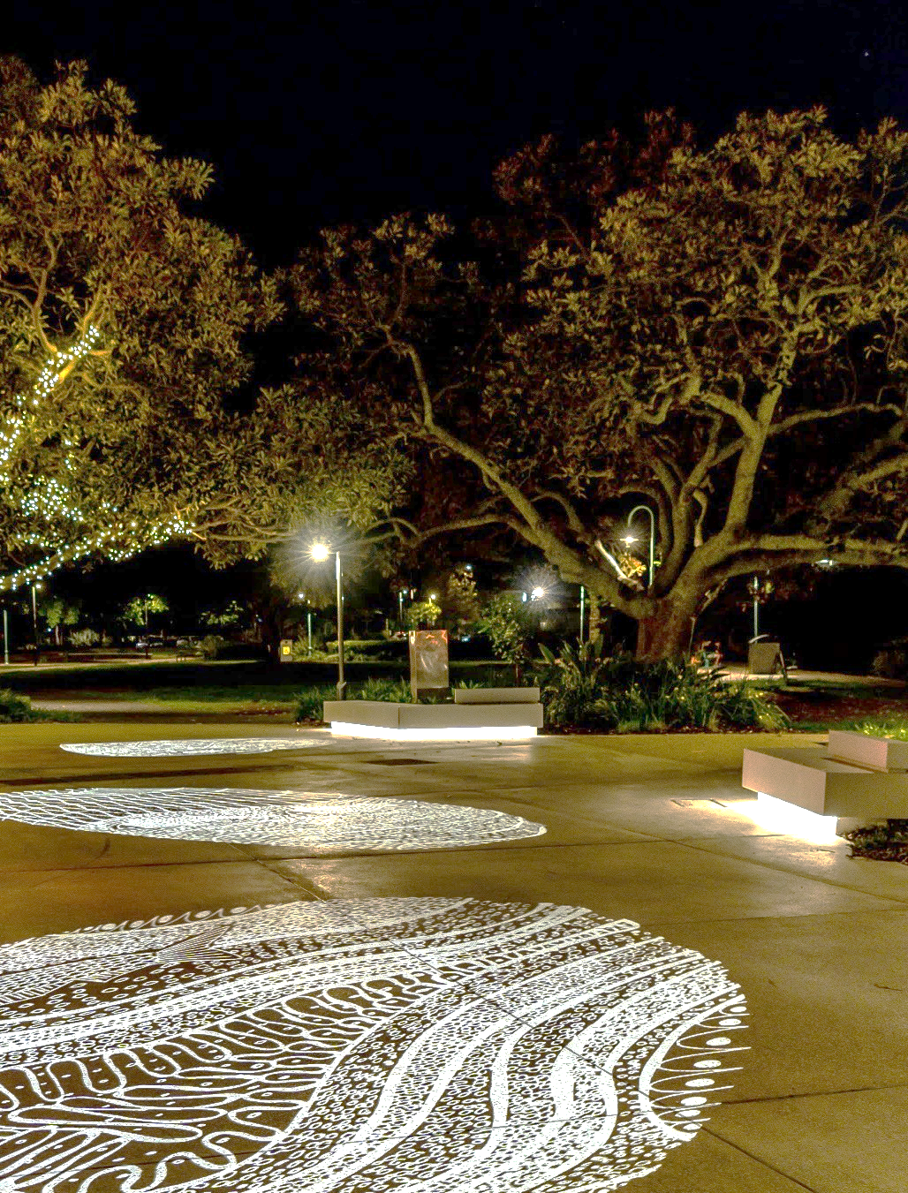
Manly Harbour Village Precinct – New Foreshore Plaza
Before
After

Slide 22
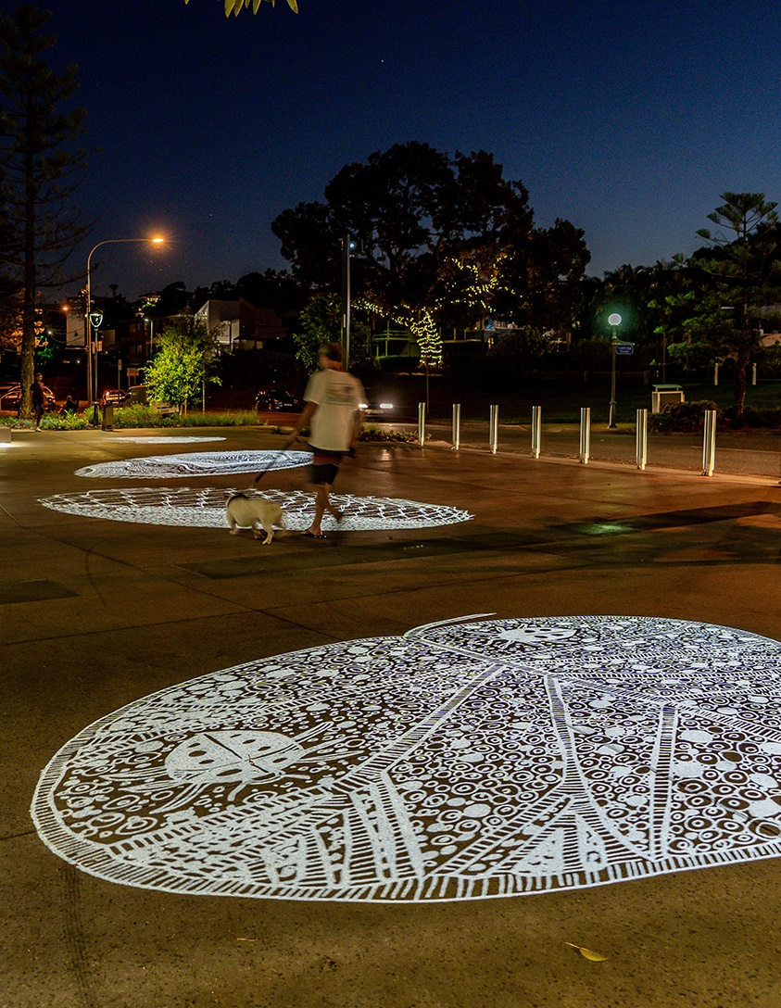
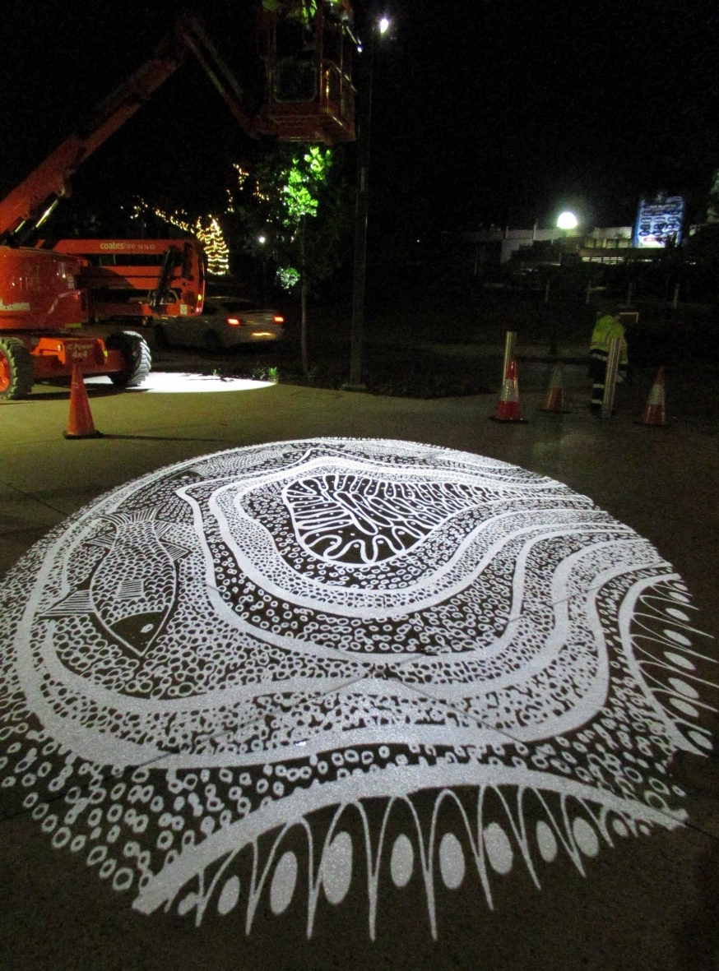
Manly Harbour VPP – Creative Lighting Outcome
Artist Delvene Cockatoo Collins Projection Artwork
Artist Delvene Cockatoo Collins Projection Artwork

Slide 23
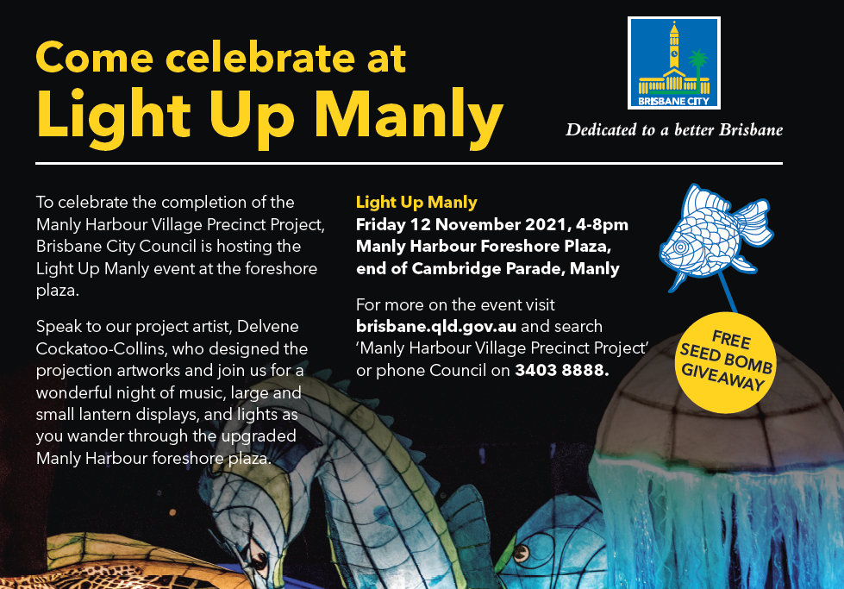

Slide 24
‘Before’ fly through
‘After’ fly through – daytime
‘After’ fly through – evening

