Slide 1
Kelvin Grove Road and Enoggera Road Traffic Improvements
Infrastructure Committee
29 November 2022

Slide 2
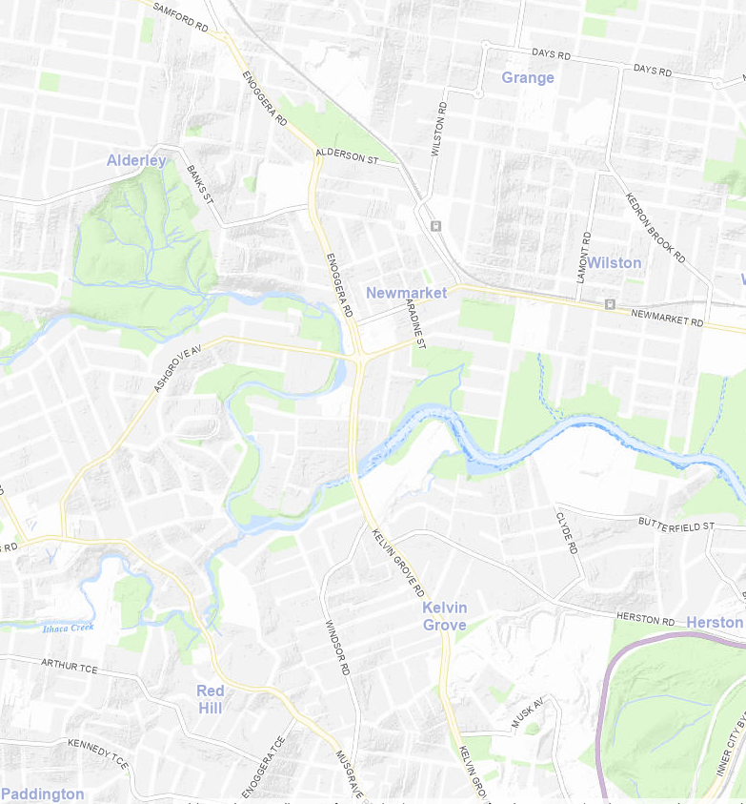
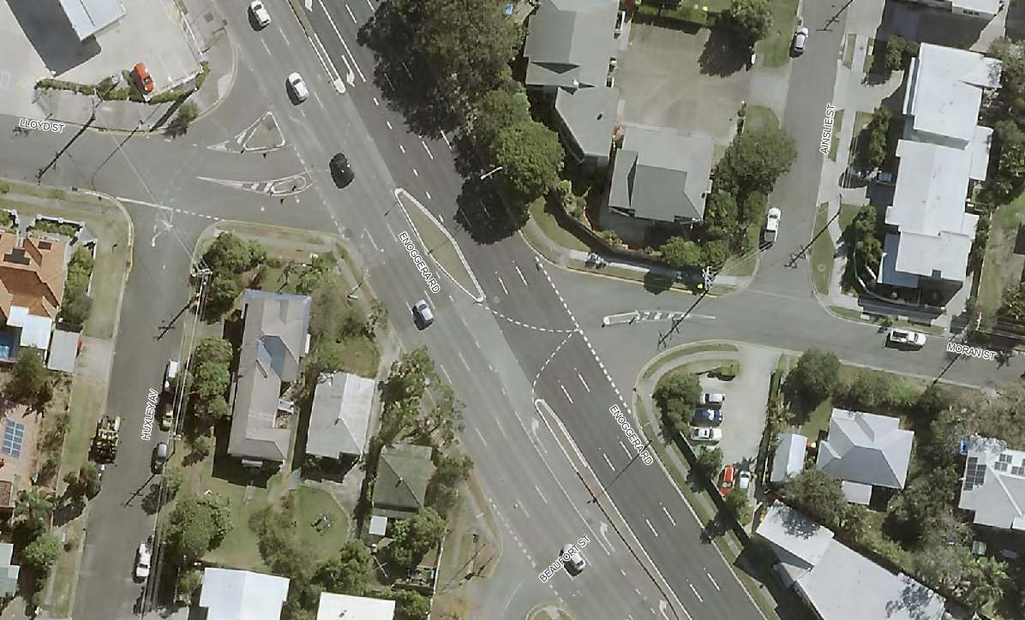
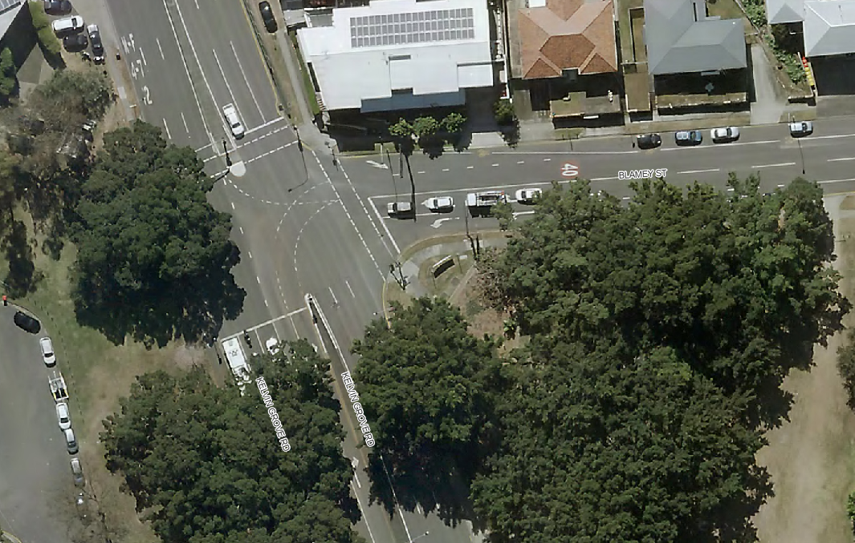
Locations
Moran St
Enoggera Rd
Blamey St
Kelvin Grove Rd
Source: BrisMap

Slide 3
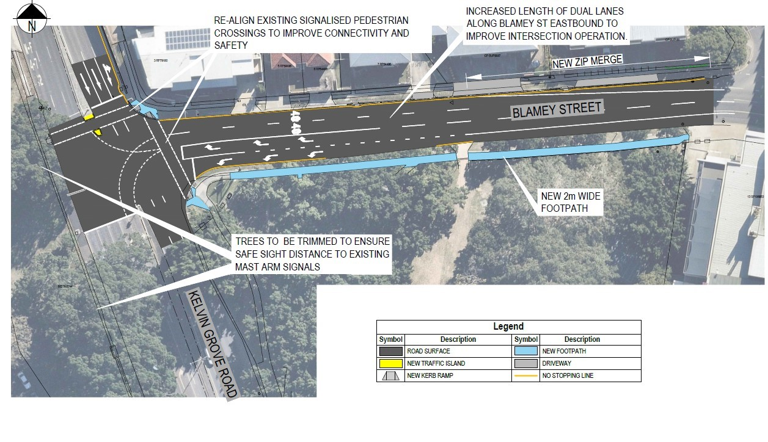
Kelvin Grove Road and Blamey Street - Project plan
Source: Council
Source: Council

Slide 4
Kelvin Grove Road and Blamey Street - Details
Background
The intersection is at capacity, particularly in the afternoon peak travel period
Objectives
Improve safety for people walking and riding through the area
Improve overall intersection traffic flow capacity by improving the right turn capacity into Blamey Street
Construction challenges
Work in close proximity to heritage protected vegetation
Presence of rock in excavations

Slide 5
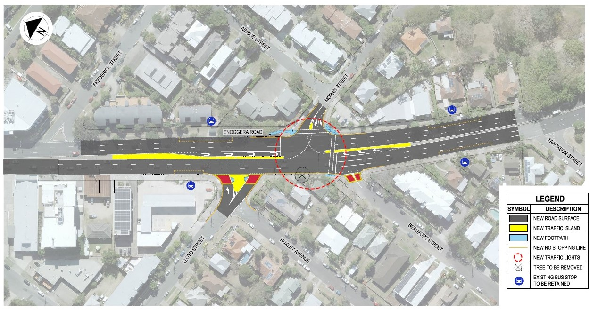
Enoggera Road and Moran Street - Project plan
Source: Council

Slide 6
Enoggera Road and Moran Street - Details
Background
The intersection has a high crash rate
Access is difficult in and out of Moran Street
Objectives
Improve access in and out of Moran Street
Improve the intersection safety
Improve active transport with formalised crossings
Construction challenges
Extremely congested with Public Utility Plant
Exclusively carried out at night due to high traffic volumes

Slide 7
Delivery and funding
The completed upgrades will improve accessibility and safety
Design completed early 2022
Contracts awarded mid 2022
Construction commenced mid 2022
Enoggera Moran completed on 8 November 2022
Kelvin Blamey to be completed in December 2022
The Kelvin Grove Road and Blamey Street and Enoggera Road and Moran Street intersection upgrade projects are jointly funded by Council and the Australian Government’s Roads to Recovery Program.
Late 2021 Planning and investigation works complete
Early 2022
Detailed design and community engagement
Mid 2022
Start of Construction
Late 2022
End of construction

Slide 8
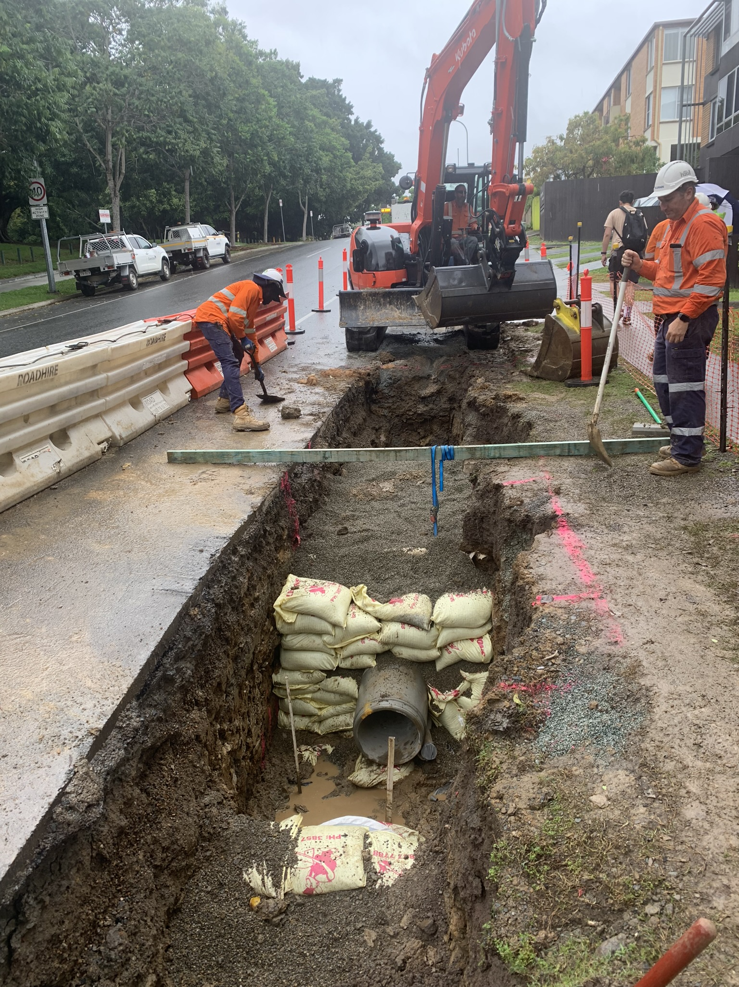
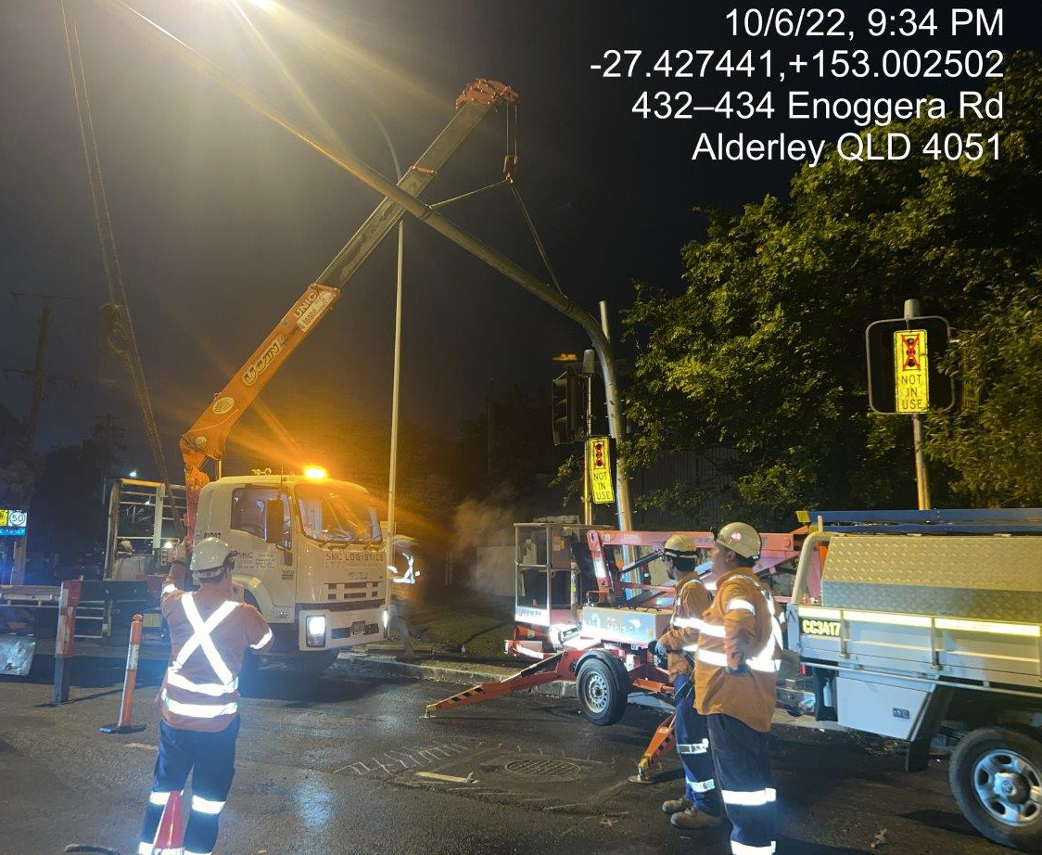
Construction works
Mast arm erection
Enoggera Road October 2022
Source: Council
Stormwater installation
Blamey Street October 2022
Source: Council

Slide 9
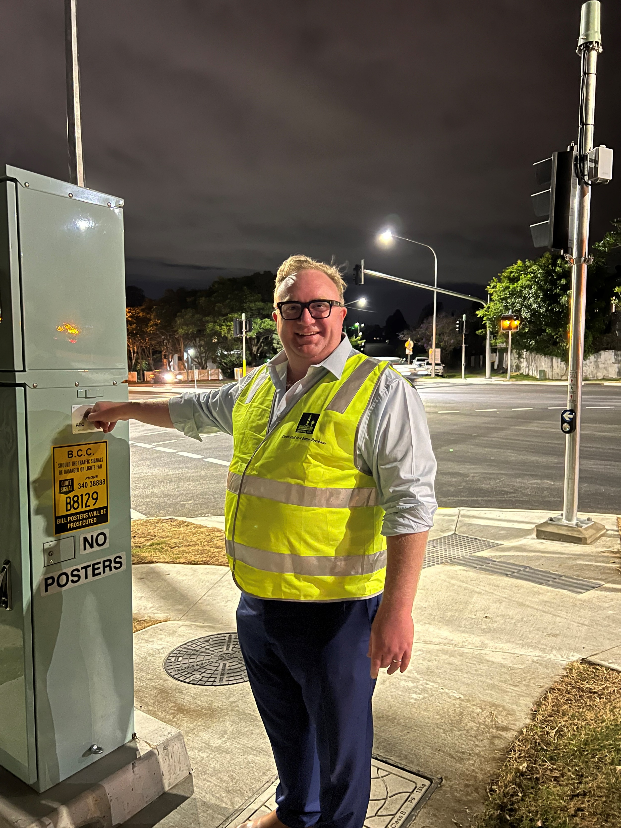
Construction works
Cr Wines turning the traffic signals on at Enoggera Road/Moran Street
night of 8 November 2022
Source: Council

Slide 10
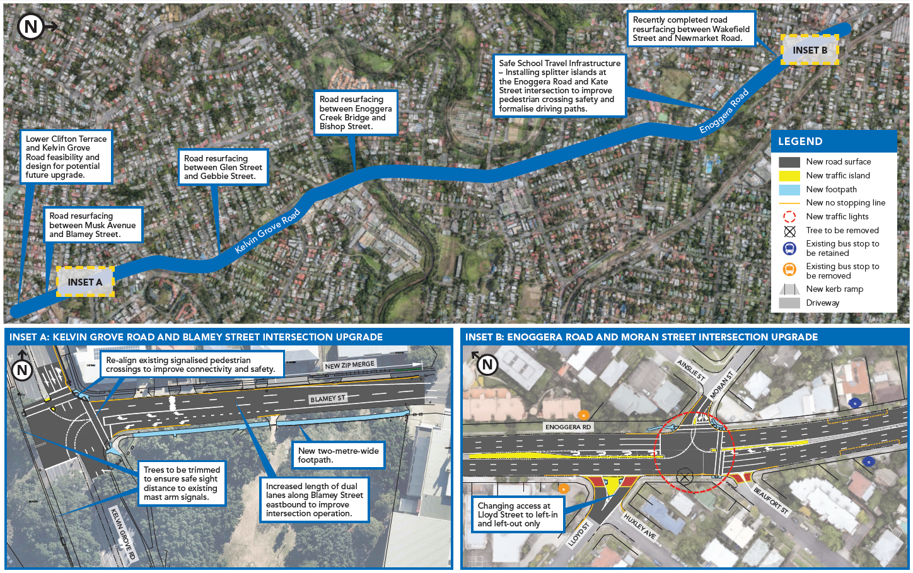
Overview of works
Source: Council

Slide 11
Questions
Source: Council

