Slide 1
City Planning and Suburban Renewal Committee
1175 Sandgate Road, Nundah
A005980915
9 May 2023
General Manager, Development Services
City Planning and Sustainability

Slide 2
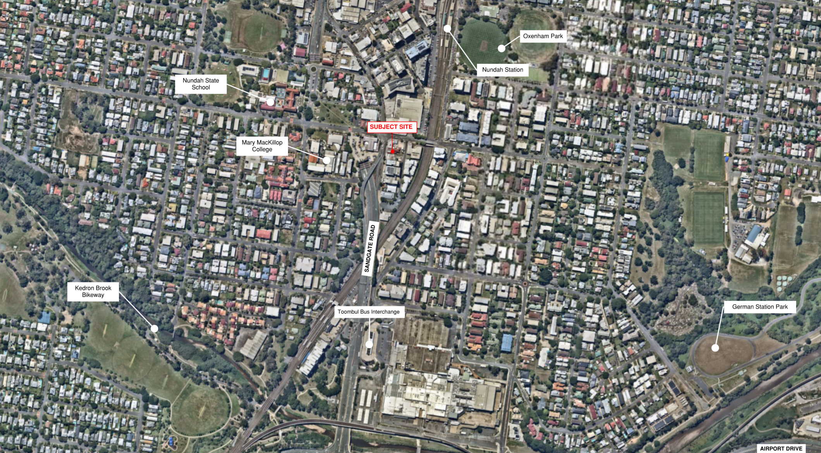
AERIAL VIEW
Aerial view of subject site

Slide 3
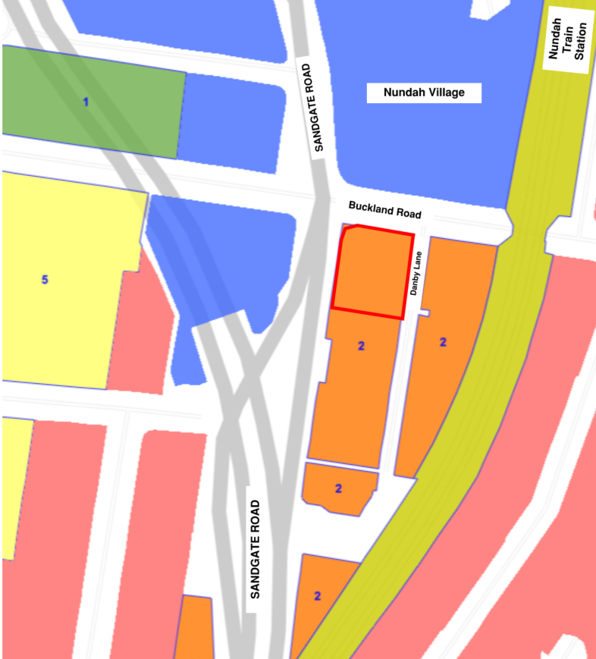
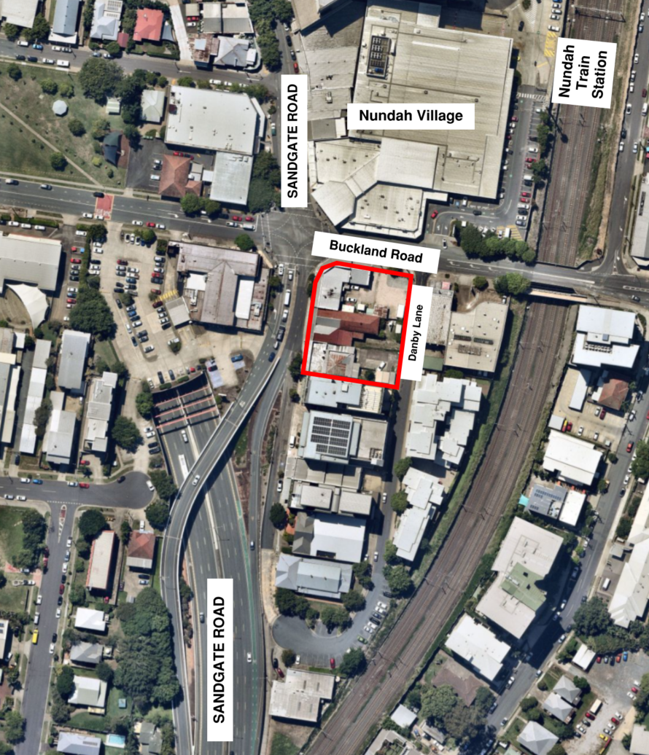
ZONE & CONTEXT
Zoning map (Brisbane City Plan 2014)
Site context
Medium density residential zone
Major centre Zone
Mixed use (Centre Frame) zone
Community facilities (Education purposes) zone
Open space (Local) zone

Slide 4
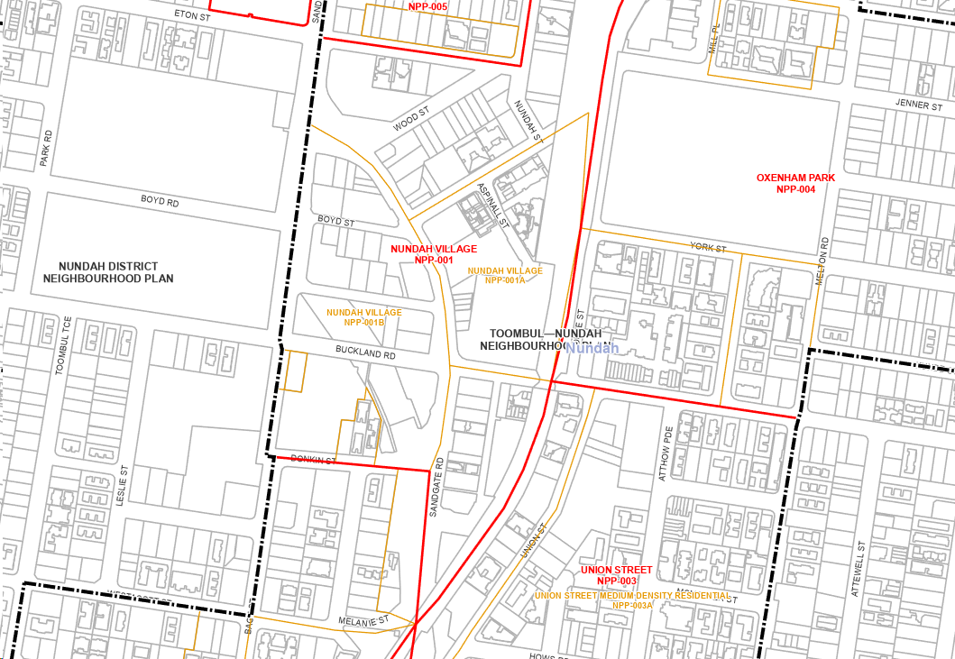
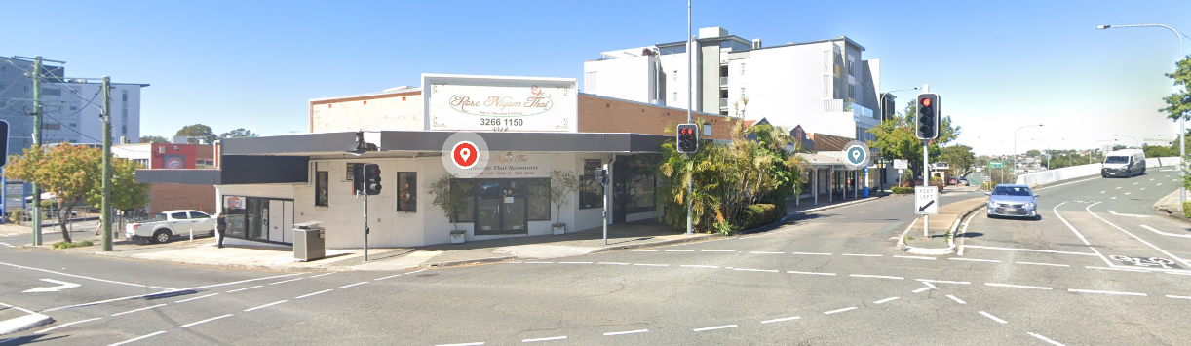
NEIGHBOURHOOD PLAN
Toombul-Nundah neighbourhood plan precinct boundary
Existing Streetscape

Slide 5
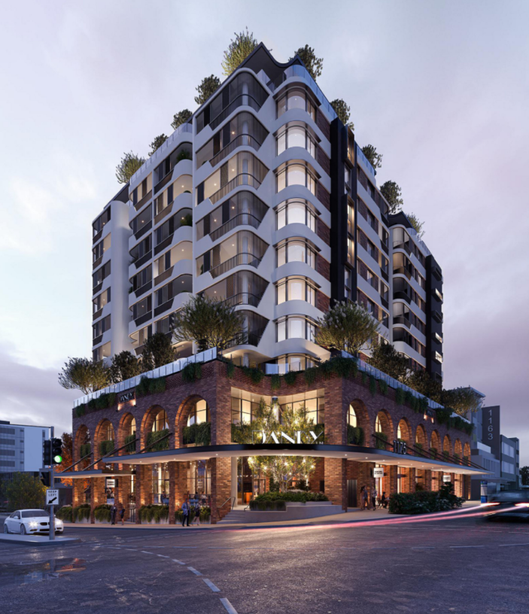
DEVELOPMENT OVERVIEW
Owner: Buckland Projects Pty Ltd
Applicant: Urban Strategies Pty Ltd
Site area: 1,949m²
Category of assessment: Impact assessable
Land use: Material change of use – Multiple Dwelling (84 units), and Centre Activities (Shop, Office, Food and Drink Outlet, Bar and Hotel)
Built Form: 11 storeys in height including a two (2) storey podium
Figure: Development Perspective

Slide 6
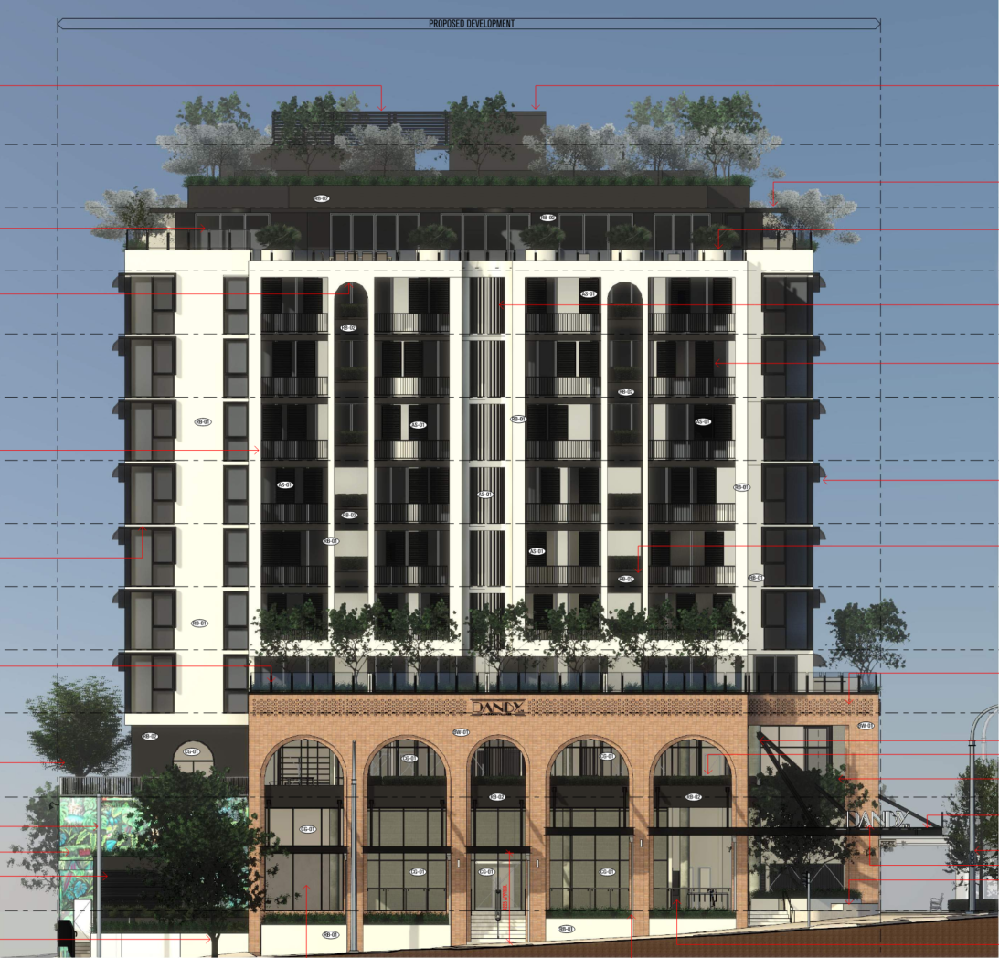
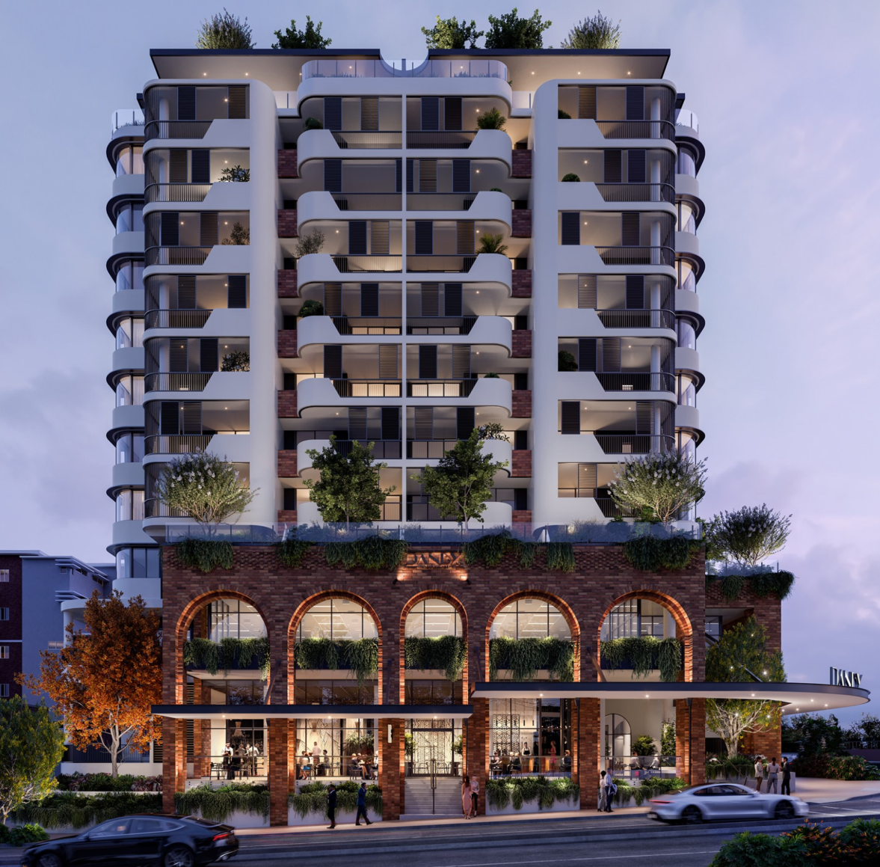
CHANGE TO THE APPLICATION
Figure: Original proposed built form
Figure: Approved built form

Slide 7
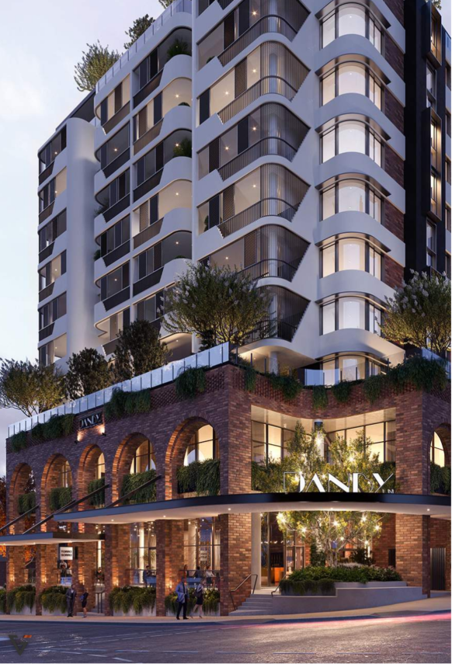


DEVELOPMENT OVERVIEW
Development details:
  11 storeys in height
    Four (4) basement levels
    Two (2) storey podium containing centre activities
    Nine (9) storey tower
    Rooftop garden
  1,547m² commercial gross floor area, split into six (6) tenancies
  High quality design features that achieve architectural excellence and respond to the “Buildings that Breathe” design guidelines
147 resident
21 visitor
39 commercial
Parking Provision
Minimum 116
Figure: Development perspective
Figure: Development elevation

Slide 8
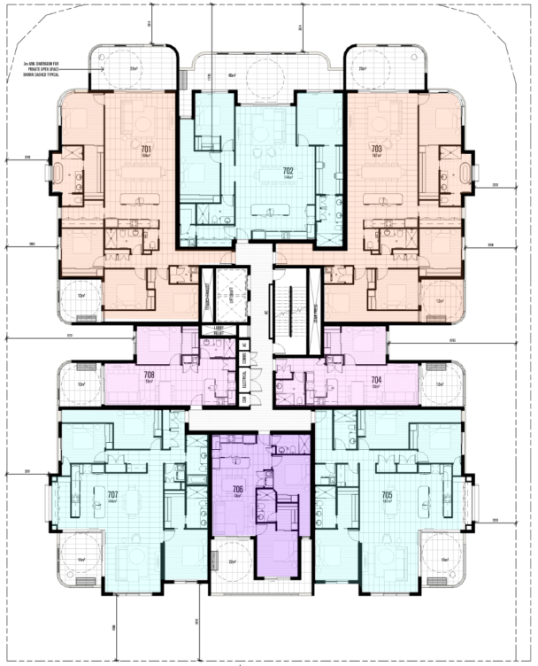
BEDROOM MIX
Provides 84 dwellings
  28 x 1 bedroom
    Approx. 56m²
  20 x 2 bedroom
    Approx. 77m²
  25 x 3 bedroom
    Approx. 114m²
  11 x 4 bedroom
    Approx. 194m²
  Suitable for down sizers, young professionals and/or families
Legend :
2 bedroom
1 bedroom
4 bedroom
3 bedroom
Figure: Floor plan level 7 floor plan

Slide 9
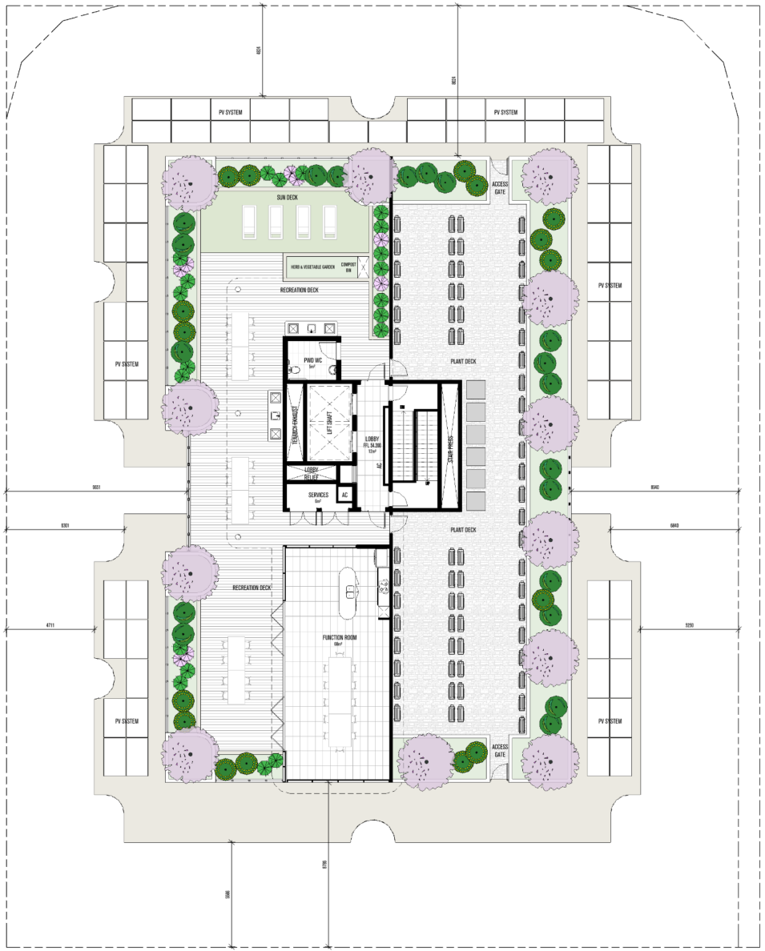
RECREATIONAL AREAS
Private open space areas range between 12m² – 77m²
Active and passive communal open space
  Swimming pool provided on the level 2 podium
    Rooftop garden provided
    Undercover BBQ facilities
    Sun lounge deck
    Recreational deck
    Herb and Vegetable garden
    Compost bin
    Containerised planting
Figure: Rooftop plan

Slide 10
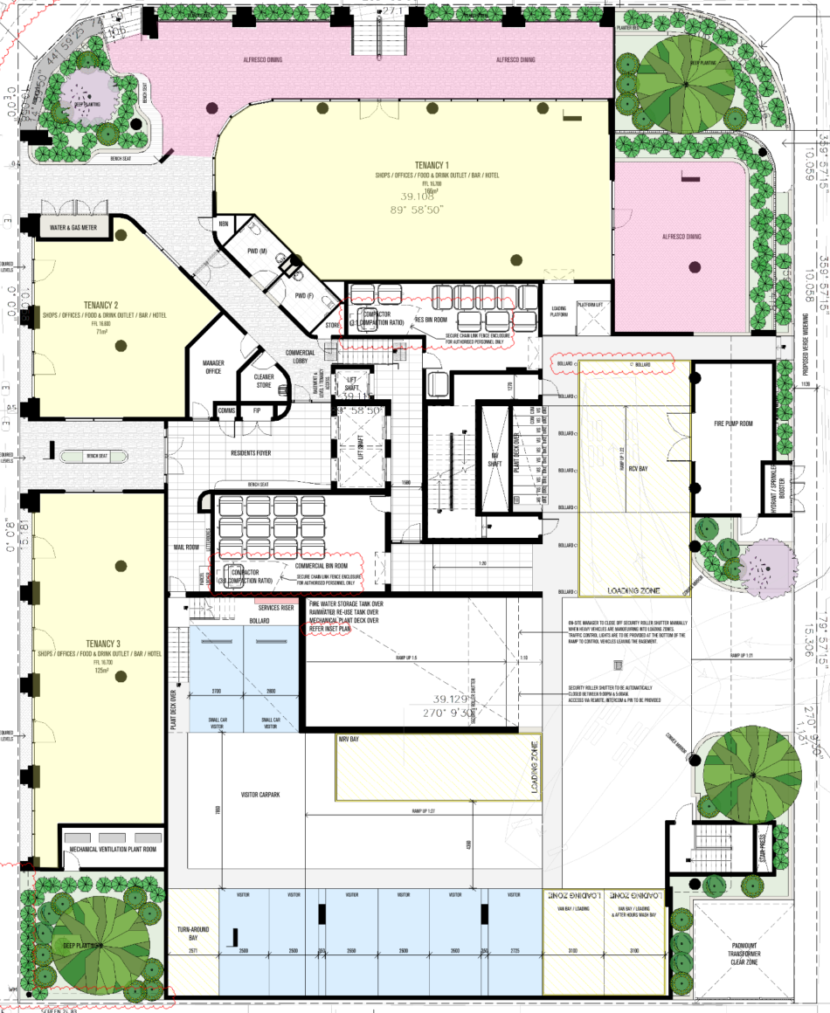
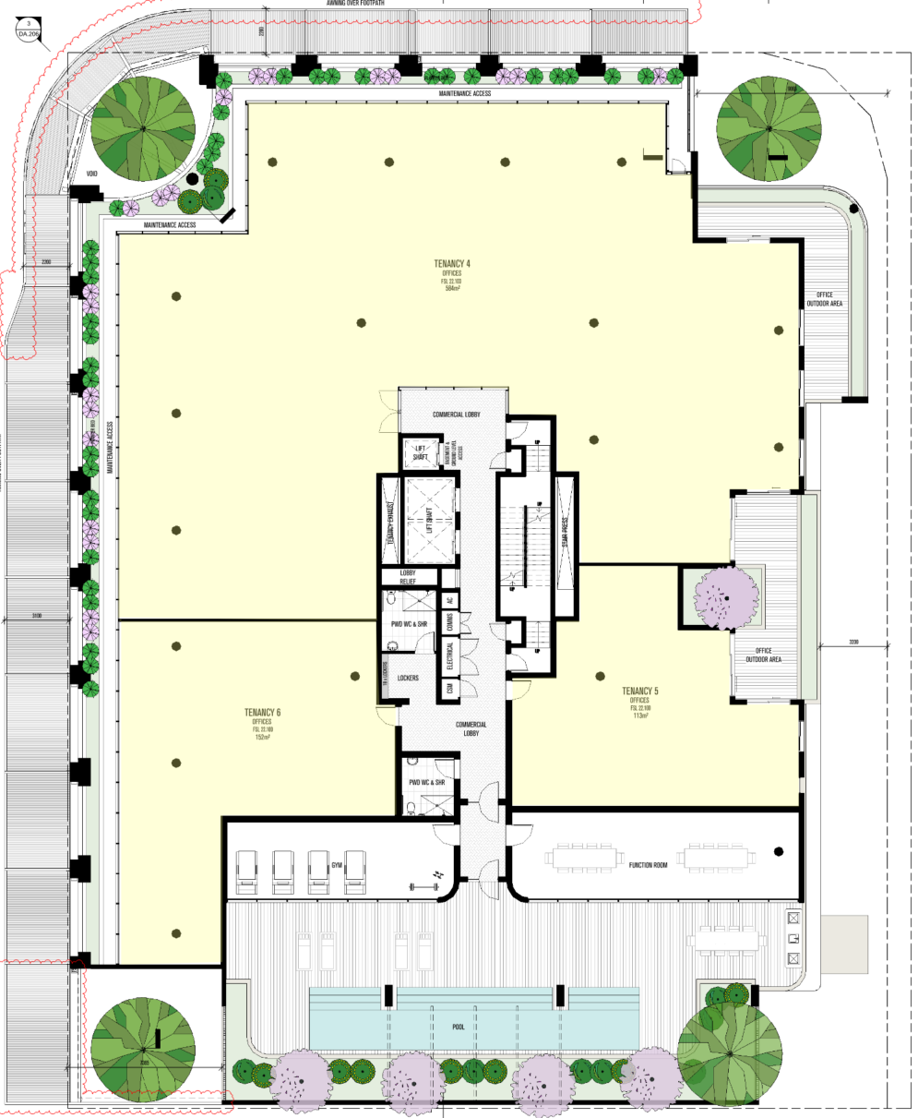
CENTRE ACTIVITES
Ground Level:
Shop, Office, Food & Drink, Bar, Hotel
Tenancy 1 – 166m²
Tenancy 2 – 71m²
Tenancy 3 – 125m²
Second Level:
Limited to Office
Tenancy 4 – 584m²
Tenancy 5 – 113m²
Tenancy 6 – 152m²
Figure: Ground floor
Figure: Second floor
Hours of operation 6:00AM to 10:00PM
Alfresco dining opportunities provided
Supports the village community
Legend :
Commercial tenancy
Indicative alfresco dining area

Slide 11
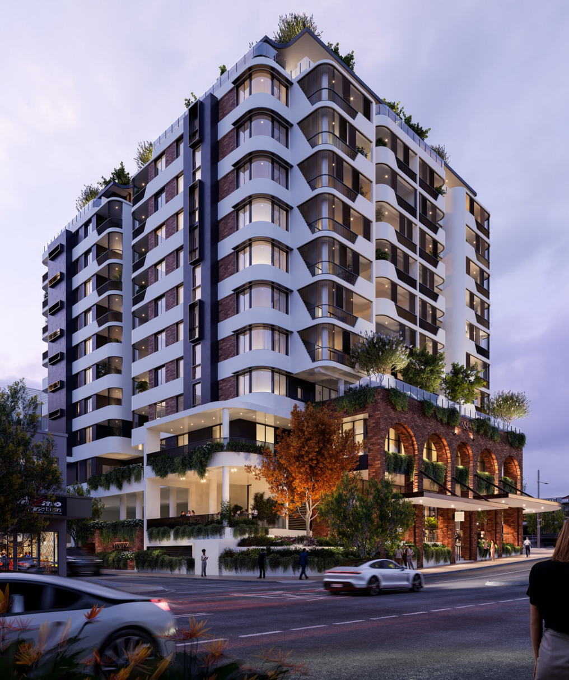
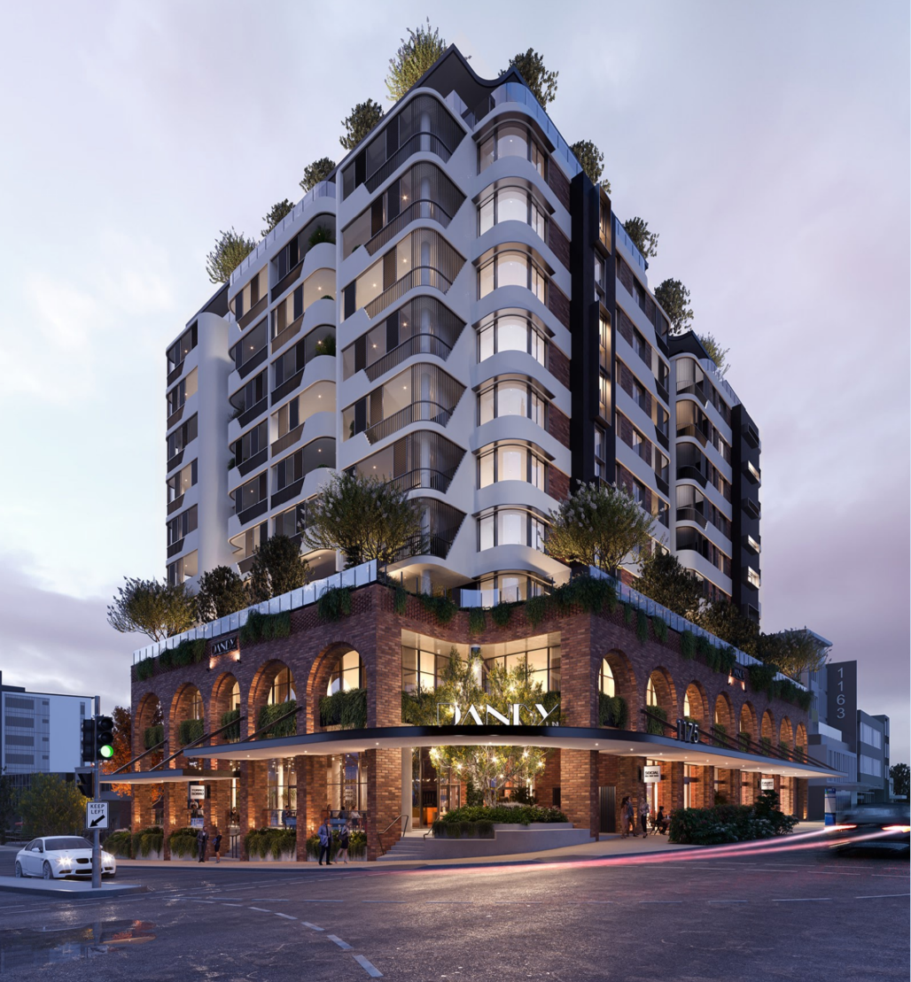
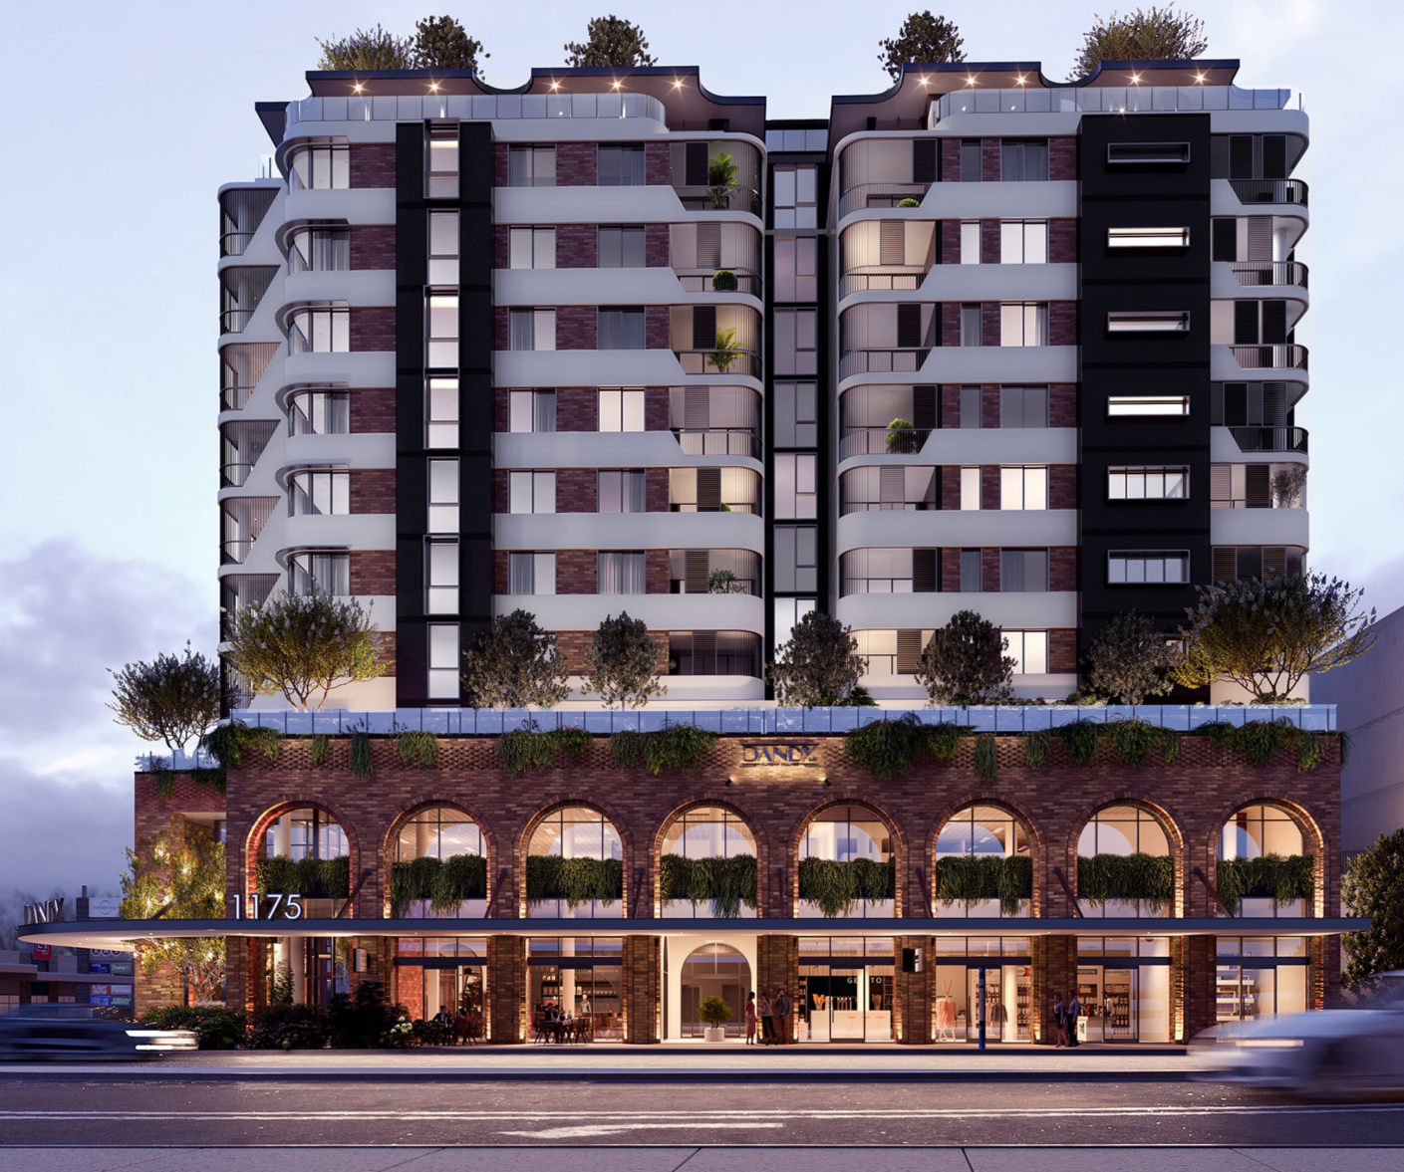
BUILT FORM
Building façade provides substantial articulation
Modern, dynamic and durable high quality materials utilised
Reduced energy via solar panels and design to maximise natural light
Shading devices to windows and balconies
Considered / feature landscaping to enhance the subtropical feel
Creative lighting conditioned
Figure: Development perspective

Slide 12
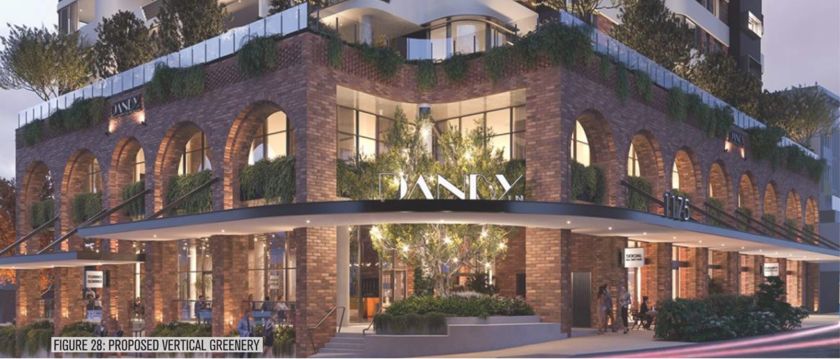
STREETSCAPE ACTIVATION
Pedestrian awning and lighting provided along the site frontage
Increased public surveillance to three streets
2.5m widening to Danby Lane and corner truncations
Land use mix and building design supports, connects and integrates with surrounding locality
Will create a sense of place and new land mark for the neighbourhood

Slide 13
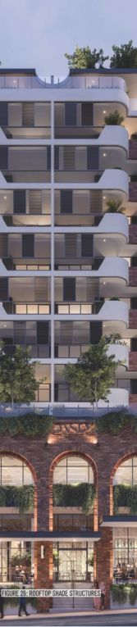
REASONS FOR APPROVAL
The development application was approved for the following reasons:
The development creates a mixed use environment complements and supports, but is distinguished from and does not compete with the retail and entertainment functions of adjoining centres
It diversifies the range of activities and functions available in the vicinity, including the commercial, residential and community uses that complement the retail focus of adjoining centres
The proposal contains an integrated mix of retail, office, residential and entertainment uses while providing for higher density dwellings close to public transport and centres
The development is a height, scale and form which is consistent with the amenity, character, infrastructure assumptions and community expectations for the area. The building design achieves a human scale at the street level and provides activation of the street level through appropriate location of uses and building design
The proposal enhances the Nundah village precinct through provision of a variety dwelling sizes and commercial activities needed to service the everyday shopping, convenience and lifestyle needs to service the local district and community
The building respects the traditional village character of the main street environment through building design and street level activation while providing modern premises in which business can thrive
The development is tailored to the site considering its intensity of activity, range of
uses and proximity to public transport, community facilities and other infrastructure
The building presents a coordinated and integrated design response to the locality

Slide 14
Questions?

