Slide 1
Mosquito Management
9 May 2023
City Standards Committee

Slide 2
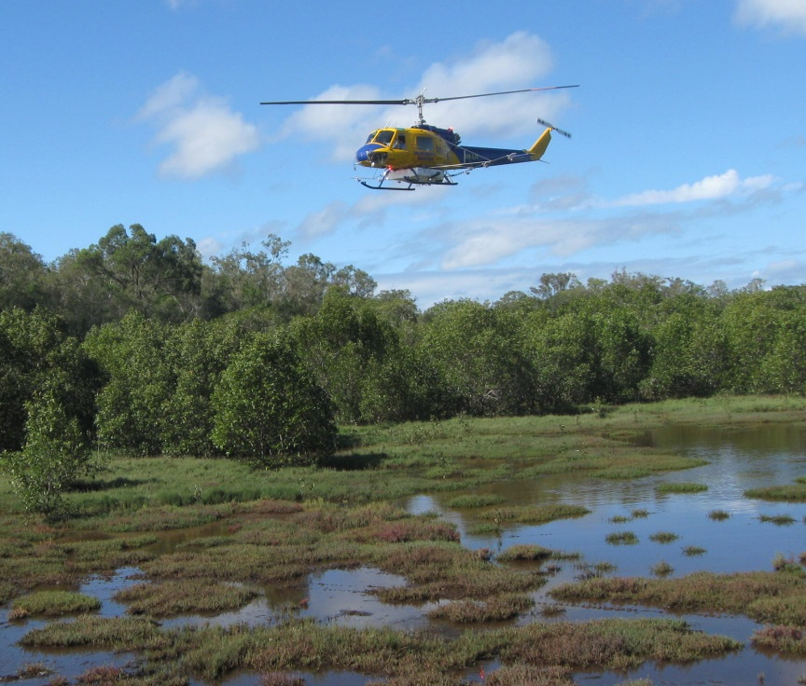
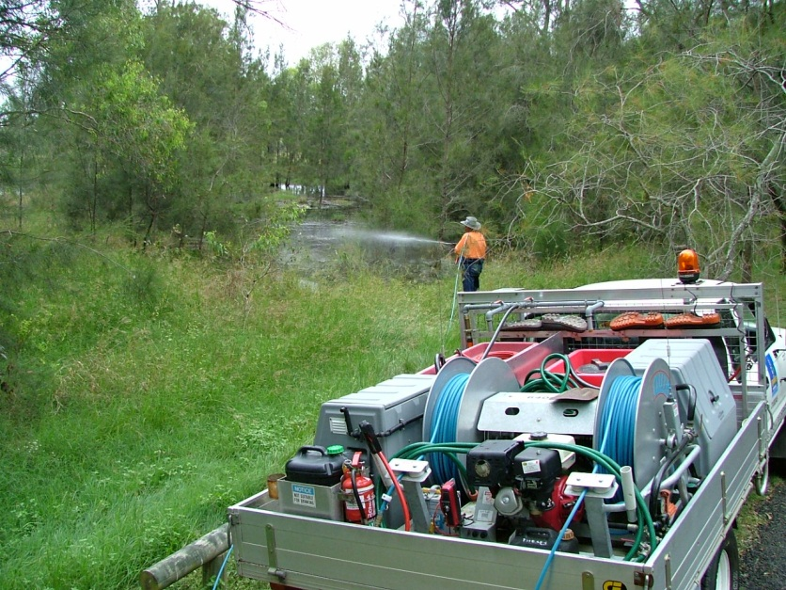
Program objectives
To improve the liveability of Brisbane by:
Reducing nuisance mosquito numbers
Preventing mosquito-borne diseases
Surveillance and control of invasive mosquitoes
Meet obligations under the Public Health Act 2005

Slide 3
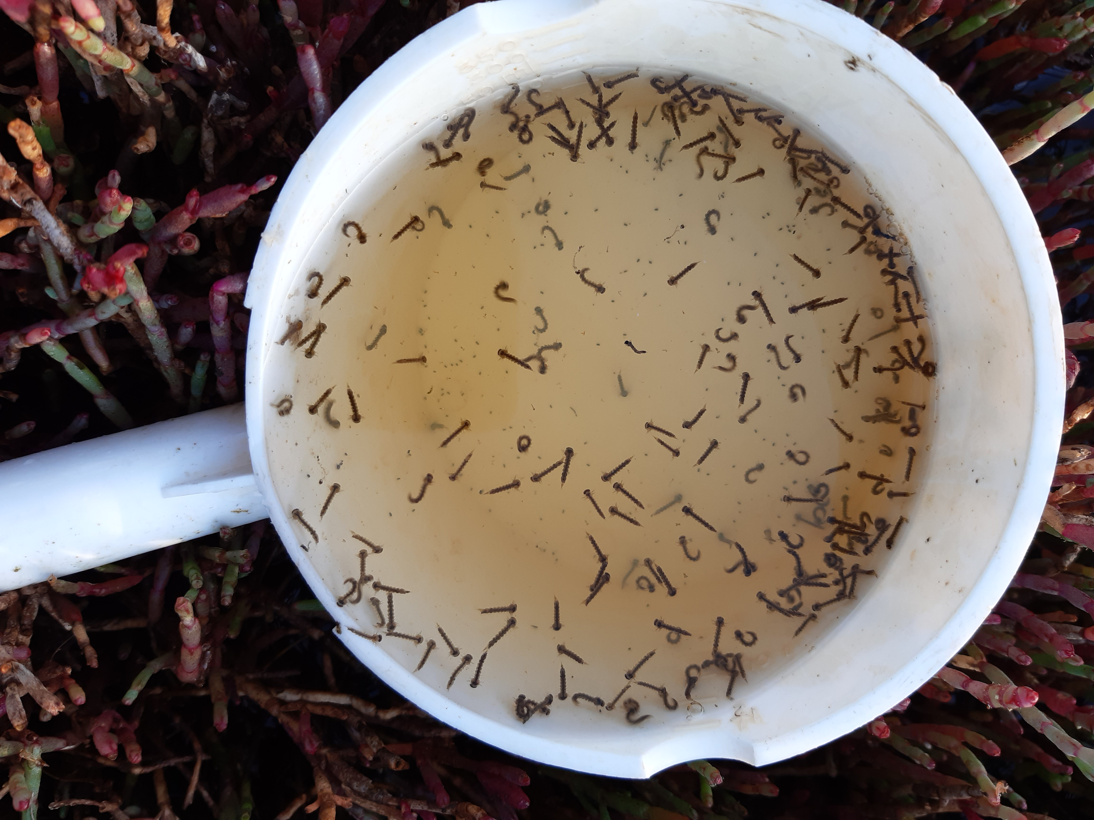
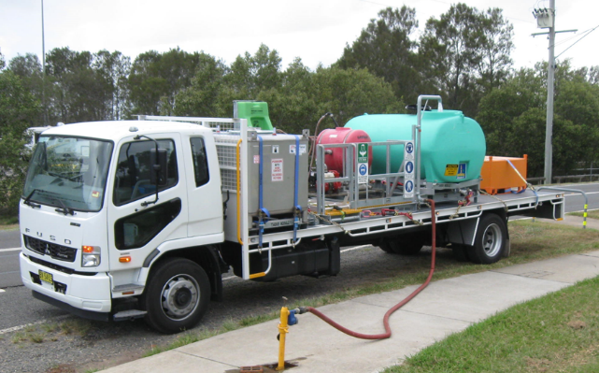
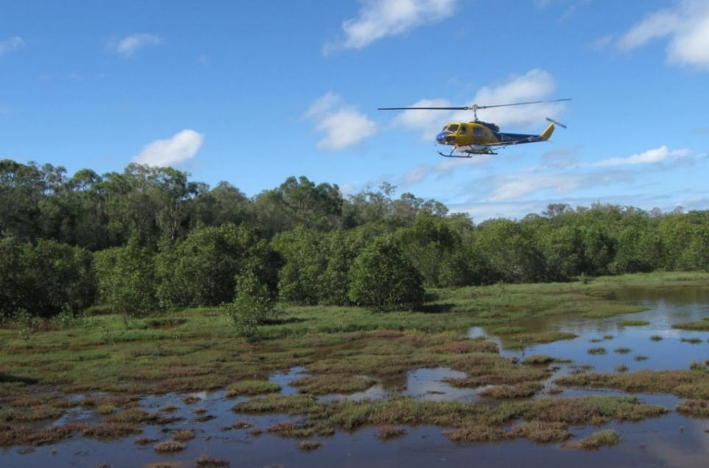
Aerial (helicopter) program
1
2
1
3
3
4

Slide 4
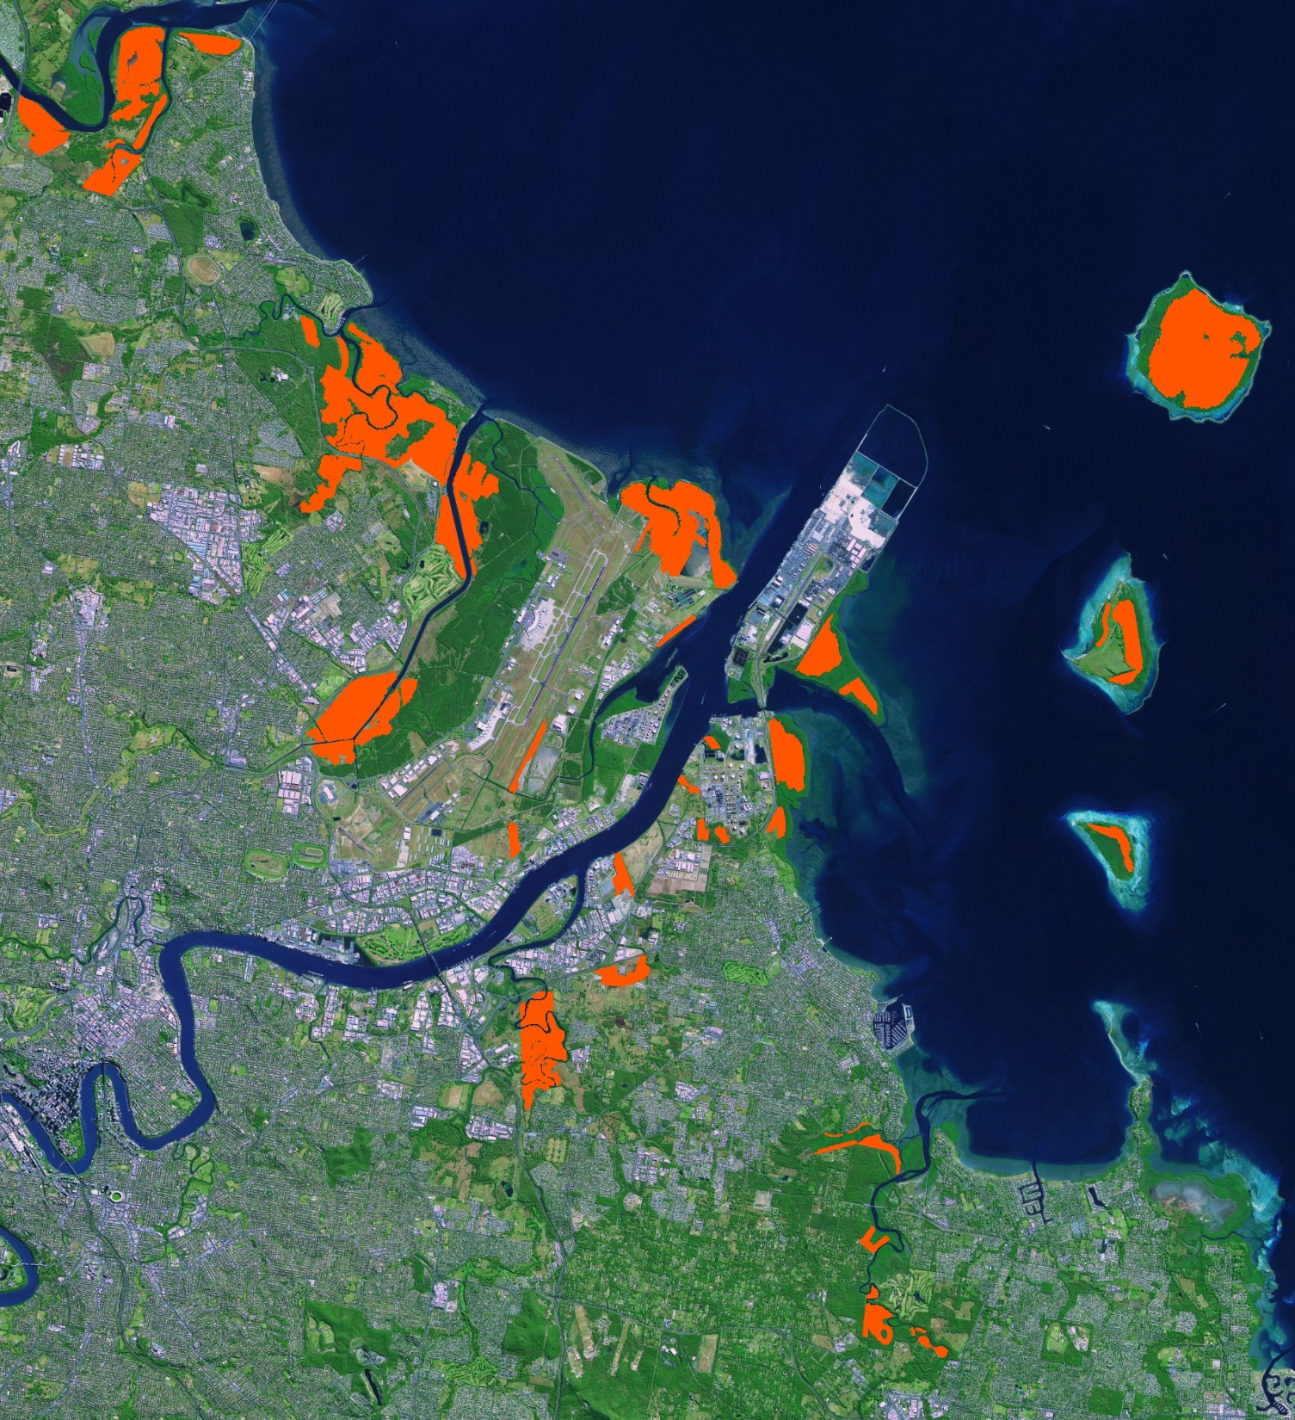
Aerial treatment areas
Tinchi Tamba Wetlands
Full treatment is about 1,800ha
Takes one to two days weather permitting
Average 14 treatments per year
Saltmarsh mosquitoes will travel 10km plus
Boondall Wetlands
Luggage Point
Bulimba Creek
Tingalpa Creek
SECURITY LABEL: OFFICIAL

Slide 5
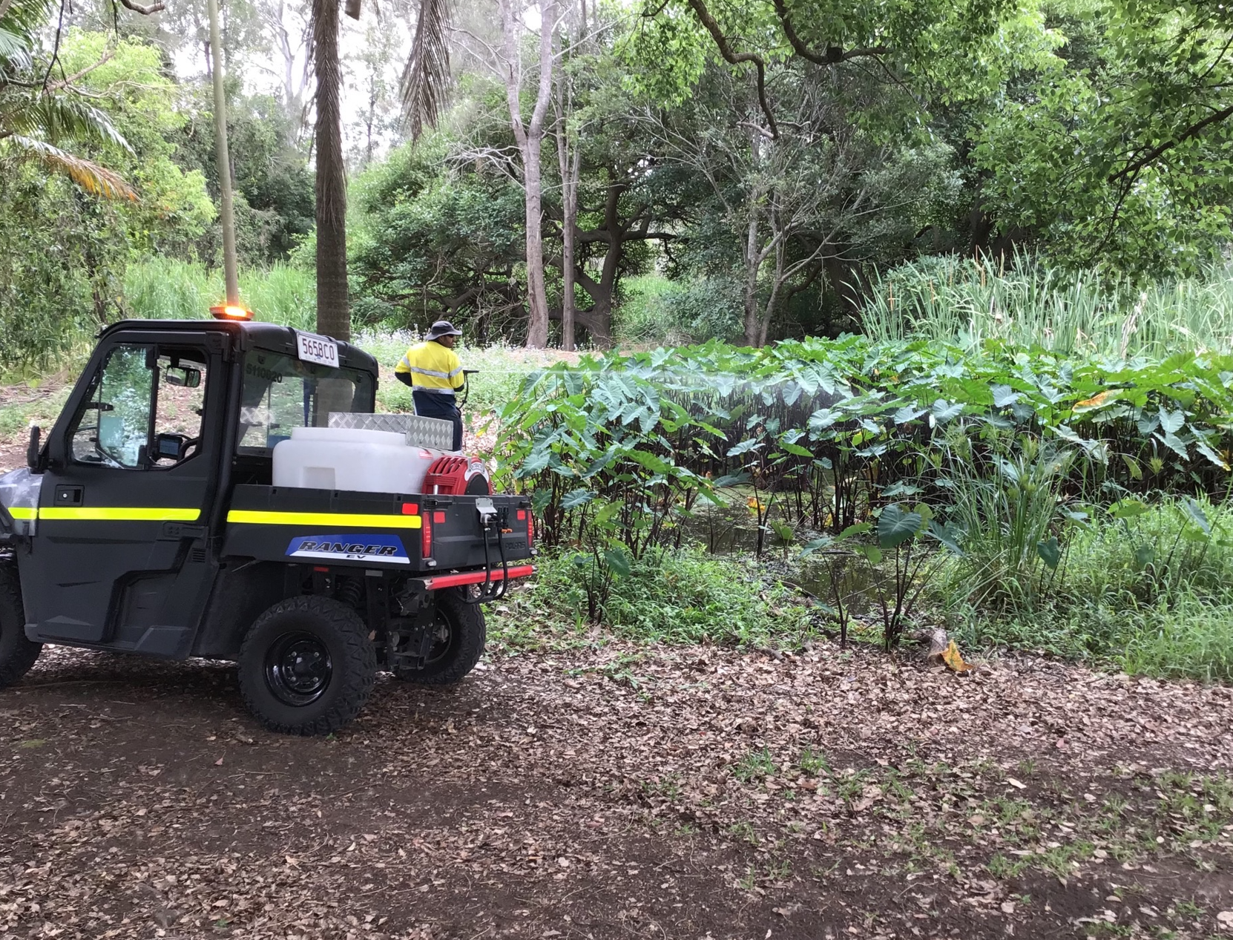
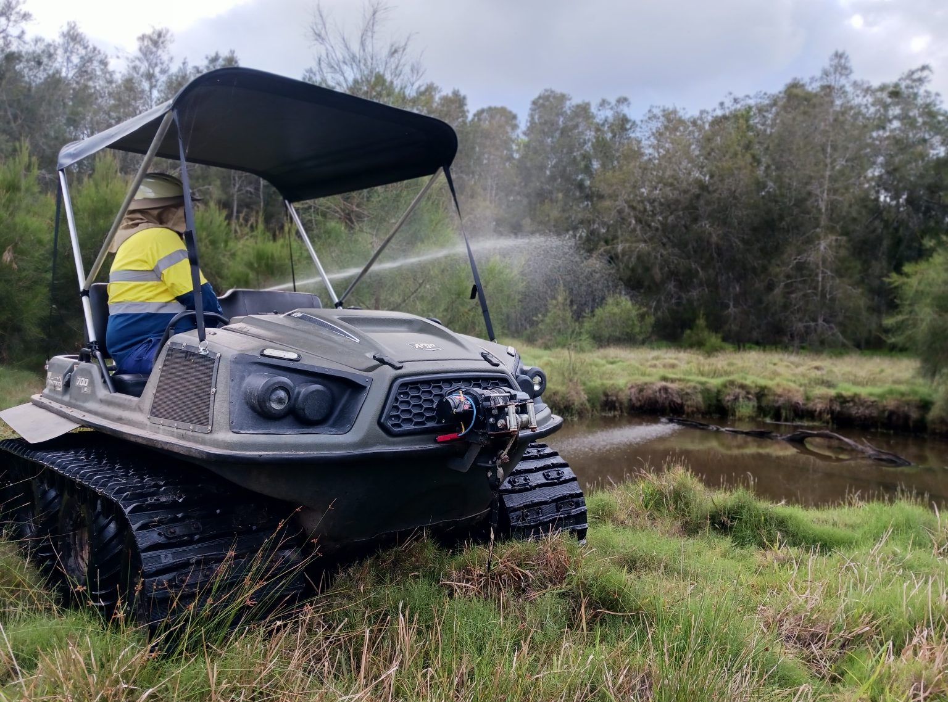
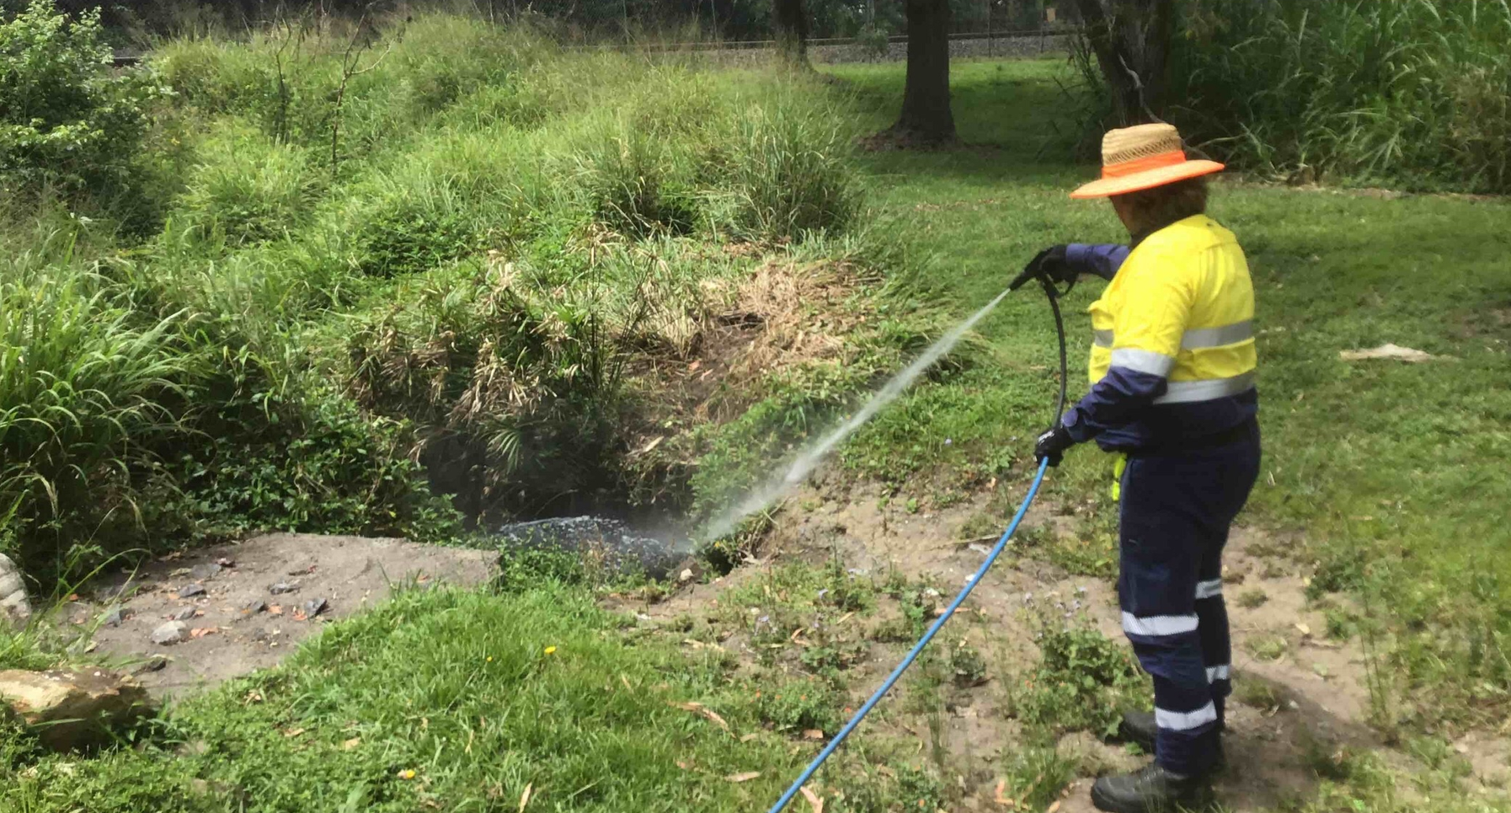
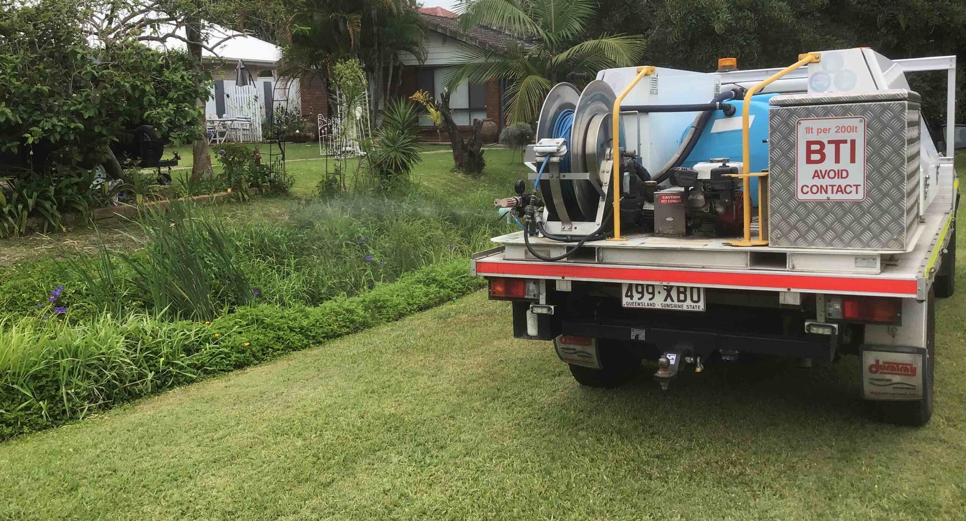
Ground spray program

Slide 6
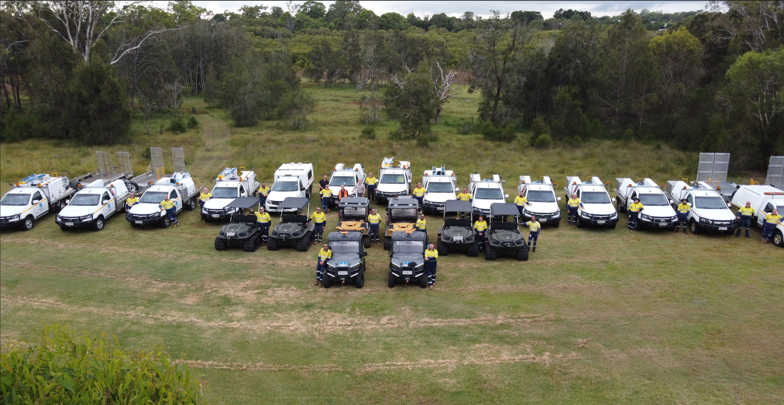
Ground spray program
14 x 4WD spray utes
2 x electric buggies
4 x 6-wheeled ATV’s
2 x 8-wheeled ATV’s

Slide 7
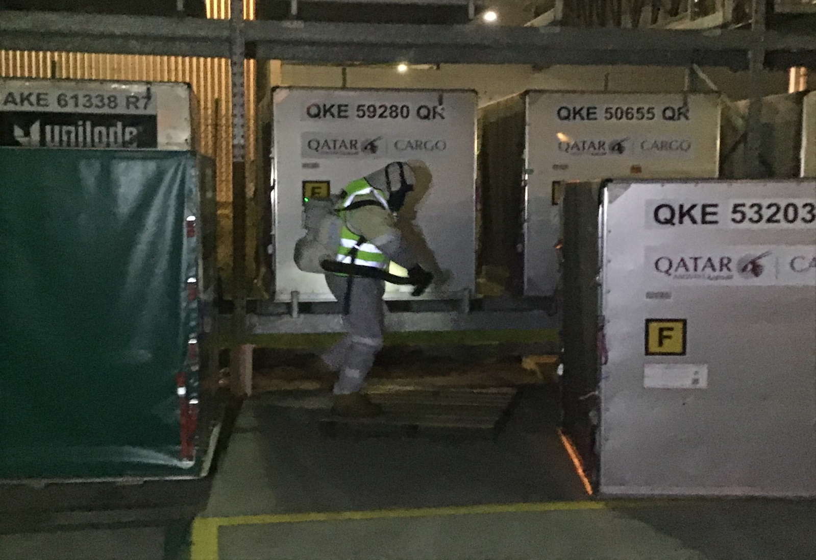
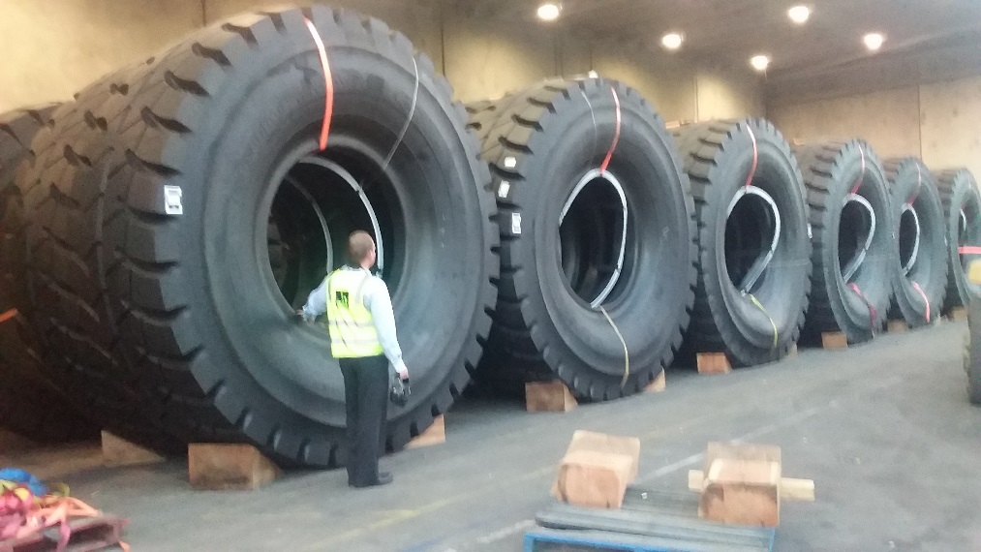
Exotic (invasive) mosquito program
Targets Dengue mosquito & Asian Tiger mosquito
Multi-agency response
Council’s role:
Rapid chemical response
Surveillance trapping

Slide 8
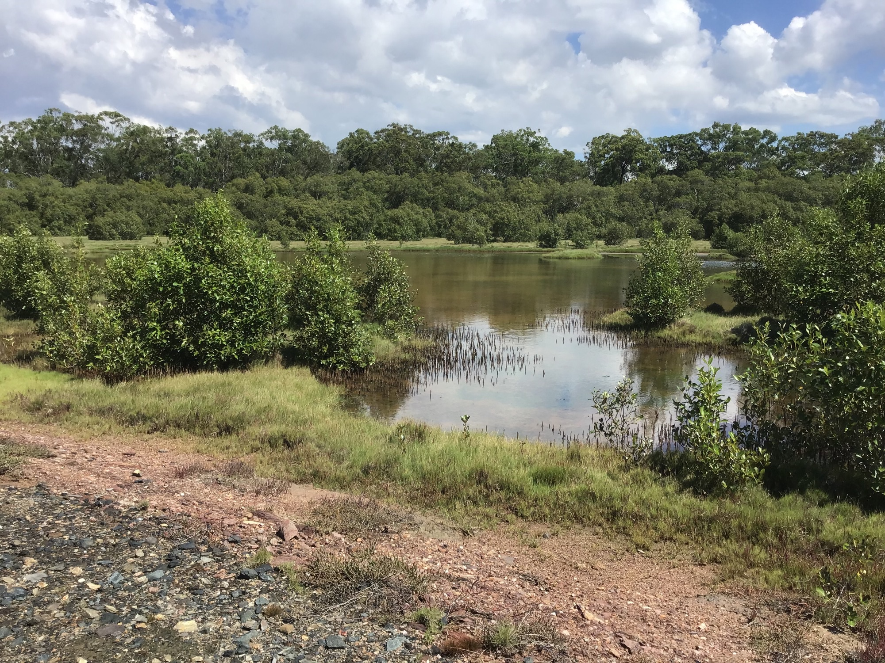
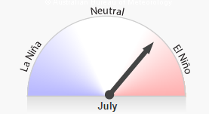
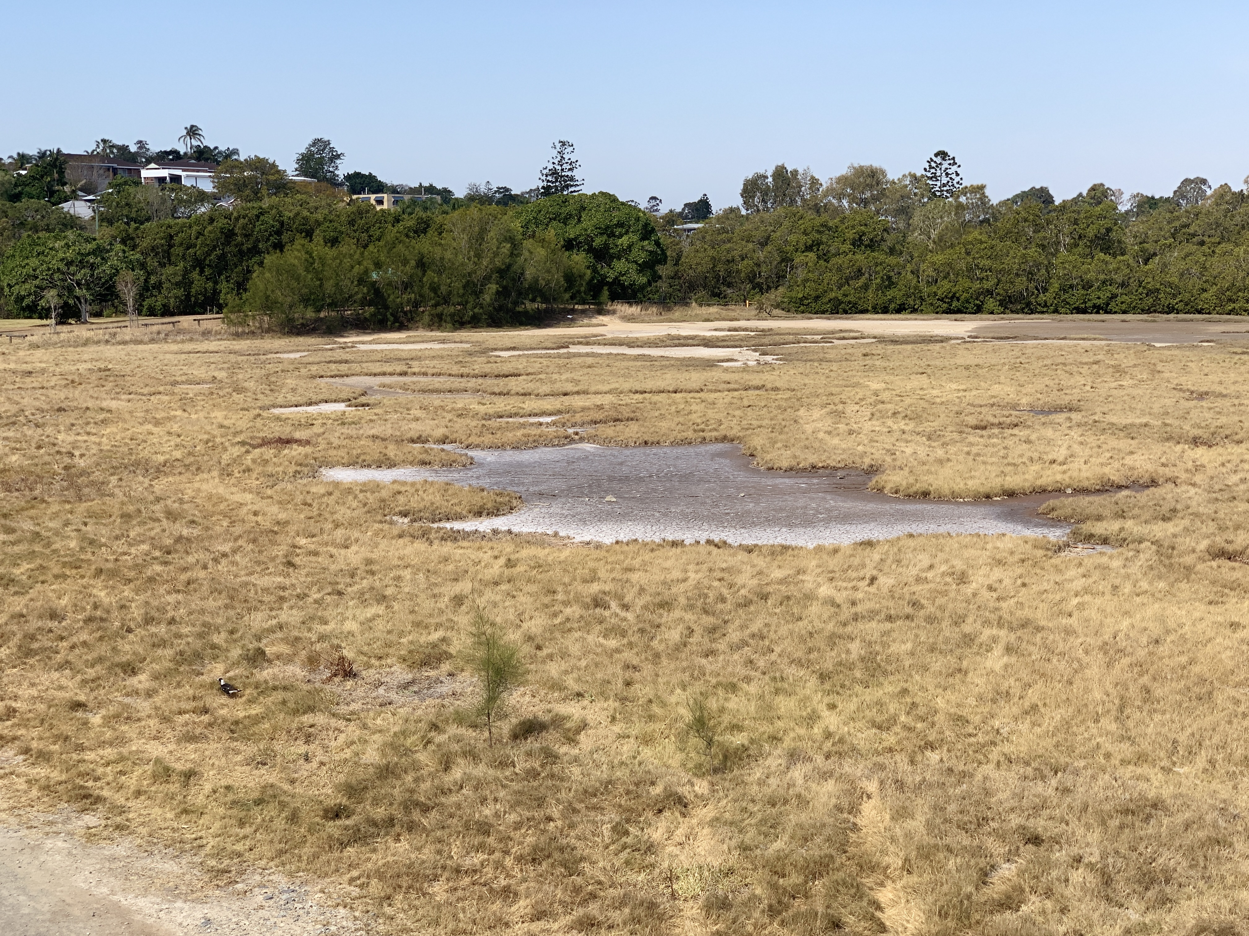
Next season
SOI predicted to shift into neutral or negative phase
i.e. hot & dry
High saltmarsh mosquito numbers
Low freshwater mosquito numbers
SECURITY LABEL: OFFICIAL

Slide 9
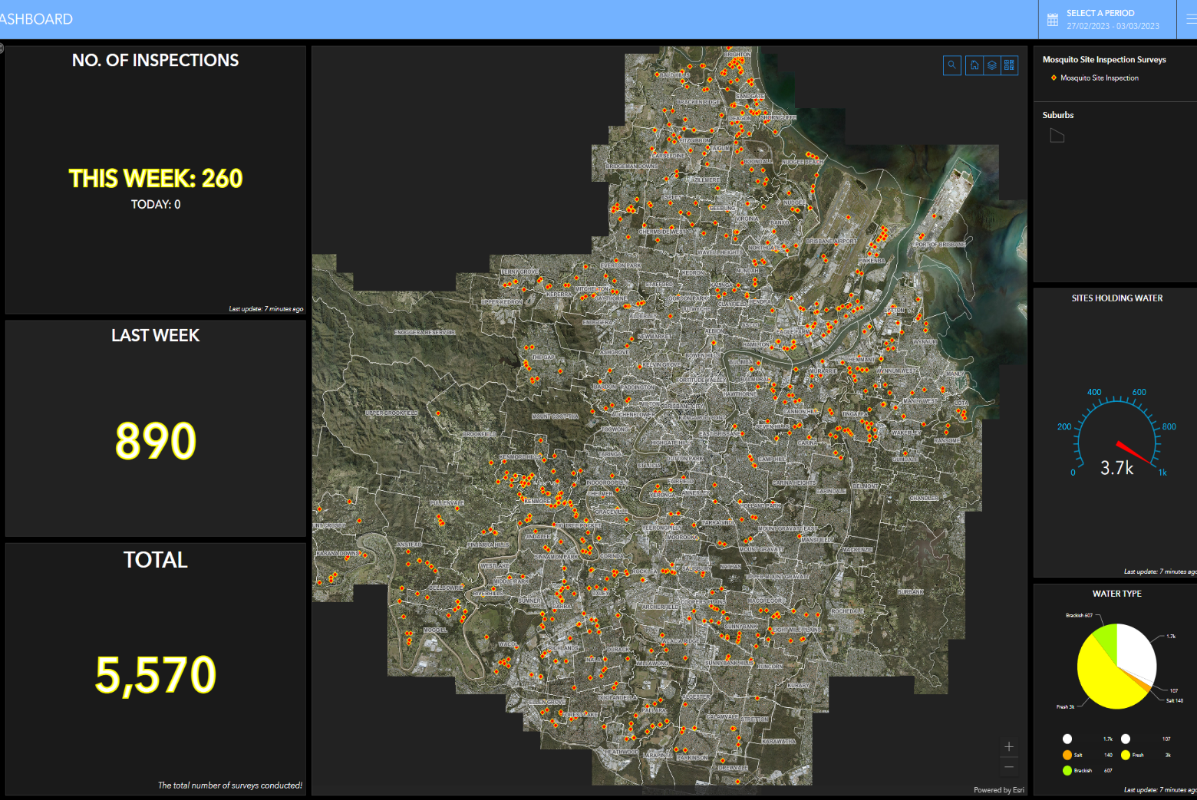
Field data capture
2,500 sites managed weekly
1,100 BAU & 1,400 triggered
Currently trialling an iPad based GIS field data capture system
Will provide:
An inspection and treatment history for each site
User friendly dashboards

Slide 10
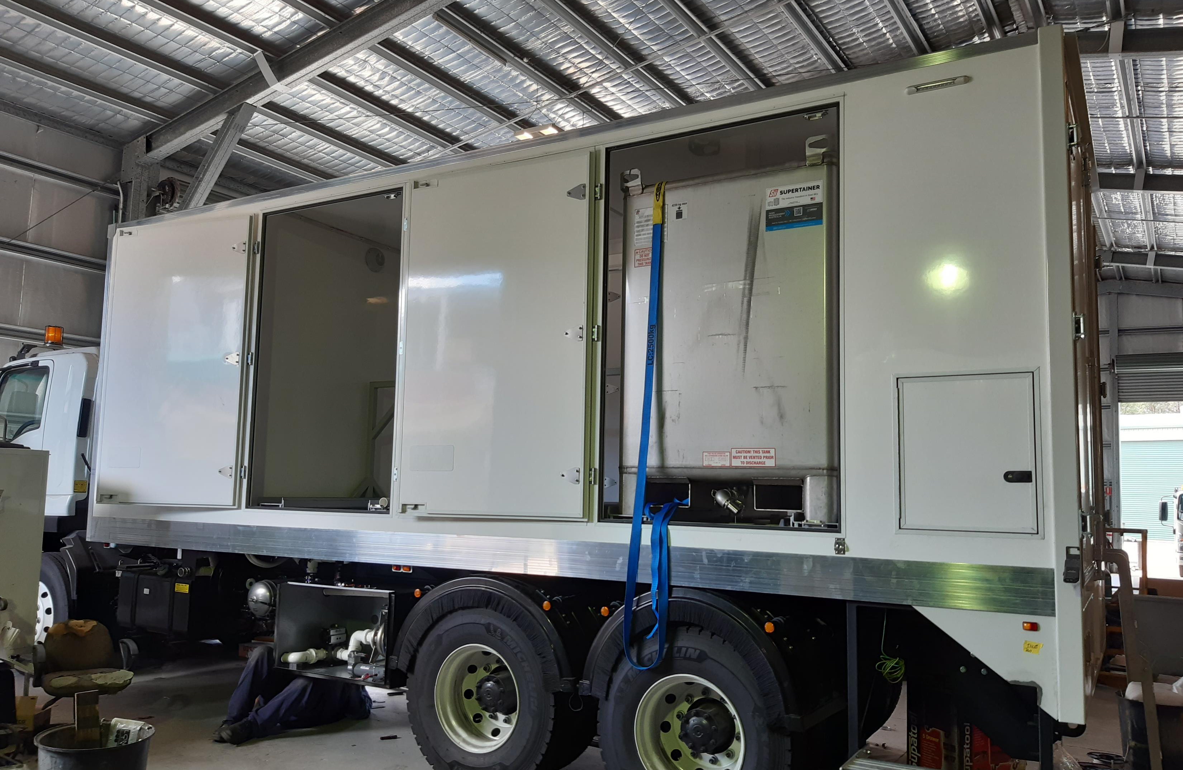
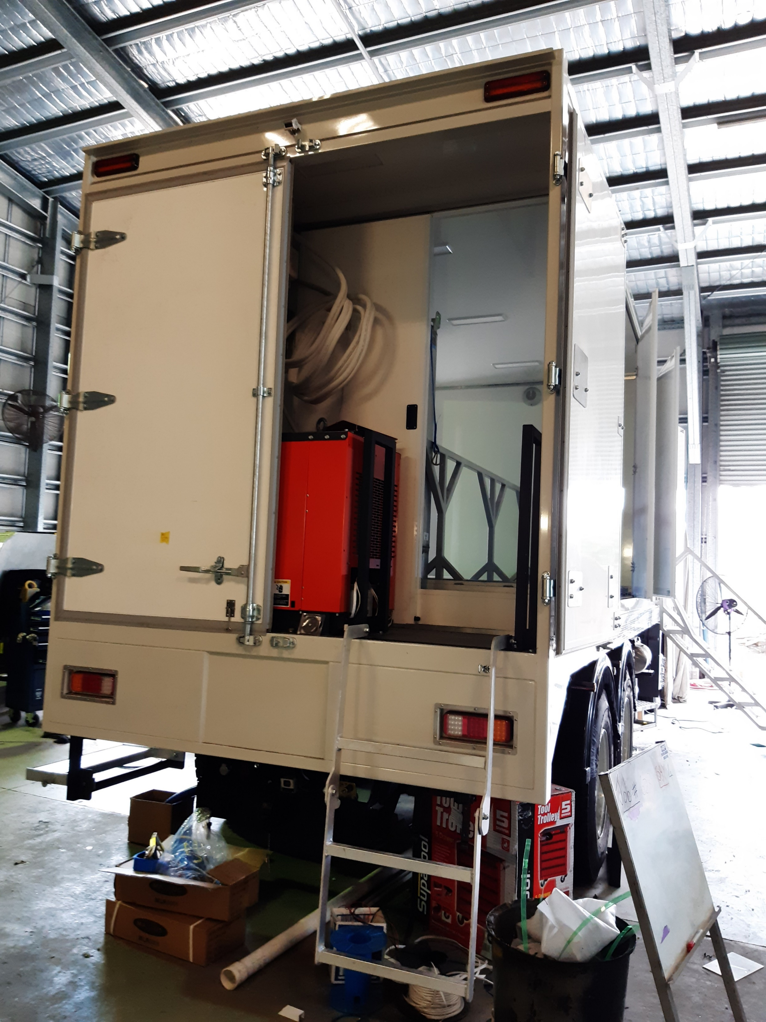
New aerial truck

Slide 11
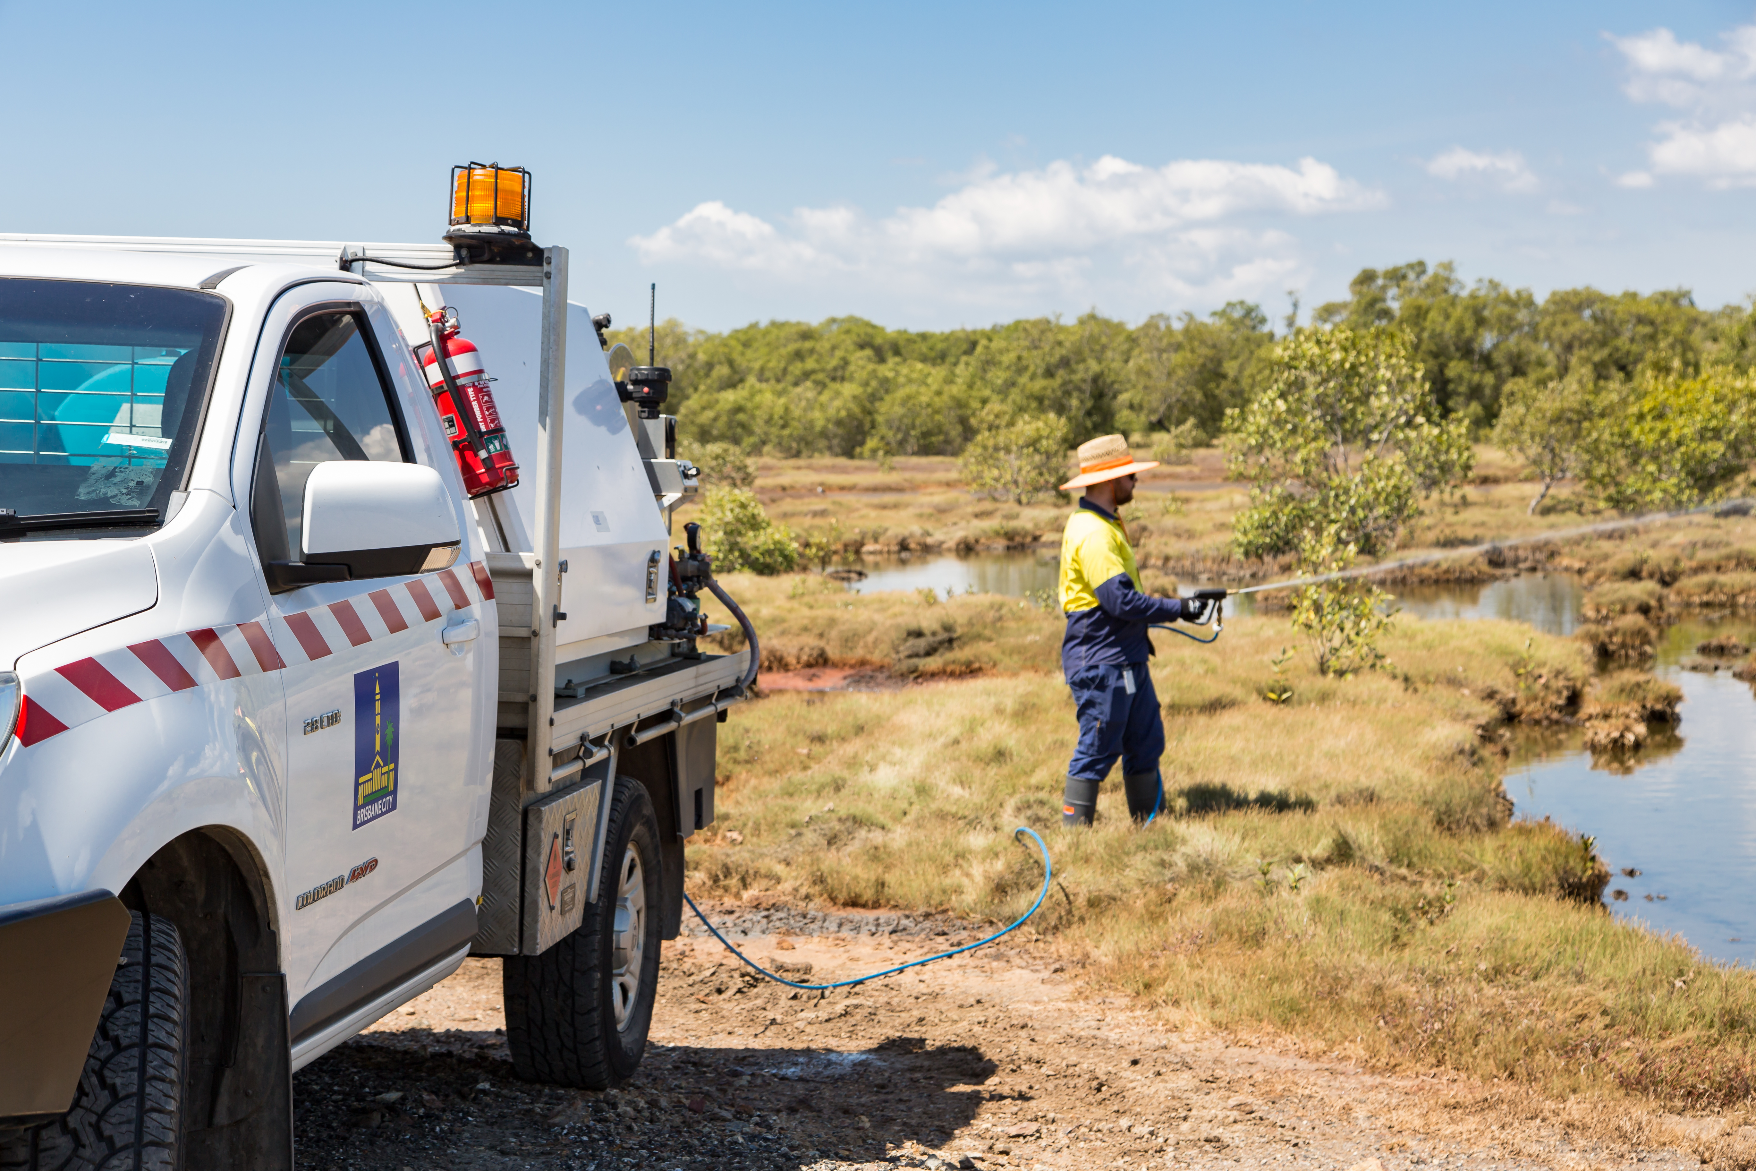
Questions?

