Slide 1
Smart Water Meters
Environment, Parks and Sustainability Committee
9 May 2023
Water, Energy and Environmental Systems Manager
Natural Environment, Water and Sustainability
City Planning and Sustainability

Slide 2


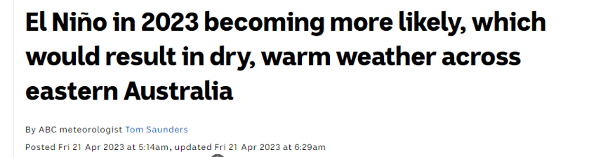
Bureau of Meteorology Forecast

Slide 3
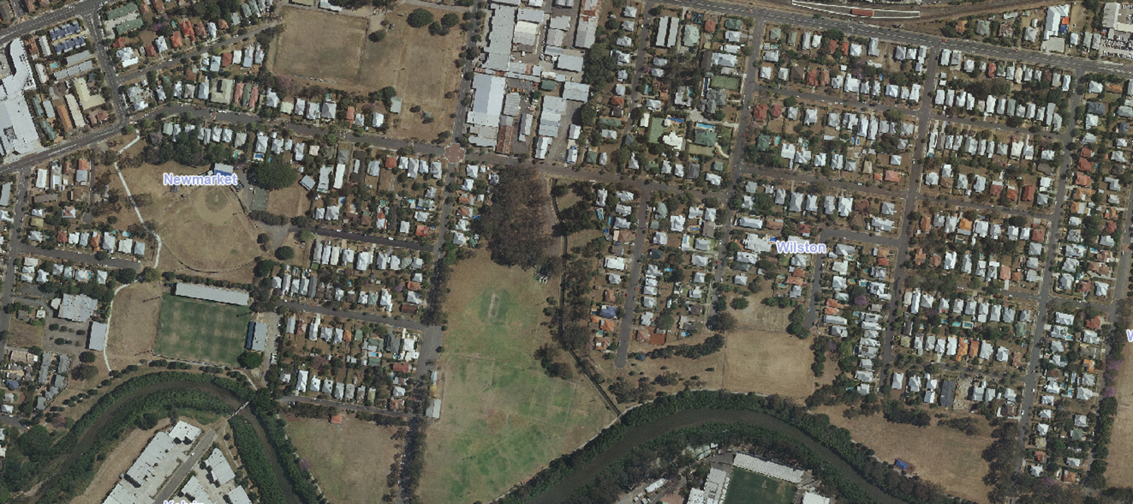
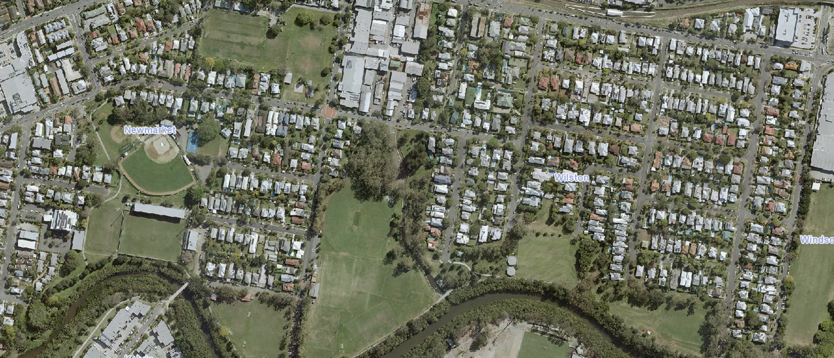
Approach - Sustainable Water Use
2009
Downey Park and
Enoggera Creek
2023
Downey Park and
Enoggera Creek

Slide 4
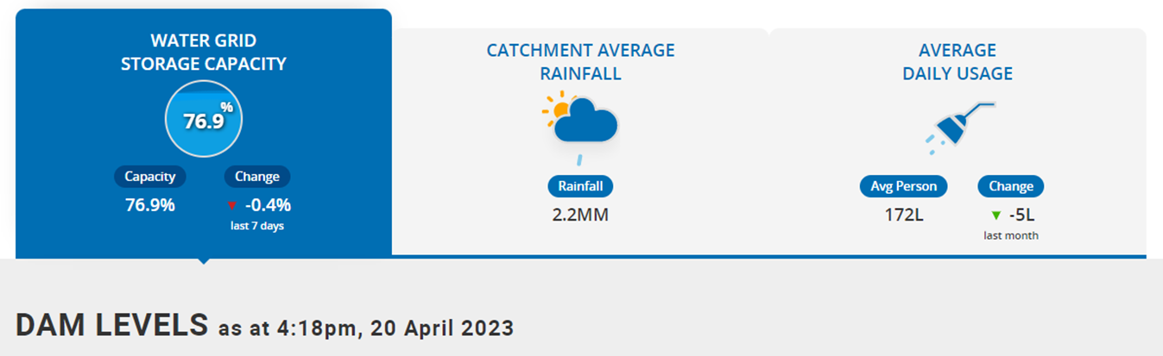


Roles have changed since the last drought
Seqwater manages the SEQ Water Grid and the Drought Response Plan
  Drought response is triggered when Water Grid reaches 60%
  Water restrictions is introduced when Water Grid reaches 50%
Urban Utilities manage water distribution and sewage services. Implementation of water restrictions
Brisbane City Council manages our own operations, sustainable water users and complies with water restrictions

Slide 5



Council’s commitment to Sustainable Water Use
Our commitment to Sustainable Water Use:
“Water is Brisbane’s most precious natural resource and central to the city’s identity and liveability.”
“Brisbane is a resilient, water smart city that uses water sustainably and protects its waterways”
Our approach to Sustainable Water Use:
Monitoring water use
Reducing water use, where possible
Replacing potable water with non potable water, where practical

Slide 6
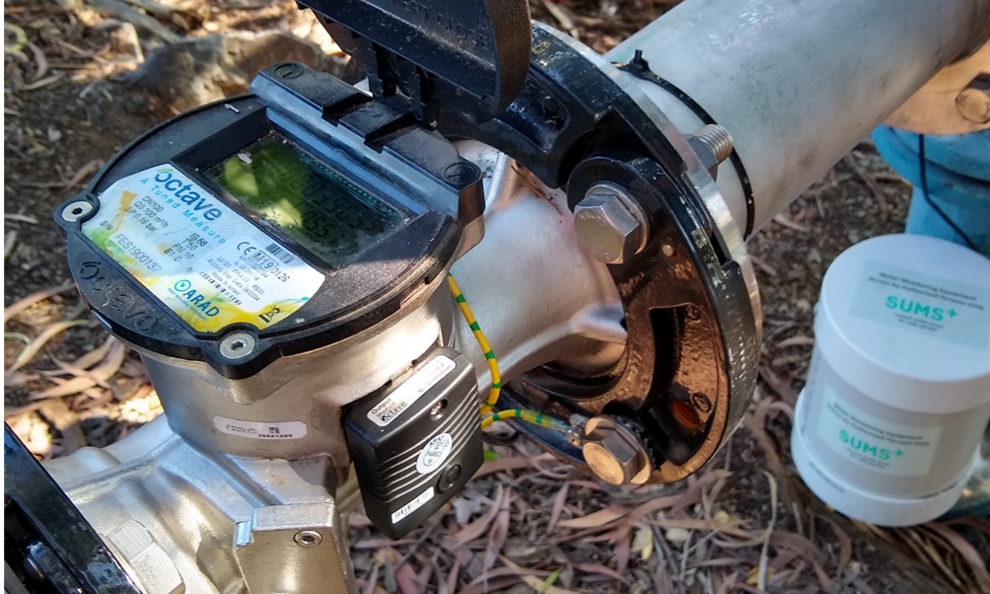
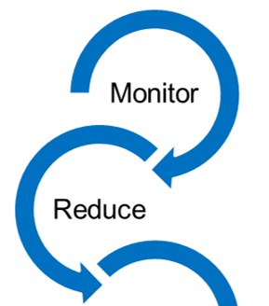
Smart Water Meters
Measure water use in real time
Allow the user to quickly identify unusual water use

Slide 7
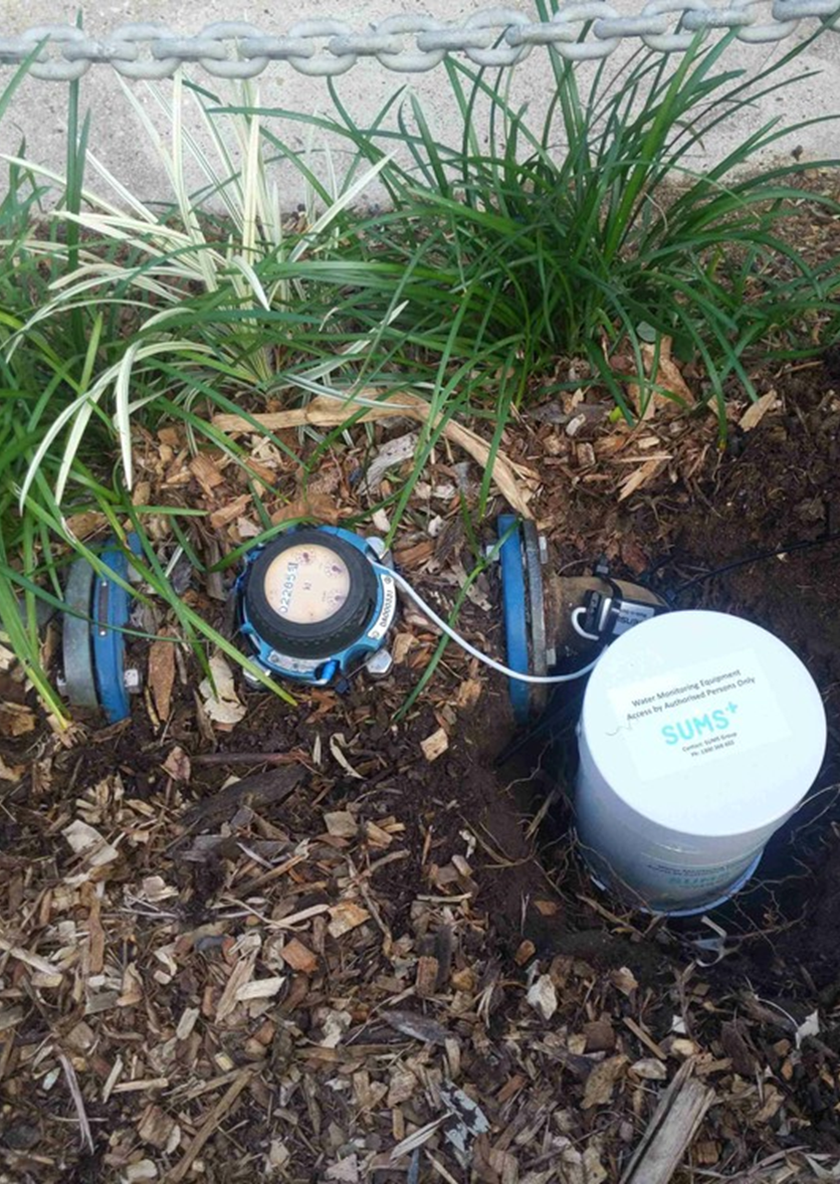
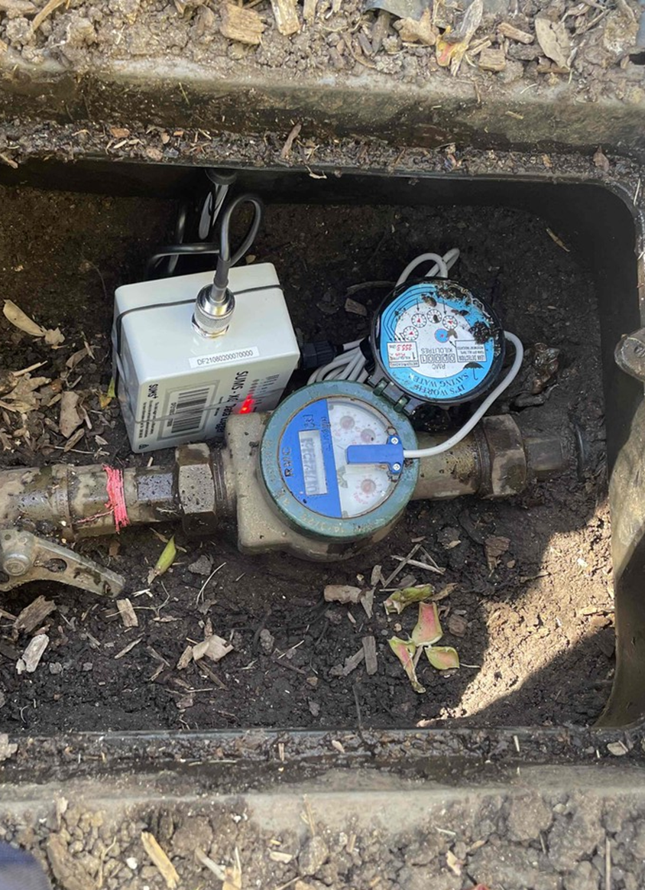
Smart Water Meters
Data logger retrofitted to a normal water meter
Records volume of water passing the meter
Uploads the data every 6 hours to a web-based portal for staff to review

Slide 8
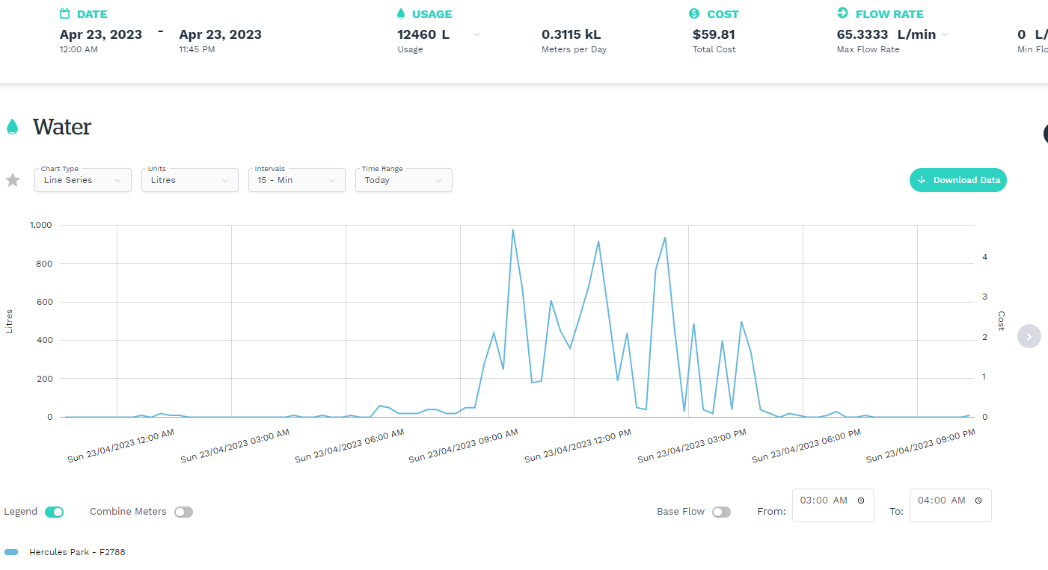
What does the portal look like?
Daily graph showing daytime water use (as expected) and no flow overnight
No leaks!

Slide 9
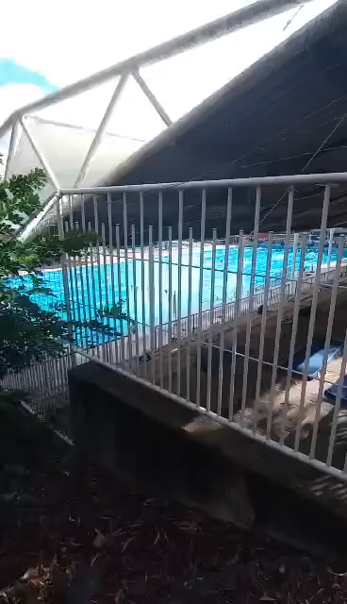
Water Smart Meters in use
City Pools

Slide 10
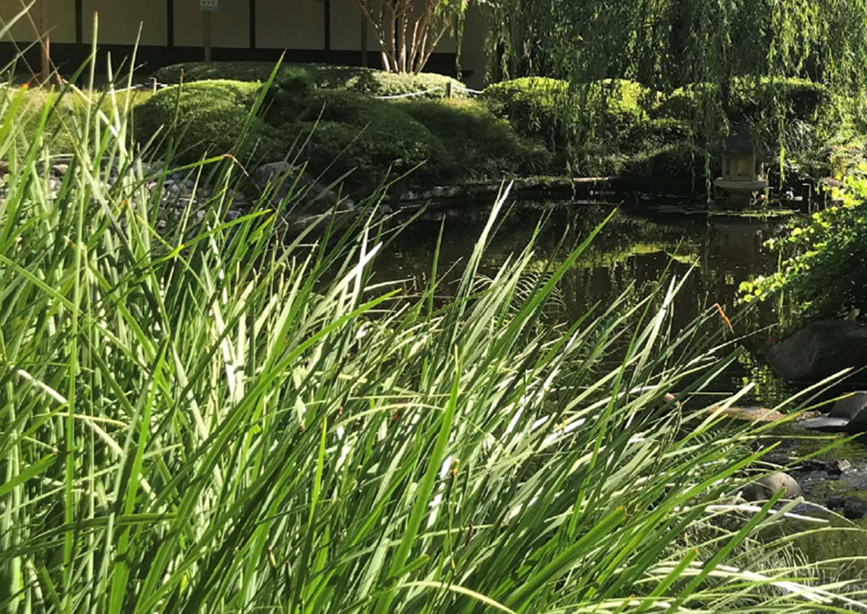
Smart Water Meter Program
95 smart water meters installed at 55 Council assets including:
  Pools
  Parks
  Cemeteries
  Bus depots
>$380,000 savings
  early leak repair
  direct intervention for process changes

Slide 11
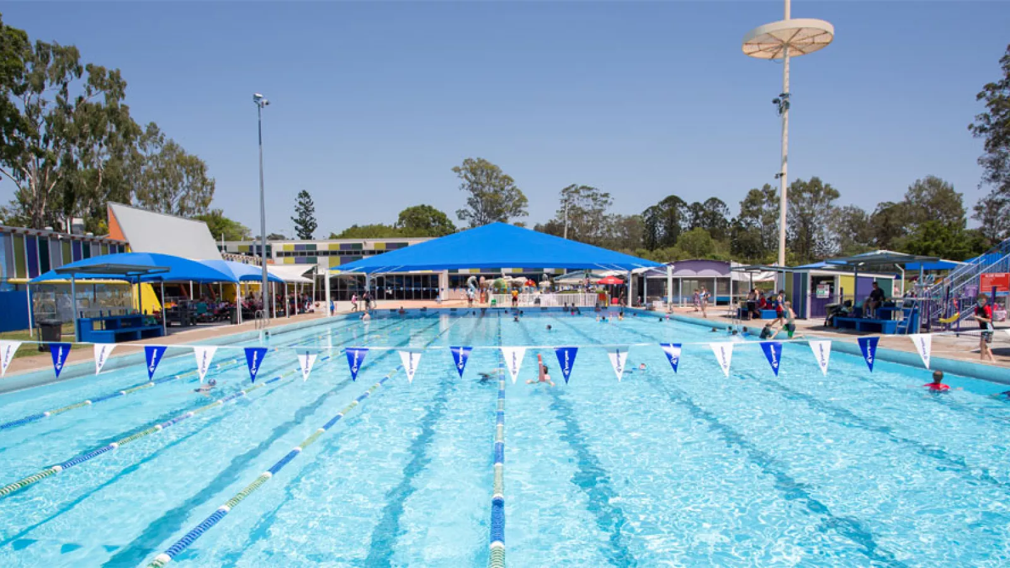
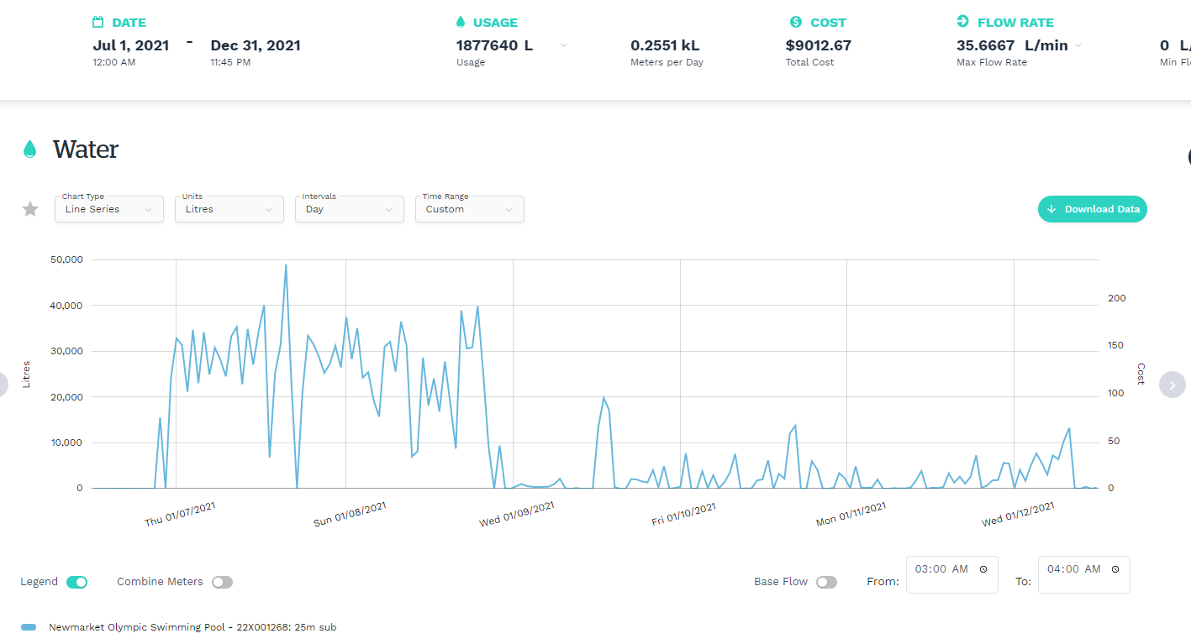
Water Saving case study – Newmarket pool

Slide 12
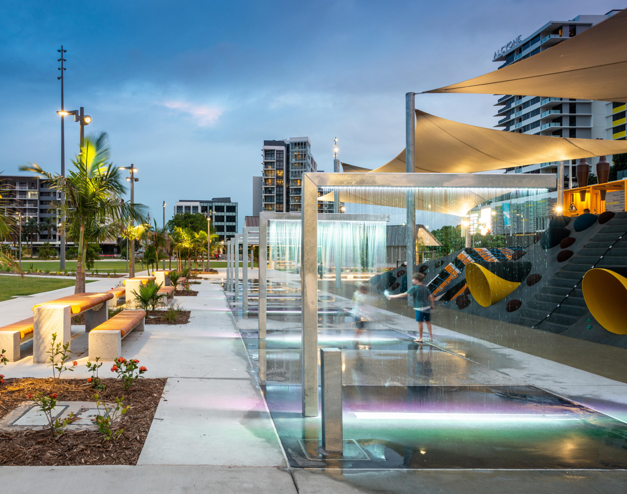
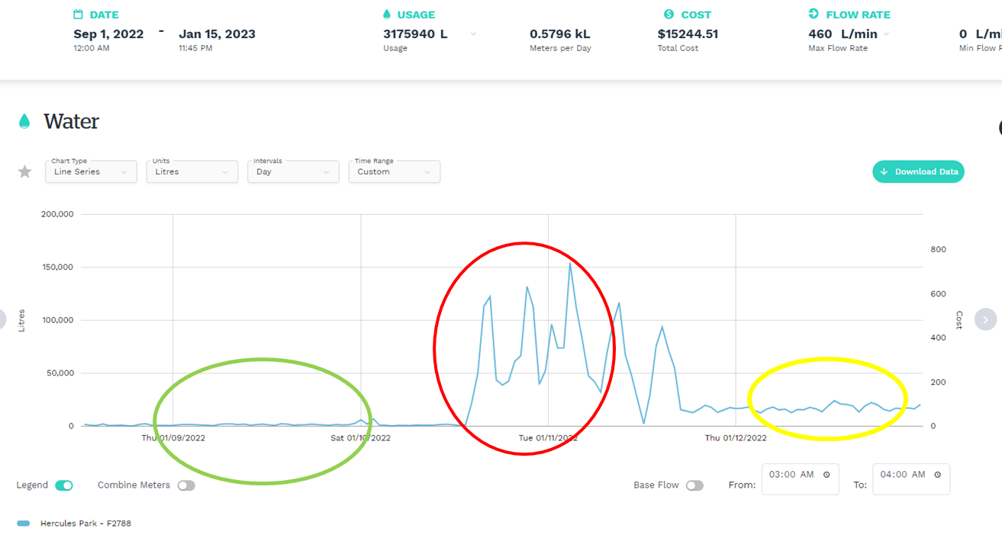
Water Saving case study – Hercules Park

Slide 13
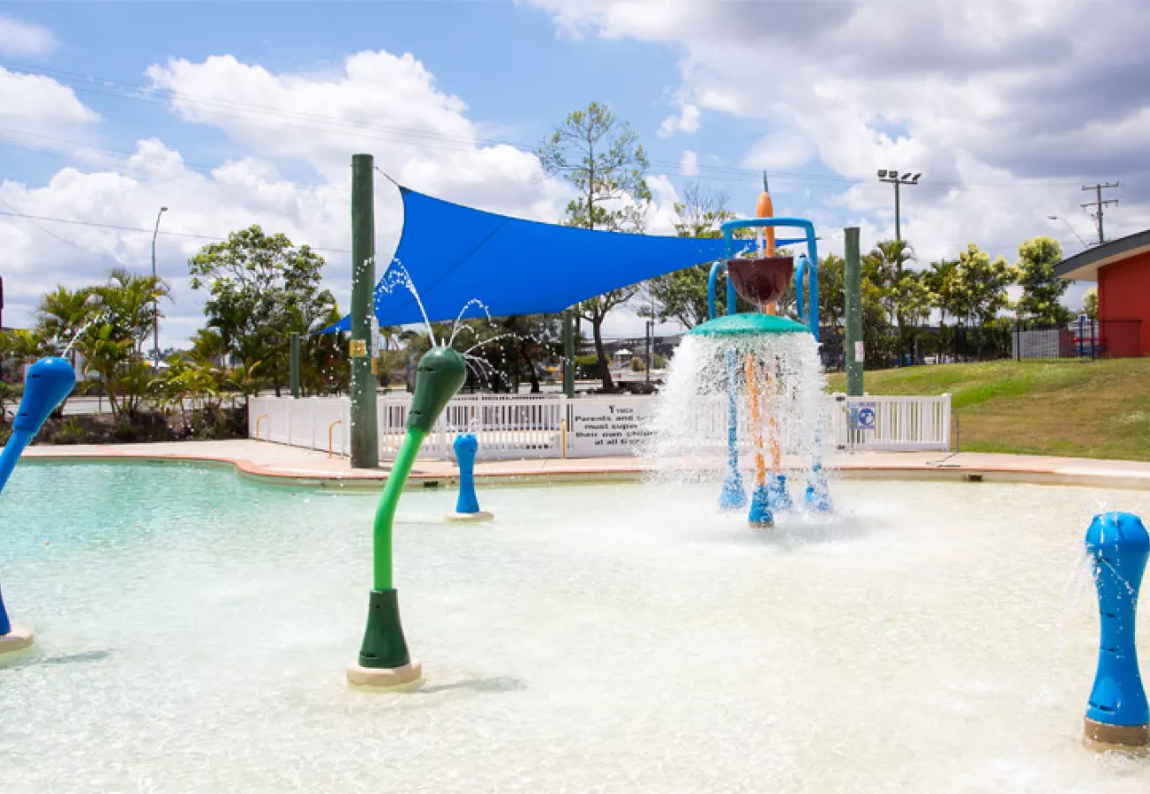
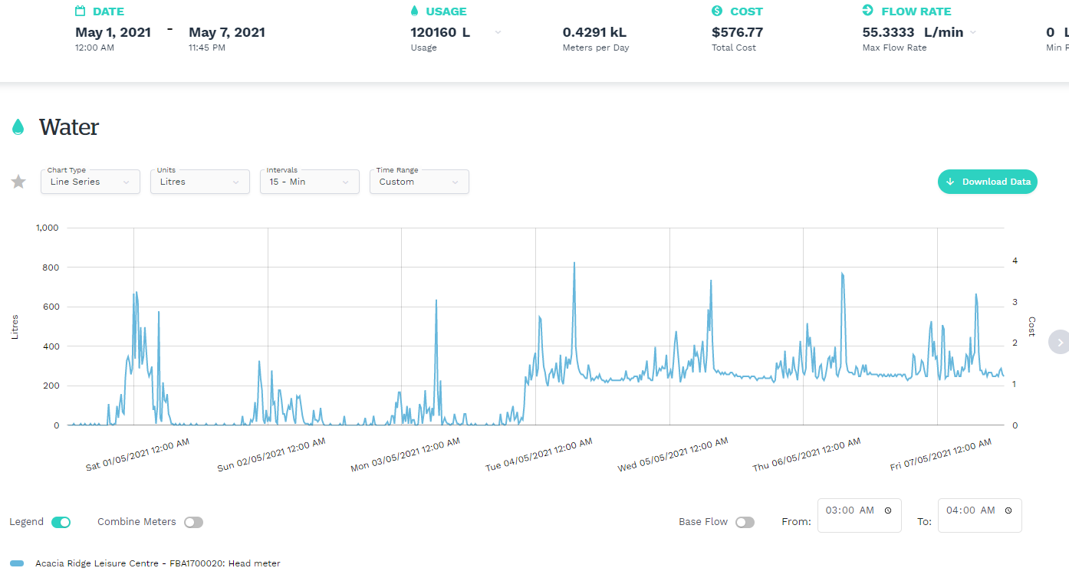
Water Saving case study – Acacia Ridge Pool

Slide 14
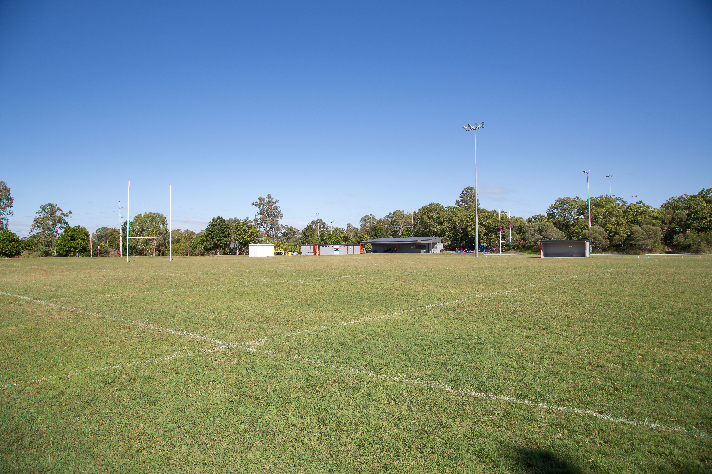
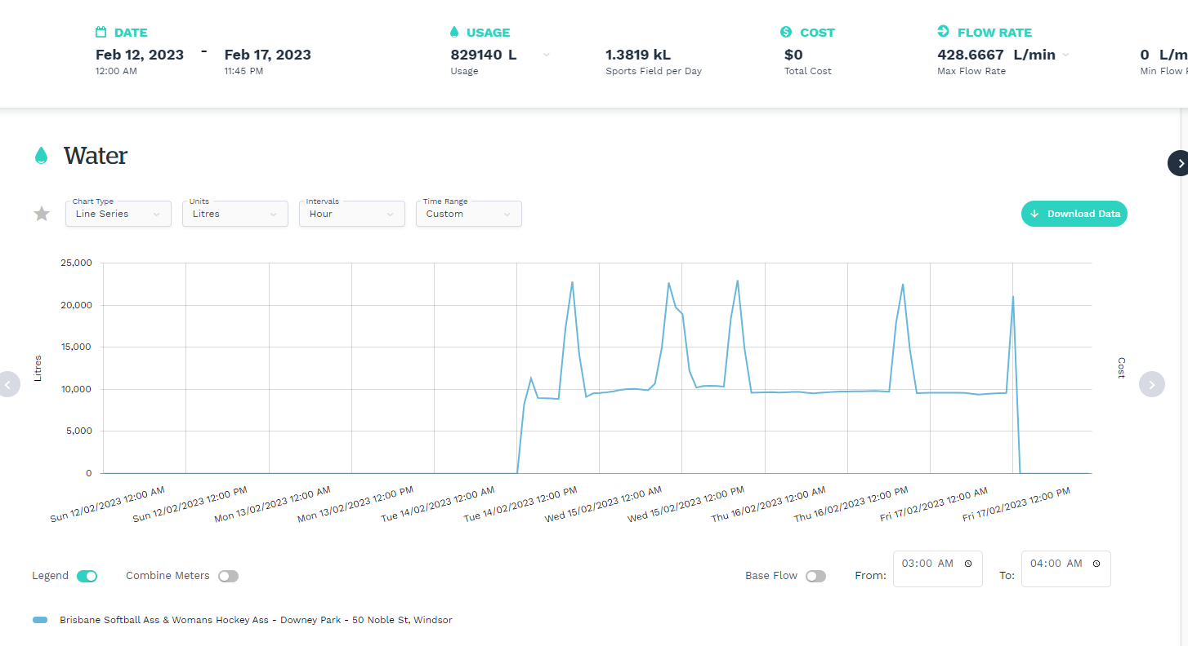
Water Saving case study – Leased sports club

Slide 15
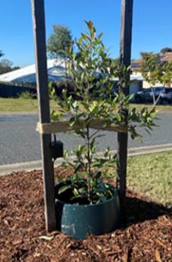
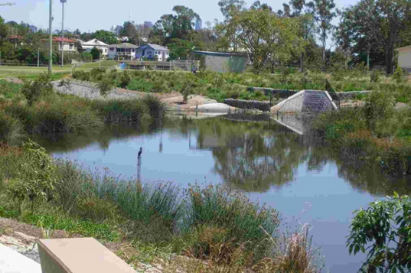
Sustainable Water Use in action
Koala Fodder Plantation
Stormwater Harvesting
Soil Moisture Sensors
Improved Business processes for water monitoring
Water smart street trees
Resilient Clubs Support Program

Slide 16

Resilient Clubs Support Program
An initiative of Brisbane City Council, delivered in partnership with Brisbane Sustainability Agency, the Resilient Clubs Program is designed to support community organisations that lease facilities from Council to optimise their water and energy use and reduce operating costs.

Slide 17
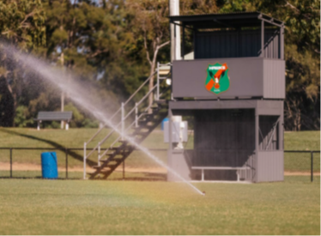


Conclusion
BOM is forecasting hotter drier weather for Brisbane, with an El Nino potentially forming this year
Council is responding and getting ready, but everyone can play a part
For example, residents can do their bit at home:
  repairing their dripping taps
  installing water efficient products and
  choosing drought tolerant plants for their garden

Slide 18
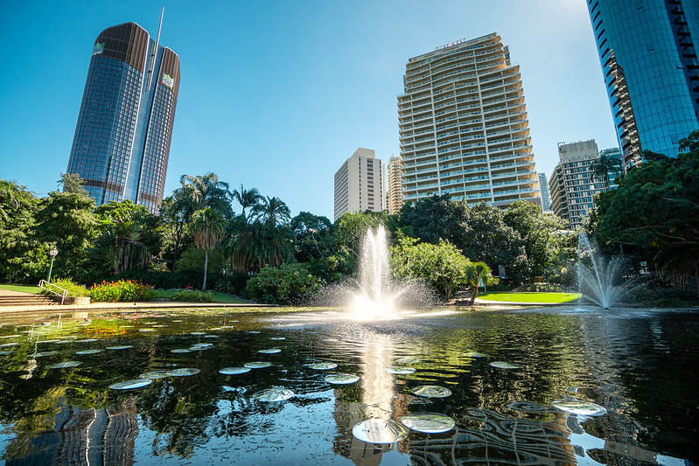
Questions?

