Slide 1
Finance and City Governance Committee
Lord Mayor’s Awards for Excellence
Human Resources Organisational Services
9 May 2023

Slide 2
Purpose - update
Lord Mayor’s Awards for Excellence (LMAE) recognise and reward individual employees and work groups for effort and initiative that is over and above what is necessary to achieve Council goals.

Slide 3
Lord Mayor’s Awards for Excellence
LMAE was initiated in 1992. Two award ceremonies are held in April and August each year.
Annual award ceremony is held in December coinciding with the ‘Brisbane City Council End of Year Thank You Reception’.
LMAE has nine award categories, recognising achievement in:
Customer Service
Environmental Achievement
Health and Safety
Innovation
Leadership in Economic Development
Performance Leadership
Social Justice & Community Development
Working Together
Value for Money

Slide 4
Lord Mayor’s Awards for Excellence
2021-22 Award Ceremonies
54 nominations for individuals and teams
1 overall winner
14 Lord Mayor Award Certificates
19 Lord Mayor Commendations
12 Divisional Manager Commendations

Slide 5
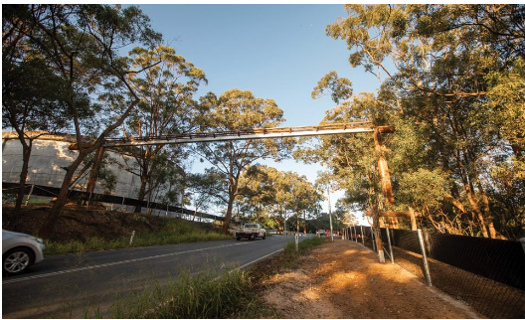
Lord Mayor’s Awards for Excellence
Overall Winner 2021-22
Environmental Achievement
​​​​​​​​​​​​​​​​​​​The Fauna Movement Infrastructure team developed a world-first koala crossing as part of Council’s commitment to conserving biodiversity and reconnecting ecological corridors to allow safe movement of local fauna through and between habitat areas.
Safety of wildlife through transport corridors continues to be a key concern for residents. It is often a challenging, resource-intensive, complex ecological and engineering issue to address.
This bespoke construction is innovatively designed, based on best science and clever engineering and required a high level of consultation and collaboration between branches within Council as well as external technical experts.
The fauna bridge ensures safe movement for Brisbane’s wildlife, reducing injuries and fatalities between habitat areas.
This solution showcases Council’s leadership and ongoing commitment to being a clean, green, and sustainable city.

Slide 6
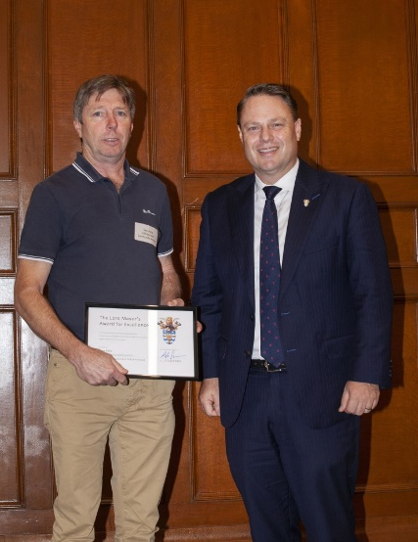
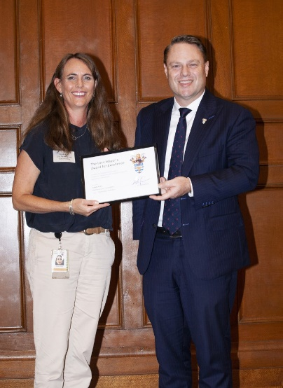
Lord Mayor’s Awards for Excellence
2021-22 Certificate Winners
Environmental Achievement
The Aquatic and Sports Venues Manager proactively and collaboratively developed a new approach to manage water use at all pool sites, to detect leaks and help instruct lessees in correct pool operations using a smart metering portal.
Early estimates indicate operational efficiencies to date have saved up to 313ML of water per year and a further 98ML of potential savings have been identified.
Customer Service
A Senior Program Officer, Natural Environment, Water and Sustainability demonstrated dedication, professionalism, creativity and resourcefulness in providing clarity of process and managing expectations to a diverse variety of internal and external customers and stakeholders.
In 2018 non-profit organisation ‘42 for 42’ made a request to Council to construct a war memorial specifically honouring Afghanistan combat veterans.
Through collaboration with multiple stakeholders, the organisation received guidance and answers needed in a timely and courteous manner to progress the memorial and ensure a result that is a wonderful memorial that honours the fallen and returned Afghanistan soldiers.

Slide 7
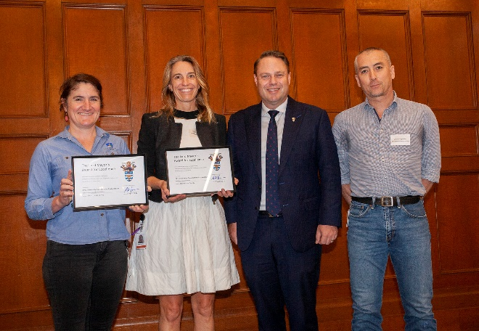
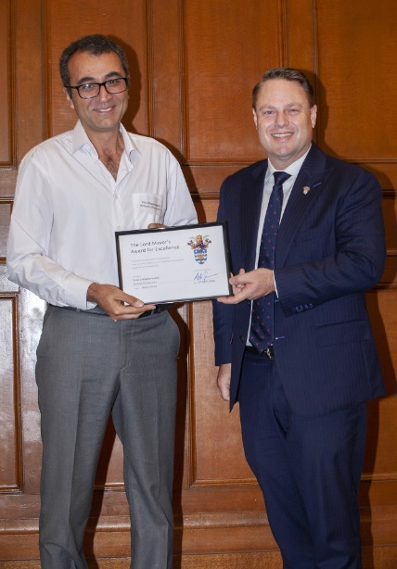
Lord Mayor’s Awards for Excellence
2021-22 Certificate Winners
Health and Safety
The Community Conservations Partnerships Program teams demonstrated unprecedented commitment to ensuring the safety of our workers, volunteers, community and environment.
Council initiated work with Contaminated Land Services and the Closed Landfill Program to undertake proactive contaminated land assessments and develop a citywide inventory of all sites.
The innovate ‘No Dig & Maintenance Bushcare Reference Manual' allows safe access and restoration for the community at sites where ground disturbance is present.
Innovation
An Engineering Surveyor, Planning and Design, showed outstanding ingenuity, innovation and dedication, inventing a device that improves the ease and speed in which survey data in the field can be captured and inputted into 12D field software.
The Rezboard invention reduces repetitive tasks improving data entry and user experience as well as the time and quality of field surveys.
In creating the device, a solution was invented which will have much use in the future for Council staff.

Slide 8
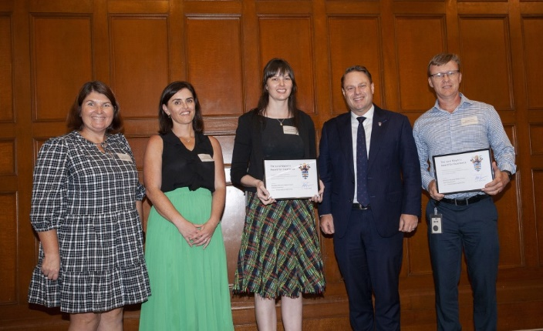
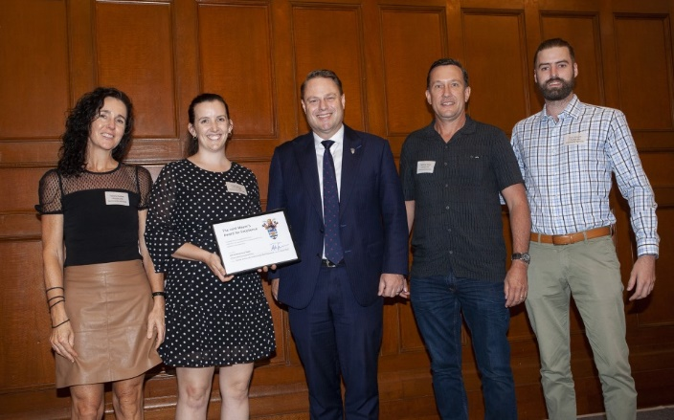
Lord Mayor’s Awards for Excellence
2021-22 Certificate Winners
Performance Leadership
The Economic Recovery Grants Project team designed, developed and delivered important economic recovery programs with benefits to the community, economic growth and employment opportunities.
In response to the COVID-19 pandemic, both the Queensland Government and Australian Government made available economic stimulus packages to local governments to assist local industry and suppliers to promote growth, employment, and longer term community benefits.
Managing 71 diverse projects with a value of $90.5 million on top of business as usual activities, the team navigated meeting grant criteria requirements around reporting, managing variations, financial oversight, and risk management.
This extraordinary effort achieved results for business and the community, but also grew Council’s reputation and therefore prospects for future support and funding.
Social Justice & Community Development
The Safe Communities team delivered effective partnerships to support some of Brisbane’s most vulnerable residents.
During 2020-2021, the team conducted more than 4,590 engagements with people experiencing homelessness.
Wickham Terrace Park has a lengthy history of homelessness with 21 homeless people 'encamped' on the site in July 2021. Partners were brought together to discuss innovative ways to support these individuals and find a solution.
By November 2021, all 21 individuals were housed and the site cleared of all belongings, with sensitivity and empathy during a time of limited affordable housing pathways. The individuals have not returned to rough sleeping since, showing the solution found to be sustainable as well as being a great outcome for the individuals, our partners and residents of Brisbane.

Slide 9
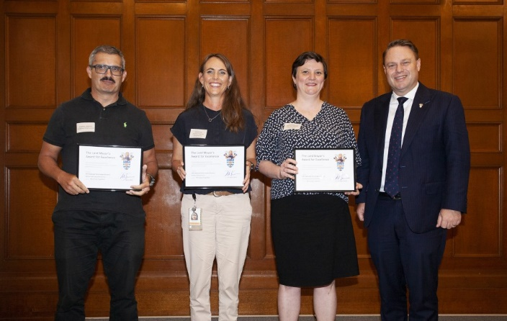
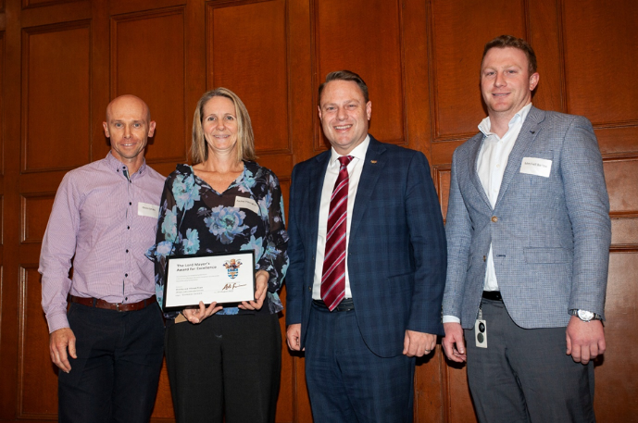
Lord Mayor’s Awards for Excellence
2021-22 Certificate Winners
Working Together
The National Servicemen Project team successfully worked together to deliver a positive community focused outcome.
The 'National Servicemen's Association of Australia' (Nashos) have had a long-standing tenancy at Boundary Road, Wacol, using it for basic training as part of the former Wacol Army Camp. The site now houses six World War II buildings used by the Nashos as well as the New Guinea Volunteer Rifles and PNG Rifles Ex-Members Association Inc.
In 2018 a development approval condition saw the land transferred to Council for community use and open space. However, legislation changes meant Council was not able to grant a lease to formalise the site's continued use by the Nashos.
The teams worked together to determine a resolution to this complex problem and ensure all areas of Council and the National Serviceman benefited. The result has allowed the National Serviceman to continue using the land for training and a place for them to meet and help provide camaraderie and support.
Customer Service
The Healthy and Vibrant team lead immediate, short-term and long-term plans to ensure all assets across the community-leased facilities portfolio impacted by the February 2022 rainfall and flood event are rebuilt better and more resilient.
The team provided exceptional customer service for 650 community tenants as they worked to understand the impact across all assets, collect data, introduce the $5K disaster relief program, and establish the Rebuild and Recover Flood Resilient Communities Program.
Community organisations felt supported during this time of need, which built goodwill with stakeholders. The impact of this work leaves a legacy across community-leased assets as they will be rebuilt better and more resilient.

Slide 10
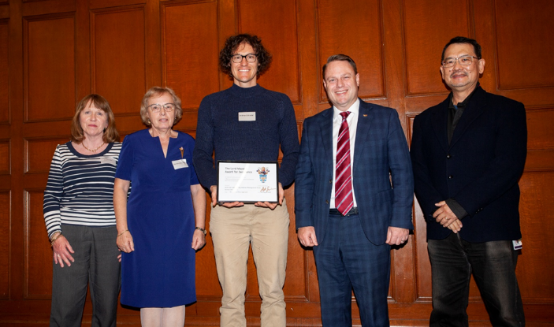
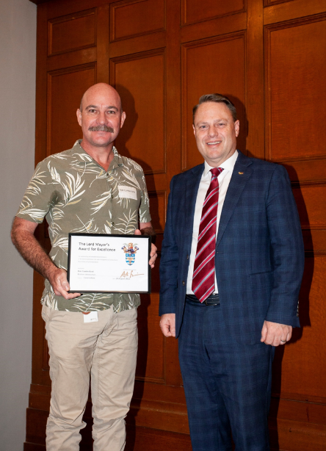
Lord Mayor’s Awards for Excellence
2021-22 Certificate Winners
Leadership in Economic Development
The City Projects Office Contract Management team are responsible for contract administration and delivery of building projects with external contractors.
During the COVID-19 pandemic, the team worked tirelessly for Council’s buildings projects through the changing economic conditions to deliver stimulus package projects and essential infrastructure to the community. They were able to deliver more projects than ever before, even when unable to attend site inspections due to restrictions and through material shortages and long delivery times.
Hit with the February 2022 rainfall and flood event, the team further adjusted to extreme and larger than normal workloads, consistently making a strong contribution to the successful delivery of outcomes for various Council programs of work. They managed this in a professional way whilst being innovative in managing workload and relationships with all customers and stakeholders.
Innovation
A Planner Estimator, Structures, was proactive and innovative in identifying that the rain forecast in February 2022 could potentially affect structural assets and developed a flood app. The app allowed a greater number of inspections to be performed as well as collect information and prevent duplication of inspections.
Initially this flood app was used by internal structures staff and external resources but an addition of a QR code linked to the flood app ensured a wider audience could easily access it.
1,104 inspections and maintenance reports were captured and the data was used to categorise assets for risk and scope of works and plan to effectively respond to asset damage.
A program was then developed to automatically identify 5,000 photos, determine the locations, associate it with relevant assets data and upload it to be saved. This program saved four weeks of manual administrative work providing a structured approach to asset damage and a significant reduction in manual collating of flood recovery data.

Slide 11
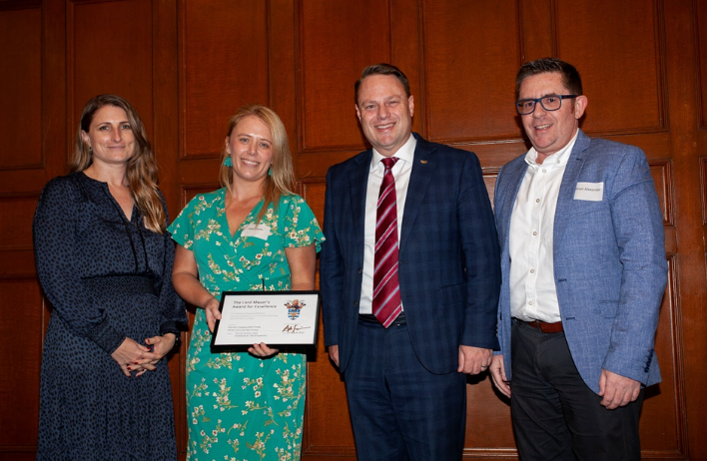
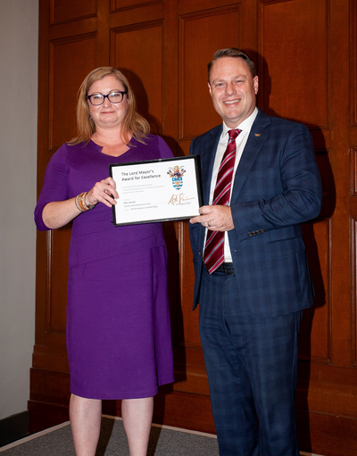
Lord Mayor’s Awards for Excellence
2021-22 Certificate Winners
Social Justice and Community Development
Recognising the positive impact creative programming has on the wellbeing of our community and the sector, the Creative Communities team worked tirelessly through the pandemic to continue to deliver all 14 creative cultural programs.
COVID-19 has had huge impacts on the creative sector of Brisbane, with reductions in creative programming affecting the community and performers, artists, and the creative sector more broadly.
Some programs underwent changes including audience restrictions, ticketing, seating maps, QR check in codes and wearing of masks, but continued to be delivered.
The dedication and ability to work together resulted in providing residents the ability to safely connect with their community and friends.
Performance Leadership
The Manager, Library Services is recognised for delivering clear compassionate leadership and steadfast alignment to Council values for the benefit of customers. Supporting leaders and teams to not only deliver to our customers, but drive a positive culture.
Working tirelessly with over 70 leaders and in partnership with employee teams, leadership behaviour statements and key values for all leaders were developed. This maximised the benefits of leadership development, increasing outcomes and ensuring wider participation in decision making from leaders.
The introduction of a business improvement function also created change initiatives that enhanced employee and customer experience, in line with Library Services core values and Council's vision.
Culture Pulse survey results support the changes initiated and had a significant positive impact on branch culture especially in themes of trust, safety, and connection.

Slide 12
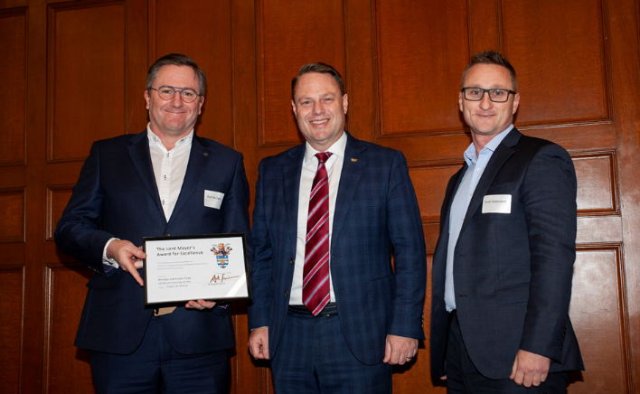
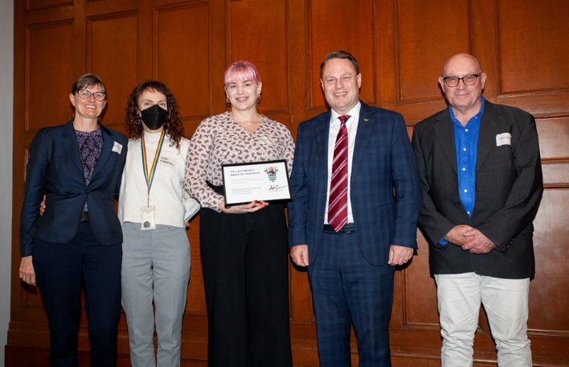
Lord Mayor’s Awards for Excellence
2021-22 Certificate Winners
Value for Money
Construction of the Minnippi Golf Course began in 2020. An excellent value for money outcome was negotiated for services to the community and facility maintenance.
By applying strong commercial acumen and good governance, an innovative ‘Request for Proposal’ process was implemented. This new approach delivered demonstrable monetary savings for Council to the tune of millions and resulted in value-adding outcomes for the community and the lessee.
Positive feedback was received from unsuccessful tenderers about the process and several other councils around Australia now considering similar approaches in tendering.
Working Together
The Norman Creek 2012-2031 Master Plan was developed via community-led visioning, identifying projects focused on healthy ecosystems, recreation and activity, living with Brisbane's climate and connected communities.
A multi-disciplinary team was tasked with converting this expansive green strip into a large scale, beautiful public space for future residents, promoting local economic vibrancy, rejuvenating the creek and providing a naturalised aquatic environment to enable wildlife adaption.
After four above average flood events which tested the construction methodology, the project was delivered with exceptional scope and budget management, and best practice community involvement. The environmental benefits to water quality, biodiversity, increased habitat, and urban cooling are already evident, and will continue to improve over time to deliver to the community and Council.

Slide 13
Questions?

