Slide 1

Kangaroo Point Green Bridge Retail lease update
Transport Committee
9 May 2023

Slide 2
Purpose
To provide an update on the Kangaroo Point Green Bridge food and beverage opportunities:
  Opportunities
  Procurement process
  Successful operator
      Above-water restaurant proposal
      Riverside café proposal
  Next steps

Slide 3
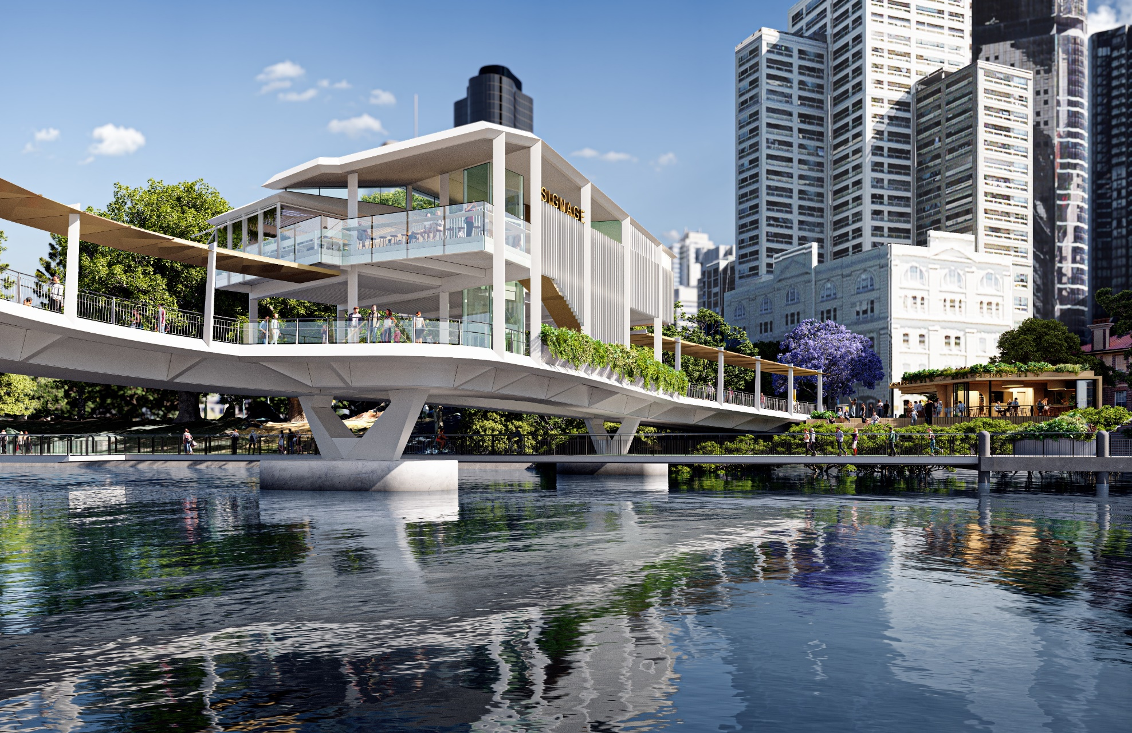
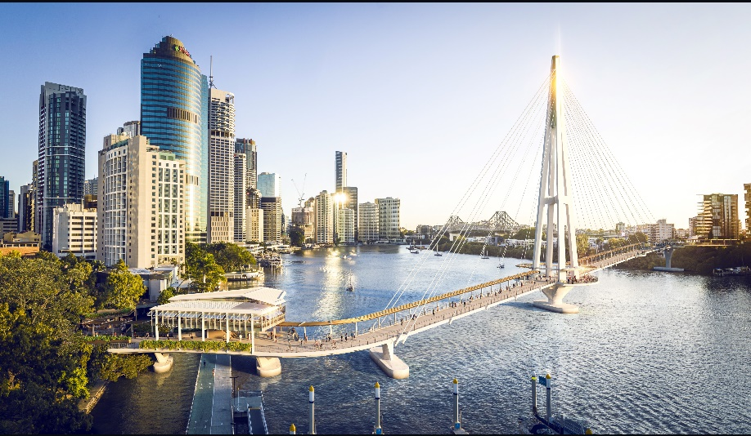
Retail Leases - Overview
Kangaroo Point Green Bridge artist impressions
Source: Council

Slide 4
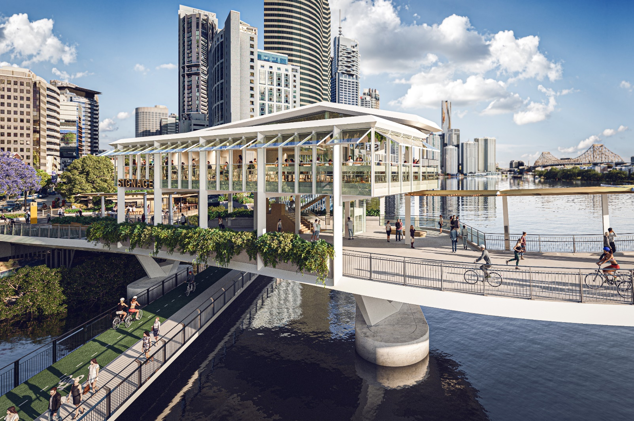
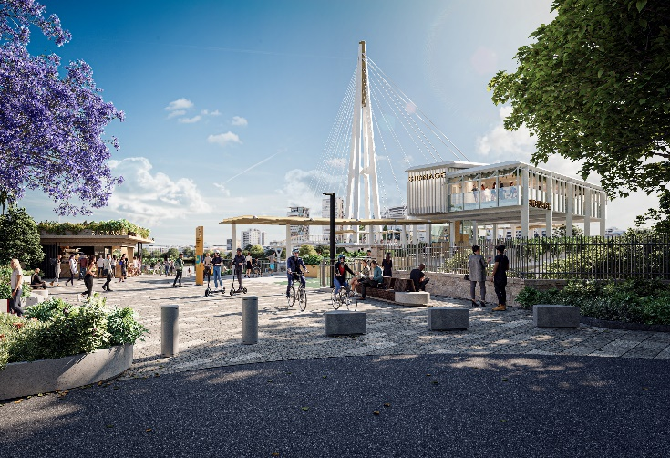
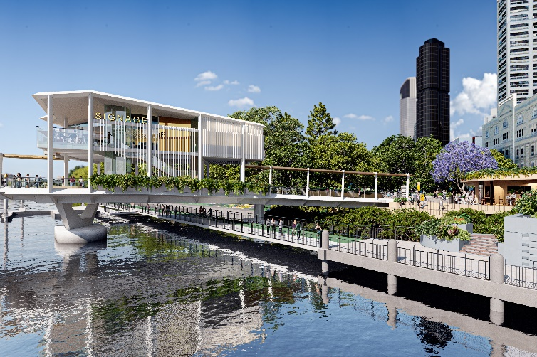
Above-water restaurant and bar
Kangaroo Point Green Bridge artist impressions
Source: Council

Slide 5
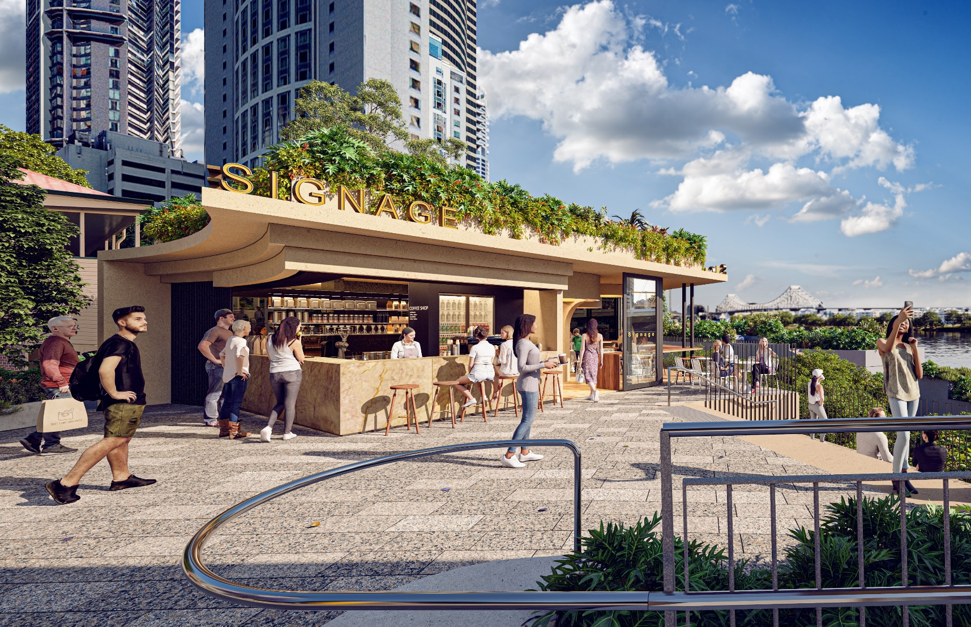
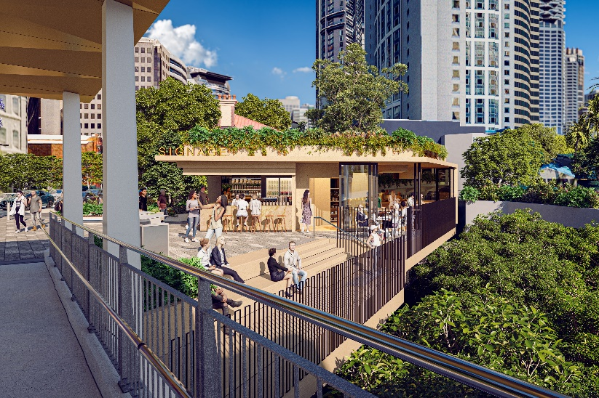
Riverside café
Kangaroo Point Green Bridge artist impressions
Source: Council

Slide 6
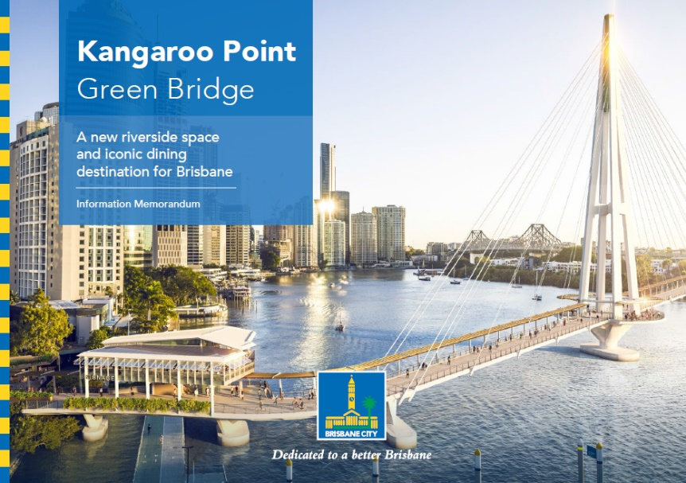
Procurement process
Procurement of commercial operator/s:
Registration of Interest (ROI) released: 17 June 2022
Request for Proposal released (suitable ROI applicants): 20 July 2022
Request for proposal close: 14 September 2022
Council approval: 2 May 2023

Slide 7
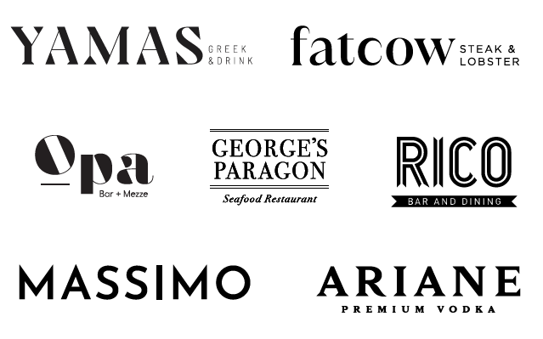
Successful operator
HellasADA Pty Ltd (part of the Tassis Group of restaurants).
Strongest overall commercial offer and tendered the highest base rent for both facilities.
Did not request a Council contribution to the fit-out costs.
High quality materials and finishes.
Commitment to 100% Green Power and re-usable and recycled materials, where possible.
Strong local benefits
  50 direct jobs for the café
  100 direct jobs for the restaurant
  Head office located in Brisbane
  100% of service providers/contractors based in Brisbane
  Supply chain is 99% local

Slide 8
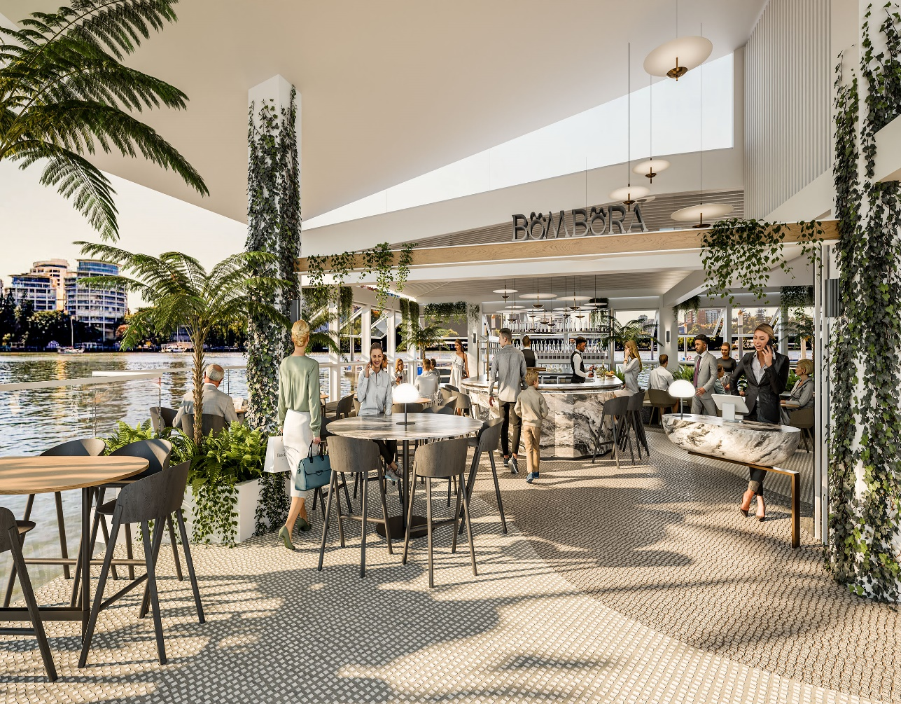
Restaurant and bar offering
Paying homage to its unique location, the restaurant has been designed to evoke moving water, and is appropriately named Bombora, an Indigenous term for large sea waves which break over a submerged reef or sand bar.
Offering locally sourced steak and seafood, Bombora will provide a world-class dining and drinking experience above the water, with a mix of both causal and formal seating including a private dining room.
Above-water restaurant and bar artist impression
Source: Council

Slide 9
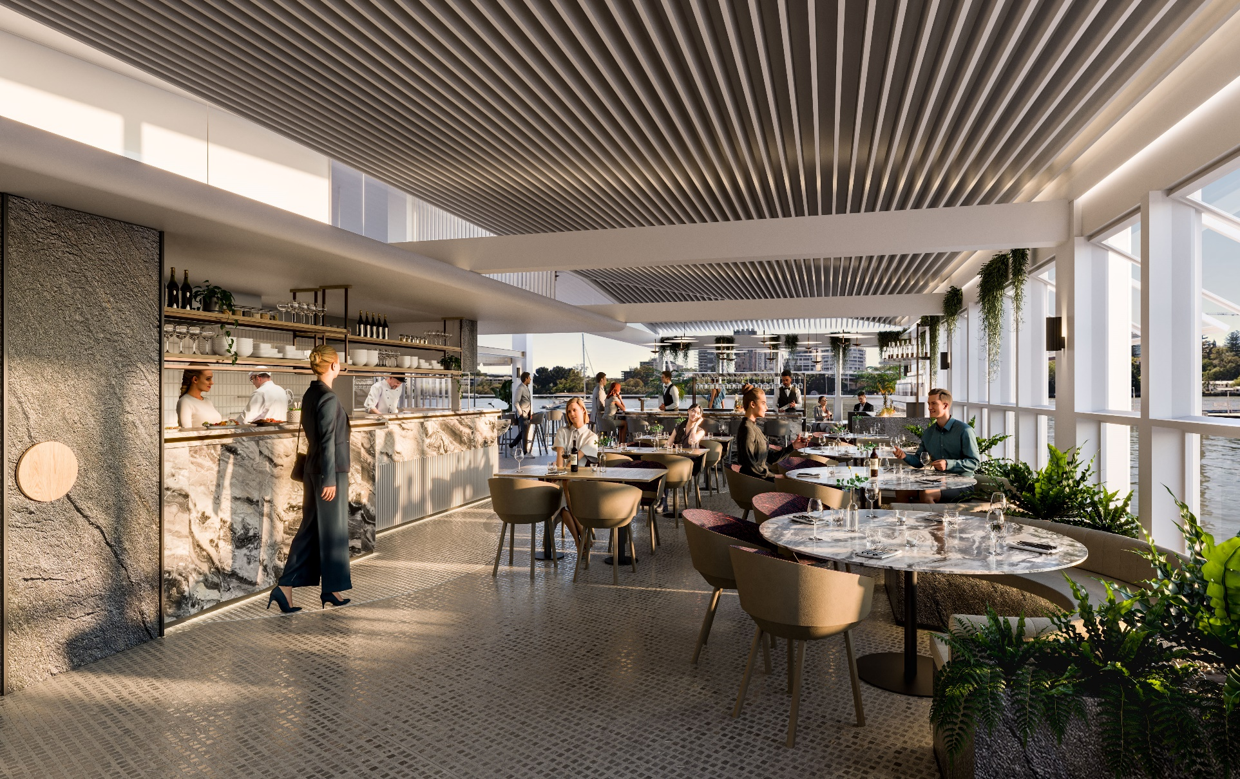
Restaurant and bar offering
Above-water restaurant and bar artist impression
Source: Council

Slide 10
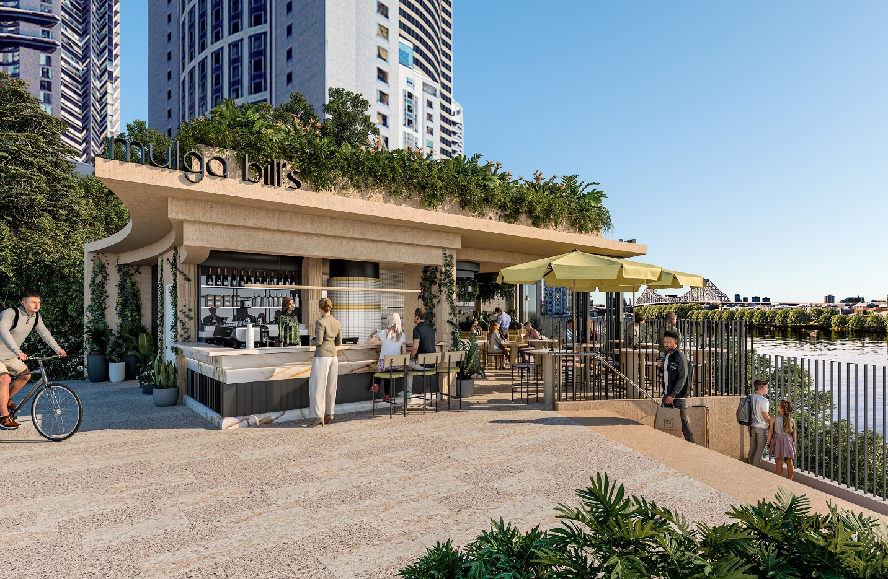
Riverside café offering
Named Mulga Bill’s – drawing inspiration from Banjo Patterson’s poem.
Serving wood fired pizza, steak and seafood, plus grab 'n go offerings including pastries and coffee and the option of picnic boxes to take into the surrounding parklands and public spaces.
Riverside café artist impression
Source: Council

Slide 11
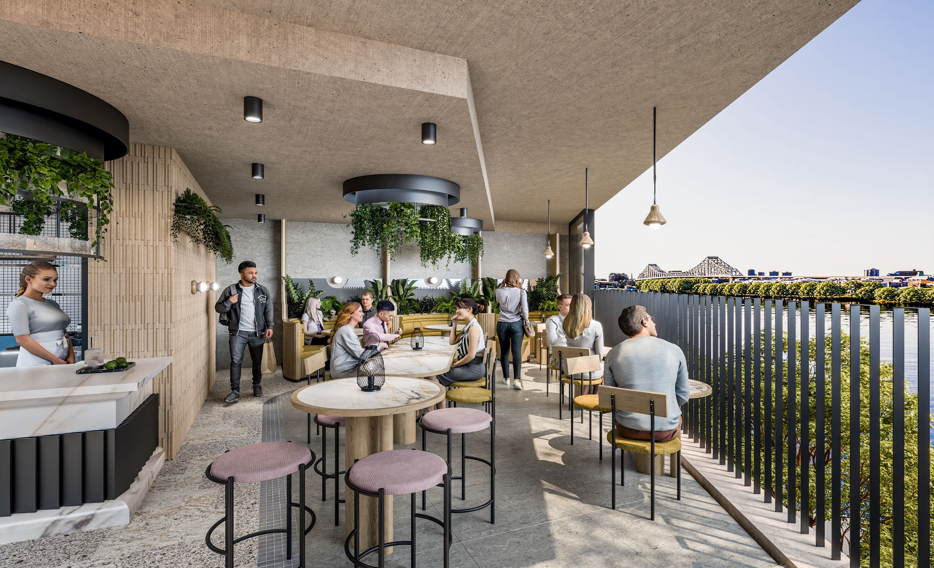
Riverside café offering
Riverside café artist impression
Source: Council

Slide 12
Next steps
Finalise fit-out design
Bridge contractor constructs hard shells
Operator fit-out
Commence operations with bridge opening

Slide 13
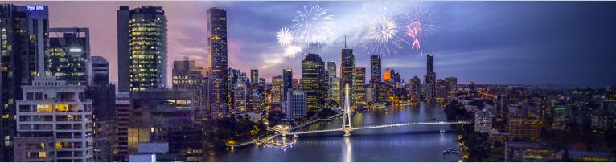
Questions
Kangaroo Point Green Bridge artist impression
Source: Council

