Slide 1
Retrofit Full Driver Barriers to Transport for Brisbane Fleet Transport Committee 16 May 2023

Slide 2
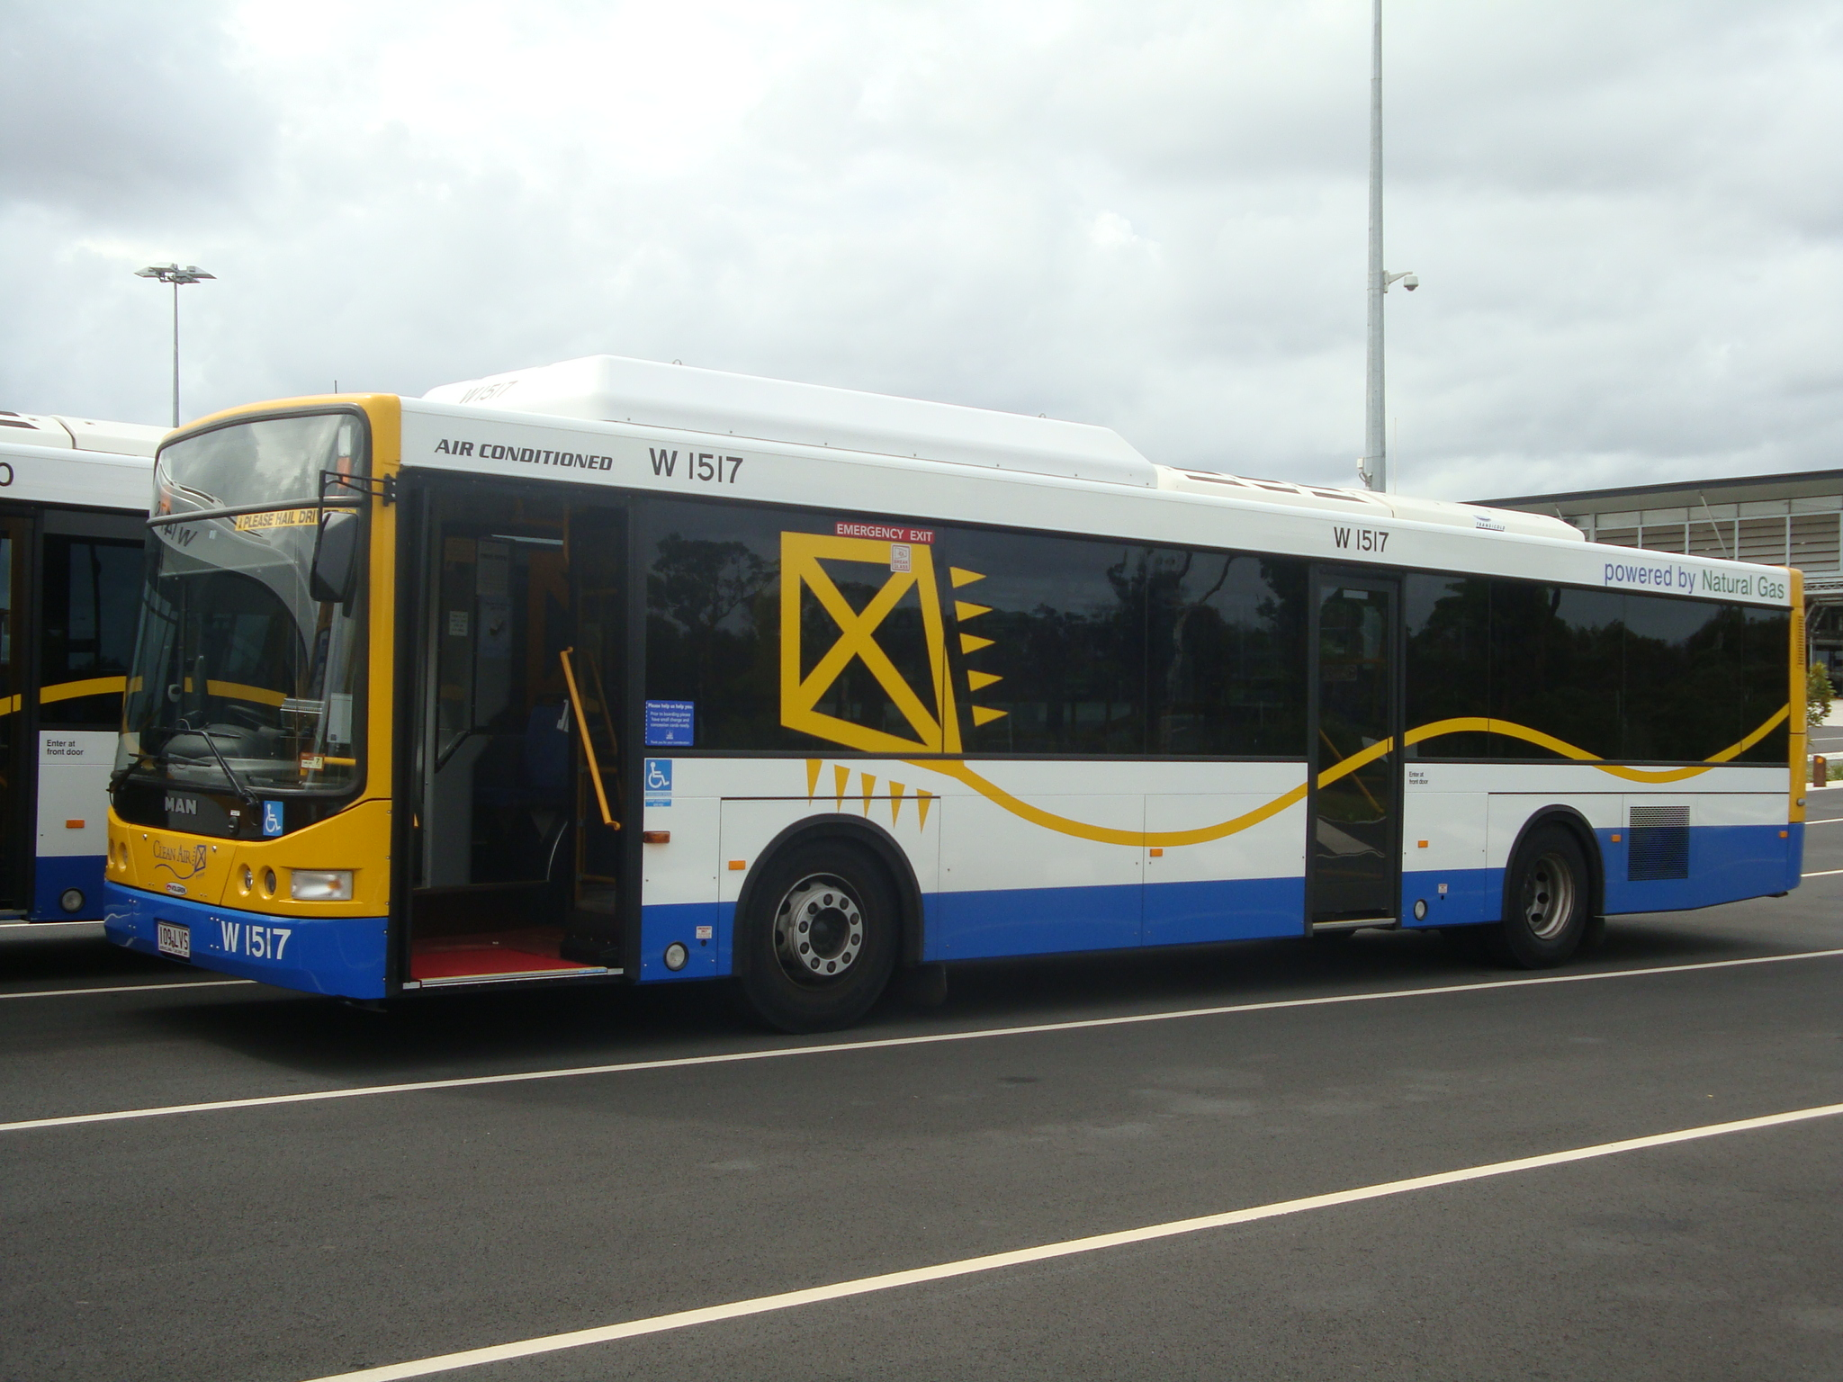
State Government Funding Announcement
25 January 2023 Queensland Government announced “almost $4 million will be invested in rolling out more full bus driver barriers across the public transport network”
$2.6M of this funding is allocated to Council buses
Installation of approximately 150-180 safety barriers
Initial focus is Willawong Depot
Routes 100 & 110
Priority MAN A69 CNG Buses

Slide 3
Full Driver Barrier Design Considerations
Opportunities
Agreement with employees on design performance
Prevent physical assault while the bus operator is seated
Based on successfully trialled barrier in new electric bus fleet
Two piece toughened safety glass
Semi-frameless design
Smart vision Rear View Camera
Reduces the impact of reflection in the barrier
Enhances vision and safety
Emergency Exit modification for driver
Challenges
Existing door and cabin design
Ticketing and cash tray
Vehicle vibration
Location of existing mirrors and cameras
Australian Design Rule approvals
Need for immediate action
Previous poor market response

Slide 4
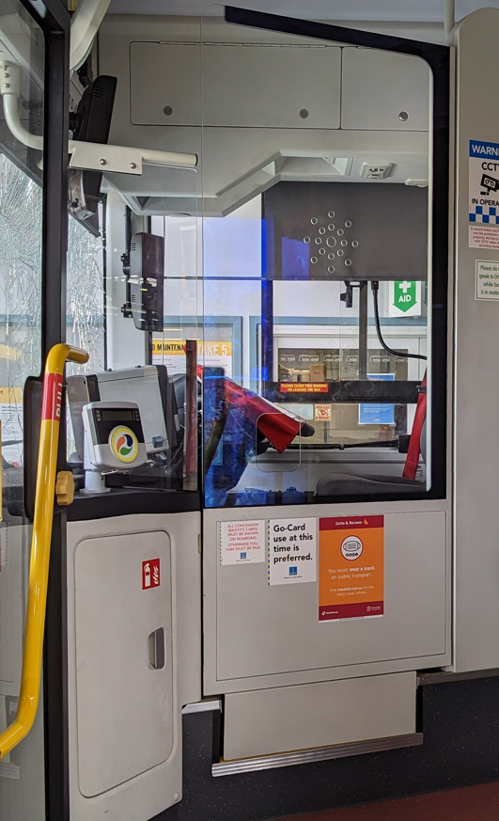
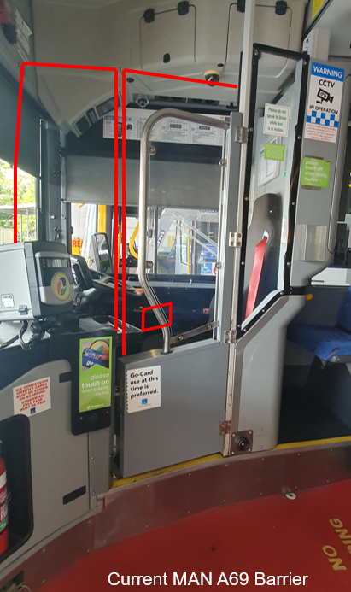
Comparing New v Retrofit Fleet
New fleet
Retrofit fleet

Slide 5
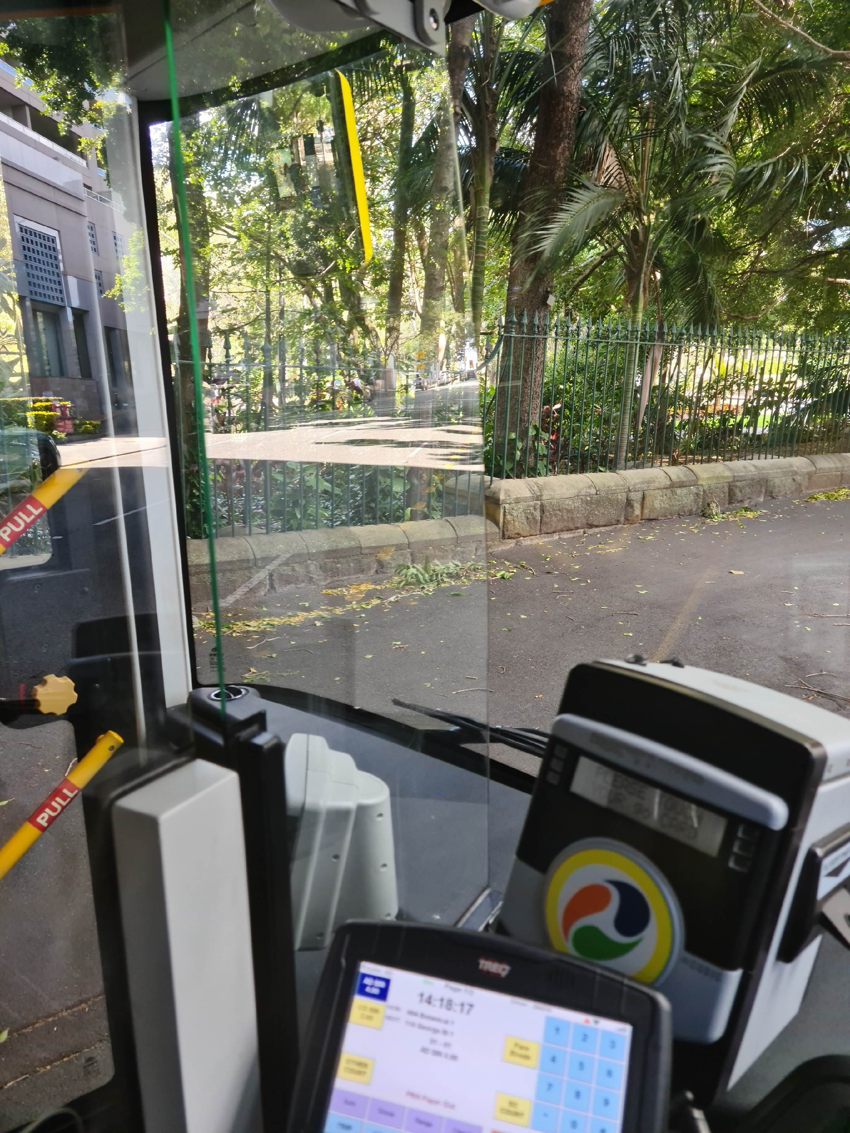
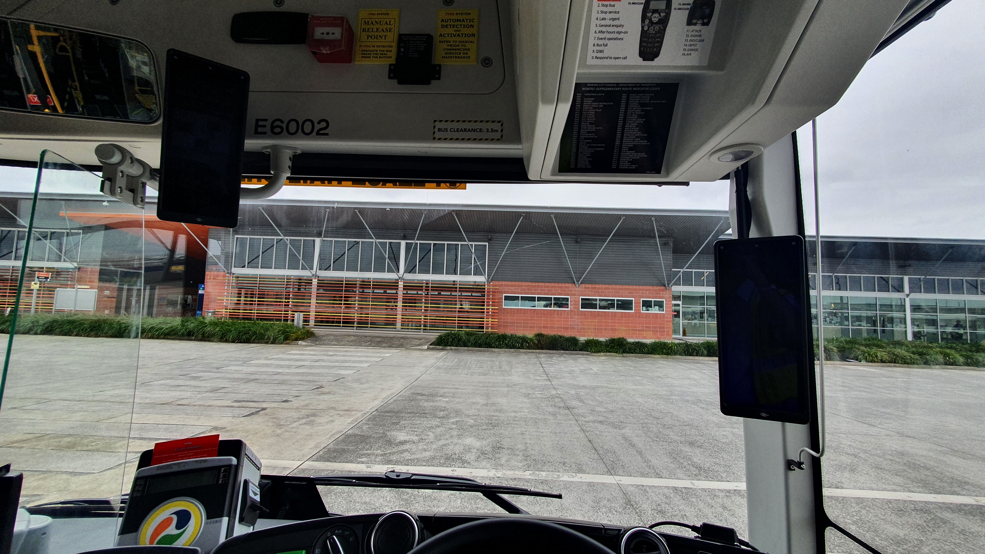
Smart Vision Indirect Rear View Camera
Issue identified was reflections off the barrier glass in certain situations particularly the vision to the nearside rear vision mirror
Trialled anti-reflective film was unsuccessful

Slide 6
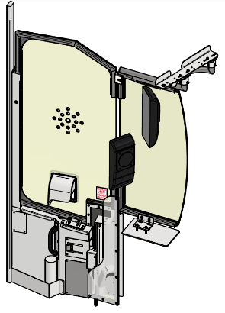
Consultation Process
Consistent
Collaborative
Expedite agreement for deployment
3 x Bus Design & Security Committee and Workplace Health and Safety Representative Consultation sessions
3 Feb 23, 21 Feb 23, 12 Apr 23 & 14 Apr 23
5 weeks in service trial at Willawong – 17 Apr – 21 May 2023
Bus operator survey between 1 -21 May 2023
12 issues raised and resolved

Slide 7
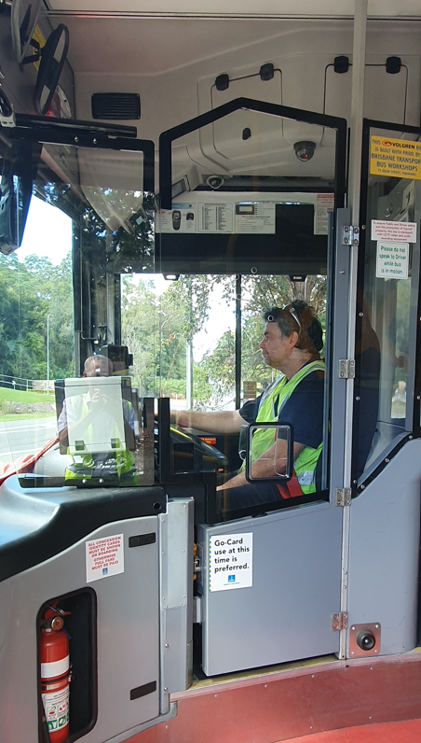
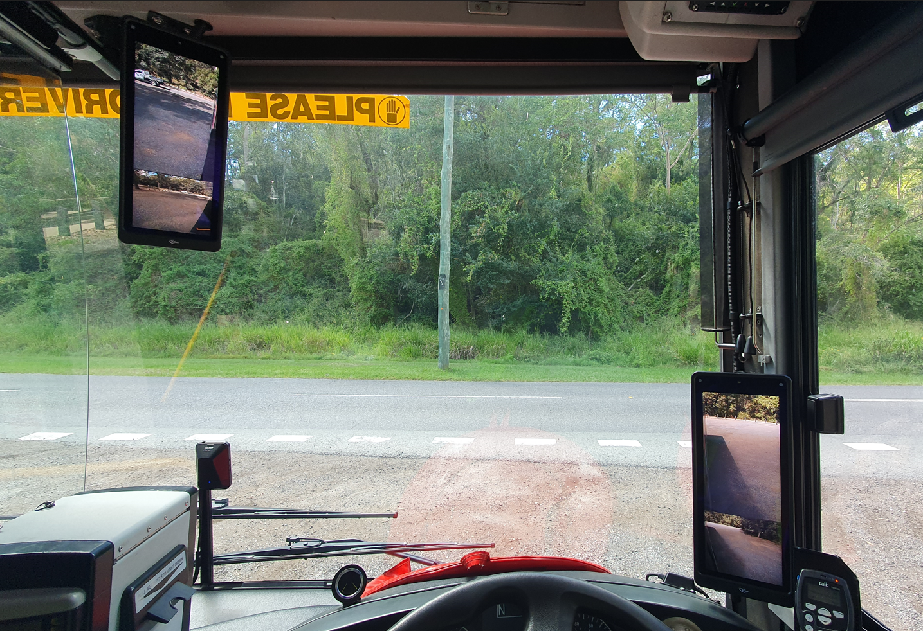
Design Process
Design completed
Prototype Full Barrier installed in Buses 1400 & 1500
ADR 14/02 confirmed
Emergency window test complete
Impact/strength testing complete
Anti-shatter testing complete
Occupational Therapist review
Stakeholder engagement

Slide 8
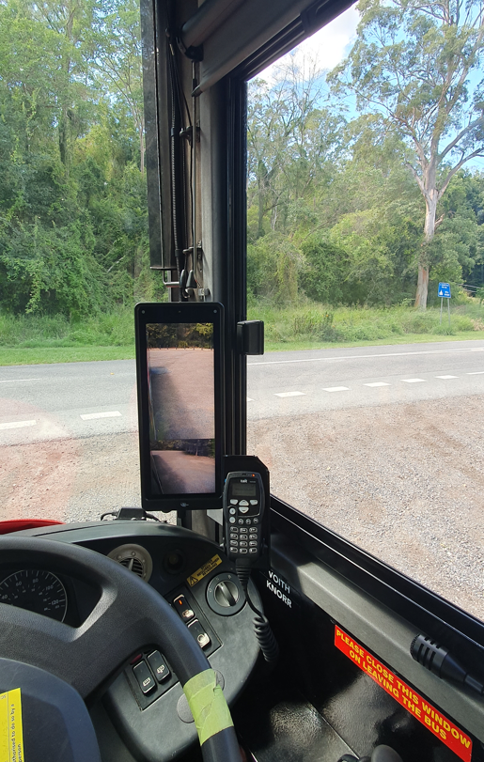
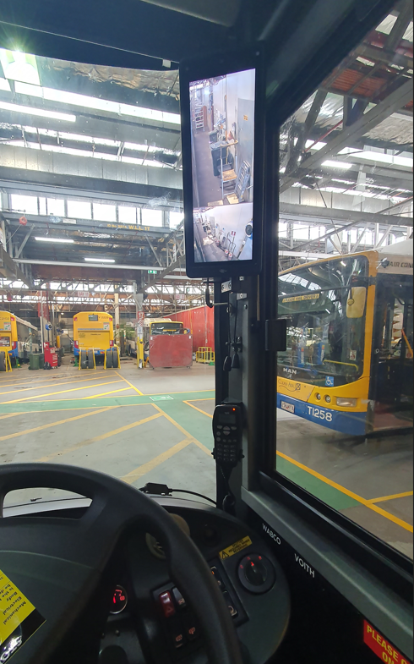
Design Variations
Offside display height - Bus 1400 low, Bus 1500 high
Anti-shatter film – fitted to Bus 1500 only - confirm visibility

Slide 9
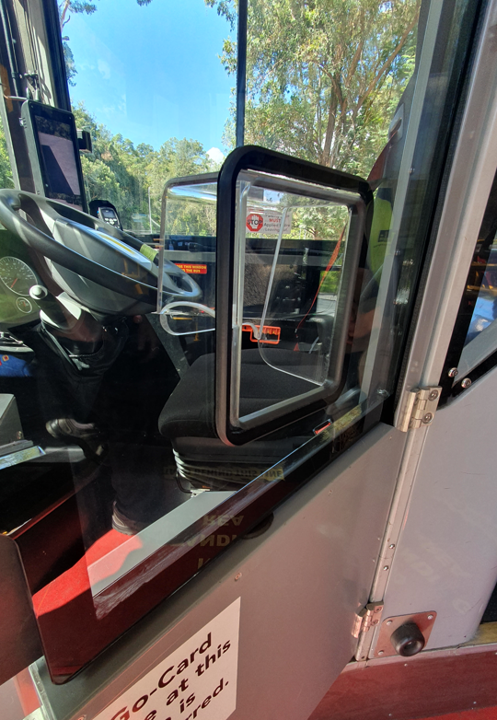
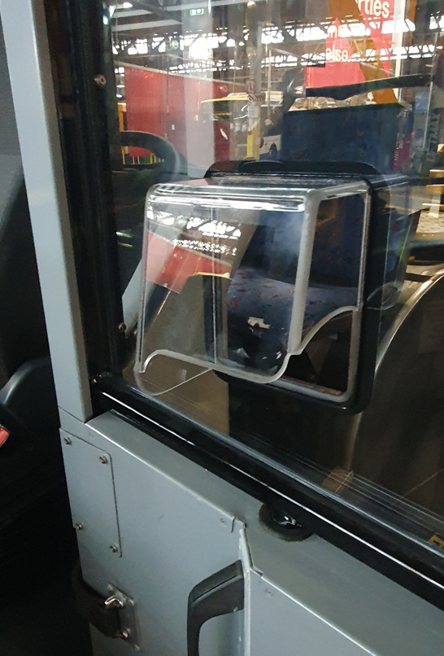
Door Access Guard
Prevents attack through door access hole

Slide 10
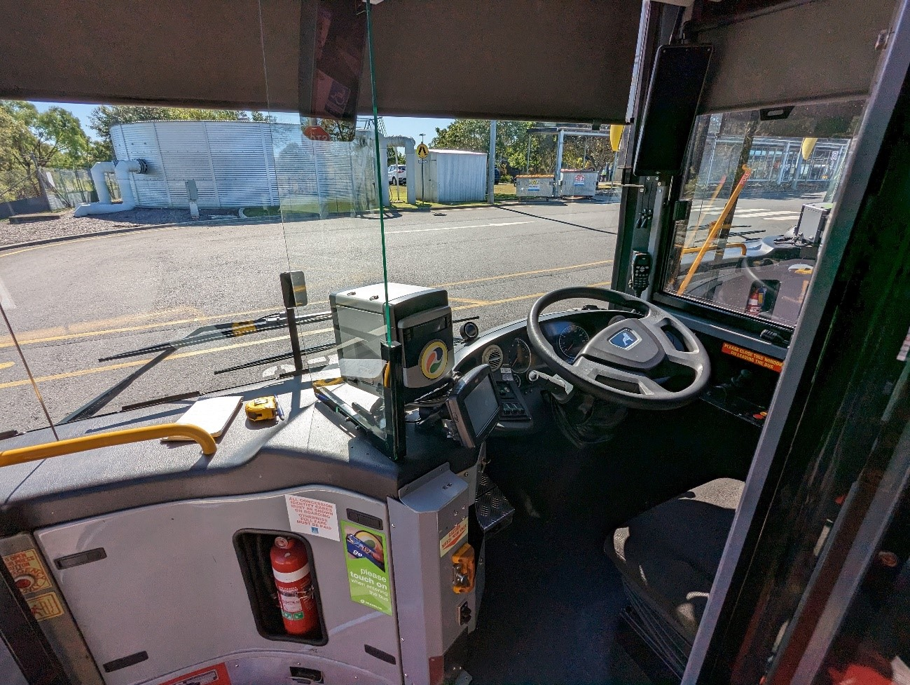
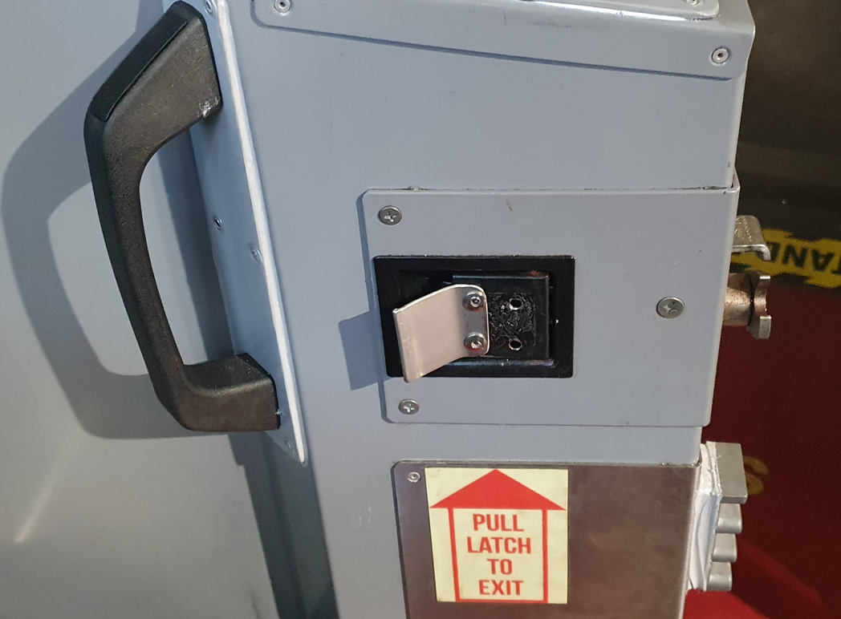
Other Key Bus Modifications
Door latch
Removal of cash tray
Single ticket validator at the front door
Relocating key equipment
Reinforcement of barn door and front dash area

Slide 11
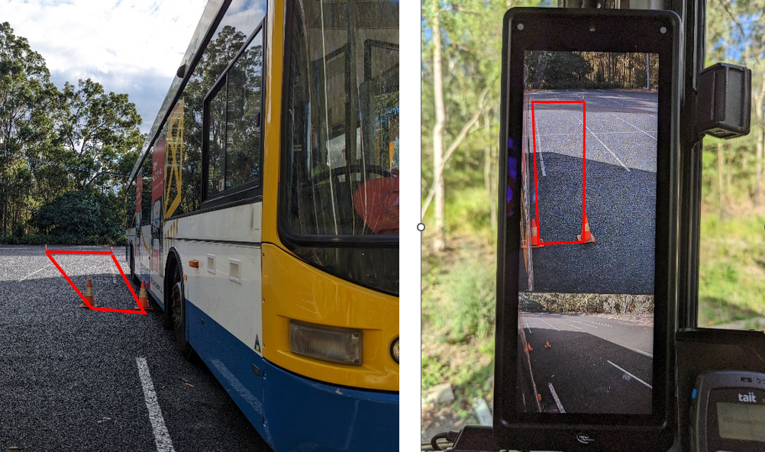
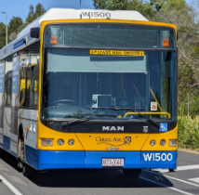
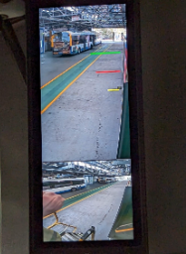
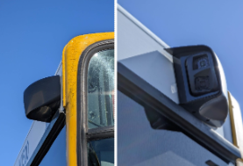
Smart Vision Indirect Rear View Camera Improvements
Improved wider angle vision
Safe lane clearance markers
Improved visibility at night and rain

Slide 12
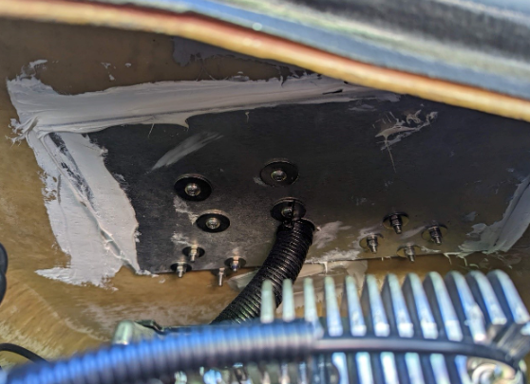
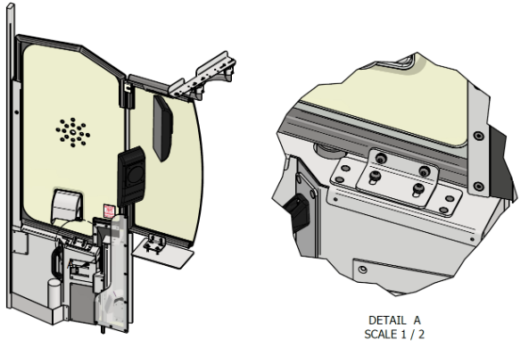
Retrofit Barrier Key Facts
Barrier design process completed by TfB internal technical staff
A total of 23 vehicle modifications are required to fit the barrier
A total of 136 unique parts
A total of 309 parts to complete the install
Installation expected to take 2.5 to 3 days per bus

Slide 13
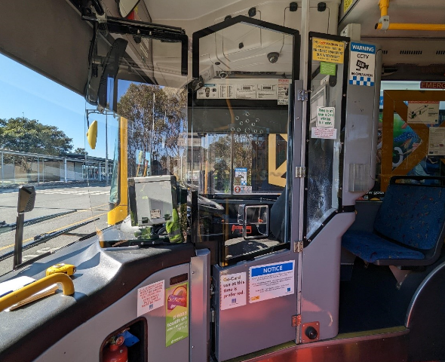
Next Steps
Complete consultation
Sign contracts for delivery of glass and smart vision rear view cameras
Confirm agreement with Translink.
Lead time for parts is approximately 12 weeks
Additional design and modifications required to expand to other bus types

Slide 14
Questions

