Slide 1
Brisbane's Housing Supply
Action Plan Briefing
City Planning and Suburban Renewal Committee
31 October 2023

Slide 2
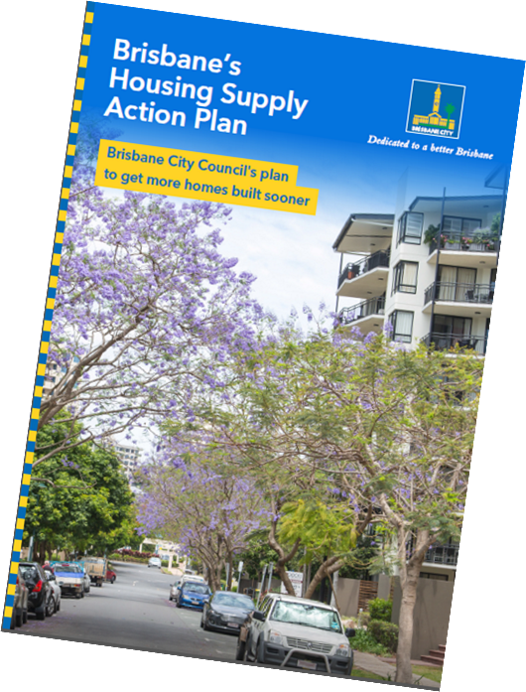
Guiding Brisbane’s Sustainable Growth
Presentation Summary
Background
Housing Supply Action Plan
Housing Supply Incentive Policy

Slide 3
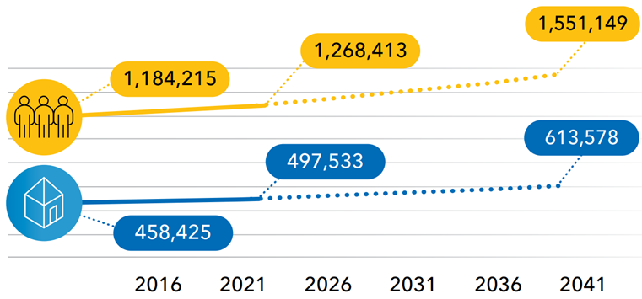
Guiding Brisbane’s Sustainable Growth

Slide 4
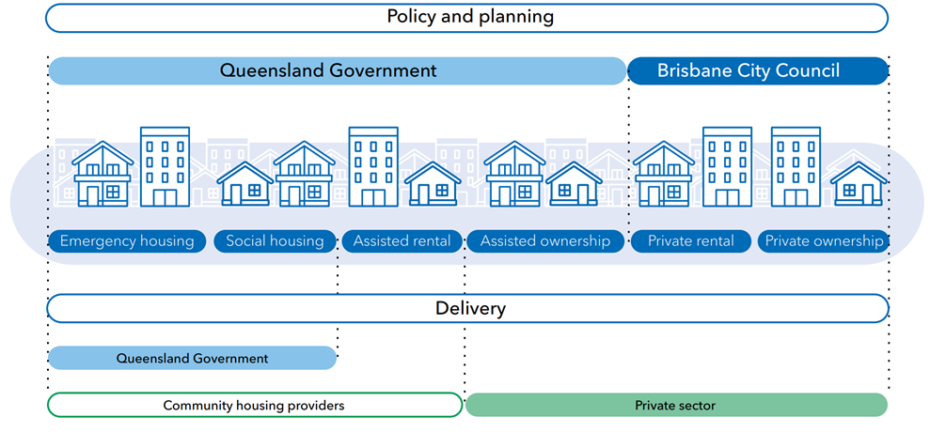
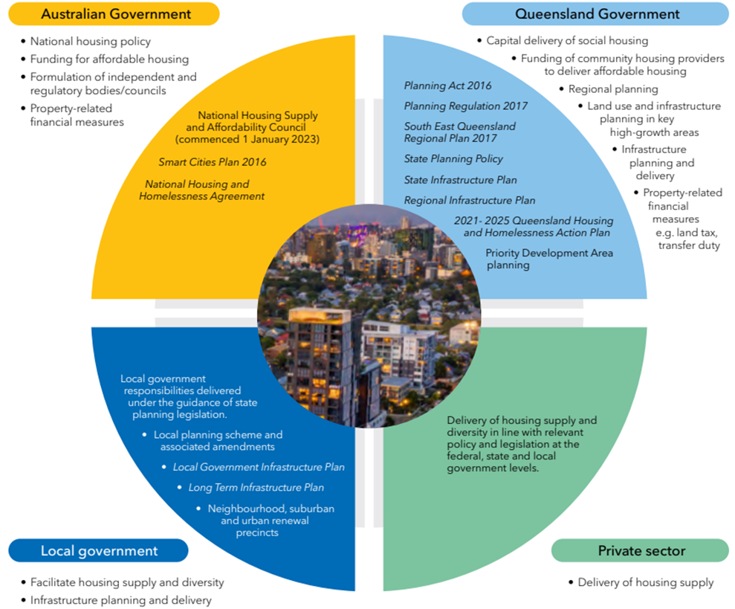
Guiding Brisbane’s Sustainable Growth

Slide 5
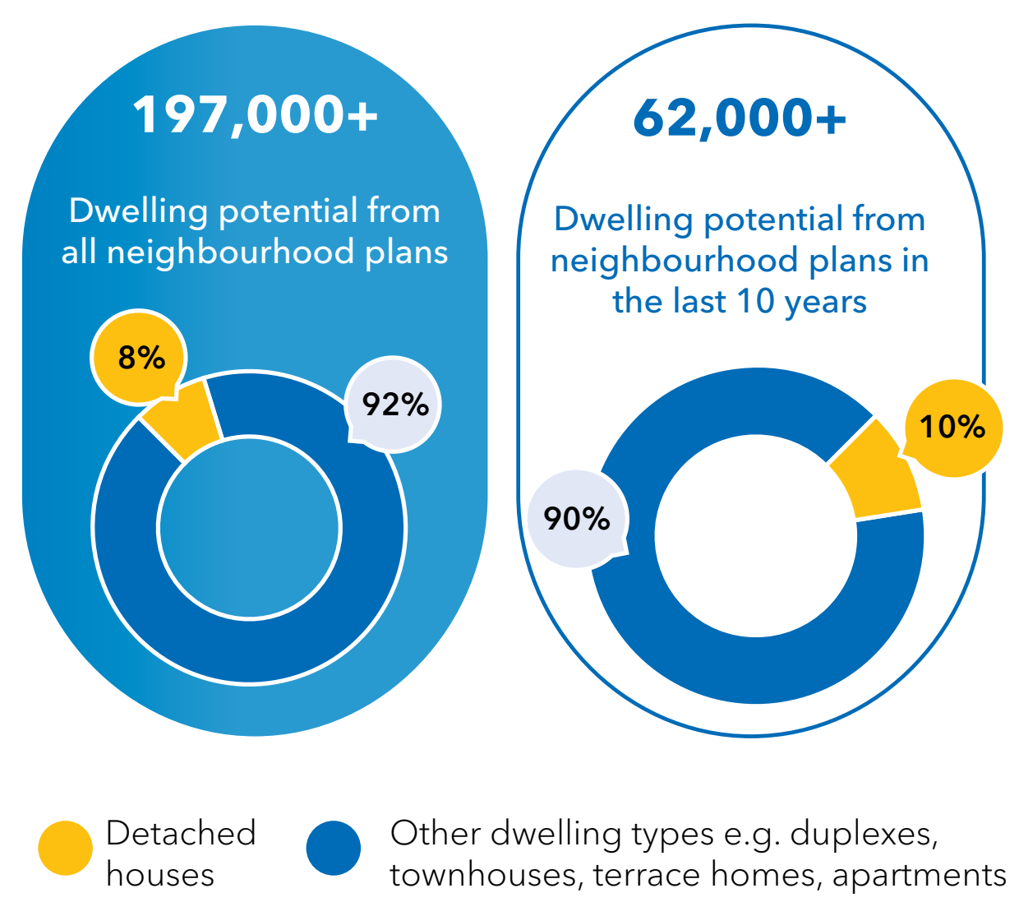
Guiding Brisbane’s Sustainable Growth
Brisbane Dwelling Supply Capacity
15-19 years land supply
Four years of uncompleted lots
Nine years of approved attached dwelling supply

Slide 6
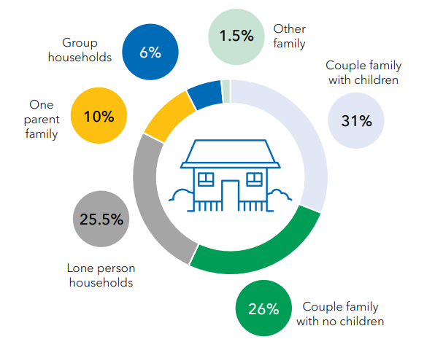
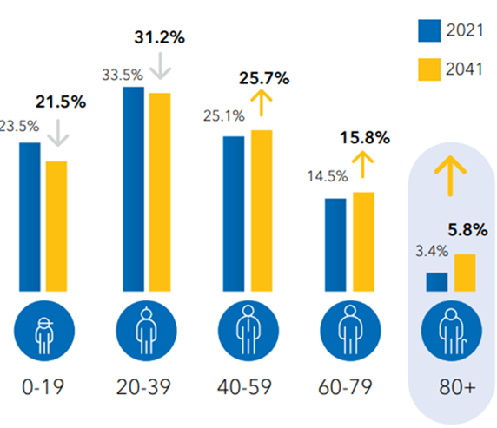
Guiding Brisbane’s Sustainable Growth

Slide 7
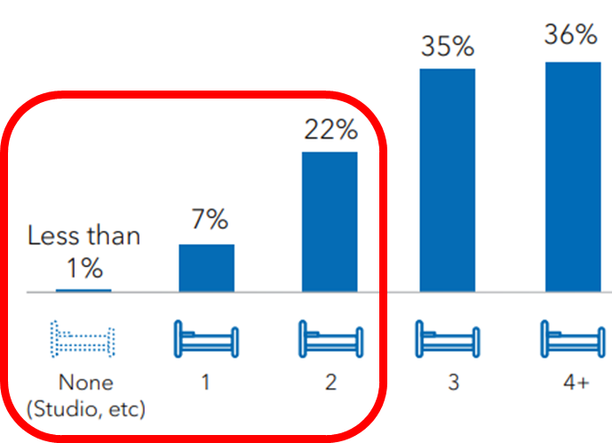
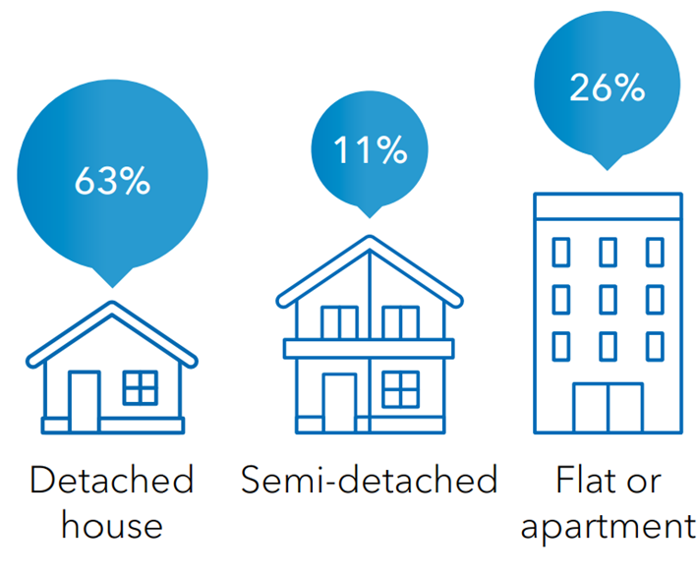
Guiding Brisbane’s Sustainable Growth

Slide 8
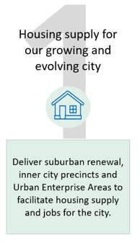
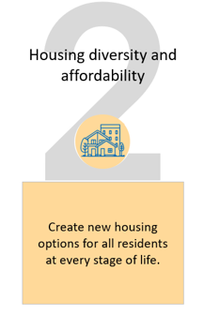
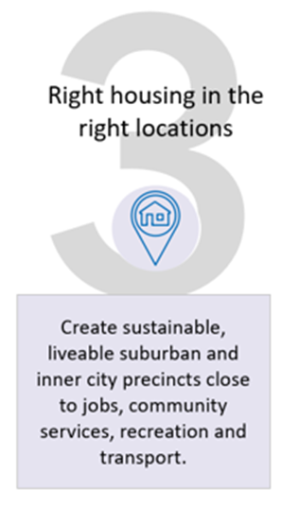
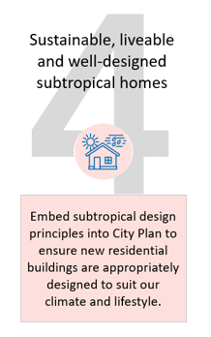
Brisbane’s Sustainable Growth Strategy

Slide 9
Brisbane’s Sustainable Growth Strategy
Our Prosperous City, Brisbane’s Inner City Strategy, Suburban Renewal, Kurilpa TLPI, major centres review
Brisbane Build-to-Rent Incentive Policy, new rating categories for transitory accommodation, Short-term Accommodation Taskforce
Brisbane Green Buildings Incentive Policy, Brisbane Universal Housing Design Incentive Policy, Brisbane Green Factor tool, Development of Design Rating Scheme
1
3
2
4

Slide 10
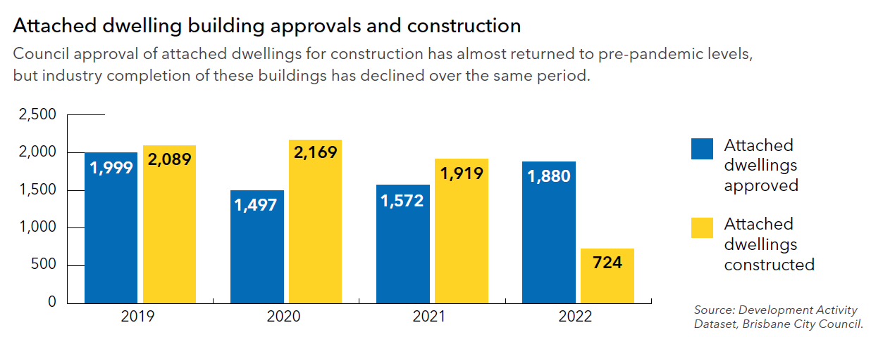
Guiding Brisbane’s Sustainable Growth

Slide 11
Guiding Brisbane’s Sustainable Growth

Slide 12
Residential vacancy rates in Brisbane (September 2023)
Guiding Brisbane’s Sustainable Growth
Legend Vacancy Rate Total Vacancies
4%
35K
4.1%
30K
3%
25K
Total Vacancies
Vacancy Rate
2.5%
20K
2%
15K
1.0%
10K
1%
0.6%
5K
0%
2014
2016
2018
2020
2022
Sep
0K
2023
Source: SQM Research PTY LTD,
Note: In compiling this information, SQM Research relies upon information supplied by a number of external sources. The total vacancies component is based on
all monitored and unique online listings for the period of a calendar month, expressed as a proportion of total established dwellings. Data up to September 2023.

Slide 13
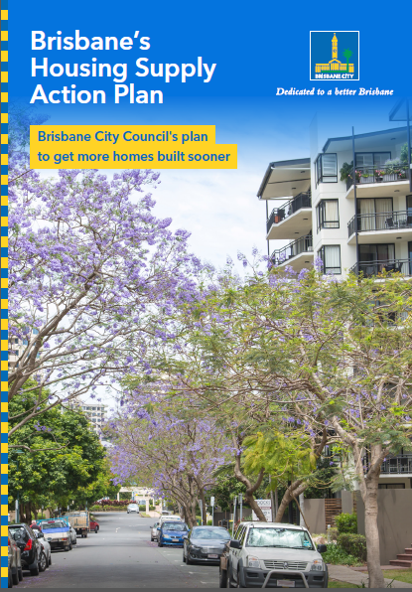
Brisbane’s Housing Supply Action Plan
Help unblock dwelling construction
Focused on locations with high transport accessibility
Encourage well-designed homes
Fast track assessment
Help reduce cost of construction
Work with other levels of government

Slide 14
Brisbane Housing Supply Incentive Policy
Reduction in some Council infrastructure charges
Encourages construction of approved development
Targeted to outcomes
Higher density nodes
Increase housing choice
Encourage good design

Slide 15
Brisbane Housing Supply Incentive Policy
Targeted Application:
High density residential zone
Mixed use zone*
Principal centre zone
Major centre zone
*where in the inner-city zone precinct
Multi-unit Dwellings | Approval Date | Discount
Community Housing | 1 Jan 2022 onwards | 100%
All other providers | 1 Jan – 31 Aug 2023 | 75%
 | 1 Sept 2023 – 30 June 2025 | 50%

Slide 16
Working with other levels of government
Advocate for:
Social and affordable housing investment
State planning reform
Construction industry support
State delivered infrastructure

Slide 17
Questions

