Slide 1

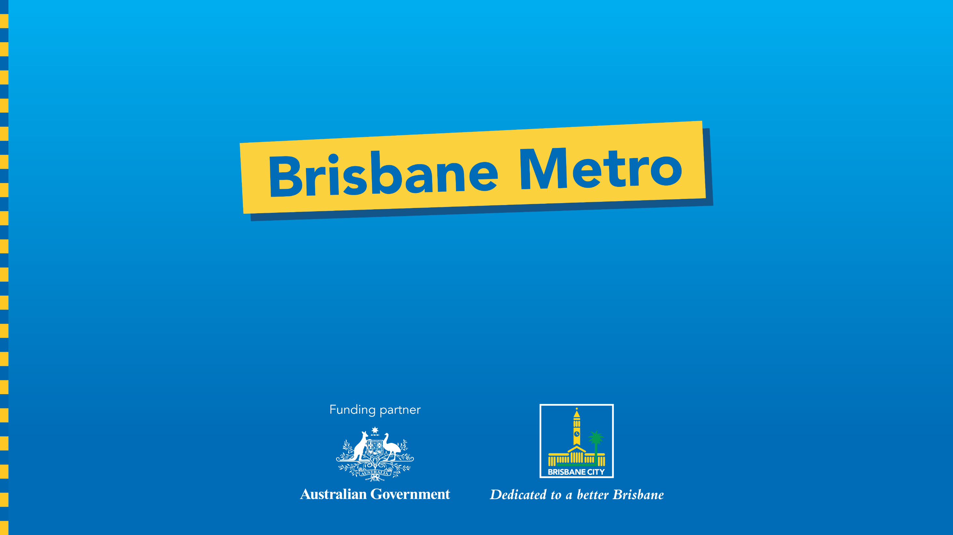
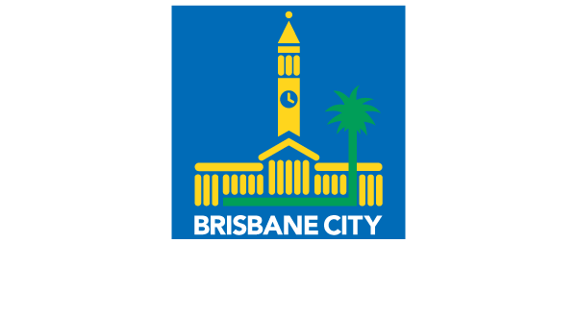
Transport Committee
Brisbane’s Final Bus Network
5 November 2024
SECURITY LABEL: SENSITIVE - OFFICIAL

Slide 2
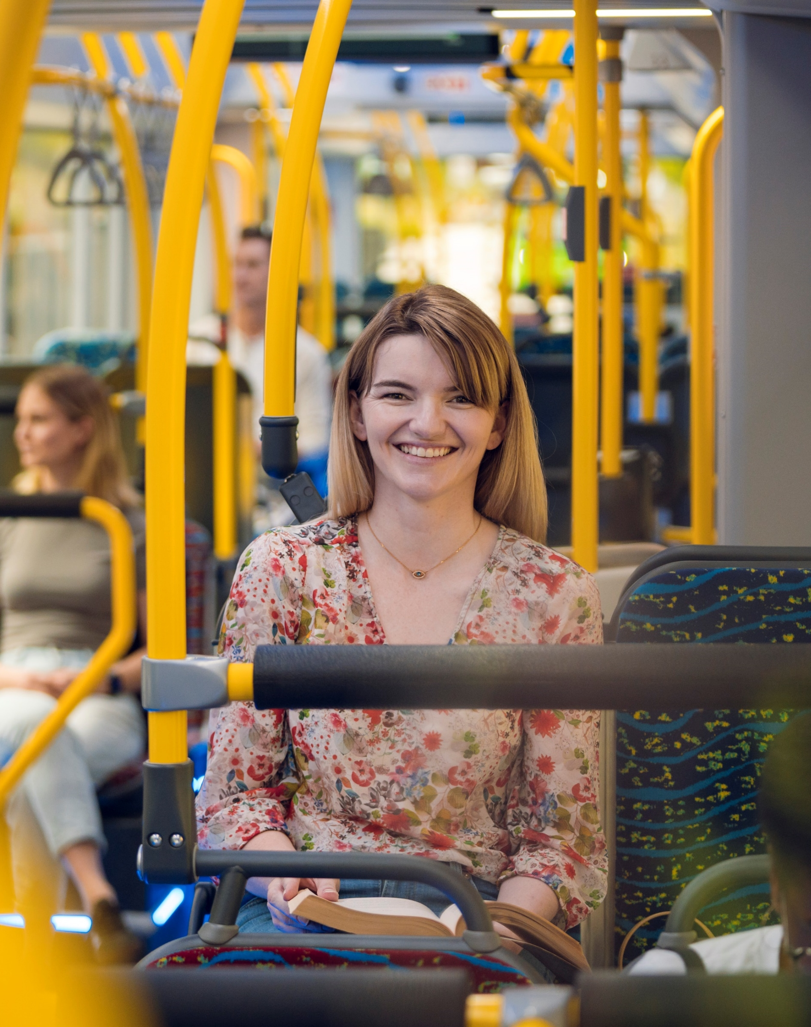
Overview
Why we're evolving the bus network
Overview of the key network milestones
Consultation process and outcomes
The final network
Next steps
SECURITY LABEL: COMMERCIAL IN CONFIDENCE

Slide 3
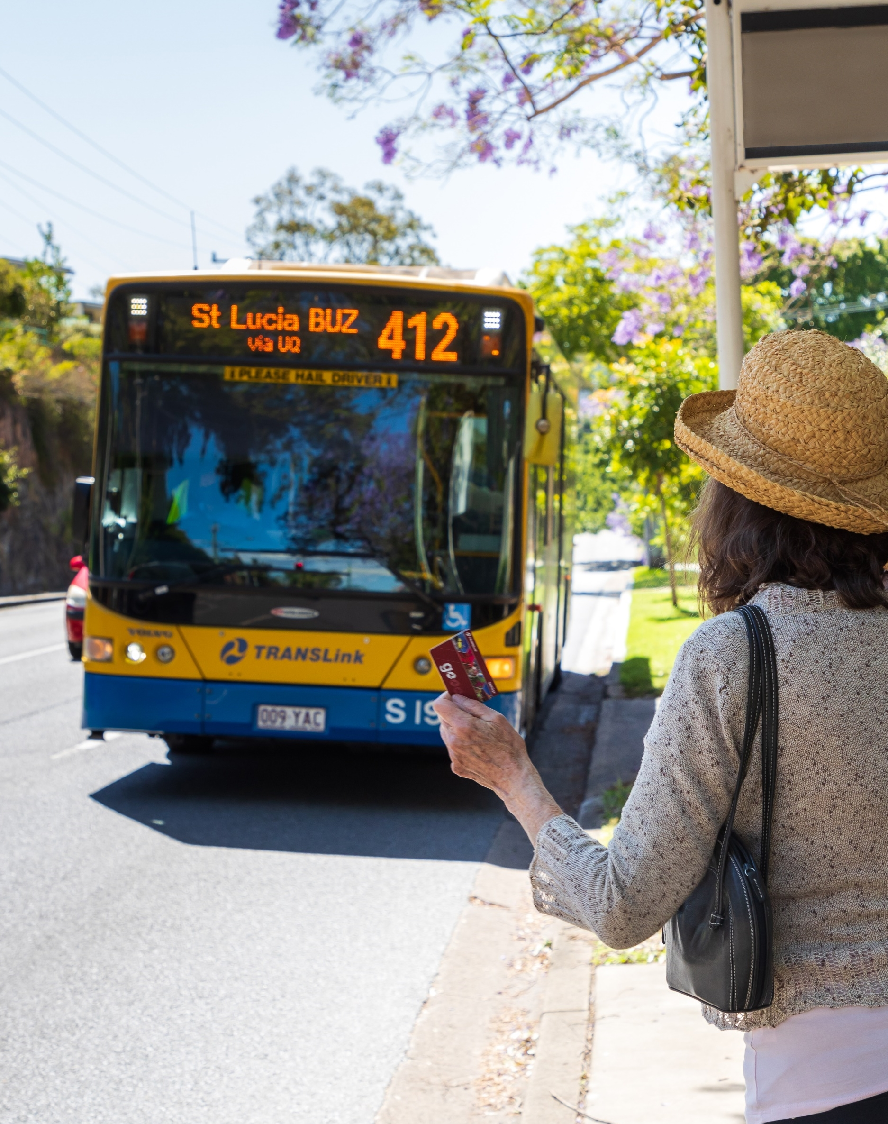
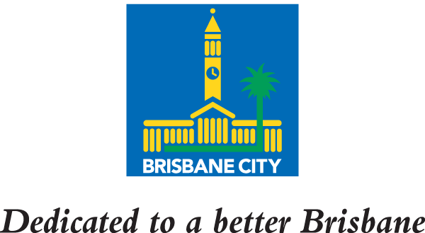
Keeping Brisbane moving
Brisbane City Council’s vision is to provide a world-class transport network that is connected, reliable and accessible, making public transport the mode of choice across our city.
Evolving our bus network
As our city continues to grow, we need to rethink our bus network and invest in smart solutions to keep our city moving.
To supercharge our city’s mass transit, Council is introducing Brisbane Metro, a bus rapid transit (BRT) system.
Brisbane Metro will complement our new bus network and provide high-capacity, high-frequency travel options that are purpose-built for our city.
By making these changes, we’re delivering more on time services for the entire network and greater capacity – moving more people, more often – as well as laying the foundation for future stages of turn-up-and-go services.
Did you know?
In Brisbane, buses do the heavy lifting on the network, carrying two-thirds of public transport passengers
SECURITY LABEL: COMMERCIAL IN CONFIDENCE

Slide 4
Evolution of Brisbane’s New Bus Network
In late 2022, we undertook extensive city-wide consultation with the community to capture feedback and insights on the proposed bus network – Brisbane’s New Bus Network (BNBN).
Since this time, our network planners have been working to incorporate this feedback and analyse additional changes and improvements.
We have now finalised the new network, which has been approved by Translink.
Review of feedback and network planning
In-depth network planning to incorporate feedback and analyse improvements
Network readiness
Finalise infrastructure updates for implementation and execute customer readiness activities in partnership with Translink
Development of draft network
Analysis of network-wide patronage data and revision of whole bus network
Stakeholder engagement on BNBN
Engagement with stakeholders and community members on new network
Extensive city-wide community consultation
Release of Brisbane’s New Bus Network (BNBN)
City-wide online survey
2018 – 2022
July - October
2022
October - December 2022
January 2023 –
late 2024
October 2024
October – November 2024
October 2024 onwards
SECURITY LABEL: COMMERCIAL IN CONFIDENCE

Slide 5
Our consultation process
From 10 October to 14 December 2022, Council sought feedback from the community and stakeholders on the proposed network changes in the inner-city and south-eastern corridor, as well as other opportunities for improvements across the city.
Engagement approach
A diverse program of activities was undertaken across the city to maximise reach and encourage participation.
Engagement activities were informed by benchmarking of local and global bus network change programs
Activities were designed to be as inclusive and accessible as possible, through the use of translated materials and interpreters, accessible venues and accessible web standards for digital tools.
Engagement methods
City-wide awareness campaign informed by customer insights
Digital and print communication activities across Council and external channels
Interactive network portal, with searchable route map and online survey
Community events, including 23 information sessions and 10 pop-ups at bus stations and stop
Briefings to key stakeholders including elected representatives, industry and community groups
A variety of feedback channels to maximise participation
Internal communication and engagement with Council employees and government partners
SECURITY LABEL: COMMERCIAL IN CONFIDENCE

Slide 6
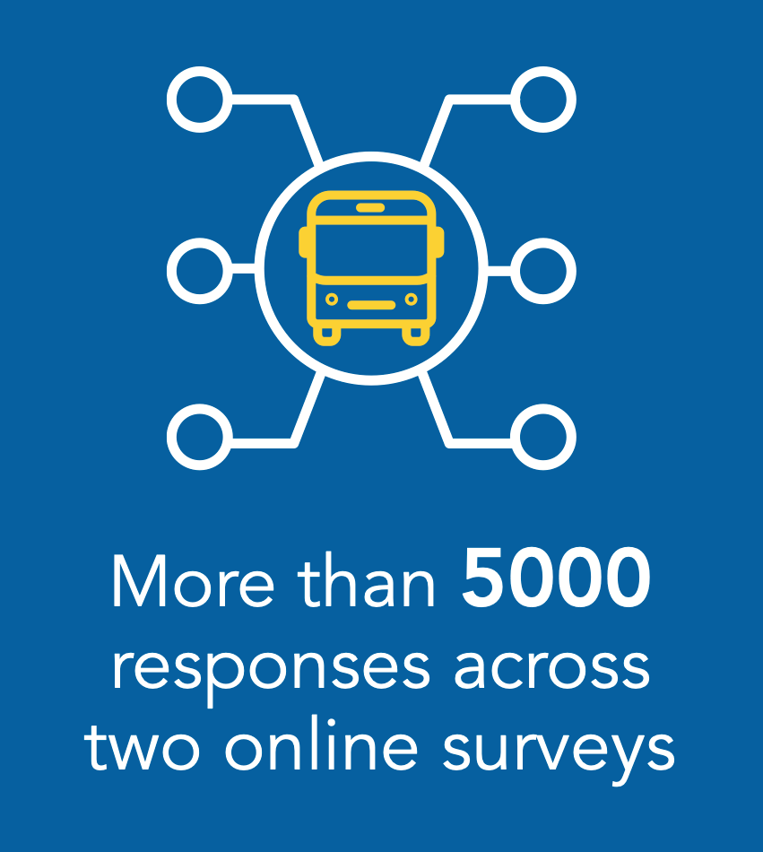
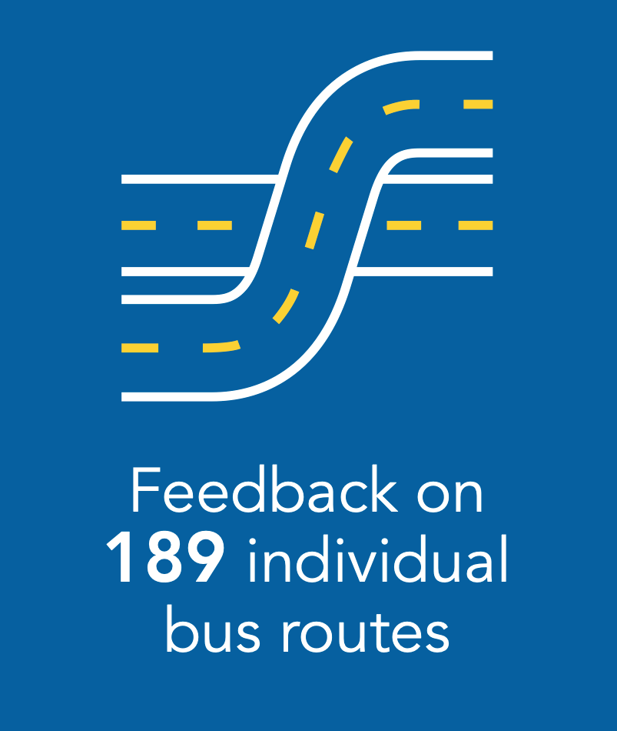
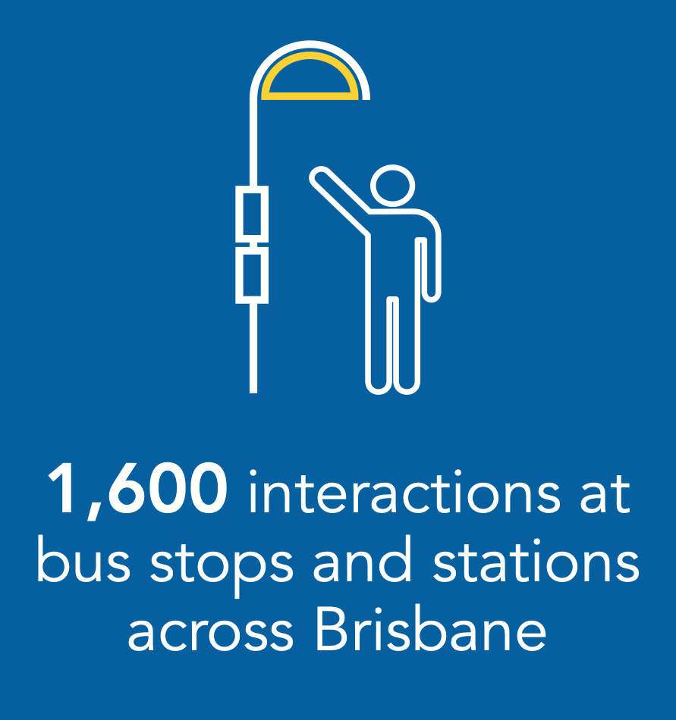
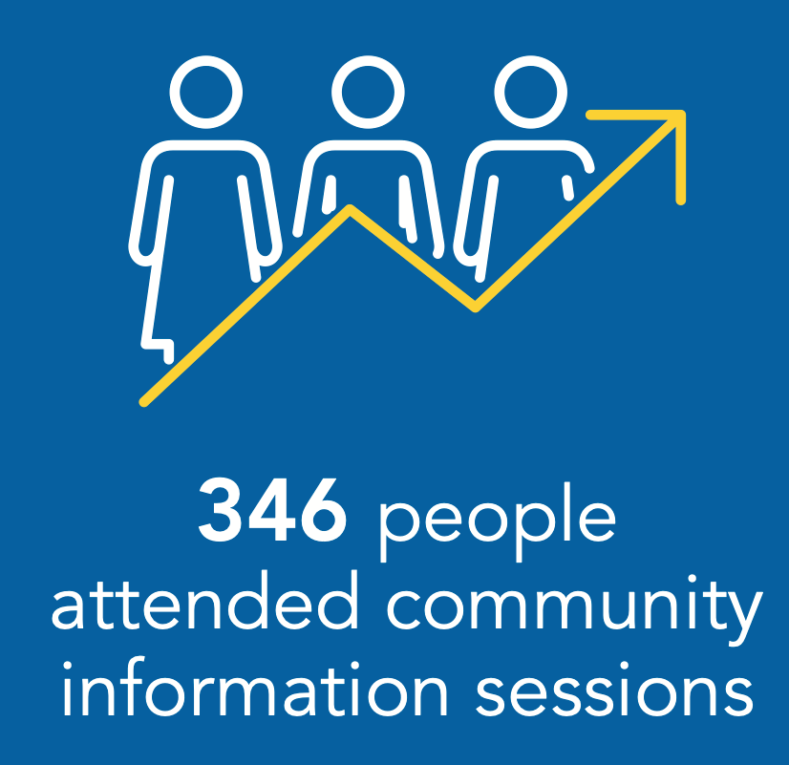


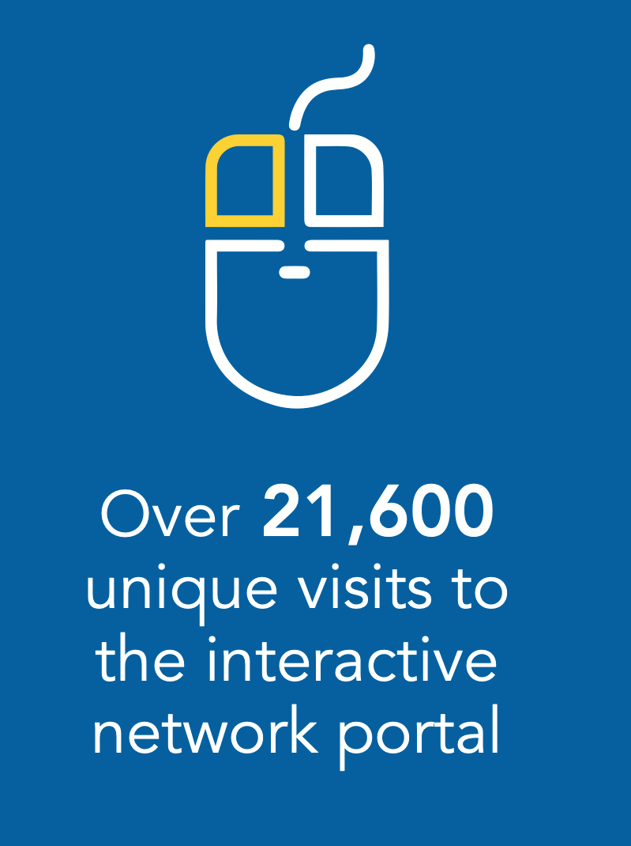
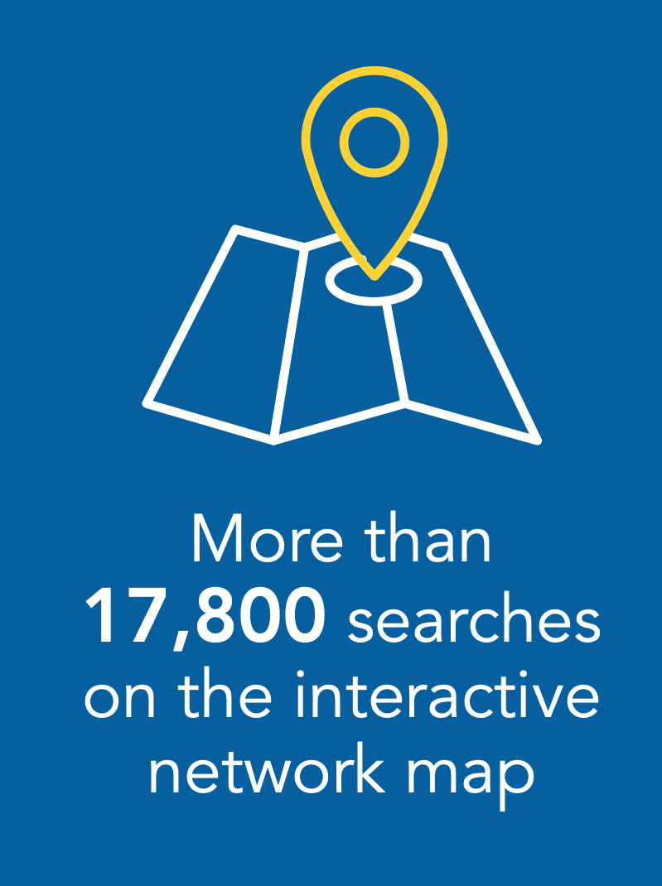
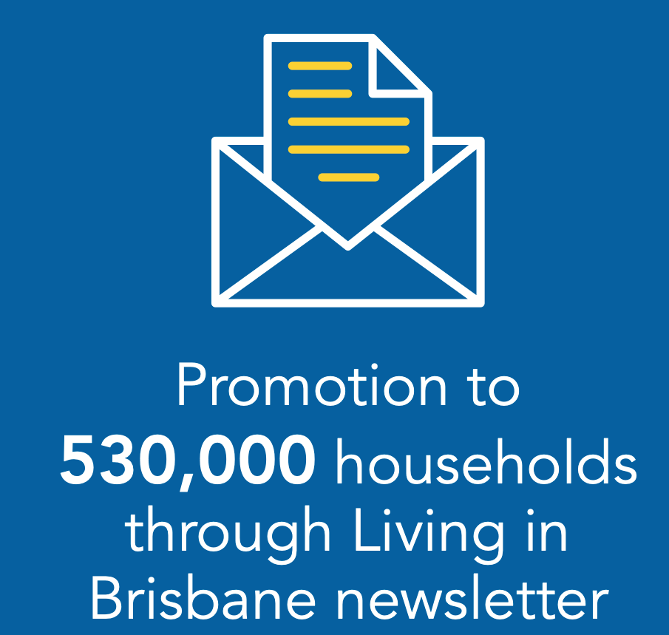
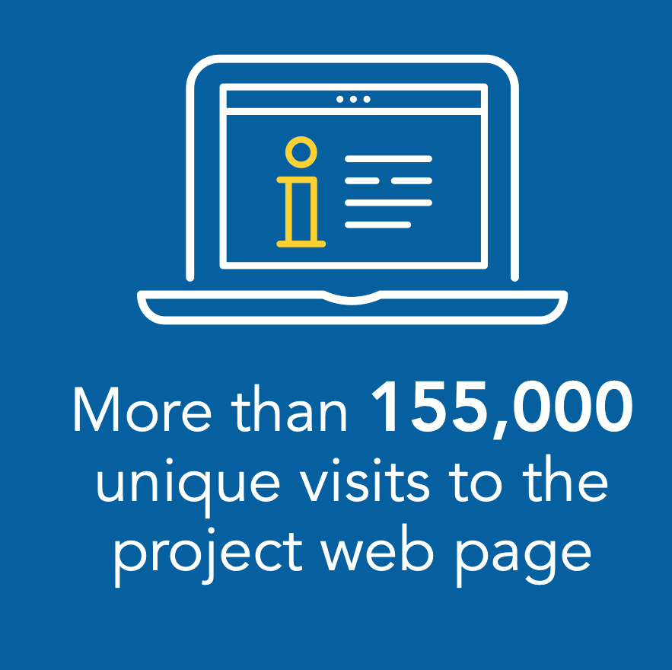
Summary of participation
37 individual briefings with key stakeholders
SECURITY LABEL: COMMERCIAL IN CONFIDENCE

Slide 7
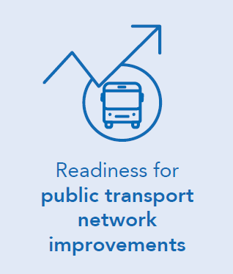
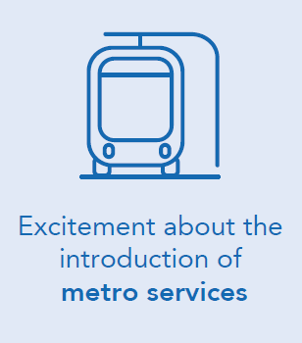
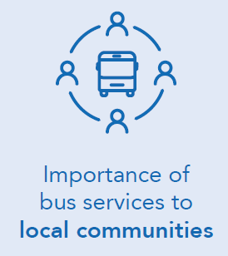
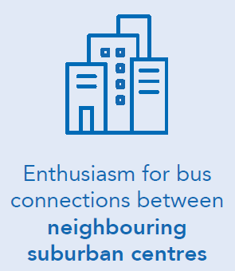
Overarching feedback themes
There is a desire to be able to use public transport for more journeys and reduce car dependency – people are ready for change
People are keen to see improvements that will help improve travel times and reduce road congestion.
Strong support for the use of fully electric metro vehicles and suggestions for electric vehicles to be used as part of the regular bus fleet
Many hoped metro services would be extended in the near future.
Many people rely on public transport as their only means of connection to local shops and services or visiting family and friends
Small service adjustments can have local impacts in specific communities.
Interest in more connections to nearby suburbs and local shopping / transport hubs without having to travel via the inner-city
However, little consideration about the demand for these types of services and if they would be sustainable

Slide 8
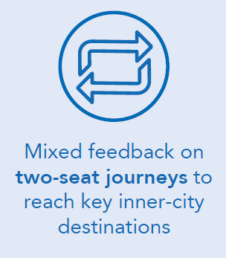
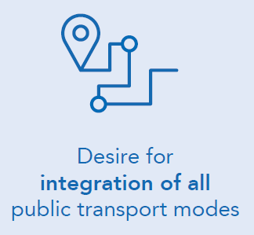
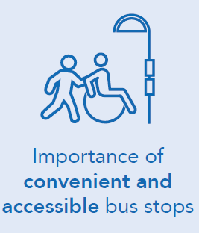
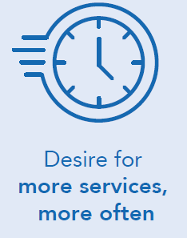
Overarching feedback themes
Frequent bus users accepting of two-seat journeys provided transfers are fast and convenient
Some concerns around the need to interchange between services particularly from elderly people, school students and people with mobility requirements.
Desire for local bus services to connect quickly and easily with metro, rail or high-frequency bus service
Expectation that timetables are coordinated across modes.
Walking distances to bus stops, road conditions (hilly terrain and intersection crossings) and hot weather affect whether people use bus services.
People will choose public transport if it is frequent, provides a fast journey time and takes them where they need to go
Requests for extended operating hours particularly on weekends to shopping and restaurant precincts.

Slide 9
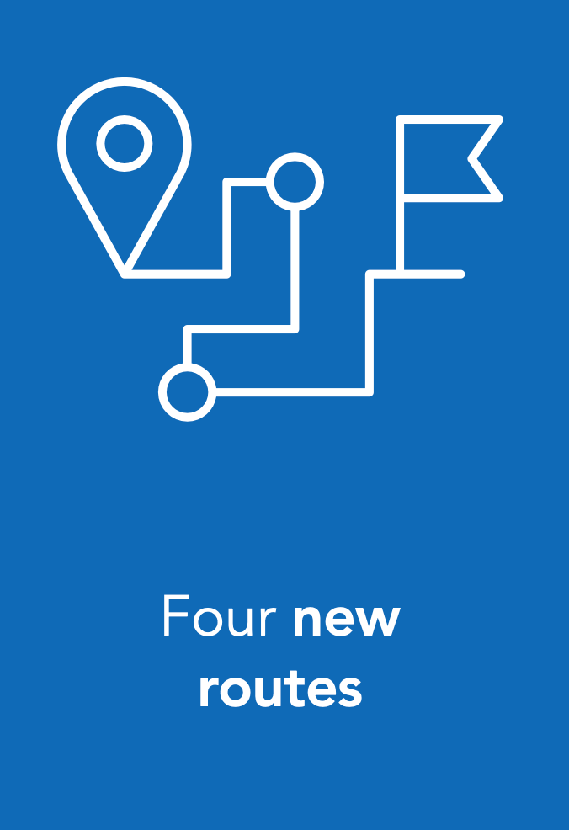
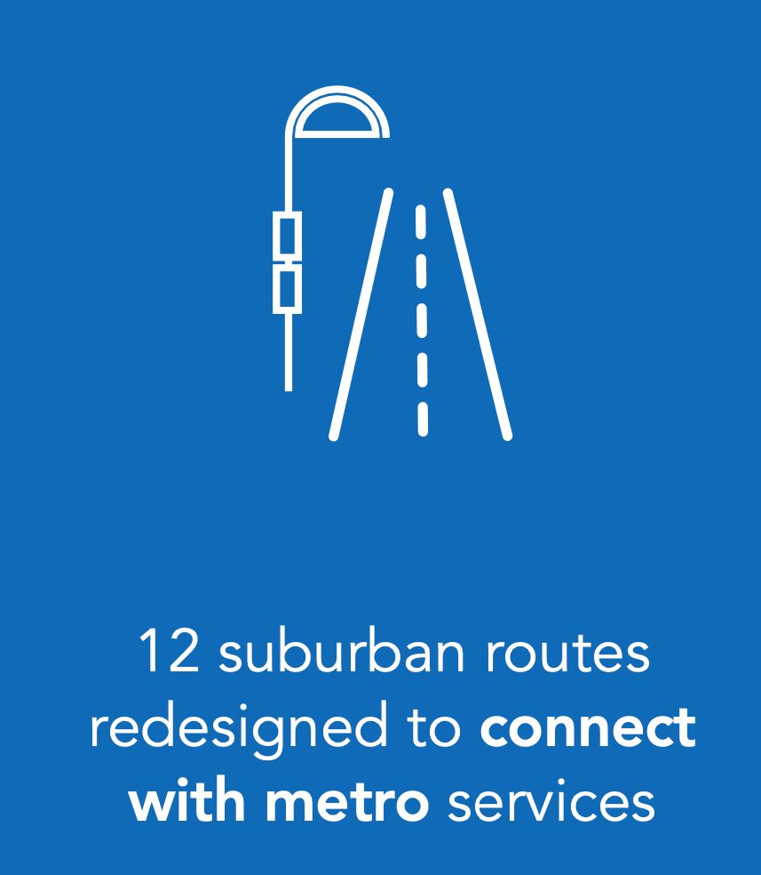
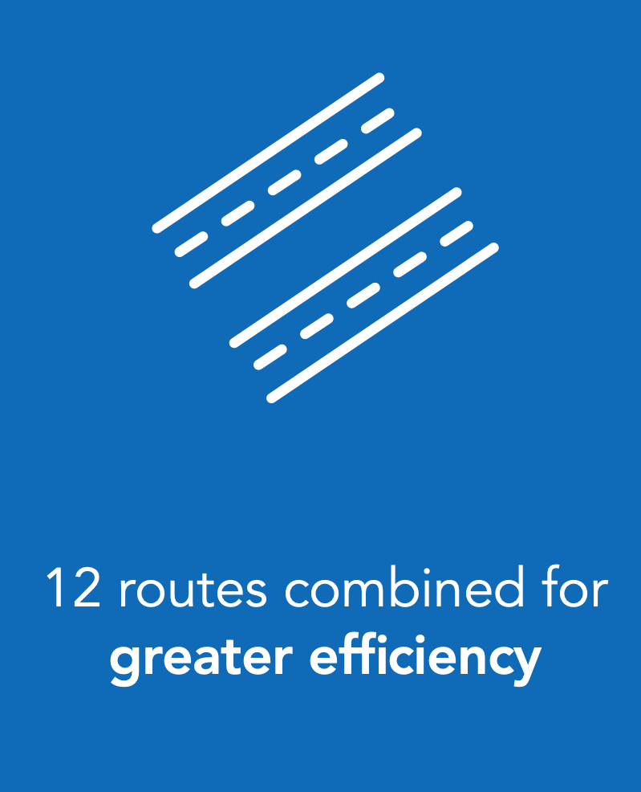
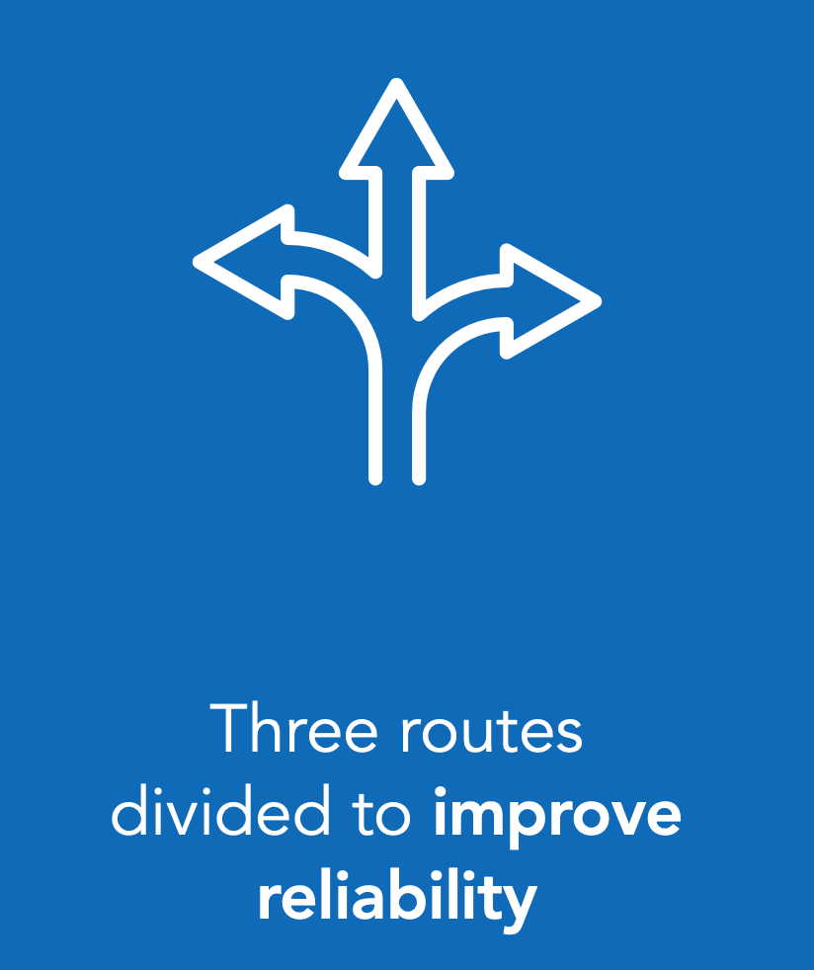
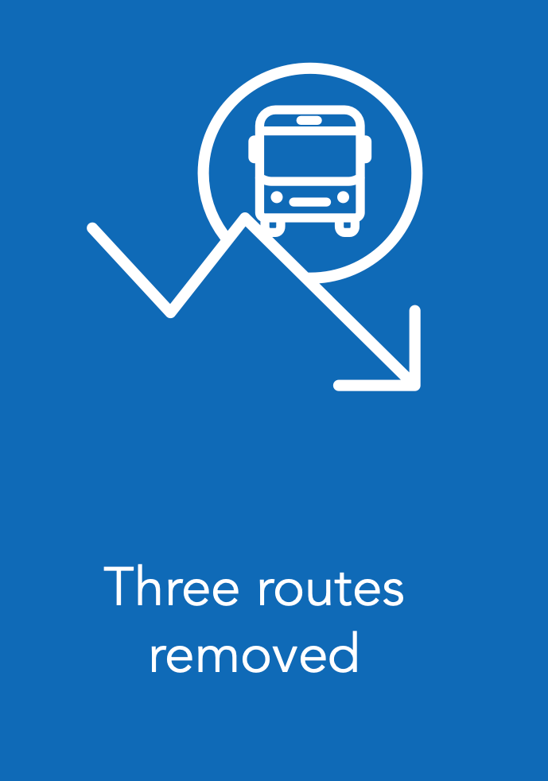
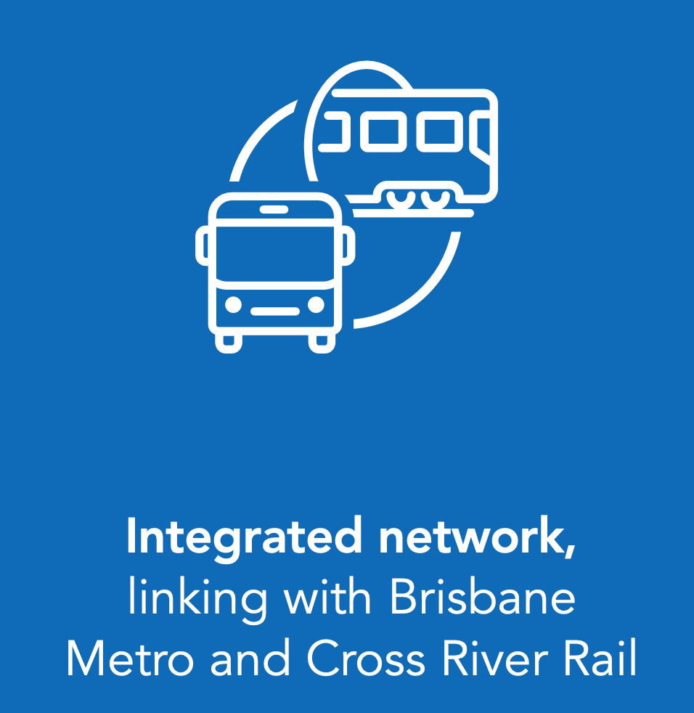
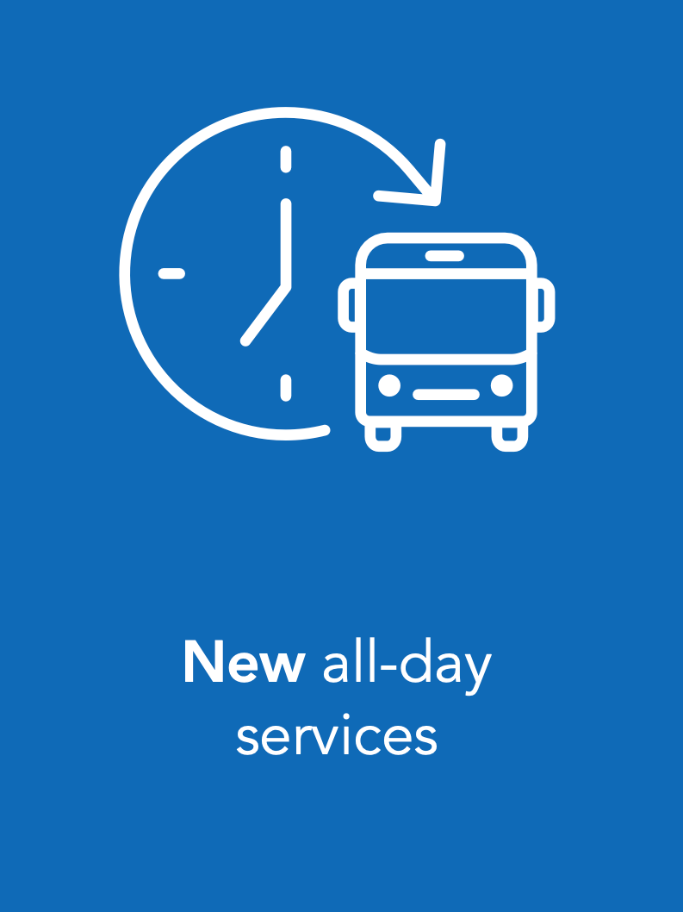
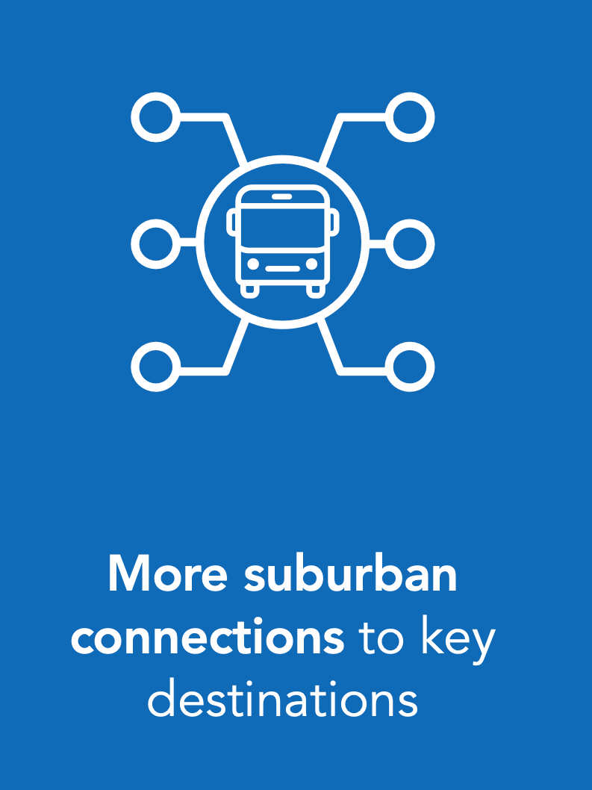
Brisbane’s final bus network
After in depth network analysis by our transport planners, and extensive consultation with the community, we finalised the bus network in the inner-city and south-eastern corridor. We’re calling this Brisbane’s New Bus Network and here’s what this means:
Five new routes
SECURITY LABEL: COMMERCIAL IN CONFIDENCE

Slide 10
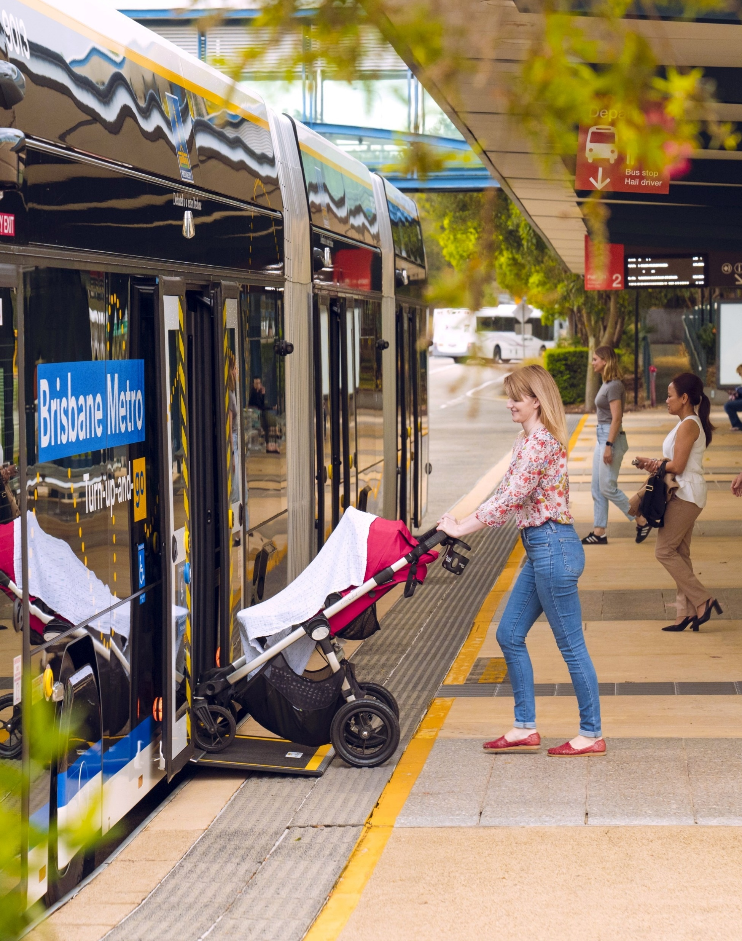
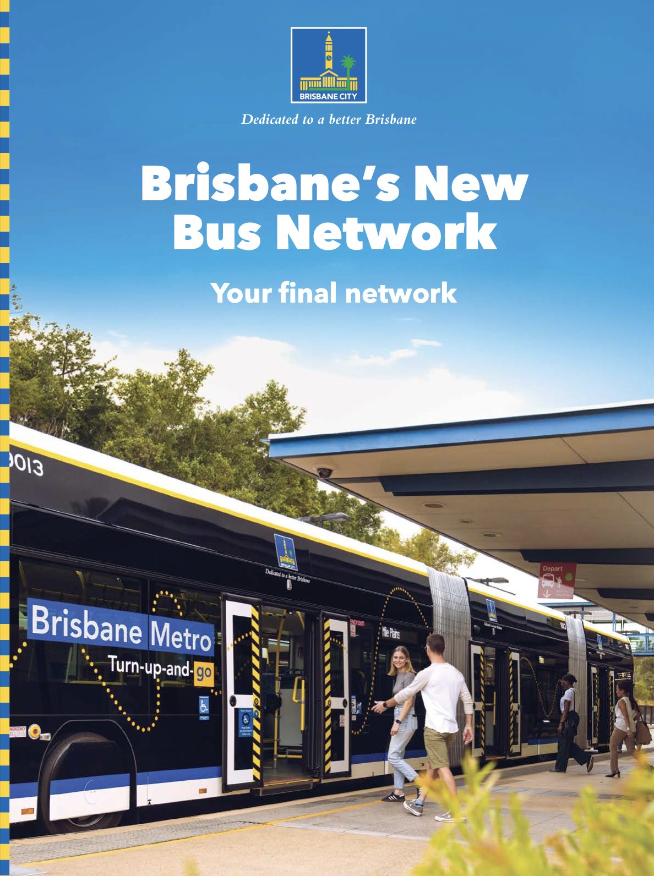
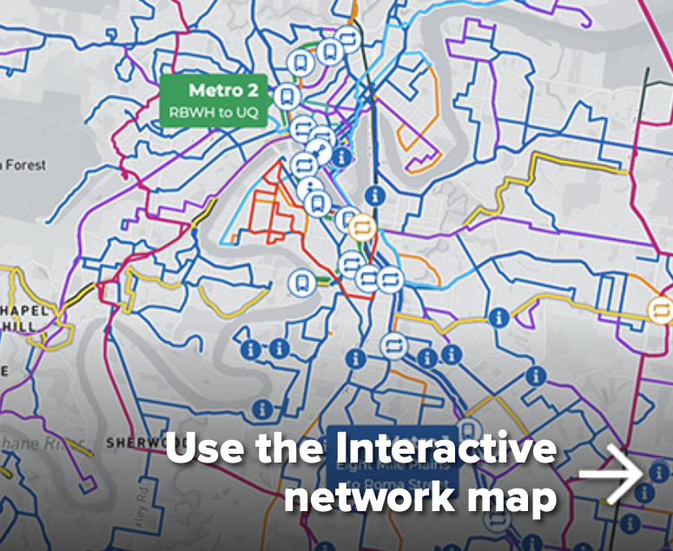
The final network
On 28 October, Brisbane’s New Bus Network was publicly released.
This included:
  Revised content on Council’s website
  Release of Brisbane’s New Bus Network guide
  Updates to the interactive network tool
  Communication with key stakeholders
  Communication with Council’s Bus Operators
SECURITY LABEL: COMMERCIAL IN CONFIDENCE

Slide 11
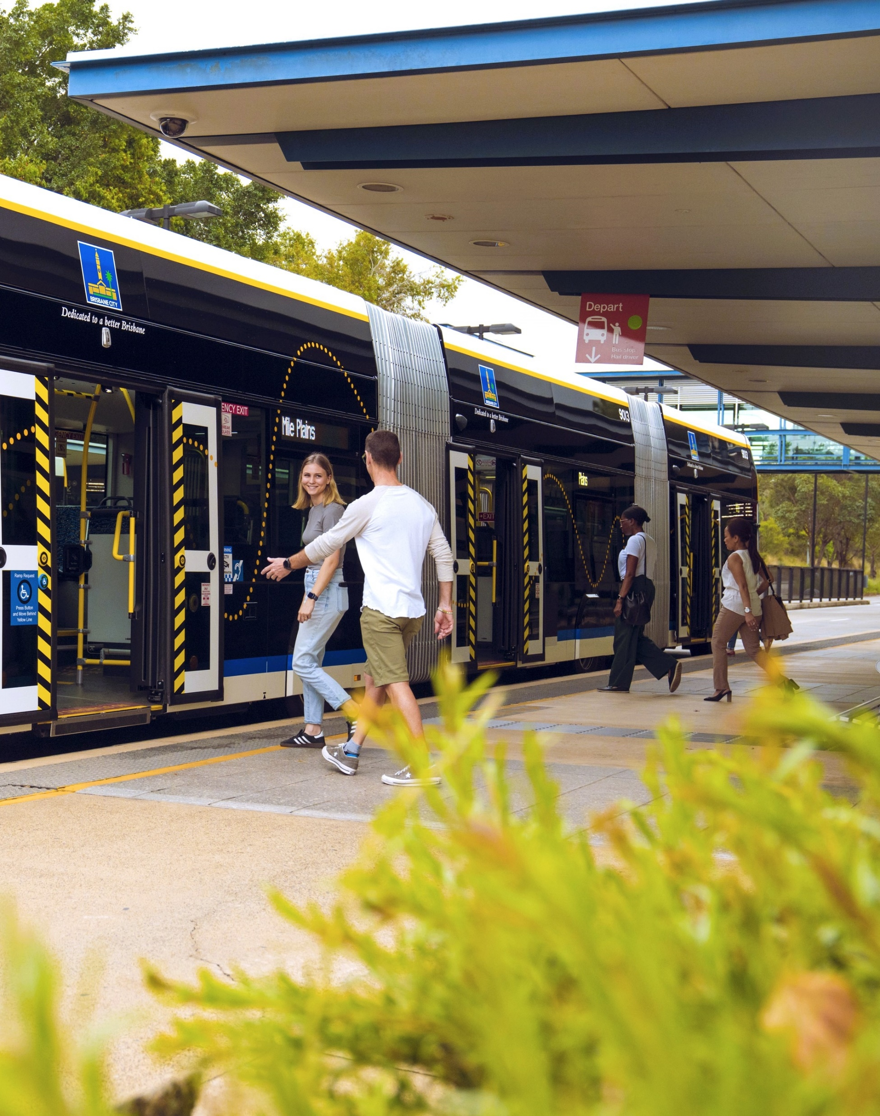
Next steps
We will continue to work closely with the State Government ahead of implementation. This will include:
Completing the construction of new and improved infrastructure – City Hall / King George Square station, Buranda busway station, Griffith University station and Cultural Centre station.
Readying the suburban network for implementation by ensuring required bus stops and layover areas are in place.
Negotiating with the State Government to reach an agreement on the commencement date of Brisbane Metro M1 and M2 and Brisbane’s New Bus Network.
Continuing to test and commission new metros and introduce them to the network.
Improving our onboard systems based on customer feedback and further testing.
Working with Translink to get our customers ready to travel on the new network including Journey Planner, timetables, maps, signage and customer support.

