Slide 1
Finance and City Governance Committee Lord Mayor’s Awards for Excellence Divisional Manager’s Office Organisational Services March 2025
CA25/138660

Slide 2
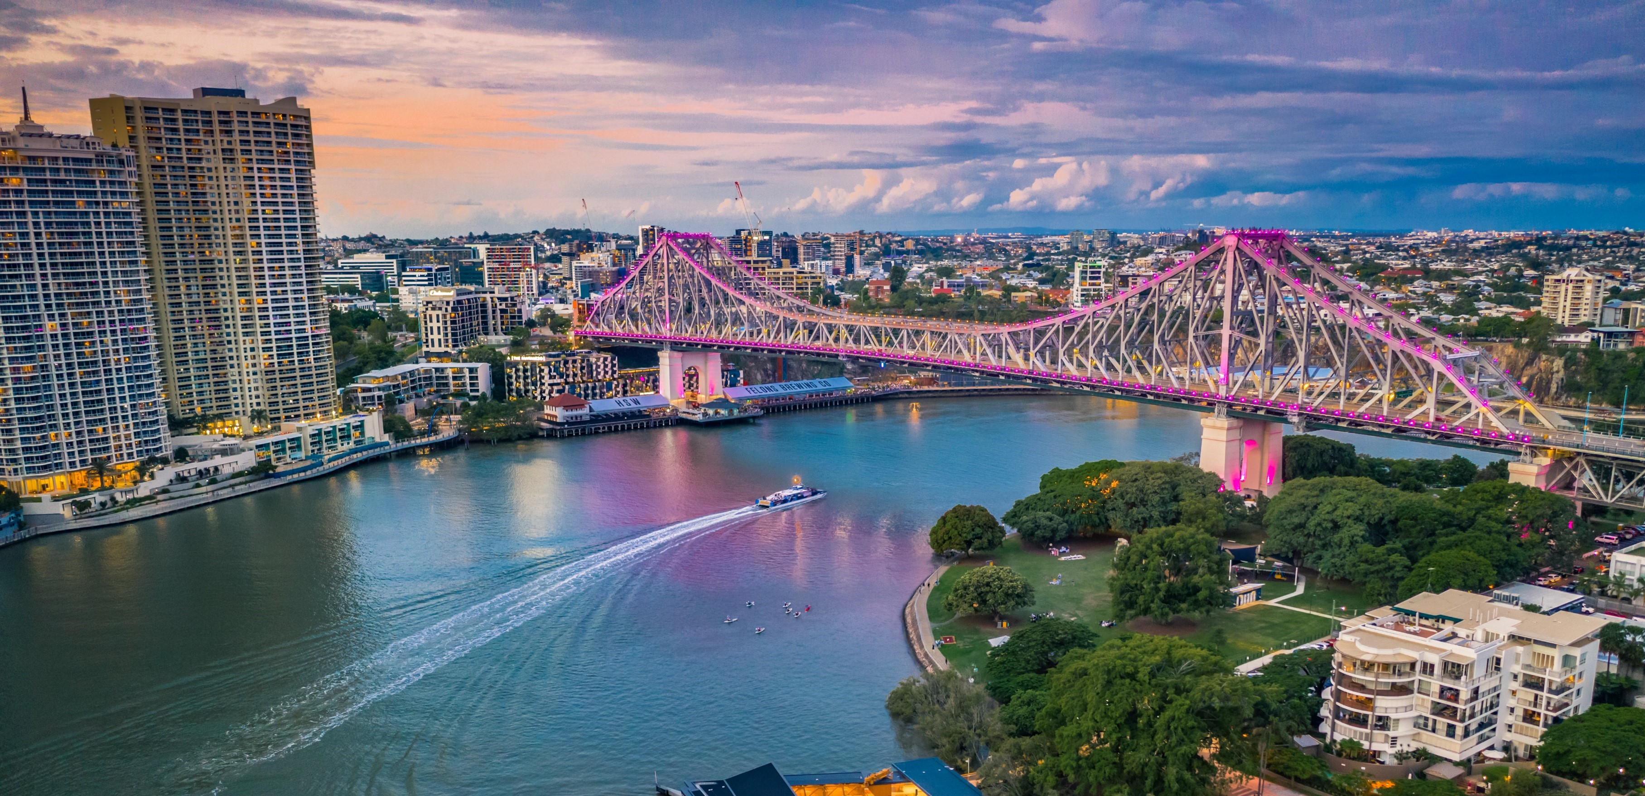
Overview
The Lord Mayor’s Awards for Excellence were initiated in 1992. They recognise and reward individual employees and teams or work groups for effort and initiative that is over and above what is necessary to achieve Council’s goals.

Slide 3
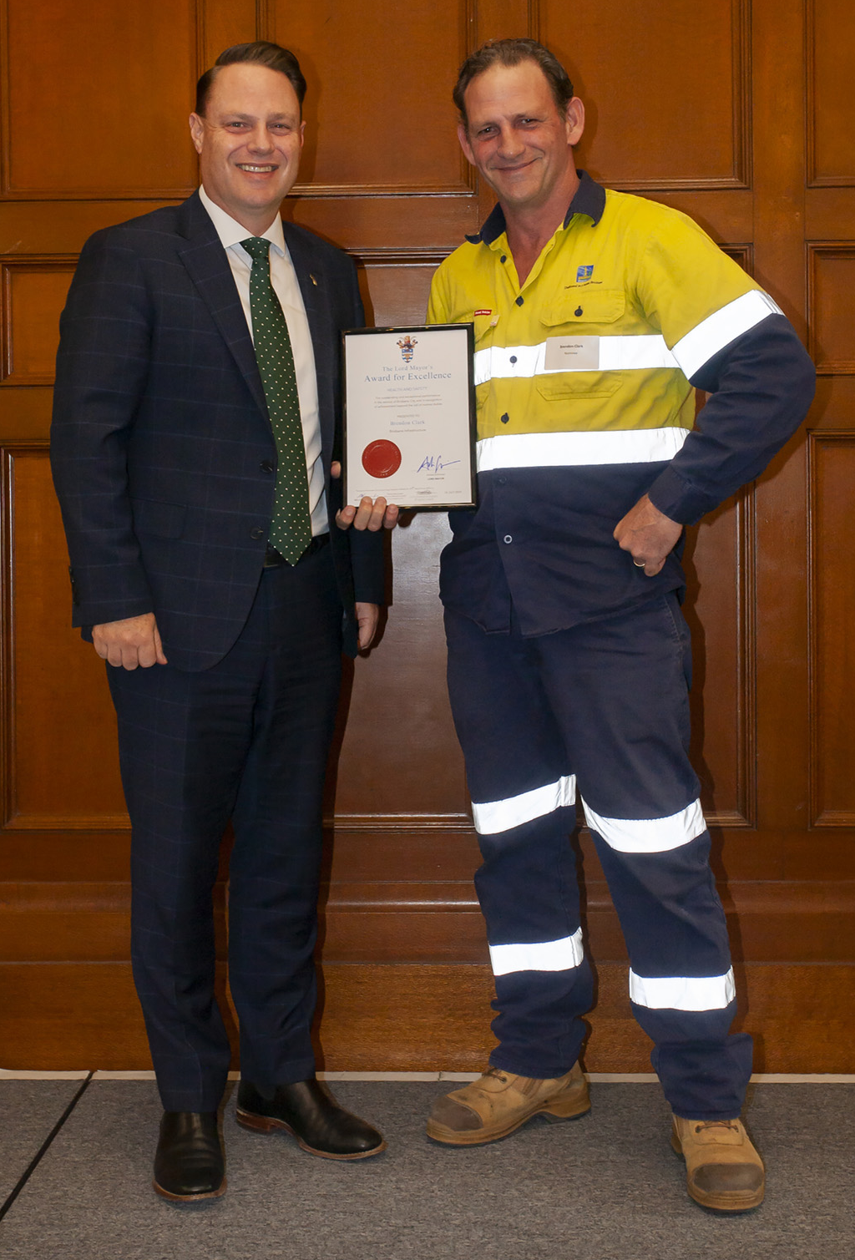
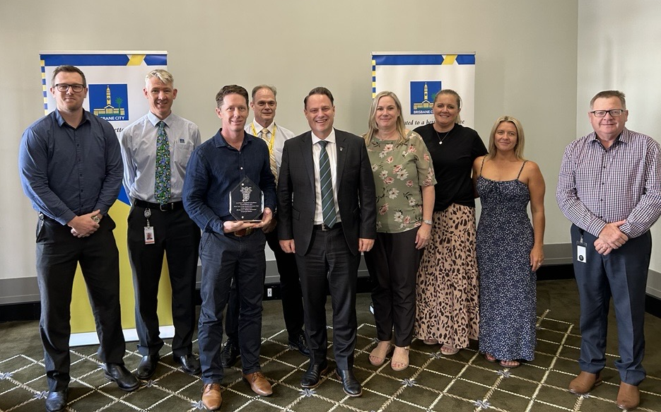
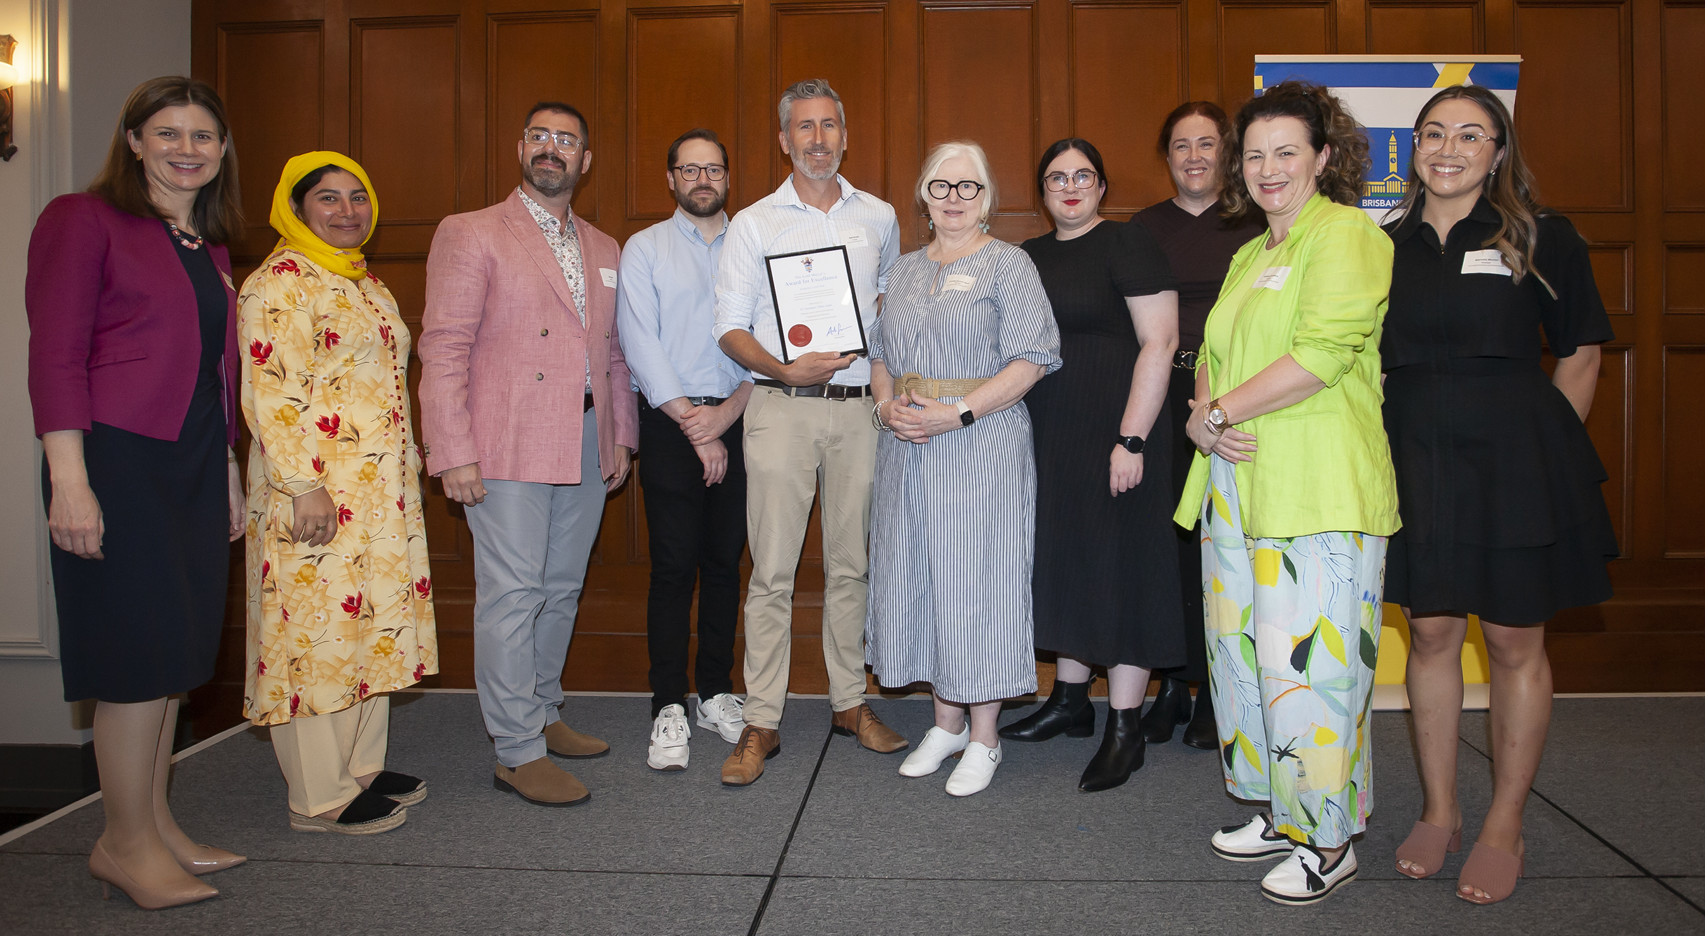
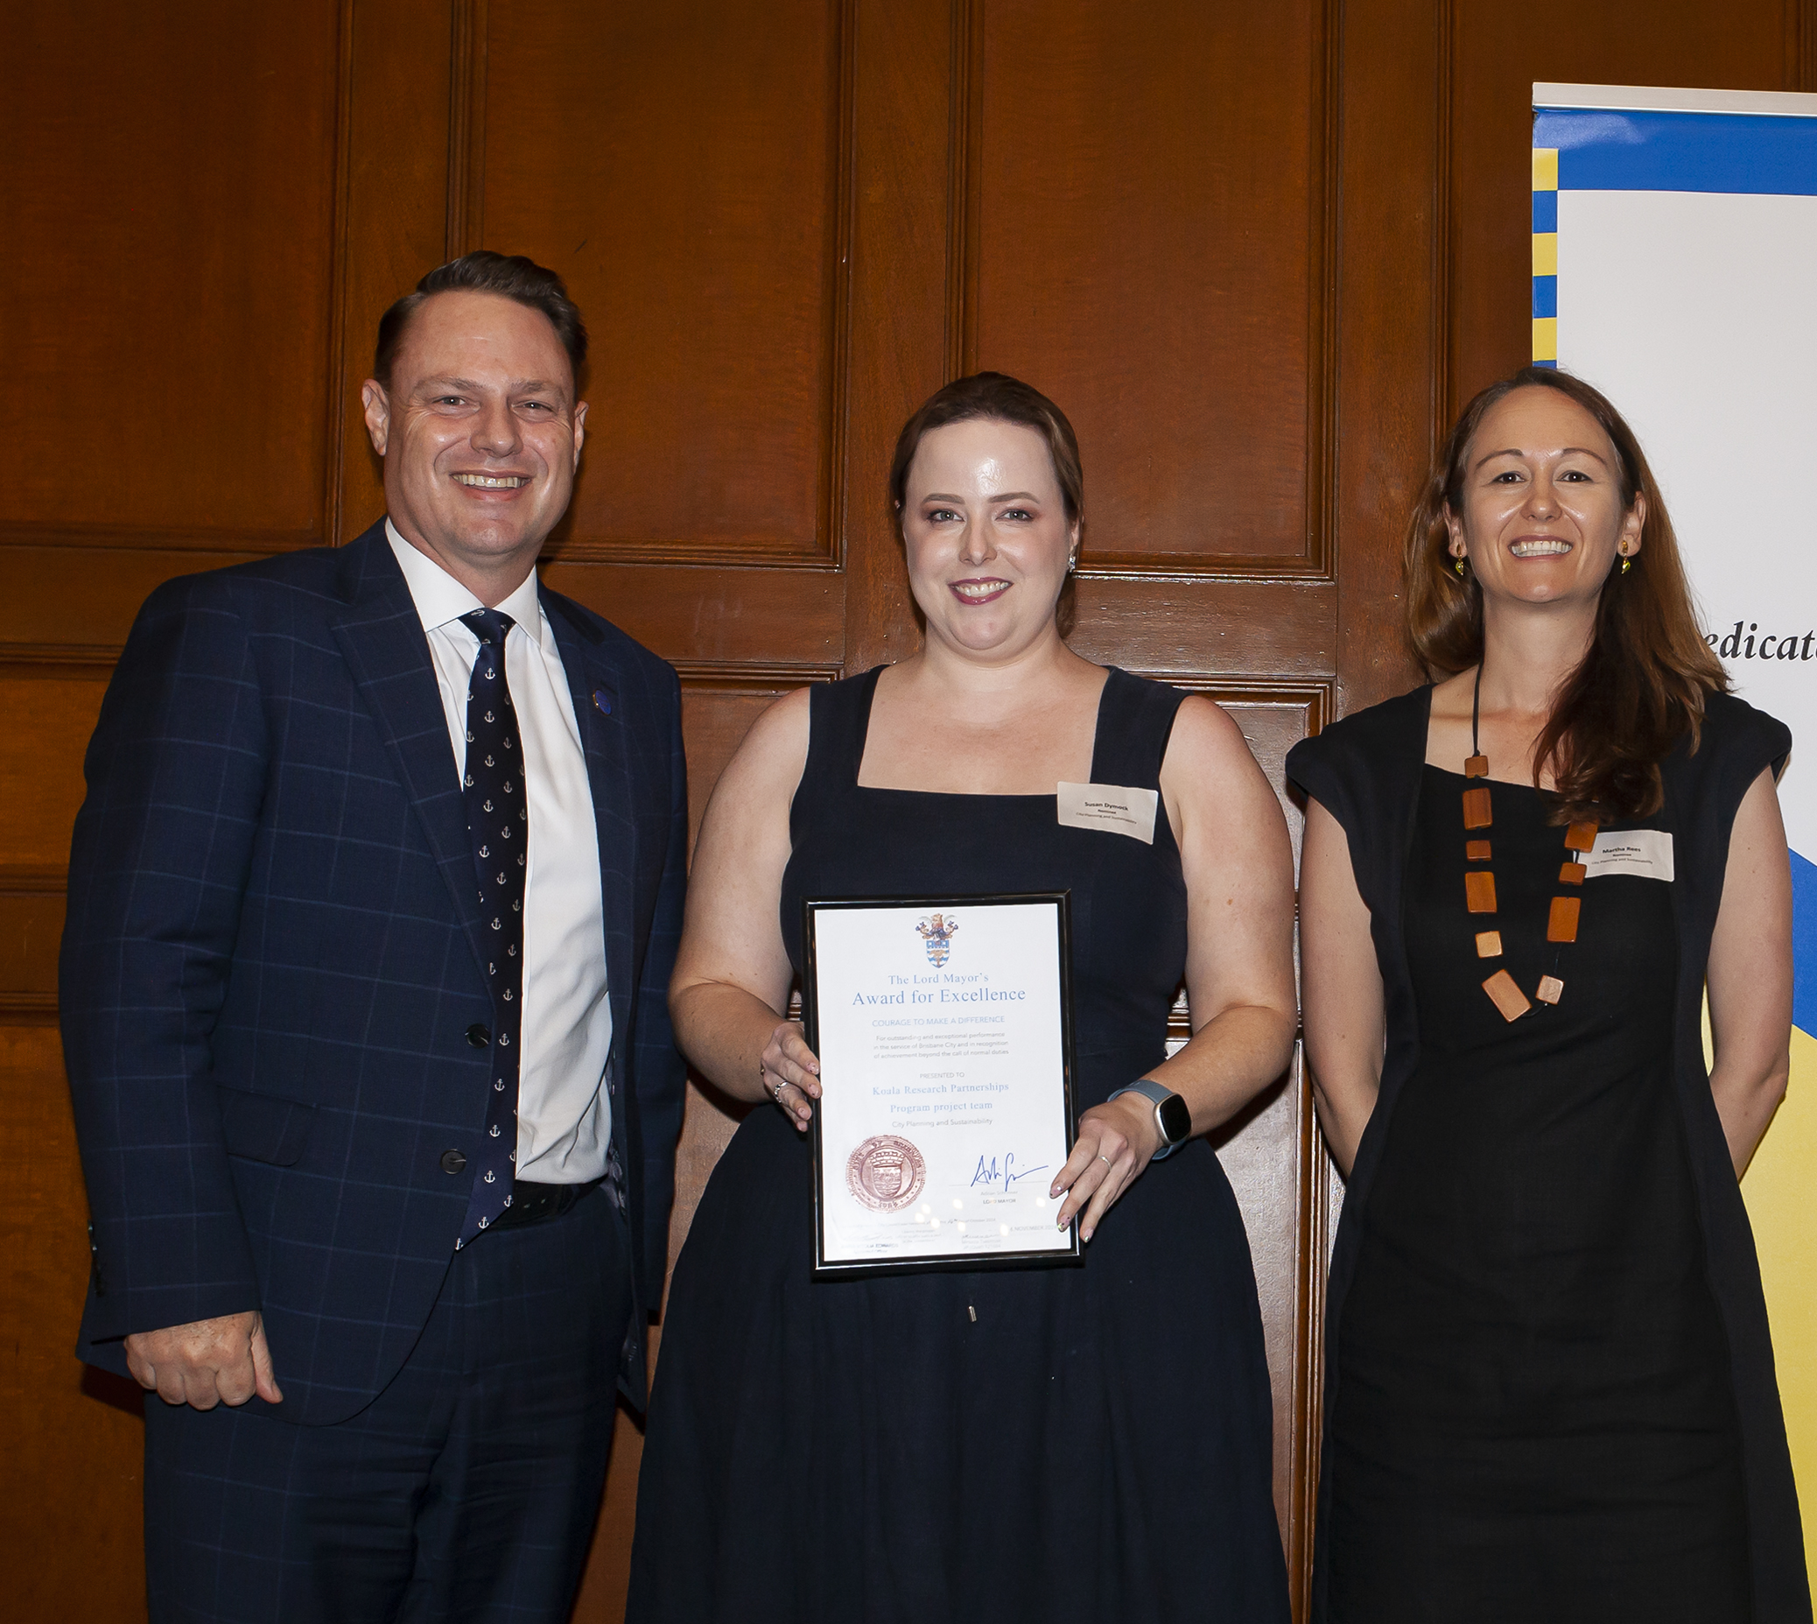
2024 summary
In 2024, there were two rounds of awards: July 2023 to April 2024 and April to September 2024.
Across both rounds, a total of 499 employees were included in 61 nominations (teams and individuals).
The Lord Mayor hosted two award ceremonies at Brisbane City Hall to announce excellence awards (winners) and commendations (runners-up) in each respective round.
More than 250 employees (as part of team or individual nominations) were recognised as winners or runners-up across the two rounds.
All excellence award winners were automatically eligible to be named the Overall Winner 2024.
In December, the Lord Mayor held a meeting with employees from the Walter Taylor Bridge Essential Maintenance Team to formally announce them as the Overall Winner 2024 and present each participating division with a trophy.

Slide 4
April to September 2024 round
Seven categories (align with Council’s corporate values).
33 nominations in total (teams and individuals).
Ceremony held on 6 November 2024.
7 Lord Mayor’s Awards for Excellence Certificates (winners).
8 Lord Mayor’s Commendations (runners-up).
Walter Taylor Bridge Essential Maintenance Team went on to be named as the Overall Winner 2024.
Category | Excellence certificates (winners)
Courage to Make a Difference | Koala Research Partnerships Program Project Team
Getting Things Done | Walter Taylor Bridge Essential Maintenance Team
Passion for Brisbane | Environment Centres’ Bush Kindy Program Team
Respect for People | Brock Winter, Organisational Services
Responsive Customer Service | Public Space Liaison Officers
Value for Money | Resilient Clubs Support Program Team
Working Together | $2 Summer Dips Team

Slide 5
July 2023 to April 2024 round
Various categories.
28 nominations in total (teams and individuals).
Ceremony held on 24 July 2024.
Lord Mayor’s Awards for Excellence Certificates (winners).
Lord Mayor’s Commendations (runners-up).
Category | Excellence certificates (winners)
Customer Service | December 2023 Storms Response Team
Environmental Achievement | Garden Organics Mulch Replacement Trial
Health and Safety | Brendon Clark, City Standards – Brisbane Infrastructure
Innovation | Joshua Skinner, City Planning and Sustainability
Social Justice and Community Development | Grey Gum All-Abilities Trail Project
Value for Money | Aluminium Cable Revolution Team
Working Together | Bus Operator Recruitment Team

Slide 6
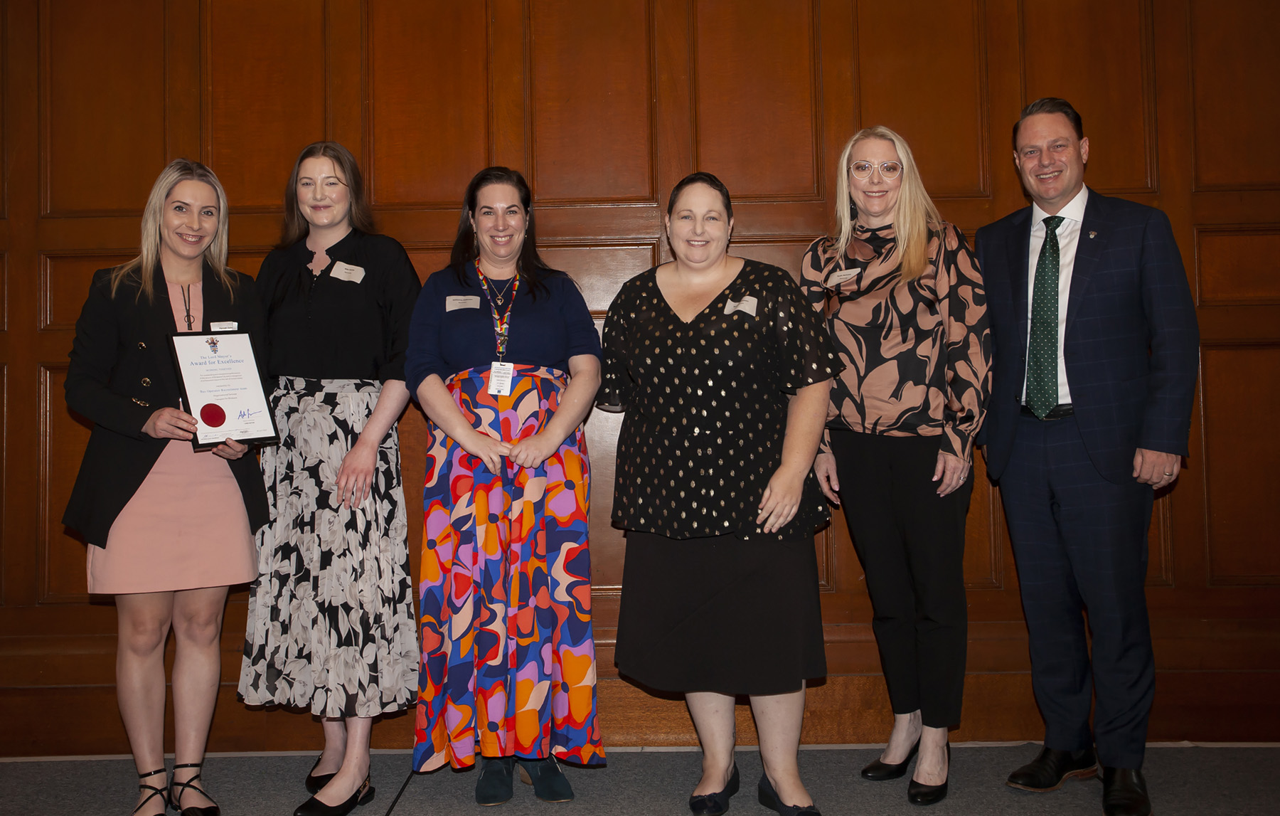
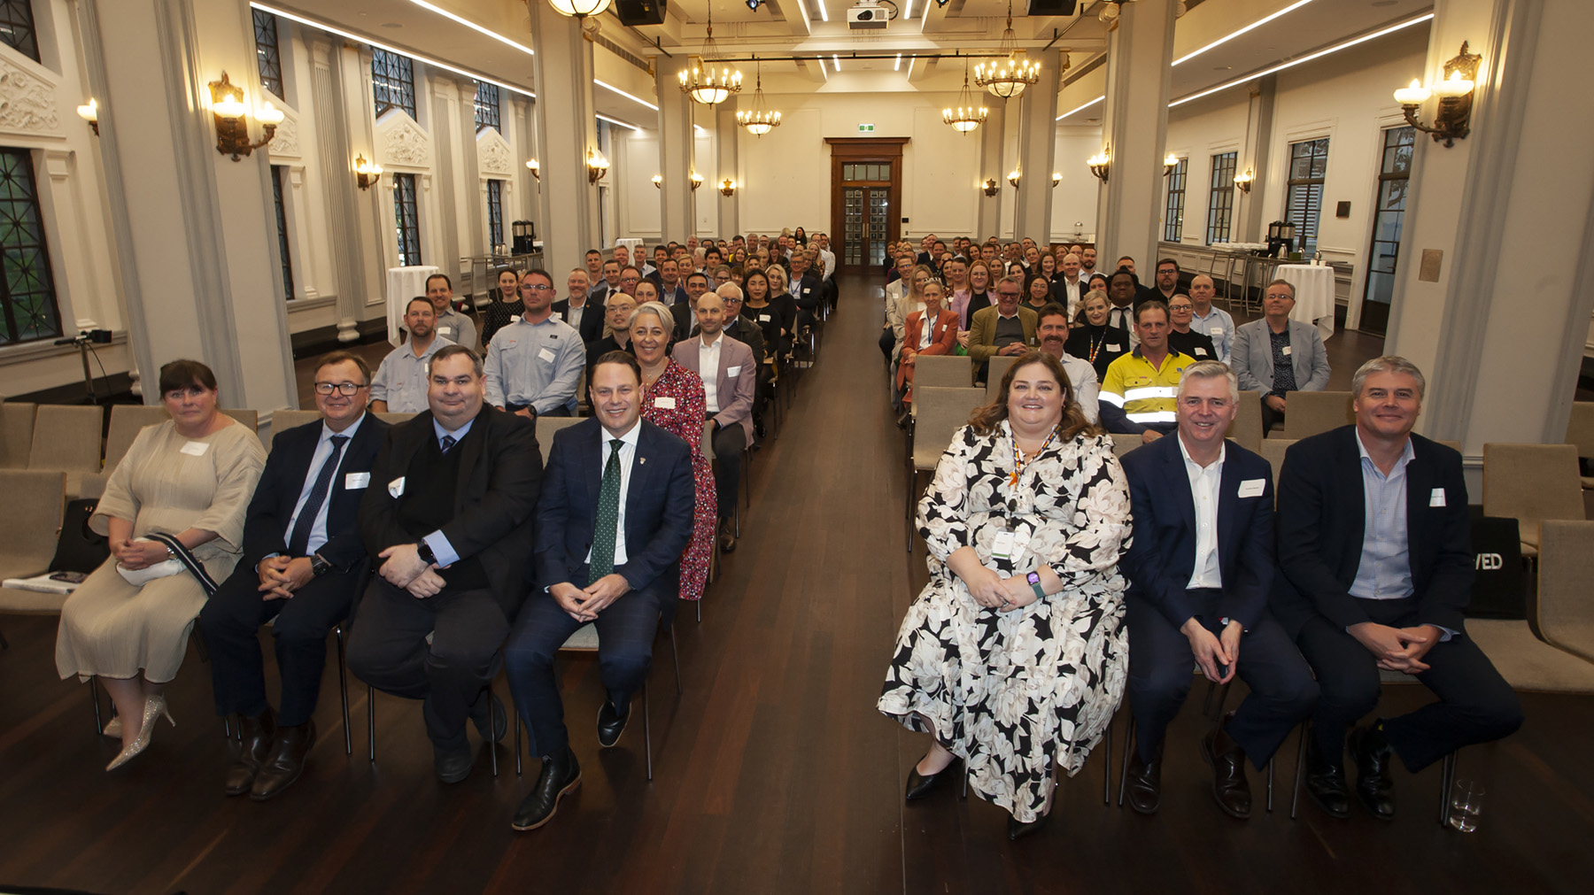
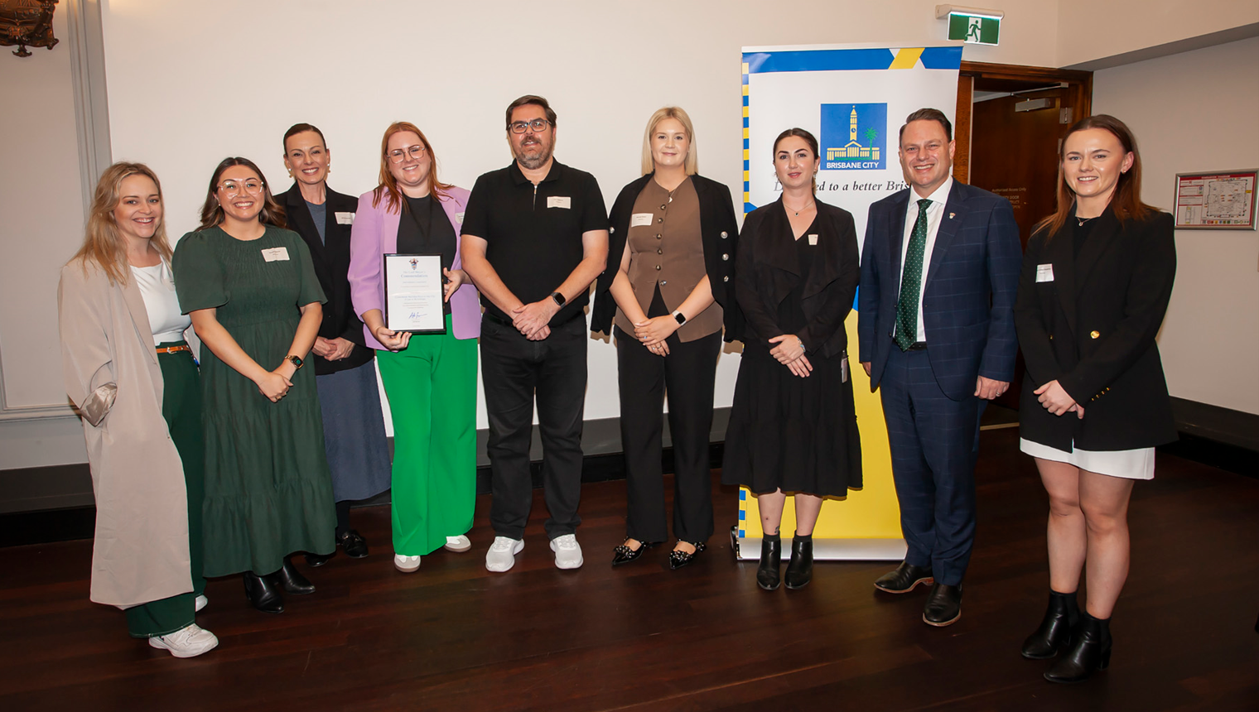
What’s next?
Council’s reward and recognition initiatives, including the Lord Mayor’s Awards for Excellence, continue to be powerful organisational tools to help maintain employee engagement, support job satisfaction and encourage performance excellence.
In 2025, the Lord Mayor’s Awards for Excellence will once again be the premier awards for Council employees. The awards:
reinforce expected behaviours, particularly Council’s corporate values
ensure employees feel their effort is valued
help employees understand how their work contributes to Council’s goals.
Nominations for the next round (September 2024 to February 2025) closed on Friday 28 February.
Nominations are currently being reviewed and will soon be presented to the adjudication panel.
The awards ceremony is scheduled for Wednesday 14 May.

Slide 7
Questions?

